Slide 1

Rwanda’s Developmental Agenda and Challenges in a Regional Context – What’s Next?
Dr. Andrew Mold
Director
UNECA Sub-Regional Office for Eastern Africa
26th June 2025

Slide 2
OUTLINE
Macroeconomic Overview
Improving Food Security in Eastern Africa
Foundations for Sustained Economic Growth
Recent UNECA Reports and Relevant Literature

Slide 3
Macroeconomic Overview

Slide 4
Eastern Africa has shown resilience despite shocks
Select Eastern African Countries, Quarterly GDP Growth, %, 2020Q1-2024Q2
Rwanda Quarterly GDP Growth, %, 2020Q1-2024Q2
Source: National Sources NISR, CBK, NBS, BOT, UBOS (2025)

Slide 5
Sectoral drivers of Rwanda’s economic momentum in 2024
2024 Sectoral Performance
Trade and transport led Rwanda’s GDP growth across all quarters of 2024, peaking in Q1 and Q4.
Source: National Institute of Statistics of Rwanda (2025)

Slide 6
Inflation eases, but remains uneven across the region
Single Digit Inflation Countries, January 2021 to May 2025
Double Digit Inflation Countries, January 2021 to May 2025
Source: National Sources (2025).
Note: *For Rwanda, Uganda, calculations were done using urban inflation

Slide 7
Inflation remains within NBR’s 2 – 8% target range
Rwanda’s Consumer Price Indices, January 2021 to May 2025
Annual headline inflation averaged 4.8 percent in 2024, a significant decline from 14.0 percent in 2023.
On a YoY basis, inflation averaged 6.0 percent between May 2024 and May 2025.
Decline largely due to improved agricultural production affecting food prices and the lagged effects of earlier monetary policy tightening
6%
Source: National Institute of Statistics of Rwanda (2025)

Slide 8
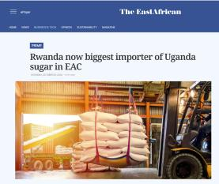
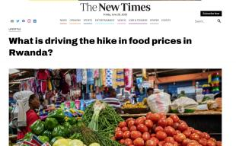
Rwanda’s local food index reveals inflation vulnerabilities
Rwanda’s Local Food vs Imported Food Index, January 2021 to May 2025
Source: National Institute of Statistics of Rwanda (2025)

Slide 9
Export growth outpaces imports in Eastern African economies
EA-14 Export and Import Growth Rates, 2024
Source: UNCTADStat (2025), MINECOFIN (2025), BoU (2025)

Slide 10
Fiscal adjustments in some countries has been quite harsh…
Overall Fiscal balance, including Grants (% GDP)
Source: IMF (2025)

Slide 11
Fiscal Debt vs Government Debt in Eastern Africa
Fiscal Deficit vs Government Debt (% of GDP), 2024
Source: IMF REO: Sub-Saharan Africa (2025)

Slide 12
The impact of debt depends on how expensive it is…..
Kenya and Uganda face high debt servicing burdens, with interest payments consuming over 20% of government revenue.

Slide 13
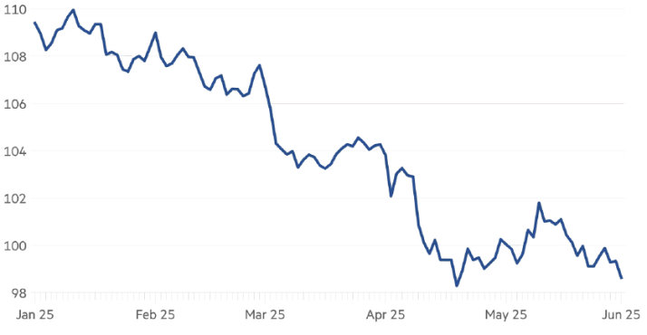
US Dollar weakens as 2025 get underway…
ICE US Dollar Index
The index dropped ~11% in since the beginning of 2025.
Reflects broad weakening of the USD vs. key global currencies.
Driven by expectations of U.S. rate cuts and easing inflation.
Source: LSEG (2025)

Slide 14
East African Government Budgets 2025/2026 Overview
Country | Budget (Nominal, USD Billion) | Increase/Decrease (Revision) | Spending Priority Area
Kenya | 33.0 | 9.4% increase from the 2024/2025 budget | Security and defense Bottom-Up Economic Transformation Agenda (BETA) (investments targeting MSMEs, grassroot industries, digital transformation…) Infrastructure and macro recovery (fiscal consolidation, expanding digital tax reforms…) Education and sports
Rwanda | 4.9 | 21% increase from the 2024/2025 budget | Construction Bugesera International Airport Agriculture Electrification Education and healthcare, Housing
Tanzania | 21.9 | 16% increase from the 2024/2025 budget | Debt management Public finance reforms (unified invoicing, e-revenue collection…)
Uganda | 20.0 | Relatively unchanged | Oil and gas activities and infrastructure projects Transportation infrastructure Agribusiness and wealth creation
Source: The East African (2025); National Sources (2025)

Slide 15
Rwanda Budget allocations in alignment with NST-2
Economic Transformation
62.8% - Frw 4,417.2 billion
The resources will support inclusive agricultural growth, infrastructure improvements (electricity, water, transport), urban and rural development, climate resilience, local manufacturing and exports, financial sector development, and job creation.
Social Transformation
21.7% - Frw 4,417.2 billion
This funding will focus on improving quality of healthcare and education, enhancing social protection programs, promoting sustainable nutrition services, family and gender promotion as well as enhancing sustainable disaster management programs.
Transformational governance
15.5% - Frw 1,088.4 billion
The allocation will target quality service delivery, good governance and transformational leadership, public finance management, justice system strengthening, peace and security maintenance, crime prevention, and the reinforcement of economic diplomacy.
Source: MINECOFIN (2025)
Notes:
Additional slide

Slide 16


Food Security Context in Eastern Africa
Download this report

Slide 17
Food Security Crisis in Africa… a growing crisis?
Number of Undernourished People by Region, 2000-2023
Number of Undernourished People in Africa 2023, by Sub-Region (millions)
Source: FAO Statistical Yearbook, 2024
Source: FAO et al., 2024

Slide 18
Prices have risen markedly for international food stuffs
Real Food Price Index, 2000-2024
Monthly Food Price Index, 2021-2024*
Source: FAO database 2025

Slide 19
Africa does NOT sustain the largest food trade deficits…
Food net trade by region (billions USD), 2000-2022
World’s Largest Net Food Exporters/Importers, 2023 (blns USD)
Source: FAO et al., 2024

Slide 20
Food production cycles across Eastern Africa are poorly synchronized… hinting a large gains from great intra-regional trade
Agricultural GDP growth rates among EAC countries are weakly correlated, meaning regional trade could help stabilize food supplies.
Quarterly Growth Rates of Agricultural GDP, 2019Q1-2023Q4
Pearson’s Correlation Matrix for Agricultural quarterly GDP Growth, 2019-2023
 | Kenya | Rwanda | Uganda | Tanzania
Kenya |  | -0.37 | -0.23 | 0.06
Rwanda | -0.37 |  | 0.00 | -0.01
Uganda | -0.23 | 0.00 |  | 0.14
Tanzania | 0.06 | -0.01 | -0.02
Sources: For Kenya, KNBS (June 2024), for Rwanda, NISR, for Uganda and Tanzania, Central Banks and ECA calculations
Given Eastern Africa’s diverse agroecological conditions, stronger regional trade policies could help smooth supply disruptions and reduce price volatility, benefiting both producers and consumers.

Slide 21
 | (1) | (2)
 | OLS(FE) | PPML(FE)
log GDP Exporter | 0.381***
 | (0.044)
log GDP Importer | 0.456***
 | (0.049)
Log distance | -0.833*** | -0.061***
 | (0.070) | (0.005)
Common border | 2.176*** | 0.155***
 | (0.173) | (0.012)
Common language | 0.737*** | 0.062***
 | (0.080) | (0.006)
Colony | 1.333*** | 0.077***
 | (0.266) | (0.018)
WTO Member | 0.519*** | 0.056***
 | (0.168) | (0.014)
African RTA | 1.469*** | 0.138***
 | (0.122) | (0.010)
Constant | 4.494*** | 3.001***
 | (0.815) | (0.047)
Exporter- FE | Yes
Importer-FE | Yes
Exporter-year FE | No | Yes
Importer-year FE | No | Yes
Number of Obs | 68193 | 71759
R-squared | 0.464
Pseudo R-Squared |  | 0.0824
Impact of Existing African RTAs on Agricultural Exports – An Econometric Analysis
On average, existing African RTAs led to a modest 15% increase in intra-regional agricultural exports (UNECA, 2025).
Afesorgbor (2016) carried out a careful meta-analysis combining 14 previous studies covering the period from 1980–2006; and found that, on average, the formation of African regional blocs boosted bilateral trade by about 27–32%.

Slide 22
But the AfCFTA’s impact could be much larger
Intra-African trade following implementation of AfCFTA, as compared to baseline (i.e. without AfCFTA), %, 2045
Sector | Consumption type | Variation
 |  | USD billion | %
Non-processed agri-food | Final | 7.1 | 81.6
 | Intermediate | 3.9 | 30.6
Processed agri-food | Final | 35.2 | 62.8
 | Intermediate | 12.4 | 59.7
According to ECA’s most recent CGE analysis, intra-African trade in agri-food would increase by around 60% by 2045 relative to the baseline
Source: ECA and CEPII (forthcoming)

Slide 23
Foundations for Long-Term Sustained Economic Growth?

Slide 24

A large variation in long-run growth performance…Why?
GDP per capita (constant prices), 1970 to 2023
Notes:
Add interesting picture here… need to re-order this…

Slide 25



Three pre-conditions for sustained economic diversification…
Robertson (2022) outlines a compelling framework for what needs to be in place for countries to achieve sustained economic growth.
His key thesis is that historical development patterns can be explained and even predicted by a set of core preconditions, which he refers to as the foundations of development. These are…
Demographic Transition
Access to Cheap and Reliable Electricity
Education (Especially Literacy)

Slide 26
Demographic transitions and links to the financial sector

Slide 27
Some Central Bank rates are high…
Ethiopia
15.0%
Kenya
10.0%
Uganda
9.75%
Rwanda
6.5%
Tanzania
6.5%
Source: National Central Bank Sources (2025)
Notes:
Can remove this slide

Slide 28
And bank lending rates to the private sector are onerous…
Bank Lending Rates, April 2025
A growing economy needs credit, banking infrastructure, and capital.
Countries with high domestic savings can invest more in infrastructure and business.
Source: Trading Economics (2025)

Slide 29
A comparison of Credit to GDP ratios in developing economies
Domestic Credit to Private Sector (% GDP), 2023
Source: World Development Indicators (2025)

Slide 30
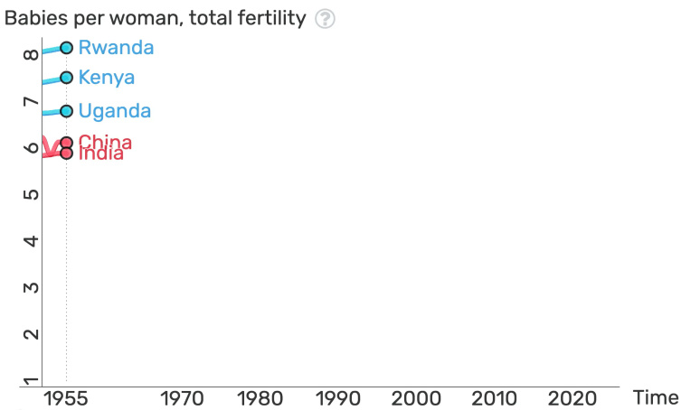
Regional demographic dynamics

Slide 31
Education, education, education!
Literacy Rates in the Region
Mass literacy (70%+ adult literacy rates) is essential for a country to diversify and grow.
Universal primary education, and later secondary education, are a key inflection point in development.
Source: UNESCO (2025), NISR EICV7 (2025)

Slide 32
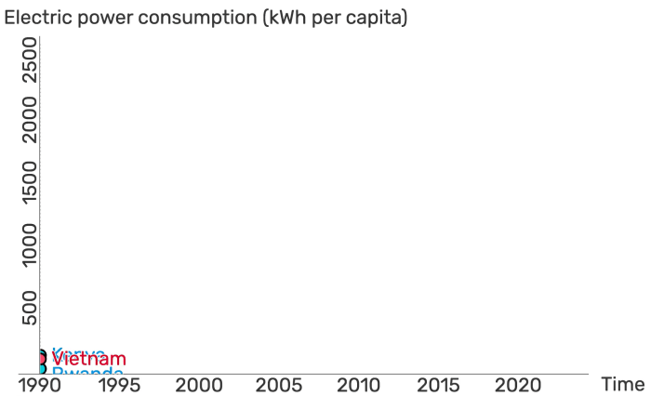
Similar starting points but different trajectories…
Vietnam started at roughly the same electricity consumption levels as Kenya, Ethiopia, and Rwanda in 1990 (around 100–150 kWh per capita)…
By 2022, Vietnam had increased its usage more than 20-fold.
Source: World Development Indicators (2025)

Slide 33






To summarise…
FOUNDATIONS FOR SUSTAINED ECONOMIC GROWTH AND DIVERSIFICATION
=
SHIFTING
DEMOGRAPHY
FINANCE
EDUCATION
ELECTRICITY
ACCELERATED
GROWTH

Slide 34
In conclusion…
1
Despite fiscal pressures, Rwanda is on a resilient trajectory, with solid macroeconomic fundamentals and continued growth momentum
2
The next stage for Rwanda, as articulated in NST2, requires accelerated job creation, the boosting of exports, improved quality of education, and enhancing public service delivery.
3
Currently, the global economy is suffering from many uncertainties, especially with regards to trade.
The answer? The continental market on our doorstep!

Slide 35
Recent UNECA Reports and Relevant Literature

Slide 36
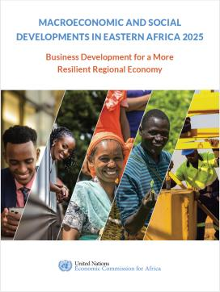
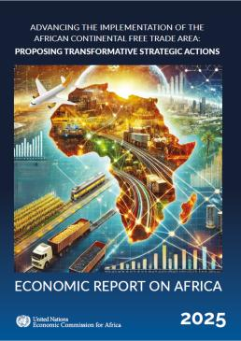



Other Recent UNECA Reports
Download this report
Download this report
Download this report

Slide 37
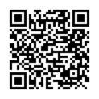
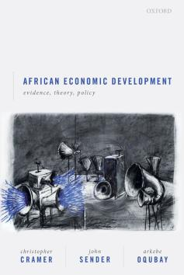

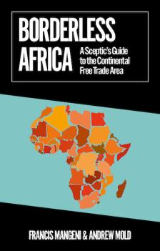
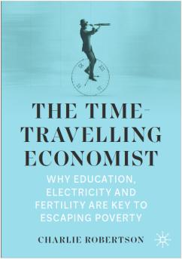

Some more relevant Literature

Slide 38
THANK YOU
MURAKOZE CYANE
Dr. Andrew Mold
Director
UNECA Sub-Regional Office for Eastern Africa

