Slide 1
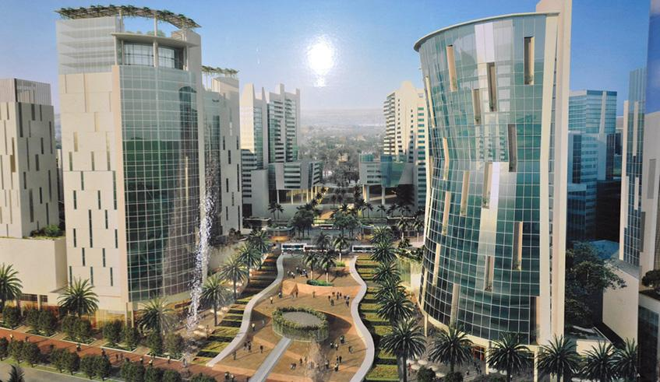

Rwanda Vision 2050
Female Working Group on Socio-Economic Transformation
Dr. Thierry KALISA
Chief Economist, BNR
10th February 2022

Slide 2
Table of Contents
1. |  | Where are we coming from: Vision 2020 Implementation
2. |  | The COVID-19 Impact
3. |  | Vision 2050: The Rwanda that We Want

Slide 3
Where we are coming from:
Vision 2020 Implementation

Slide 4
A series of Development Strategies Implementing the Vision 2020 have been developed
PRSP 1 (2002 – 2006)
Recovery from post conflict situation;
Major gains in social sectors e.g. health and education;
EDPRS 1 (2008 – 2012)
Preparation for take off;
Poverty reduced by 3% points (60% to 57%).
High poverty reduction (12% points);
High growth (average 8.2%);
Strong contribution to achievement of MDGs.
Reduced inequality;
EDPRS 2 (2013 – 2018)
Fast poverty reduction (15% points) to less than 30%;
Closing trade balance with rapid growth of exports (28%);
Increased private sector investment.
Rapid growth 11.5%;

Slide 5
Vision 2020
Pillars of Vision 2020 | Cross-Cutting Areas
1. Good Governance and a capable state | 1. Gender equality 2. Protection of environment and sustainable natural resource management 3. Science and technology, including ICT
2. Human Resource development and a knowledge based economy
3. A private Sector–led Economy
4. Infrastructure development
5. Productive and Market Oriented Agriculture
6. Regional and International Economic Integration

Slide 6
Vision 2020 Implementation Progress
Indicator | Baseline (status in 2000) | Vision 2020 Targets | Current Status
Examples of Indicators Fully Achieved
Life expectancy (years) | 49 | 66 | 67
Women representation in decision making organs (%) | 30 (2012) | 40 | 47
% of adult population accessing financial services | - | 90 | 93%
Internet users per 100 people | - | 50 | 62.3%
Mobile subscriptions per 100 people | - | 60 | 83%
Forest cover (% of land area) | - | 30 | 30.4%
Examples of Indicators on Track
Access to improved sanitation facilities (% of pop.) | 20 | 100 | 86.2%
Access to clean water (% of population.) | 52 | 100 | 87.4%
Maternal mortality rate per 100,000 | 1071 | 200 | 210

Slide 7
Vision 2020 Implementation Progress
Indicator | Baseline (status in 2000) | Vision 2020 Targets | Current Status
Examples of Indicators Lagging Behind
Percentage of population under poverty line | 60.4 | 20 | 38.2%
Child Malnutrition (Chronic malnutrition (%)) | - | 15 | 38%
Urban population (%) | 10 | 35 | 18.4%
% of HHs using Wood as source of energy | 94 | 50 | 79.9

Slide 8
Vision 2020 Implementation
Vision 2020 has been largely achieved
Life expectancy (years) has increased from 49 in 2000 to 67 exceeding the target of 66
Of course all targets have not been achieved but does it mean that it is a failure?
For example, Rwanda is not a middle income country yet, but will reach this status most likely in the coming 4-5 years.
In terms of social achievements and standards of living, Rwandans are not necessarily worse off than some middle income countries like for example: Congo (Braza), Djibouti, Mauritania…

Slide 9

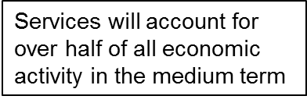
Rwanda’s Development Hat Trick
Rwanda’s development hat trick over last two decades
GDP Per Per Capita (US$)
Rapid economic growth and macroeconomic stability: resilient to shocks;
Important poverty reduction;
Reduced inequality and increased access to services: health, education, financial inclusion;
Sustained economic growth has lifted more than
1 million people out of poverty
Economic Transformation
2005
2020
5

Slide 10
Social Progress
Social progress has been possible due to good governance
Kigali representative of this progress:
Clean and green city, with the lowest crime of any capital city in the region;
Winner of UN Habitat Award (2008) the highest award for an urban area;
Safe for women to walk alone (2nd Globally – Gallup report).
Social progress has accompanied economic progress
Under 5 mortality per 1,000 : 34.3 (MDG Target:50.1)
Maternity Mortality per 100,000 : 210 (MDG target: 268)
Life expectancy : from 49 years in 2000 to 69 years by 2019;
Literacy rates (aged 15 to 24) : from 48% in 2000 to 86.5% in 2018;
Financial inclusion : from 48% in 2008 to 93% in 2020;
Mobile phones owners : from 6% in 2006 to 76.49% in 2019;
Pupils – qualified teacher ratio in Secondary : 28-1 in 2018;
Access to improved sanitation facilities (% of population): 87.3% in 2017;
Access to clean water (% of population) :88.5% in 2016;
A hub for rapidly integrating East Africa : located centrally bordering 3 countries in East Africa, part of EAC Common Market and Customers Union with market potential of over 125 million people
Market of over 12 million people with a rapidly growing middle class.

Slide 11

Rwanda on International Scene
Rwanda
3nd Country in Cyber Security in Africa
2nd Easiest Place to do Business in Sub-Saharan Africa
1st safest place in Africa
7th Global Most efficient Government
^{9th} Best Place to be a Woman Globally
2nd most competitive in Africa
Global Cyber Security Index 2018
World Economic Forum 2015
WB Report 2019
WEF:Global Gender Gap Index 2020
Global Competitiveness report 2018/19
Gallup Global Report 2019
World Travel Guide 2018

Slide 12
The COVID-19 Impact

Slide 13
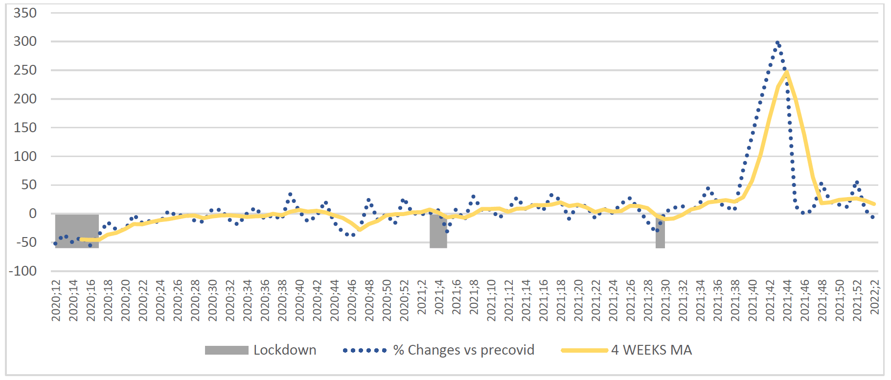
Economic Recovery: Composite index

Slide 14
Real Sector
 | 2015 | 2016 | 2017 | 2018 | 2019 | 2020 | 2021 | 2022 | 2023
GDP | 8.9% | 6.0% | 4.0% | 8.6% | 9.4% | -3.4% | 10.2% | 7.2% | 7.9%
Agriculture | 5% | 4% | 5% | 6% | 5% | 1.0% | 6.6% | 5.8% | 5.3%
Food crops | 4% | 3% | 5% | 6% | 4% | 0.0% | 5.8% | 5.1% | 5.1%
Industry | 9% | 7% | 2% | 9% | 17% | -4.0% | 16.6% | 10.8% | 12.7%
Mining & quarrying | -5% | 10% | 20% | 3% | 0% | -31.0% | 22.6% | 14.3% | 12.6%
Manufacturing | 8% | 7% | 6% | 13% | 11% | 2.0% | 14.4% | 8.2% | 8.2%
Construction | 15% | 5% | -10% | 5% | 33% | -6.0% | 19.6% | 13.8% | 18.3%
Sevices | 10.4% | 7.2% | 5.6% | 9.7% | 8.2% | -6.0% | 9.8% | 6.0% | 7.0%
Negative growth in 2020 due to the COVID 19 pandemic with services and industry sectors declining by 6% and 4% respectively.
2021: Economic recovery with 10.2% growth
For the medium-term, we are anticipating a recovery: 10.2% in 2021 and 7.2% in 2022.
The pre-COVID-19 growth level of 8.0% will be reached by 2023.

Slide 15
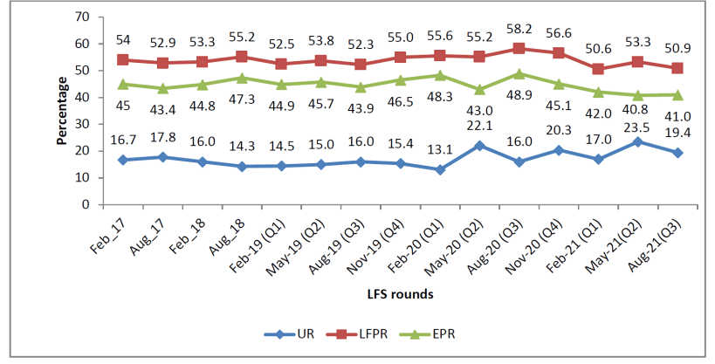
Labor Force Indicators in %

Slide 16
Vision 2050: The Rwanda that We Want

Slide 17
NST1 growth targets reflect the Vision 2050 requirements
NST1 will serve as the implementation for the first four years of the Vision 2050 journey:
Upper middle-income by 2035 (USD 4,035 per capita)
High-income by 2050 (USD 12,476 per capita)
Avg. growth of >9% over 2036-2050
Avg. growth of 12% over 2025-2035
Avg. growth of 9.1%
over NST1

Slide 18
NST1 implementation will determine the future growth Path
Notes:
Base is the year growth acceleration started in each economy: 1977 for China, 1990 for Vietnam, 1962 for Korea, 1958 for Thailand, 1959 for Morocco, 1972 for Botswana, 1951 for Taiwan (China) and Brazil, and 2005 for Rwanda

Slide 19
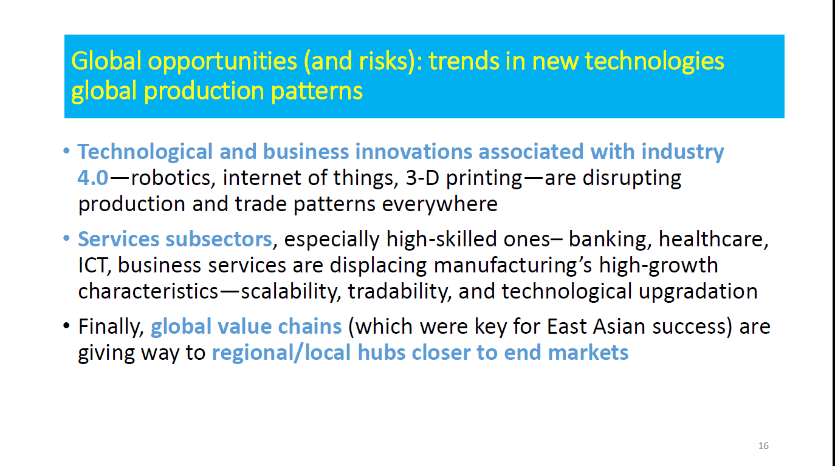

Slide 20
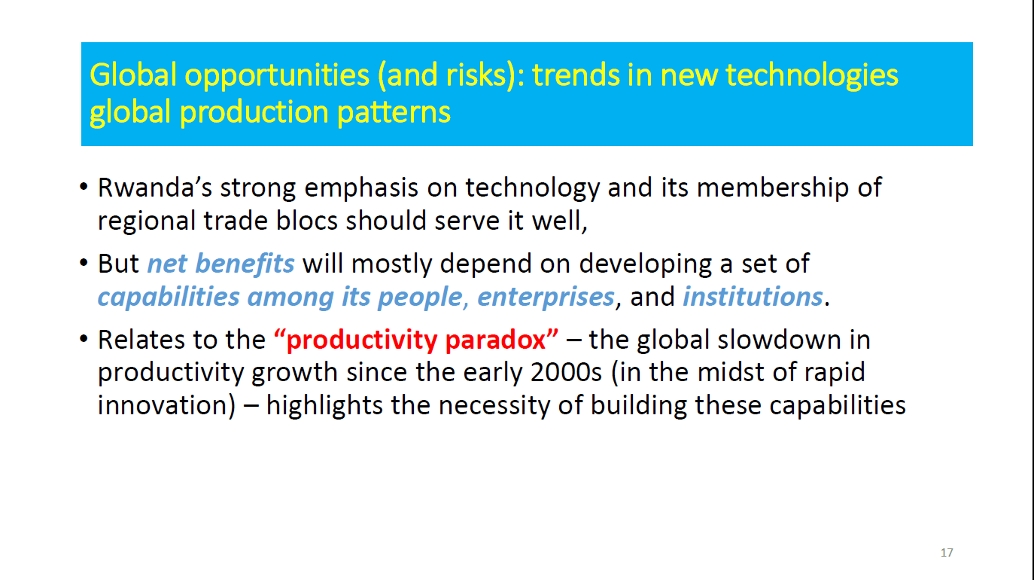

Slide 21
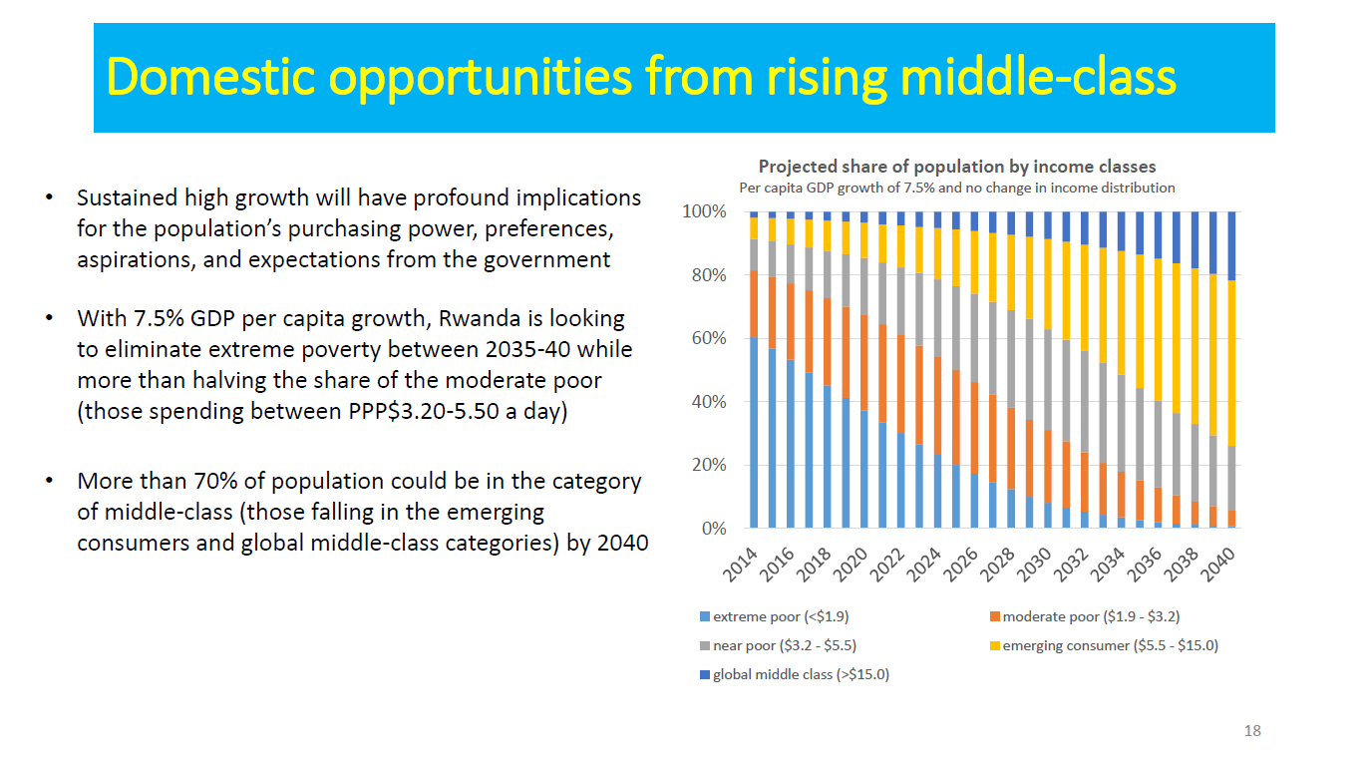

Slide 22
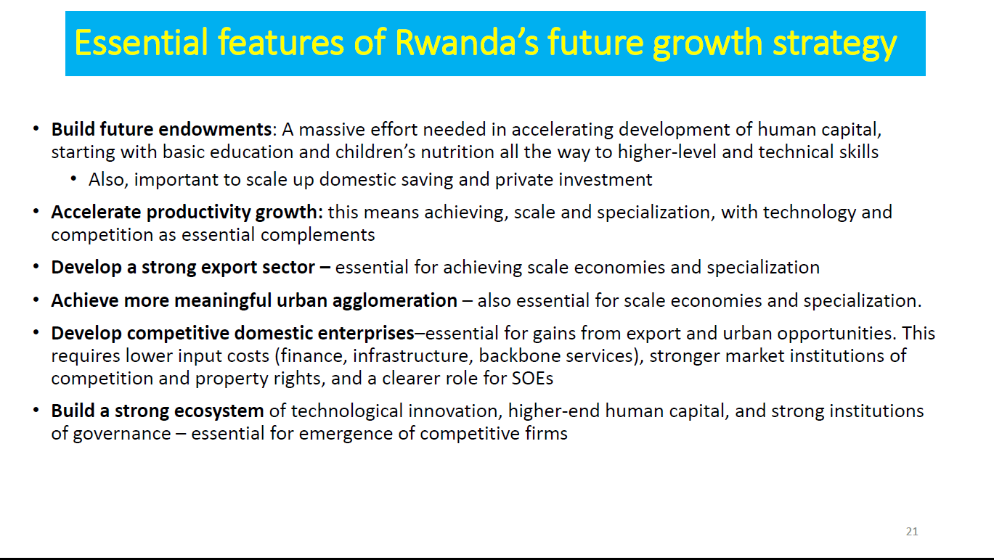

Slide 23
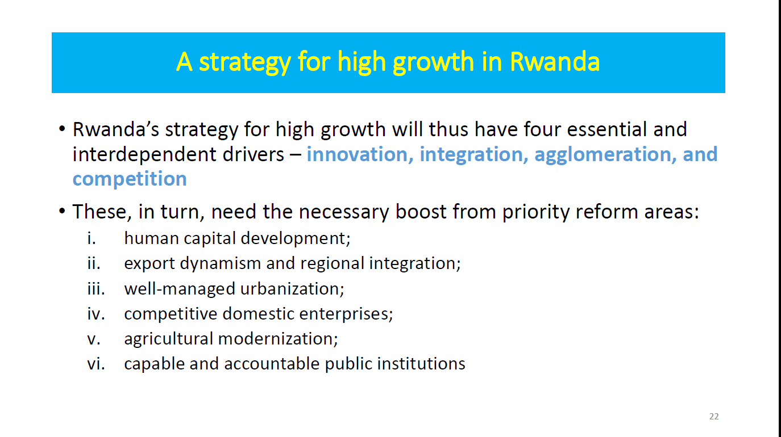

Slide 24
Key Prerequisites and drivers for future Growth in Rwanda
Highly-developed Human capital
Trade and regional integration
Competitive Private Sector
High Growth
Modern Agriculture/Food sector
Well-managed Urbanization
Efficient and Accountable institutions

Slide 25
Common Success Factors across successful High Income Countries
Well-governed and fast growing countries with Visionary Leadership
High investment in human capital (with focus on Research and Development)
Attracting and expanding FDI with swiftness
High focus on productivity (productivity of labour, competitiveness of firms led to increased productivity of the economy)
Labor intensive industries that later moved into technology intensive industries and services
A shared national mindset for development
Development of long term savings

Slide 26
Rwanda: Key Success factors in Development progress
Visionary Leadership
Good Governance and accountability
Inclusive development model – gender equality, pro-poor, unity and solidarity
Home grown initiatives (e.g. Umuganda, Gacaca, Agaciro, Kwigira, Ubudashyikirwa,) etc.
Determination to succeed after a tragic past following the Genocide committed against the Tutsi
Investment in human capital – mainly capacity building from a low base
Results oriented institutional framework – performance contracts

Slide 27





Pillars of Vision 2050
Rwanda Vision 2050
Human
Development
A healthy,
well educated &
highly skilled labor
force to sustain
the economy
Competitiveness
&
integration
Production of inputs for
neighboring countries,
such as materials
for modern constructions,
aviation, mosquito nets,
organic fertilizers
and aquaculture.
Agriculture for
wealth creation
Transformed agricultural
Sector will be
market-driven, linked
to urbanization and
trade, and nearly
25 times more
productive than today
Urbanization and
Agglomeration
be well beyond access
and tackling the issues
of sustainable
energy generation
and utilization,
water and sanitation.
Accountable & Capable
State Institutions
Modern institutions &
Governance, accountable
to citizens, and fully
rooted in the rule of law.

Slide 28
Human Development and Agriculture for wealth creation
Human Development Pillar
High quality & access to affordable health care
Improving maternal and child health care
Access to affordable high quality education
A transformed workforce for higher productivity
Agriculture for wealth creation Pillar
Modern and market-oriented agriculture
Scaled up use of modern inputs and technologies to maximize productivity
Increased access to agriculture finance and risk sharing facilities
Integration within global value chains for higher-value products

Slide 29
Competitiveness and Integration
A diversified economy built upon future industries
Competitive manufacturing anchored to a regional logistics hub
By 2050, “Made in Rwanda” household goods used at home & worldwide.
State-of-the-art industrial parks
Commercial agro-processing and agri-businesses
Local-content dominated construction industry
Modern and innovative services sectors driving transformative growth
By 2050, Rwanda’s manufacturing and commercial agriculture sectors will be regionally and globally competitive with access to modern, high quality, and cost-effective services as inputs.
Export-oriented knowledge services
High-end sustainable tourism
Development of new tourism products, diversifying the MICE events & continue to position Rwanda at the global frontier for conservation.
Universal access to financial services
Strengthening Export Competitiveness and trade connectivity

Slide 30
Urbanization and Agglomeration
Universal access to daily amenities
Affordable and high-quality housing
More than 70% of Rwandans are projected to be living in urban areas.
Ease of mobility and efficient transport
Urbanization as a driver of growth
Agglomeration will drive growth to keep unemployment in urban areas below 5% between 2035 and 2050
Sustainable supply and demand for energy
Sustainable utilities and resource management

Slide 31
Accountable and Capable State Institutions
Effective and accountable institutions for socioeconomic transformation
Deepening Decentralization to bring services closer to the citizens
Rule of law and justice for all
To fulfil the Vision 2050 aspirations, Rwanda’s institutions and governance will need to become modern, accountable to citizens, and fully rooted in the rule of law.

Slide 32
Key considerations for Vision 2050 success
Strong and sustainable macroeconomic fundamentals
Positive values for societal transformation
Self-sufficiency as a Nation (Kwigira), Solidarity and Dignity (Agaciro)
Unity and Rwandan Identity/culture
Integrity
Equity (including gender)
Transparency and openness
Accountability
Community participation and contributing to local innovation
A rigorous and effective monitoring and implementation framework
Prerequisites:
Consistency in prioritization;
Increasing the role of private sector;
Deepening regional integration;
Adopting an unconventional approach.

Slide 33
Vision 2050 Implementation
Vision 2050 will be implemented through Medium Term Development Strategies – Starting with NST 1 that acts as the bridge between Vision 2020 and Vision 2050.
There will be a mid-term review in 2035 to allow for readjusting plans and targets as necessary.
A mechanism for regular assessment of progress achieved and alignment of the Vision to take into account Rwanda’s changing development context will be implemented.

Slide 34
NST1 Structure
National Strategy for Transformation,1
Economic Transformation
Social Transformation
Transformational Governance
NST1 Pillars
Cross-Cutting Areas:
Capacity Development, HIV/AIDS and Non-Communicable Diseases,
Disability and Social Inclusion, Gender and Family Promotion,
Regional Integration and International Positioning,
Environment and Climate Change, Disaster Management

Slide 35
Links to Resourceful Documents
Rwanda Vision 2050
https://www.minecofin.gov.rw/fileadmin/user_upload/Minecofin/Publications/STRATEGIES/Vision_2050/English-Vision_2050_Full_version-Web.pdf
National Strategy for Transformation/7YGP (2017-2024)
https://www.minecofin.gov.rw/fileadmin/user_upload/Minecofin/Publications/STRATEGIES/NST1/NST_A5_booklet_final_2.04.19_WEB.pdf
Future Drivers of Growth in Rwanda – Joint GoR & World Bank Study Report
https://openknowledge.worldbank.org/handle/10986/30732#:~:text=The%20report%20identifies%20four%20essential,agricultural%20modernization%2C%20and%20capable%20and
Key Statistics on Rwanda:
https://www.minecofin.gov.rw/publications/data?tx_filelist_filelist%5Baction%5D=list&tx_filelist_filelist%5Bcontroller%5D=File&tx_filelist_filelist%5Bpath%5D=%2Fuser_upload%2FMinecofin%2FPublications%2FDATA%2FRwanda_Key_Economic_Statistics%2F&cHash=942f6282fd87e23ee1e2c002f4668a59

Slide 36
Thank you!

