Slide 1

Unlocking the Property Tax Potential for Domestic Revenue Mobilization
Dr. Colette Nyirakamana
Research Lead, Local Government Revenue Initiative (LoGRI)
Senior Research Associate, University of Toronto
EPRN Conference
Kigali, June 27, 2024

Slide 2

Potential for Equitable Revenue Raising
Property taxes should be a popular, progressive and easy to collect tax.
High revenue potential, as properties are visible and immovable
Relatively progressive tax linked to wealth, as compared to largely regressive local taxes and fees
Transparency potential through links to observable wealth

Slide 3
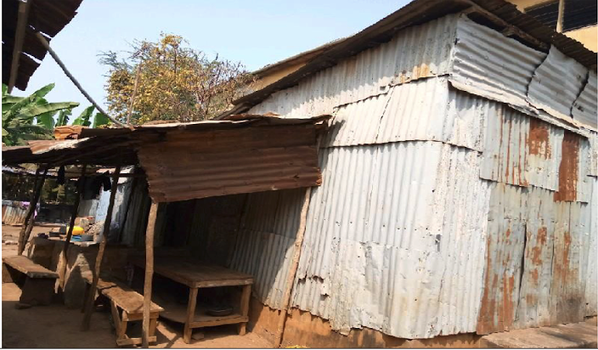
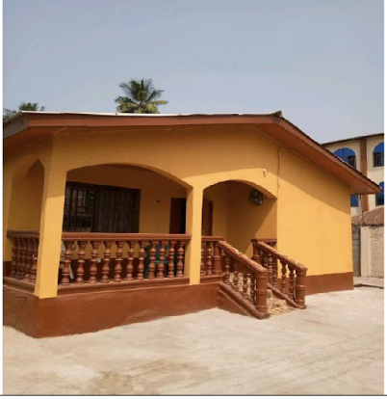
Divergence Between Potential and Practice
Most underperforming major tax type
Frequently highly regressive and unfair
Limited links to service delivery
Weak accountability
Various reform barriers
vs

Slide 4
Distinctive Features of Low-Income Countries
Highly incomplete property records: Many systems aim to legally register properties before they can be taxed, but this process is time-consuming, costly, incomplete, and difficult to update
Inefficient property valuation systems: Most countries rely on either (a) expert valuation, which is costly and non-transparent, (b) zonal systems that lack progressivity or (c) incomplete and unverified self-reporting systems.
Lack of automation: Many systems are still manual, making data management very difficult and limiting opportunities for control and transparency.
Ineffective cooperation between government agencies, compromising administrative efficiency
Weak links between revenue collected and service delivery, limiting public trust and tax compliance
Political resistance to reforms, from administrators, top taxpayers and central governments, which limits reform and effective enforcement of tax obligations

Slide 5
Is the push for capacity development and technology an adequate strategy for reform?
OR
Can reform strategies be simplified and better aligned to existing capacity, institutional and political constraints?

Slide 6
1. Simplified Property Identification
Problems
  Many systems rely on central government registration of land and land ownership prior to property taxation. Such registration is contentious, costly and slow – creating a barrier to property taxation
  Local addressing systems are often complex and incomplete, leading to gaps in registration and undermining delivery and enforcement
Strategies
  Allow properties to be registered for tax purposes separate from formal cadaster processes – and use data to support land registration
  Use satellite data to identify and map properties and support simple addressing.

Slide 7
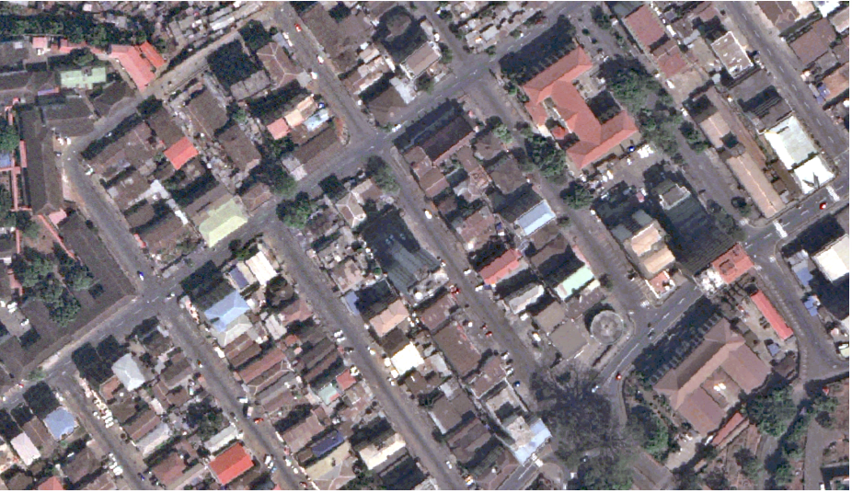
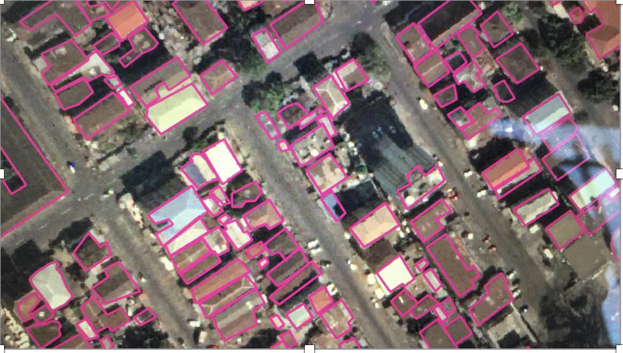
Mapping Freetown

Slide 8
2. Simplified Property Valuation
Problem
  Expert valuation is slow, expensive and subjective – and so often out of date, incomplete and prone to collusion and corruption
  Area based systems are highly regressive, undermining revenue, equity and trust
Strategy
  Hybrid valuation models – often called “points-based”
  Build simple models for translating easily observable property characteristics into taxable values.
  Reduced costs, increased speed, very transparent.

Slide 9
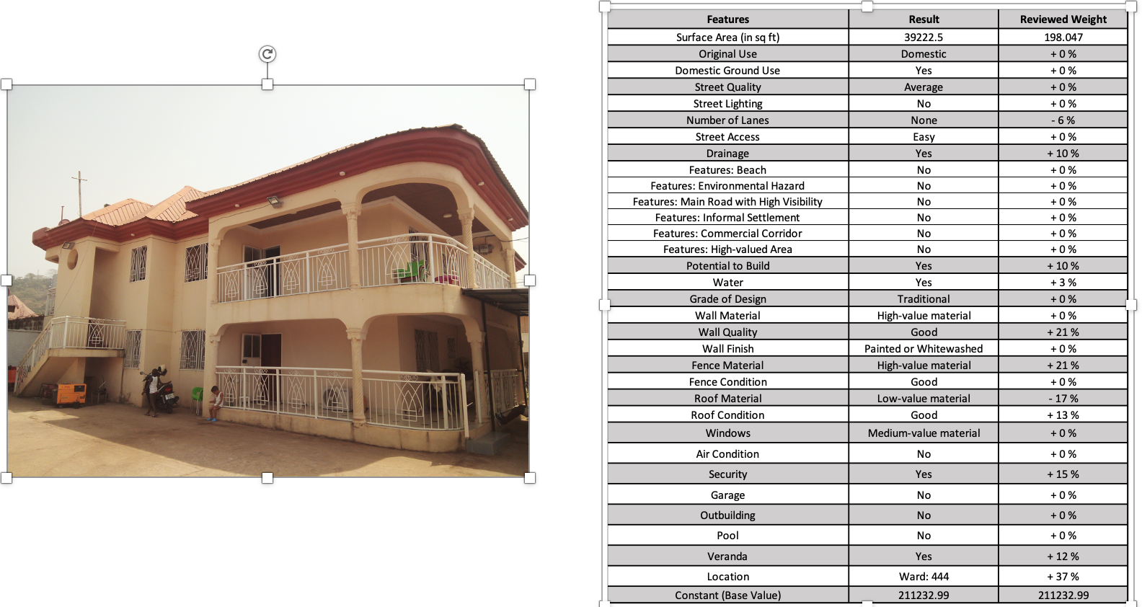

Slide 10
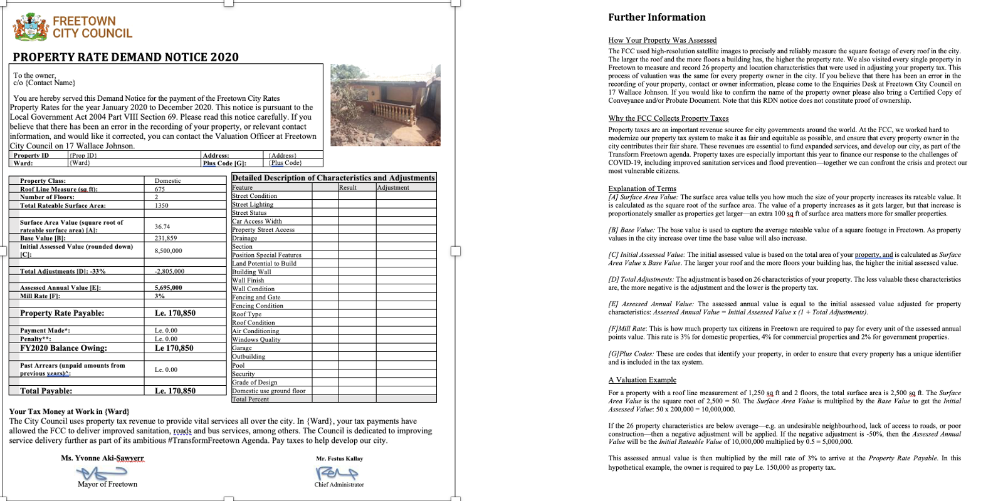
Transparency for Taxpayers

Slide 11
3. Appropriate IT Systems
Problem
  Automation is critical to improvements, but many systems are complex, very expensive, unsustainable and/or create “lock-in” with providers
  Procurement is subject to significant risks of corruption and, at minimum, very limited market transparency
Strategy
  Adopting simplified and lower-cost systems, putting more emphasis on interoperability, flexibility and sustainable local support, avoiding “lock-in” with providers

Slide 12
4. Building Trust and Political Support
Problem
  Very limited public trust leads to low compliance and limited political support for reform
  Low trust reflects (a) lack of transparency and equity and (b) weak reciprocity/accountability, reflected in limited and poorly communicated service delivery
Strategy
  Substantial outreach to taxpayers
  Reform strategies that provide transparency and evidence of fairness and equity
  Establish strong revenue-services linkages, potentially including participatory budgeting or earmarking of funds for visible public services

Slide 13
Reform Experience in Freetown
Doubled assessed properties, fully mapped and automated
Five-fold increase in revenue potential, driven by large increases in assessment for previously undervalued high-value properties
Actual revenue tripled in the first full year of implementation, with compliance highest among higher-value properties
Success in responding to political resistance by building popular and political support through transparency, participatory budgeting, clear evidence of impact

Slide 14
Conclusion
The approach presented is not a one-size-fits-all but a template for thinking about the best strategies for reform
Local strategies should reflect
  Legal institutional constraints and settings
  Technical capacity and resources
  Administrative organization
  Political dynamics

Slide 15
Thank You
Thank you
Murakoze

