Slide 1
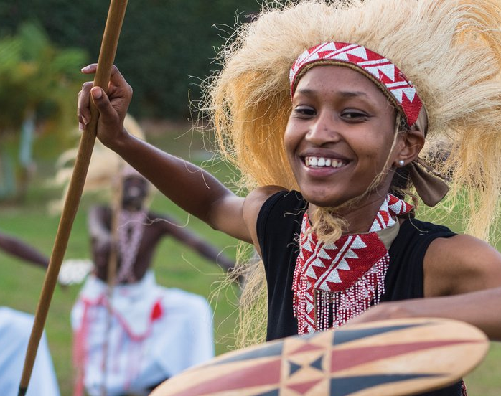



The role of Informal economy and entrepreneurship in socio-economic
Transformation
Osten Chulu
UNDP Rwanda

Slide 2
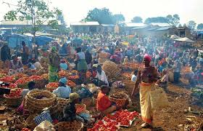
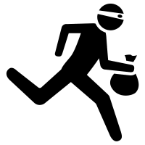
What is the Informal Economy?
In 2015, the ILO described the “informal economy” as referring to all economic activities by workers and economic units that are – in law or in practice – not covered or insufficiently covered by formal arrangements.
The informal economy does not cover illicit activities.

Slide 3
Total Population
Working age population
Non-working age population
In labour force
Not in labour force
Unemployed
Employed
Formal employment
Informal employment
Employment in the informal sector
Employment Outside the Informal Sector
The Informal Economy: Labour Force Framework

Slide 4
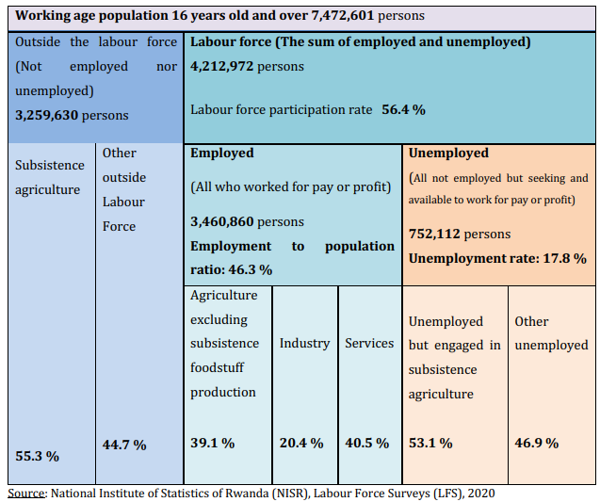
In Rwanda (LFS 2021)

Slide 5
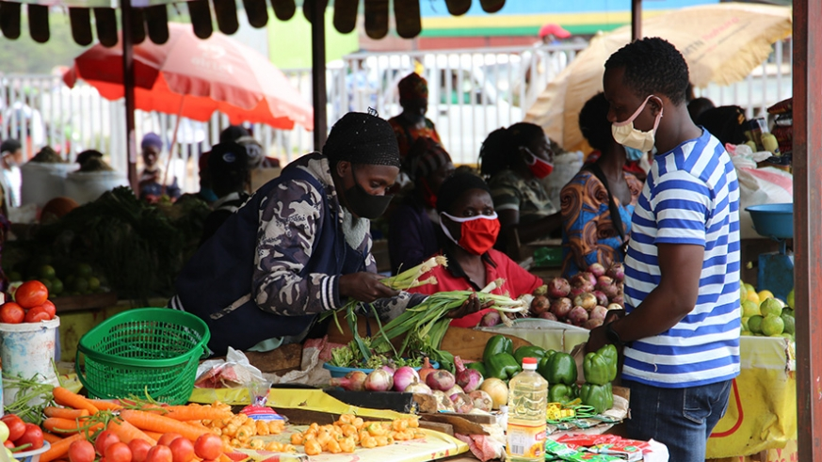
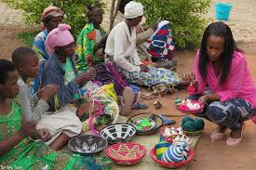
Features of Informality
Ease of entry
Small scale of activity
Self employment, with a high proportion of family workers
Little capital and equipment
Labour intensive technologies
Low skills
Low level of organisation
      Self-employment in informal enterprises:
        employers
        own account operators (don’t employ anyone else)
        unpaid contributing family workers
      Wage employment in informal jobs:
        non-standard employees of informal enterprises
        non-standard employees of formal enterprises
        casual or day labourers
        industrial outworkers (also called homeworkers)

Slide 6
CHARACETRISTICS OF THE INFORMAL ECONOMY
Across the world, 2 billion workers – 61% of all workers including agriculture are informal workers.
Informality has a strong rural dimension, with about 3 out of every 5 informal workers living in rural areas
Agriculture and industry sectors are the most exposed to informality
Within households, a majority of working households rely solely on informal employment
A large number of children and older individuals live in completely informal households
Informal economy workers face high risks of occupational risks in inferior working conditions and are most likely to fall into poverty

Slide 7
The Informal Economy in Rwanda
Rwanda’s definition: The Informal Sector is defined as all persons 16 years of age and above who were engaged in unregistered private business enterprises that do not keep written records of accounts.
Composition
  Domestic workers
  Hawkers
  Taxi bicycles
  Street vendors
  Barbers and hairdressers
  Workers in restaurants
  Casual labourers in mines, tea plantations
  Other unregistered service providers
73.4% of total employment outside agriculture are in the informal sector
Three out of every four people in Rwanda are employed in the informal sector.
For women, the percentage reaches 80%.

Slide 8
Segmented labour markets/ employment structures
What do we mean by segmentation?
    Constraints exist which prevent individuals from moving into better employment opportunities (or improving the quality of existing employment)
What causes segmentation?
    Discrimination, social norms, unequal wealth/assets, lack of credit, lack of public goods/services, etc
    Unpaid care responsibilities
Why does segmentation matter?
    Reinforces existing patterns of poverty and social exclusion.
    Issue of equity: class, gender, racial, caste segmentation.
    Issue of basic rights and the choices available to individuals.

Slide 9


Segmentation of the informal economy:
Segmentation by Sex
Poverty Risk
Average Earnings
High
Predominantly Men
Low
Employer
Regular wage workers
Own account operators
Men and Women
Casual wage operators
Industrial Outworkers
/Homeworkers
Predominantly Women
Unpaid Family Workers
High
Low

Slide 10
Measuring GDP: GDP by Production Mode
NISR produced GDP by product mode up to 2012
 | 2009 | 2010 | 2011 | 2012
Gross Domestic Product in % | 100 | 100 | 100 | 100
Formal sector % | 22 | 24 | 23 | 24
Informal sector (monetary) in % | 48 | 46 | 46 | 46
Non-monetary in % | 20 | 19 | 19 | 19
Government and NGOs in % | 10 | 11 | 12 | 11
 | 2009 | 2010 | 2011 | 2012
Gross Domestic Product in % | 100 | 100 | 100 | 100
Formal sector % | 22 | 24 | 23 | 24
Industry % | 4 | 5 | 5 | 4
Services % | 12 | 13 | 12 | 14
Adjustments % | 6 | 6 | 6 | 6
Informal sector (monetary) in % | 48 | 46 | 46 | 46
Agriculture % | 21 | 20 | 20 | 20
Industry % | 10 | 9 | 10 | 11
Services % | 17 | 17 | 16 | 16
Non-monetary in % | 20 | 19 | 19 | 19
Agriculture % | 13 | 12 | 12 | 13
Industry % | 1 | 1 | 1 | 1
Services % | 6 | 6 | 5 | 5
Government and NGOs in % | 10 | 11 | 12 | 11
Services % | 10 | 11 | 12 | 11
Non-monetary GDP includes:
household labour, care giving, civic activity or even friends doing something for each other that does not have a monetary value but remains a vitally important part of the economy.
If lumped up with informal sector GDP yields on average 65% of GDP as informal

Slide 11
Average monthly earnings from employment activity (Formal and Informal) RLFS 2020
 | Rwanda
 | Total | Male | Female
Total (16+ yrs) | 63 291 | 75 415 | 47 126
age group
16-24 yrs | 29 442 | 33 383 | 24 559
25-34 yrs | 72 530 | 83 961 | 56 398
35-54 yrs | 81 174 | 97 269 | 59 351
55-64 yrs | 65 151 | 86 150 | 40 687
65+yrs | 47 007 | 61 904 | 19 010
 | Urban
 | Total | Male | Female
Total (16+ yrs) | 147 432 | 173 798 | 111 277
age group
16-24 yrs | 39 955 | 52 014 | 30 460
25-34 yrs | 153 880 | 168 144 | 130 914
35-54 yrs | 213 826 | 231 228 | 182 846
55-64 yrs | 257 907 | 318 931 | 171 094
65+yrs | 188 848 | 221 186 | 36 036
 | Rural
 | Total | Male | Female
Total (16+ yrs) | 35 121 | 41 947 | 26 104
age group
16-24 yrs | 25 901 | 28 708 | 21 838
25-34 yrs | 39 388 | 47 002 | 29 197
35-54 yrs | 39 379 | 48 586 | 27 891
55-64 yrs | 32 777 | 42 821 | 21 456
65+yrs | 25 694 | 30 388 | 17 813

Slide 12

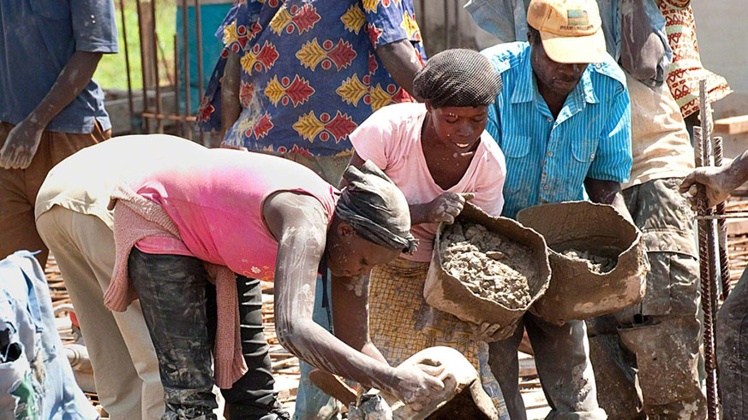
But informality plays a crucial role in Rwanda’s development
The informal sector accounts for over 65% of GDP
90% of all firms, micro, small and medium enterprises are informal
Currently, approximately 72% of the total employed population is informal (LFS)
93% of firms have fewer than five employees
But we cannot address informality without looking at earnings from employment activities
23.5% GDP contribution by Formal Sector - 10% of all businesses
65% GDP
Informal – 90% of all businesses

Slide 13
We have a problem… You don’t count if you’re not counted
Measuring the Non-Observed Economy
ECONOMIC WELL BEING
HAPPINESS
Leisure
Non-market activity
Wealth
(Unemployment)
(Insecurity)
Family
Friends
Work Satisfaction
Communities
02
01
03
GDP: Observed Economy
LIVING CONDITIONS
Environment
Health
Education
Inequality
(Expenditure) Sum of final Expenditures =
(Income) Sum of income payments and costs incurred in production =
(Production) Sum of gross value Added
04

Slide 14

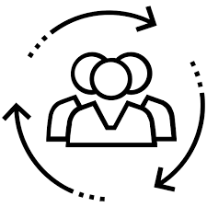



BUILT CAPITAL
Roads, Dams, Buildings, machinery and Equipment
HUMAN CAPITAL
Knowledge, Aptitude, Education and Skills
The Real Wealth of Nations
+
=
GDP
INCLUSIVE WEALTH - UNEP
OBSERVED
=
NON-OBSERVED
NATURAL CAPITAL
Forests, Agricultural land, the Atmosphere, Oceans, Ecosystems, Subsoil resources
SOCIAL CAPITAL
Community, Shared Values, Vision, Shared Identity
+

Slide 15
Rwanda’s Development Conundrum: Tradeoff between Natural, Built and Human Capital

Slide 16
Formalising the informal economy
Most informal sector operators use Natural Capital for their livelihoods
The value of that Natural Capital element is difficult to measure
How do we account for the livelihoods of the majority of the population who depend on Natural Capital
Alternatively, how can we transform/formalise informal entrepreneurship?

Slide 17
Four policy options to tackle informal entrepreneurship
Do nothing (Unacceptable)
Leaves intact the existing negative impacts such as:
Unfair competition - formal businesses
No access to credit to expand – informal businesses
No guarantee that health and safety standards have been followed – customers
Taxes owed are not collected – Governments
De-regulate formal entrepreneurship (Unacceptable)
Results in levelling down rather than levelling up of working conditions
Eradicate informal entrepreneurship (Unacceptable)
Leads to governments repressing enterprise culture and jobs
Formalise informal entrepreneurship (Most viable policy choice)
But: The other unacceptable options can have their uses too:
Doing nothing: Sometimes can be supportive to small-scale entrepreneurial endeavour for closer social relations
De-regulate: Useful when seeking to simplify compliance especially for business start-ups
Eradication: Useful for tackling those who fail to comply
Direct controls: Seek compliant behaviour by ensuring that benefits of operating in formal economy outweigh the cost of working in the informal economy.
Stick - increase the cost of non-compliance
Carrot – make the conduct of formal entrepreneurship more beneficial
Indirect controls: Seek behaviour change through a social contract between state and citizens based on high trust, high commitment culture

Slide 18
Conceptual Framework: Formalising informal sector entrepreneurship
Tackling informal sector entrepreneurship
Direct controls
Deterrents (‘sticks’)
Incentives (‘carrots’)
Indirect controls
Reduce asymmetry between formal and informal institutions
Improved detection
Increased penalties
For businesses
For individuals
Change informal institutions (values, norms, and beliefs)
Change formal institutions (laws, regulations and codes)
Data matching and sharing, joined-up strategy and operations
Increasing sanctions, advertising penalties
Simplify compliance, direct and indirect tax incentives, supply chain responsibility, support and advice to start-ups
Supply side incentives (e.g., society-wide amnesties, voluntary disclosure, smoothing transaction to formalisation)
Demand-side incentives (service vouchers, target direct taxes, targeted indirect taxes)
Tax education, normative appeals, education and awareness raising of benefits of declared work
Procedural fairness and justice, redistributive justice, wider economic and social developments
Williams, CC : Informal Sector Entrepreneurship (https://www.oecd.org/employment/leed/Background-Paper-PB-Informal-Entrepreneurship-final.pdf)

Slide 19
WE NEED MORE THINKING
OUR IN-TRAY IS GROWING
VISIONS OF THE FUTURE
OUR POLICIES
LNOB GDP of the poor? Non-observable GDP and how to measure informal economy realistically? Are we putting a proper value on Natural Capital on which a large proportion of the population depends?
Direct or Indirect Controls: Its not one or the other – both are required! Which policy mix is most effective to elicit formalisation?
THE ECONOMICS TO ACHIEVE THEM
FIXING THE DUAL ECONOMY
How do we account for undeclared work? How do we improve the data/information ecosystem
Move away from deterring informal
entrepreneurship and towards the use of incentives and indirect controls to formalise the informal sector

Slide 20
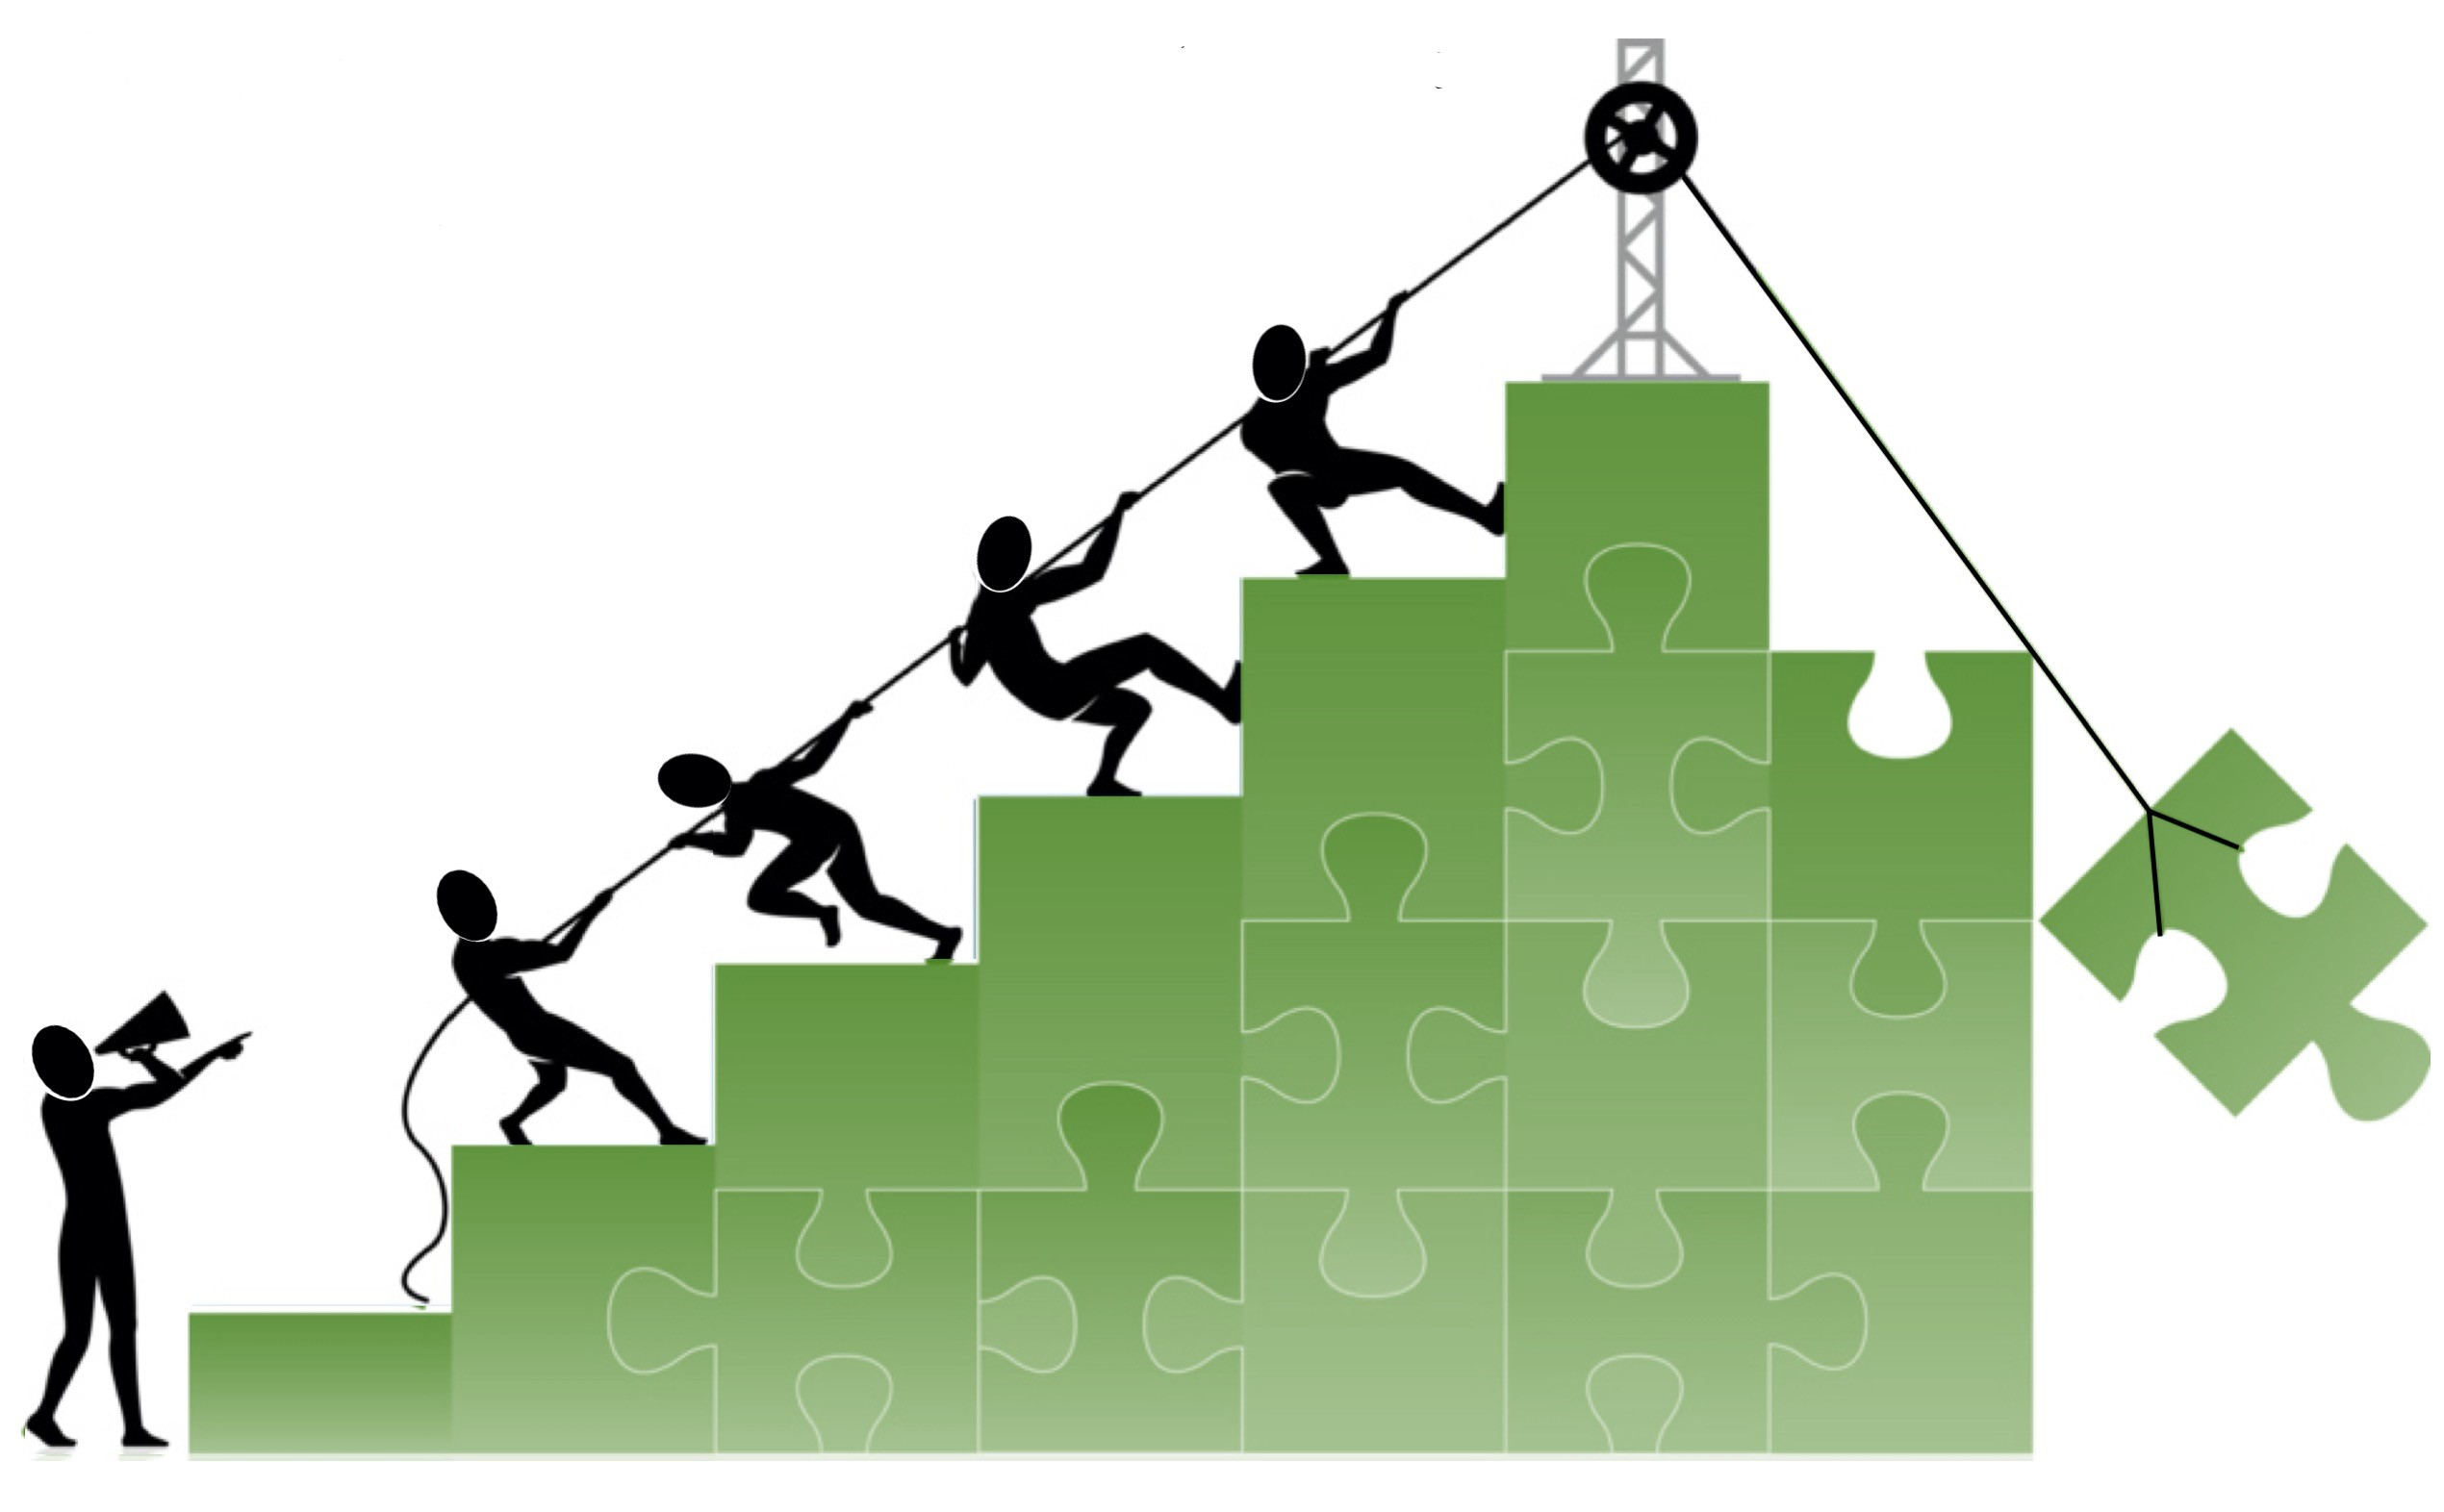
Build Back Better – Thank You!

