Slide 1

Taxing the wealthy in lower-income countries: research evidence and policy implications
Fabrizio Santoro, PhD
ICTD – IDS
June 27, 2024

Slide 2
The world is experiencing a combination of multiple crises, including increasing global tensions, skyrocketing debt levels, and climate change
  Lower-income countries (LICs) are bearing the brunt of these
Finances LICs count on are not growing at a sufficient pace
A key tool to raise more revenue: taxing the wealthy more effectively
How to do that?
We argue that this will be possible even without introducing new wealth taxes
  hot debate in US, UK, Europe and Latin America
  recent UN report with a strong focus on wealth taxation in LICs (UN 2023)
  no LIC has to date successfully implemented a wealth tax successfully

Slide 3
Revenue LICs raise from existing taxes on properties, inheritances, or financial transactions is much less as % of GDP than in HICs

Slide 4
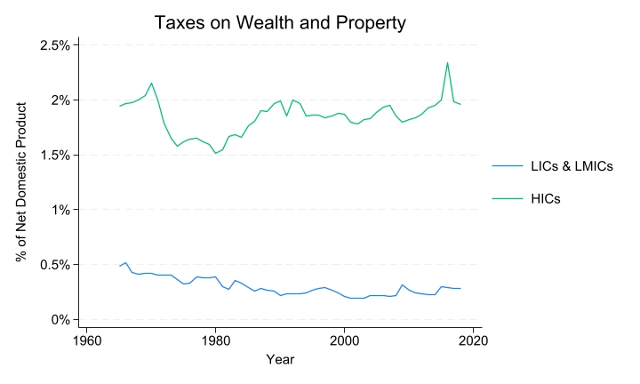

Slide 5
LICs in general, and SSA in particular, exhibit an even starker wealth inequality than HICs

Slide 6
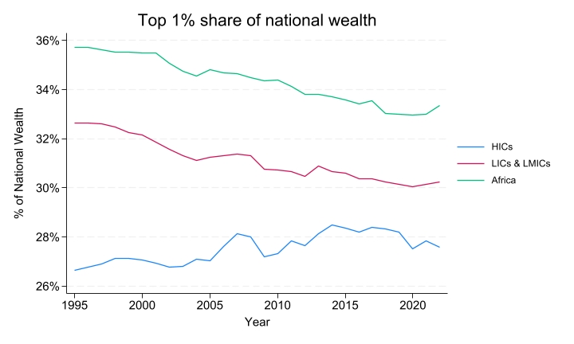

Slide 7
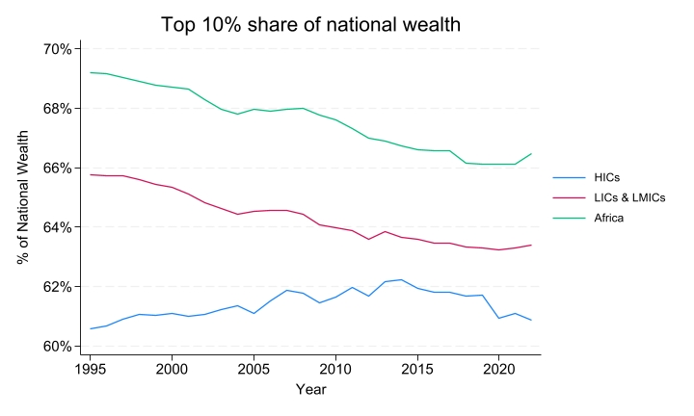

Slide 8
LICs will be better off by first focusing on improving the performance of existing instruments – that is, taxes on various sources of income, including rents and capital gains

Slide 9
  These tax instruments are already enshrined in existing laws, and debates about their more thorough enforcement are likely going to be less controversial than introducing new taxes
  Research on property tax reforms (Jibao and Prichard 2015, 2016) and taxation of wealthy individuals (Kangave et al. 2016, 2023, Occhiali et al. 2024) conducted in SSA
    mustering the political will necessary to counterbalance elite opposition is one of the main obstacles to proper enforcement of existing tax laws
    opposition to the introduction of new taxes will be even more substantial
    high risk of hijacking of parliamentary discussion in order to kill significant reforms (Fairfield 2010)

Slide 10
  the effective design of wealth taxes requires the accessibility of a variety of data sources which are often lacking across many LICs
    a better enforcement of income and property taxes, which often have information forms as part of the tax return, could importantly contribute to acquiring this data

Slide 11
  personal income taxes (PIT) account for a much lower proportion of LICs than of HICs domestic product
    their top marginal tax rates have also been decreasing substantially, although they remain above those of HICs
    when effective tax rates are considered, they are significantly lower in LICs
      narrower tax bases, discretionary tax exemptions, and suboptimal enforcement of various tax handles due both administrative and political issues

Slide 12
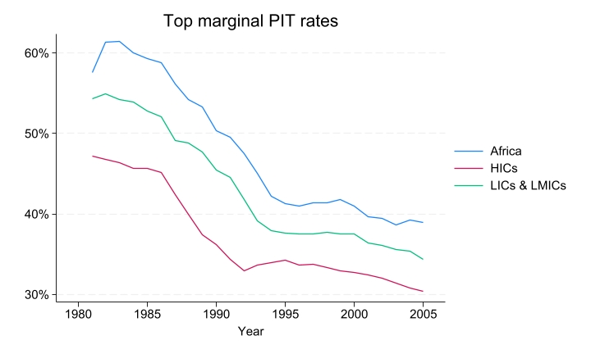

Slide 13
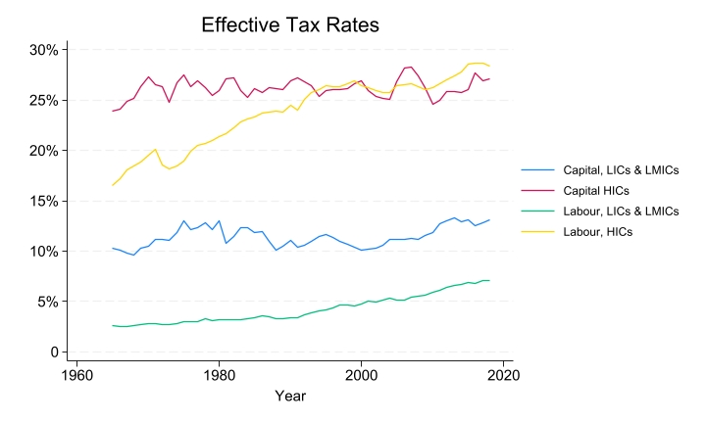

Slide 14
  improving compliance from wealthy individuals with existing tax obligations would contribute to increasing the equity of LICs’ tax system
      often disproportionate burden on few formal employees, small domestic firms, and consumers
      often more enforcement on registering small informal actors than to expand revenue collection from self-employed professionals or those with investment income (Gallien et al. 2023)
      studies on CIT (Mascagni and Mengistu 2019) and VAT (Brockmeyer et al. 2024) in LICs show that smaller taxpayers often face higher effective tax rates than larger ones

Slide 15
  5. revenue foregone by lax enforcement of income and property taxes is likely to be substantial
  evidence from Uganda shows that focusing on the compliance of wealthy individuals with income taxes can quickly lead to substantial gains (Kangave et al. 2018) – although they are hard to maintain (Santoro and Waiswa 2023)
  and the same is true in the case of progressive property tax reforms in Freetown (ATI)

Slide 16
How to make existing taxes work better in targeting wealthy individuals?

Slide 17
  Strengthen tax administration
    establish a taskforce or a unit with trained officials to work specifically on HNWIs
    fully enforce the submission of information forms for withholding taxes, of tax clearance certificates, and of conveyances
      crucial sources of information
    consider the establishment of a voluntary asset declaration scheme connected to a one-time amnesty
      one-off wealth tax introduced in Argentina relied on information gathered during a voluntary assets declaration scheme implemented in 2016, through which over USD 117 billion were repatriated leading to a collection of almost USD10 billion in tax revenue (Londoño-Vélez and Tortarolo 2022)
    medium-term investments on digitalising individual tax returns, technical and technological capacity to register properties and assess their value, agreements with other institutions to gather more information

Slide 18
  Improve legal and policy frameworks for better data sharing
    introduce new legal provisions where needed
      verifying if capital gains, rental, dividend, and interest incomes are currently covered by tax legislation
      ensure that the submission of dedicated tax and information returns is mandatory
      explicit legal provisions for the sharing of information between public bodies (for example, the Ministry of Land) private entities (chiefly commercial banks) and the revenue authority
    adopt a clear definition of who qualifies as a HNWI
      very small number of individuals with a (legal) net worth of USD 1mln, the OECD definition
      URA established two main sets of criteria were developed to define HNWIs – core and non-core parameters
        qualifying for any single core parameter, or for the combination of any two non-core parameter, is sufficient to be considered an HNWI

Slide 19
  Political considerations
    establish a cooperative, rather than coercive, compliance strategy
      URA engaged and obtained “buy in” from politicians – the unit approach was framed as “cooperation” rather than “enforcement”
    invest in sensitisation, education, and communication campaigns
    engage broadly with civil society actors and associational bodies to promote a culture of compliance

Slide 20
Thank You
Contact:
Fabrizio Santoro
f.santoro@ids.ac.uk

