Slide 1



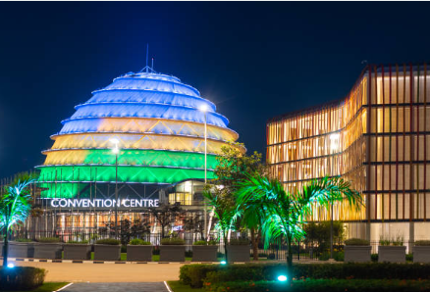


Tax Policy Reforms

Slide 2
Outline
Current tax
to GDP trend
1.
Objectives
2.
3.
VAT
4.
Excise Duties
5.
Motor vehicle tax
and fees
6.
Other taxes

Slide 3




  Introduction
  Broaden the tax base
  Enhance fairness and domestic business competitiveness
  Increase revenue mobilization
  Streamline tax administration in order to meet Rwanda’s development goals
  Strengthen resilience of Rwanda’s economy and promote self-reliance
  Objectives

Slide 4
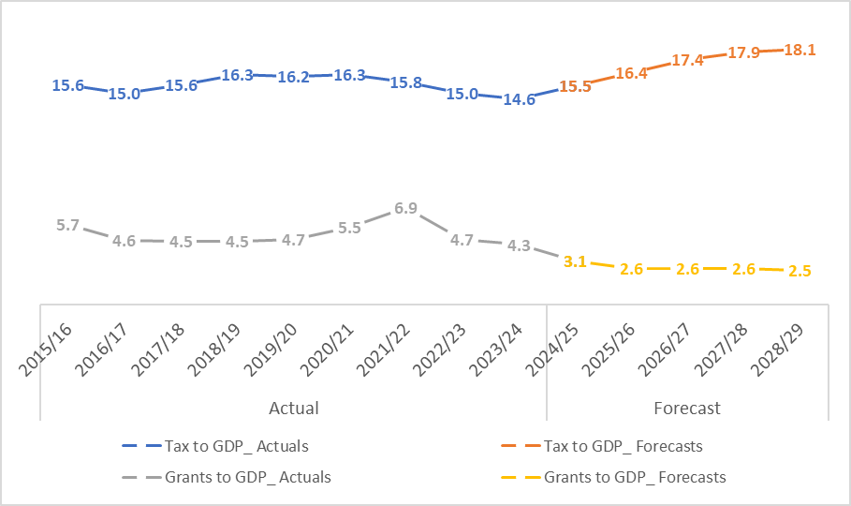
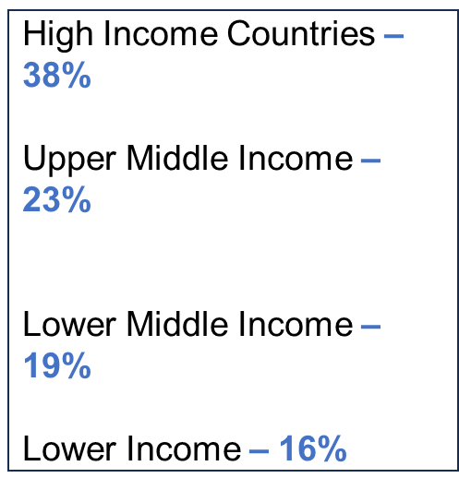
Tax to GDP & Grants to DGP (in %)
MTRS1 projections:
To reach 21.5% in 2034/35 and 34% by 2050

Slide 5
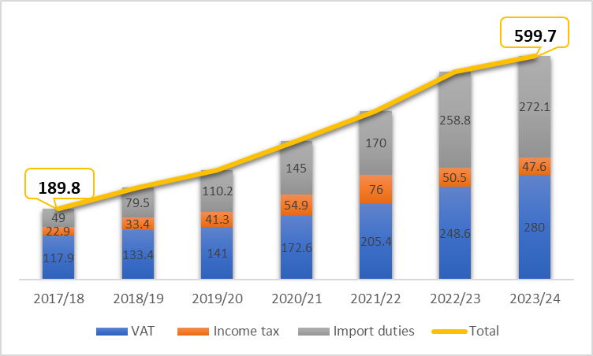
Tax Expenditure -Revenue foregone (in bln FRW)
Revenue foregone increased up to Frw 599.7bln in FY 2023/24 from Frw 557.9 billion in FY 2022/23.
Import duty revenue foregone are the highest Frw 272.1bln in FY 2023/24 mainly driven by exemption granted to industries.

Slide 6


















1
VAT on mobile telephones
Zero-Emission Vehicles
7
  Repeal the exemption which started in 2010.
  .Set sunset VAT exemptions for zero-emission vehicles until June 2028
2
VAT on ICT equipment
Business Inputs
6
  Repeal the exemption introduced in 2012.
  Repeal VAT exemptions on business inputs.
  To be implemented by July 2026.
3
VAT on fee-based financial services
VAT on Fossil Fuels
5
  Introducing VAT on fee-based financial services, excludes interest-based payments and cashless services.
  To start by July 2025.
  Reinstate VAT on fossil fuels.
  To be started by July 2025.
4
VAT on transport of Service of goods by road
  Reinstate VAT on the transport service of goods by road,
  Starting by July 2025.
Official Gazette No. Special of 29/05/2025 - Law Nº 009/2025 of 27/05/2025.

Slide 7







EXCISE DUTIES
Beer Excise Duty
Excise Tax on Airtime
  Increased the excise duty on beer from 60% introduced in 2006 to 65% of the factory price,
  Rate to be increased gradually, from 10% to 12% by April 2025, to 14% year 2, and to 15% year 3.
  Price / min.: From 40 Frw -> 40.8 Frw -> 41.5 Frw -> 42 Frw.
Excise duty on Cosmetic and Beauty Products
Excise on fees charged for financial transactions
Excise duty on Cigarettes
  Increased the specific rate from Frw 130 to Frw 230 per pack, while maintaining the percentage rate at 36%
  Introduced an excise duty of 15% of the value (CIF).
  Excise of 15% on fees charged for financial transactions, aligning with regional practice.
Official Gazette No. Special of 29/05/2025 – Law Nº 011/2025 of 27/05/2025.

Slide 8







MOTORVEHICLE TAX AND FEES
Registration Fees for Vehicles
  Adjusted registration fees for vehicles, which have been unchanged since 2009.
  Fees Structure (Frw) per cc:
      0 - 1000: 75,000
      1001 - 1500: 285,000
      1501 - 3000: 445,000
      3001 - 4500: 748,000
      4501 & Above: 997,000
      Other categories :1,000,000
      Electric vehicles : 285,000
      All Electric motocycles: 75,000
Official Gazette n° Special of 17/04/2025 - Ministerial Order Nº 003/25/10/TC.
Reinstate Tax on Hybrid Vehicles
Motorvehicle Road User Charge
  Maintain import duty exemption,
  Reinstate VAT and Withholding tax,
  Introduce excise duty based on vehicle age:
      0-3 years: 5%
      4-7 years: 10%
      8+ years: 15%
  Reinstated annual motor vehicle road user charge to finance road maintenance.
  Charges per category (Frw):
      Cars and Jeeps: 50,000
      Bus and Pickups: 100,000
      Half trailers : 120,000
      Trucks and Trailers: 150,000
FY 2025/26
by July 2025
Official Gazette No. Special of 29/05/2025 – Law Nº 009/2025 of 27/05/2025 and Law Nº 011/2025 of 27/05/2025
Official Gazette No. Special of 29/05/2025 - Law nº 013/2025 of 27/05/2025.

Slide 9

Fuel & Road Maintenance Levies Adjustment
Road Maintenance Levy
Adjusted the Fuel Levy from a fixed fee of Frw 115 to a percentage rate of 15% of CIF.
Strategic Reserve Levy
Increase the Strategic Reserve Levy from 32.73 Frw to 50 Frw per liter.
See the Official Gazette No. Special of 29/05/2025;
Law nº 012/2025 of 27/05/2025 - Strategic Reserve Levy
Law nº 013/2025 of 27/05/2025 - Road Maintenance fuel Levy

Slide 10












OTHER TAX POLICY MEASURES
Increased Tax on Gambling
Environmental Levy
Tourism Tax
Digital Services Tax
  Withholding tax on winnings from 15% to 25% for players ,
  GGR tax from 13% to 40% for operators
  Introduced an environmental levy of 0.2% of CIF on imported plastic-packaged goods
  Introduce Digital Services Tax on income sourced in Rwanda by foreign companies providing services through online platforms
  Introduced Tourism tax of 3% of the cost of room.
July 2025
July 2025
July 2025
FY 2026/27
Official Gazette No. Special of 29/05/2025 – Law Nº 014/2025 of 27/05/2025.
Official Gazette No. Special of 29/05/2025 – Law Nº 014/2025 of 27/05/2025.
Official Gazette No. Special of 29/05/2025 – Law Nº 010/2025 of 27/05/2025.
Official Gazette No. Special of 29/05/2025
– Law Nº 015/2025 of 27/05/2025.

Slide 11











OTHER TAX POLICY MEASURES
Revise Capital Gain Tax
Revise Capital Gain Tax from 5% to 10% on sale of shares, debt, license, guarantee.
FY 2025/26
Investment Code Revision
See the Official Gazette No. Special of 29/05/2025 – Law Nº 014/2025 of 27/05/2025.
  Phase Out Tax Holiday
  Clarify Qualification Criteria
FY 2026/27
See the Official Gazette No. Special of 29/05/2025 – Law Nº 014/2025 of 27/05/2025.
Sunset clause for energy equipment Exemption
Maintain the exemption for energy equipment until 2030
Official Gazette No. Special of 29/05/2025 - Law Nº 009/2025 of 27/05/2025.

Slide 12
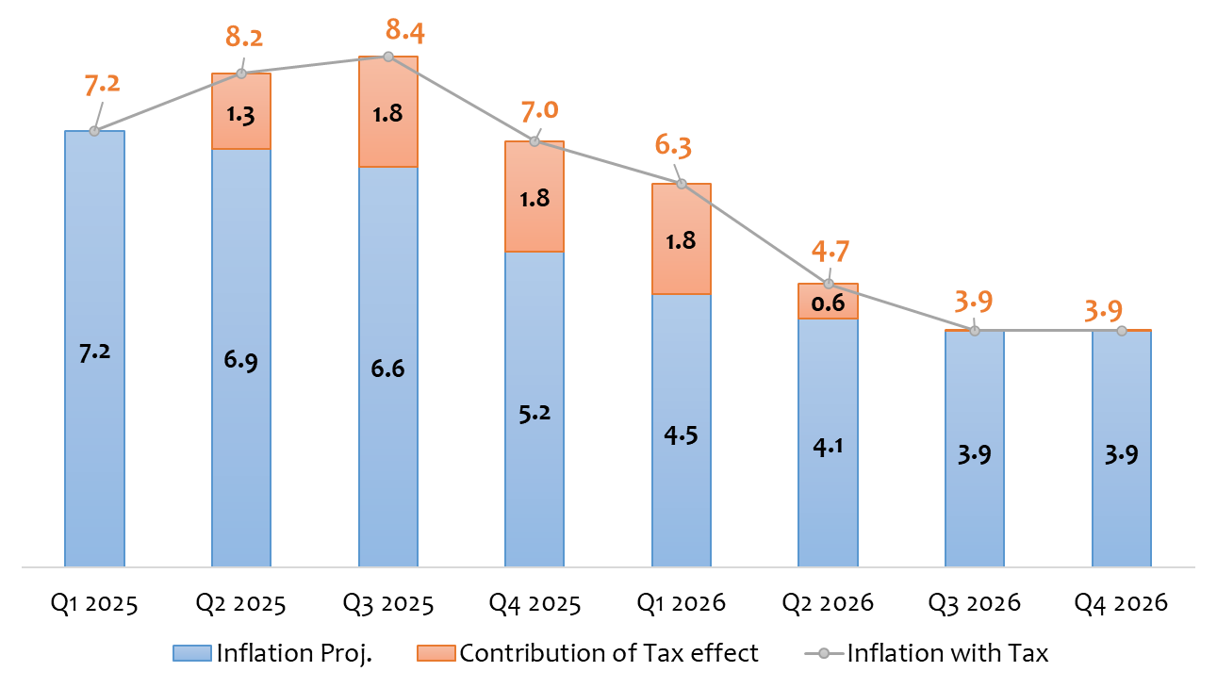
  Most VAT measures are deductible for businesses, reducing the final cost to consumers. Registered businesses can claim VAT on key inputs like transport and fuel, minimizing inflationary pressure.
  Phased tax increases allow for smooth adjustment, preventing sudden price shocks.
  Taxes mainly affect businesses and luxury goods, keeping essential goods largely unaffected.
INFLATION IMPACT

Slide 13
IMPLEMENTATION TIMELINE

Slide 14


Thank You
EPRN
Tel: 0788357648
info@eprnrwanda.org
www.eprnrwanda.org
MINECOFIN
TAX POLICY DIRECTORATE

