Slide 1



Strengthening Fiscal Resilience through VAT Compliance: Leveraging Data-Driven and Modern Tax Administration Approaches
EPRN 12th Annual Economic Research Conference
June 2026

Slide 2
Presentation Agenda
Revenue Performance and Fiscal Resilience
VAT Gap Analysis: Magnitude and Drivers
VAT Policy, Compliance and Administrative Initiatives for Fiscal Resilience
Impact of Data-Driven Compliance Interventions
VAT Compliance and Fiscal Resilience
Conclusions

Slide 3
01
Revenue Collection Trend
Revenue collection has been growing steadily and is projected to increase by 27.8% in 2025/26
RRA Revenue Collection Trend
4,099.2
Total collection (Frw bn)
3,206.6
27.8 %
Collection growth rate (%)
2,419.1
2,728.7
17.5 %
12.8 %
1,985.1
21.9 %
1,732.2
14.6 %
2020/21
2021/22
2022/23
2023/24
2024/25
2025/26
Table 1: Total RRA Revenue Collection in Frw billions
INDICATOR | 2020/21 | 2021/22 | 2022/23 | 2023/24 | 2024/25 | 2025/26
Total RRA collection | 1732.2 | 1,985.1 | 2,419.1 | 2,728.7 | 3,206.6 | 4,099.2
Central Government Revenue | 1654.4 | 1910.1 | 2,332.6 | 2,639.0 | 3,099.0 | 3,963.5
o/w: Tax Revenue | 1,605.1 | 1,852.3 | 2,250.4 | 2,534.8 | 2,993.6 | 3,841.2
o/w: Other Revenue | 49.3 | 57.8 | 82.2 | 104.2 | 105.4 | 122.3
Local Government Tax and Fees | 77.8 | 74.9 | 86.5 | 89.8 | 107.6 | 135.7
o/w: Local Government Tax | 36.7 | 35.4 | 41.5 | 50.4 | 75.2 | 97.9
o/w: Local Government Fees | 41.7 | 39.5 | 45.0 | 39.4 | 32.4 | 37.8

Slide 4
02
Tax to GDP Ratio
Table 2: GDP and Tax Revenue Trends
Indicators | 2016/17 | 2017/18 | 2018/19 | 2019/20 | 2020/21 | 2021/22 | 2022/23 | 2023/24 | 2024/25 | 2025/26
Nominal GDP (Frw Bn) | 7,237 | 7,982 | 8,784 | 9,640 | 10,499 | 12,359 | 15,800 | 18,371 | 21,512 | 24,776
Annual Growth | 12.3% | 10.3% | 10.0% | 9.7% | 8.9% | 17.7% | 27.8% | 16.3% | 17.1% | 15.1%
Tax revenue including LGT (Frw Bn) | 1,104 | 1,253 | 1,418.9 | 1,523.6 | 1,672.4 | 1,887.7 | 2,291.9 | 2,585.2 | 3,068.7 | 3,939.0
Annual Growth | 10.4% | 13.5% | 13.2% | 7.4% | 9.8% | 12.9% | 21.4% | 12.8% | 18.7% | 28.4%
Tax to GDP Ratio | 15.3% | 15.7% | 16.2% | 15.8% | 15.9% | 15.3% | 14.5% | 14.1% | 14.3% | 15.5%
Notes: -Expected tax-to-GDP at end of MTRS1 was 16.8% (2023/24)
-Average OECD Countries tax-to-GDP is 34%

Slide 5
03
Tax to Budget Ratio
Rwanda’s revenue-to-budget ratio has increased to over 59%, reducing dependency on external sources to fund the national budget
Revenue-to-Budget Ratio Trend
61.7%
57.8%
55.1%
59.0%
52.3%
50.8%
53.3%
50.0%
44.7%
2017/18 2018/19 2019/20 2020/21 2021/22 2022/23
2023/24
2024/25
2025/26
Table 3: National Budget and RRA Revenue Trends
Indicators | 2017/18 | 2018/19 | 2019/20 | 2020/21 | 2021/22 | 2022/23 | 2023/24 | 2024/25 | 2025/26
National Budget (Frw Bn) | 2,115.3 | 2,565.7 | 3,017.1 | 3,464.8 | 4,441.0 | 4,764.8 | 5,115.6 | 5,816.4 | 6,952.1
Annual Growth | 8.2% | 21.3% | 17.6% | 14.8% | 28.2% | 7.3% | 7.4% | 13.7% | 19.5%
RRA Revenue (Frw Bn) | 1,305.9 | 1,483.5 | 1,578.2 | 1,732.3 | 1,985.1 | 2,419.1 | 2,728.7 | 3,206.6 | 4,099.2
Annual Growth | 13.5% | 13.6% | 6.4% | 9.8% | 14.6% | 21.9% | 12.8% | 17.5% | 27.8%
Total Revenue to National Budget | 61.7% | 57.8% | 52.3% | 50.0% | 44.7% | 50.8% | 53.3% | 55.1% | 56.5%
Note:
Above RRA revenue amount includes Central Government and Local Government Revenue collected by RRA

Slide 6
04
Tax Revenue by Major Tax Type
VAT has consistently been the largest contributor to tax revenue, accounting for nearly 1/3 of Rwanda’s tax revenue each year
The next largest tax types are CIT/PIT (23%) and PAYE (21%) in previous FY
Tax Revenue Contribution by Major Tax Type
VT
Value Added Tax
EXCISE
PIT
Personal Income Tax
Notes: -Customs Duties include Import Duty, Infrastructure Development Levy, and African Union Levy
-Other includes Royalty Tax on Mining and Motor Vehicle Tax

Slide 7
The Path to Fiscal Resilience: Addressing Africa's Tax Challenges
VAT Gap Estimation
Version 2025
July,2 205

Slide 8
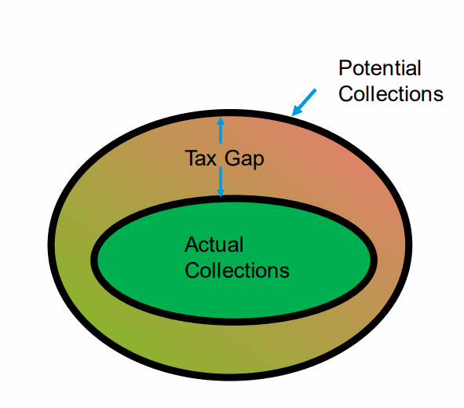
05
VAT Gap Analysis
To further deepen our understanding of the VAT collection gap and its components, RRA underwent a rigorous analysis to quantify the VAT Gap for Rwanda from 2013-2023
Comprehensive estimates distinguish between the revenue foregone from the Policy Gap and the Compliance Gap
Results are derived from a dual-methodology approach combining two approaches:
      1. Top-Down RAGAP Approach (Macro based)
      2. Bottom-Up Approach (ML Micro based)

Slide 9
VAT Gap Estimation-Top-Down Approach Based
(Macro/SUT Based)

Slide 10
06
VAT Gap Overview : Top-Down Approach
VAT GAP
Compliance Gap
Policy Gap
Assessment Gap
Collection Gap
Tax Expenditure
Efficiency Gap
Estimation results indicate that the overall VAT gap declined steadily until 2019 – driven mainly by improvements in compliance – but widened again after 2020, with policy remaining the dominant driver
Notes: - For Kenya, estimated VAT Gap is 11.8% of GDP
- For EU countries, estimated VAT Gap varies from 0.5 to 1.5% of GDP

Slide 11
07
Compliance Gap overview : Top-Down Approach
Breaking down the Compliance Gap further, we observe it is mainly driven by the Assessment Gap (80% share)
Assessment Gap consists of:
Hidden economic activities in the informal sector
Underreporting sales or overstating inputs
Non-filing of VAT returns
Misclassification of taxable, exempt, or zero-rated supplies
Collection Gap consists of:
Payment arrears
Insolvencies or closure of business
Compliance Gap Components (% share)

Slide 12
08
Compliance Gap by sector : Top-Down Approach
Compliance Gap by Sector (% of GDP)
Section | Section description | 2013 | 2014 | 2015 | 2016 | 2017 | 2018 | 2019 | 2020 | 2021 | 2022 | 2023
A | Agriculture, Forestry and Fishing | 0.14 | 0.13 | 0.13 | 0.14 | 0.14 | 0.15 | 0.14 | 0.14 | 0.13 | 0.12 | -
B | Mining & Quarrying | - | - | - | - | (0.14) | (0.15) | (0.28) | (0.27) | - | - | -
C | Manufacturing | 1.66 | 1.42 | 1.31 | 0.29 | 0.41 | 0.29 | 0.43 | 0.82 | 1.03 | 1.48 | 1.24
D | Electricity | - | - | (0.13) | - | - | - | (0.14) | (0.14) | (0.13) | (0.12) | (0.14)
E | Water & waste management | 0.14 | - | - | - | - | - | - | - | - | - | -
F | Construction | - | 0.13 | - | - | 0.14 | 0.29 | 0.14 | 0.55 | 0.26 | 0.74 | 0.28
G-H | Trade & Transport | 1.94 | 1.81 | 1.70 | 2.01 | 1.93 | 2.49 | 2.41 | 2.32 | 2.58 | 2.95 | 3.16
I | Hotels & restaurants | 0.42 | 0.52 | 0.52 | 0.57 | 0.41 | 0.44 | 0.28 | - | 0.13 | 0.25 | 0.28
J | Telecoms, IT and Publishing services | - | - | - | - | (0.14) | (0.15) | (0.14) | - | - | - | -
K | Financial services | - | - | - | (0.14) | - | (0.15) | (0.14) | (0.14) | - | - | -
L | Real estate activities | 0.28 | 0.26 | 0.26 | 0.29 | 0.28 | 0.15 | 0.14 | 0.14 | 0.13 | 0.12 | 0.14
M | Professional, scientific activities | 0.42 | 0.26 | 0.26 | 0.29 | 0.28 | 0.29 | 0.28 | 0.27 | 0.26 | 0.25 | 0.14
N | Administrative & support ce activities | - | - | 0.13 | - | - | - | - | - | - | - | (0.14)
O | Public administration & defense; social | - | - | - | - | - | - | - | - | - | - | -
P | Education | 0.28 | 0.13 | 0.13 | 0.14 | 0.14 | 0.15 | 0.14 | 0.14 | 0.13 | 0.25 | 0.14
Q | Human health & social work activities | 0.14 | 0.13 | 0.13 | 0.29 | 0.28 | 0.29 | 0.28 | 0.27 | 0.26 | 0.25 | 0.28
R-U | Other service activities | 0.55 | 0.52 | 0.52 | 0.72 | 0.55 | 0.59 | 0.57 | 0.55 | 0.52 | 0.49 | 0.41
Z | Unknown Sector | (0.55) | (0.39) | (0.26) | (0.29) | (0.28) | (0.59) | (0.71) | (0.55) | (0.52) | (0.37) | (0.28)
Grand Total |  | 5.3 | 4.9 | 4.9 | 4.2 | 3.9 | 4.1 | 3.6 | 4.1 | 4.9 | 6.3 | 5.5
The Compliance Gap declined until 2019 before widening again after Covid-19
The post-Covid expansion in the Compliance Gap was mainly driven by under-reporting in the Trade, Transport, Manufacturing, and Construction sectors

Slide 13
09
Policy Gap – Top-Down Approach
Breaking down the Policy Gap further, it is mainly driven by the Efficiency Gap (76% share), yet the Expenditure Gap has notably increased due to the introduction of new exemptions (from 14% to 24% share)
Policy Gap Components (% share)
Expenditure Gap consists of:
VAT foregone from exemptions and reduced rates established by policy (e.g., in education, health, financial sector, etc.)
Efficiency Gap / Non-taxable Gap consists of:
VAT foregone from non-taxable or untouchable sectors that lie outside the VAT sector (e.g., agriculture, public services and VAT threshold)

Slide 14
VAT Gap Estimation-Bottom Up Approach
(Micro Based - Machine Learning techniques)

Slide 15
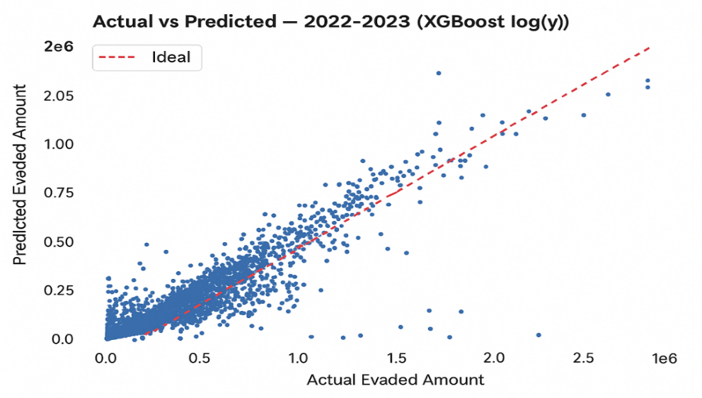
10
VAT Gap overview – Bottom-Up Approach
The Bottom-Up approach involves applying ML techniques to predict evaded VAT
The scatter plot shows a strong positive relationship between actual and predicted evaded VAT amounts for 2018-2023, indicating that the XGBoost model (log-transformed target) predicts evasion accurately, with only minor deviations
Actual vs. Predicted VAT Gap 2022-2023 (XGBoost log(y))
Model evaluation metrics
Machine Learning Model | RMSE (K) | R-square
XGBoost | 0.14 | 87.3%
Random Forest | 0.39 | 64.3%
Other models, like Light Boost, Gradient Boosting, and Stacking, are not suitable due to very high errors and weak fit

Slide 16

11
VAT Gap overview – Bottom-Up Approach
According to the XGBoost model, the under-reporting gap accounted for an estimated RWF 162.4 billion of the VAT compliance gap in 2023.
The rate of under-reporting as share of potential VAT is estimated at 16.7% of potential VAT in 2023
VAT under-reporting gap (%) and amount (RWF bn),
by province (2023) and by year (2018-2023)
6.0bn
37.1 %
North
5.8bn
13.4%
East
7.4bn
45.8%
West
133.4bn
15.2%
9.7bn Kigali City
42.5%
South

Slide 17
12
VAT Gap By Scale – Bottom-Up Approach
Breaking down the VAT under-reporting gap by taxpayer size, we observe that SMEs account for approximately 90% of the gap
VAT under-reporting gap (%) and amount (RWF bn) by taxpayer size
Scale | 2018 | 2019 | 2020 | 2021 | 2022 | 2023
LARGE | 17.0 | 18.3 | 13.5 | 16.4 | 16.9 | 17.0
MEDIUM | 15.8 | 18.5 | 11.3 | 16.3 | 21.3 | 23.4
SMALL | 49.2 | 64.6 | 65.0 | 85.6 | 106.7 | 122.0
TOTAL | 82.0 | 101.4 | 89.8 | 118.3 | 144.9 | 162.4

Slide 18
13
VAT Gap by Sector – Bottom-Up Approach
The largest contributors to the VAT under-reporting gap are the Trade, Construction, Manufacturing, Transport, and Professional Activities sectors
VAT under-reporting gap (RWF bn) by sector
ISIC | ISIC Description | 2018 | 2019 | 2020 | 2021 | 2022 | 2023
A | A - Agriculture, forestry and fishing | 1.1 | 1.2 | 1.4 | 2.0 | 2.1 | 3.6
B | B - Mining and quarrying | 0.6 | 0.7 | 0.8 | 1.4 | 3.2 | 2.9
C | C - Manufacturing | 8.4 | 12.1 | 9.2 | 13.7 | 17.7 | 20.8
D | D - Electricity, gas, steam and air conditioning su | 1.1 | 1.4 | 1.3 | 1.1 | 1.9 | 2.4
E | E - Water supply; sewerage, waste management | 0.8 | 1.3 | 2.4 | 1.8 | 1.7 | 1.2
F | F - Construction | 14.8 | 18.5 | 13.9 | 21.6 | 26.5 | 26.6
G | G - Wholesale and retail trade; repair of motor veh | 19.3 | 26.8 | 26.5 | 31.3 | 34.5 | 42.4
H | H - Transportation and storage | 2.5 | 4.2 | 3.6 | 4.6 | 5.8 | 7.2
I | I - Accommodation and food service activities | 6.5 | 7.6 | 5.3 | 7.3 | 6.5 | 6.7
J | J - Information and communication | 3.2 | 2.2 | 1.8 | 2.7 | 4.3 | 2.9
K | K - Financial and insurance activities | 1.5 | 1.7 | 1.0 | 1.4 | 2.1 | 2.2
L | L - Real estate activities | 2.1 | 3.3 | 4.4 | 4.3 | 4.6 | 4.7
M | M - Professional, scientific and technical activities | 3.3 | 4.4 | 2.5 | 4.7 | 7.4 | 9.2
N | N - Administrative and support service activities | 2.1 | 2.2 | 1.6 | 3.1 | 5.0 | 5.3
O | O - Public administration and defence; compulsory | 0.0 | 0.1 | 0.5 | 0.1 | 0.3 | 0.3
P | P - Education | 3.2 | 2.6 | 2.2 | 2.7 | 5.1 | 5.8
Q | Q - Human health and social work activities | 0.6 | 0.4 | 0.4 | 0.4 | 0.9 | 0.8
R | R - Arts, entertainment and recreation | 1.5 | 0.6 | 0.4 | 1.5 | 2.1 | 2.6
S | S - Other service activities | 2.4 | 3.9 | 4.1 | 5.6 | 6.2 | 6.9
T | T - Activities of households as employers (and oth | 0.0 | 0.0 | 0.0 | 0.0 | 0.0 | 0.0
U | U - Activities of extraterritorial organizations and | 0.0 | 0.1 | 0.4 | 0.4 | 0.7 | 0.6
Z | Unclassified | 7.1 | 6.2 | 6.2 | 6.4 | 6.4 | 7.1
Total |  | 82.0 | 101.4 | 89.8 | 118.3 | 144.9 | 162.4

Slide 19
14
VAT Gap by Filing Periodicity – Bottom-Up Approach
Even though monthly VAT filers contribute a larger absolute amount to the VAT under-reporting gap, quarterly filers exhibit a much higher under-reporting rate of 36.7% (versus 13.7% for monthly filers)
VAT under-reporting gap (%) and amount (RWF bn)
by VAT filing frequency
VAT Filing Frequency | 2018 | 2019 | 2020 | 2021 | 2022 | 2023
QUARTERLY VAT | 16.2 | 23.6 | 23.9 | 33.5 | 40.1 | 46.3
MONTHLY VAT | 65.9 | 77.8 | 65.9 | 84.8 | 104.8 | 116.1

Slide 20
15
Components of VAT Gap Estimated – Bottom-Up Approach
Various subcomponents of estimated under-reporting of VAT due, such as under-reporting of taxable sales and over-reporting of input VAT paid
Other includes over-claiming VAT withheld by public institutions, under-invoicing, misclassification of taxable goods as exempted or zero-rated, and other non-compliance by VAT-registered taxpayers
VAT under-reporting gap components (% share)

Slide 21
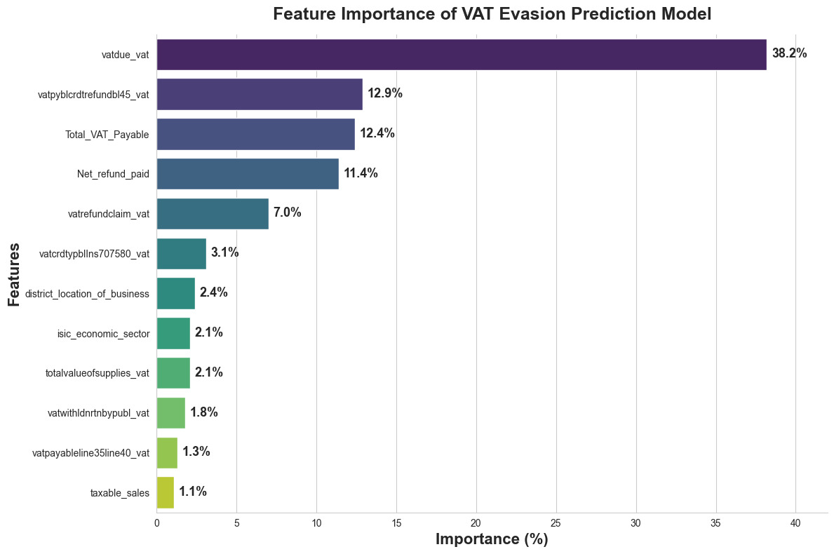
16
Driving factors of VAT Gap– Bottom-Up Approach

Slide 22
17
Driving factors of VAT Gap– Bottom-Up Approach
Key Drivers :
VAT liability and refund-related variables are the strongest predictors of VAT evasion risk, contributing over 80% of the model's predictive power.
VAT Due (38.2%) is the most influential factor, followed by VAT Credit Refund Balance (12.9%), Total VAT Payable (12.4%), Net Refund Paid (11.4%), and VAT Refund Claims (7.0%).
Regional (district) and economic sector (ISIC) characteristics also contribute to identifying compliance risks, though to a lesser extent.
Policy Implications:
Enhance monitoring of under-reporting of sales and input VAT claims, particularly refund claims, carried-forward credits, and purchase-related deductions.
Strengthen risk-based audits targeting taxpayers with unusual VAT liability and refund patterns.
Apply sectoral and regional risk profiling to focus compliance efforts on higher-risk sectors.

Slide 23
The Path to Fiscal Resilience: Addressing Africa's Tax Challenges
Policy , Compliance and Administrative initiatives
Version 2025
July,2 205

Slide 24
18
VAT Policy Initiatives
In light of the considerable VAT gap, it has already adopted measures aimed at reducing the Policy Gap, with additional measures planned for FY 2026/27 onwards
Notable VAT policy initiatives include:
Policy measures:
          Introducing VAT on fee-based financial services
          Removing VAT exemptions on mobile telephones and ICT equipment
          Removing VAT exemption on hybrid vehicles
          Reinstating VAT on transport service of goods by road
          Reinstating VAT on fossil fuels
          Repealing VAT exemptions on business inputs (machinery, capital, raw materials
          Repealing VAT on Digital Services
          Other policy measures mentioned in MTRS1 and MTRS2
During FY2025/26 (July–May), new tax policy measures increased revenue by RWF 251.7 billion, with VAT-related measures accounting for 57.1% of the total revenue gain.

Slide 25
Compliance and administrative initiatives
19
Data-driven compliance management – real-time analytics supported rapid decision-making
Advanced analytics and predictive compliance – deployment of micro-simulation models and ML-based risk to improve compliance targeting.
Automated systems controls – strengthened input/output matching , detection of fictitious EBM invoices and other malpractices.
Enhanced taxpayer services – streamlined VAT refund processing and expanded EBM adoption and system integration.
Behavioral and supply-chain interventions – VAT rewards scheme, stock analysis, and supply-chain audits to improve compliance.

Slide 26
Impact of Data-Driven Compliance Interventions
20
Revenue-leakage detection & data-informed compliance improvement using data analytics: VAT evasion from sales under-reporting alone declined from RWF 51.5 billion (2023) to RWF 25.8 billion (2024), and further to RWF 1.2 billion (2025) as an effort of data analytics.
Significant increase in desk audits completed: Number of completed audit cases nearly quadrupled over the past five years, increasing from 21,604 cases in 2020/21 to 81,669 in 2024/25, with desk audits accounting for 98.7% of all cases completed.
Automated EBM controls strengthened verification of reported sales.
Risk-based audits improved targeting of non-compliant taxpayers.

Slide 27
How VAT Compliance Strengthens Fiscal Resilience
21
Creates Fiscal Space
      The estimated VAT under-reporting gap indicates substantial recoverable revenue.
      Additional revenue supports national development priorities without increasing tax rates.
Strengthens Fiscal Sustainability
Reduces reliance on borrowing and external financing.
Improves predictability and stability of government revenues.
Builds Resilience to Economic Shocks
Stronger compliance improves government's capacity to sustain public services during periods of uncertainty.

Slide 28
22
Conclusions
Overall revenue collections have steadily increased year-on-year, with VAT contributing roughly one-third of total tax revenue and playing a critical role in strengthening fiscal resilience.
Rwanda’s VAT gap is estimated at approximately RWF 2 trillion in 2023, with about 44% stemming from the Compliance Gap and 56% from the Policy Gap.
The main compliance challenge is the Assessment Gap, driven by under-reporting and informality, while the main policy challenge is the Efficiency Gap, driven by non-taxable sectors.
Specifically, the VAT under-reporting gap is estimated at RWF 162.4 billion in 2023, corresponding to an under-reporting rate of 16.7%.
The highest evasion levels are observed in the Trade, Transport, Manufacturing, and Construction sectors, particularly among quarterly VAT filers and SMEs.
Strengthening VAT compliance through data-driven and modern tax administration approaches offers significant potential to reduce revenue leakage, expand fiscal space, and enhance Rwanda’s fiscal resilience.

Slide 29
- END -

