Slide 1

Regional Overview of the Economic Impact of the COVID-19 Crisis
7th EPRN Annual Research Conference | May 27th
Dr. Andrew Mold
Chief, Regional Integration & AfCFTA Cluster
UNECA Sub-Regional Office for Eastern Africa

Slide 2
01
ECONOMIC IMPACT
02
SOCIAL IMPACT
03
CONCLUSION & POLICY RECOMMENDATIONS

Slide 3

Eastern Africa has been hit hard by the crisis…
…but Eastern Africa fared better than Africa & the world
First and largest economic contraction in
27 years
Annual GDP growth, 2015 – 2022
 | Average 2015-2017 | 2018 | 2019 | 2020 | 2021 | 2022
EA | 5.8 | 6.7 | 6.5 | -0.7 | 3.0 | 4.1
Africa | 2.6 | 3.4 | 2.9 | -3.4 | 3.4 | 3.6
World | 2.8 | 3.1 | 2.5 | -4.3 | 4.7 | 3.4
-3.4% GDP
Source: UNDESA, 2021

Slide 4
Why the relative resilience?
Lack of Structural Change plays to our advantage?
    Agriculture is a higher share of GDP
    Low integration into global value chains
Low level of urbanization
DEMOGRAPHICS!
Mixed level of stringency in lockdowns?

Slide 5
Varying effects of pandemic according to type of economy
GDP growth in 2020
Source: NISR

Slide 6





Sectoral Impact of the Crisis: The Example of Rwanda
Year-on-Year Growth by Sector, 2020
Selected Observations
Tourism and hospitality industries were hit the hardest
Art & Entertainment equally affected
Manufacturing industries were affected differently
For example, continued expansion in metals and chemicals but contraction in wood and paper
Supply side disruptions in subsectors are explanatory factors
ICT industry experienced growth
Source: NISR

Slide 7
Manufacturing bounced back…
Rwanda Manufacturing Production Index 2020
The lockdown provoked sharp decline in manufacturing
Recovery surpassed January levels
Faltering recovery in latter part of year during second and third waves.
Source: National Sources

Slide 8
What high-frequency data can tell us about the pace of recovery
Cement production, 2019-2020 (Thousand Tonnes)
DRC saw a sharper fall followed by an unstable and less robust recovery through 2020
Source: National Sources

Slide 9
Sectoral recovery has NOT been uniform across countries
Electricity consumption, 2019-2020 (Million KWH)
Some recoveries have been partial and slower: For certain industries, 2019 levels may only be achieved in late 2021

Slide 10
Economic recovery has been fragile
Uganda Composite Index Economy Activity
Economic resilience varied according to the pandemic waves
Second Wave
More preparedness and better measures led to more resilience in the second and third waves
First Wave
Source: National Sources

Slide 11
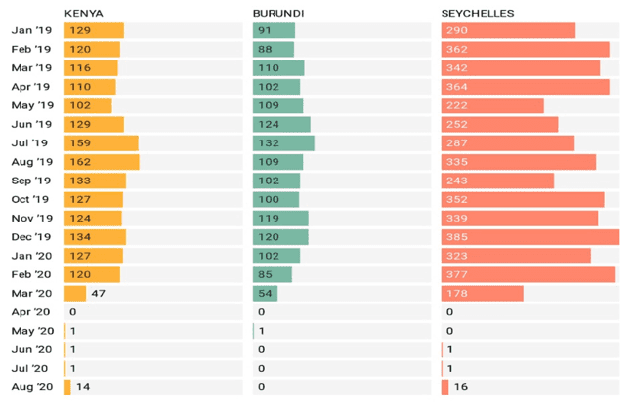
Tourism was one of the first sectors to be negatively affected
Tourist arrivals
Travel restrictions remain a blow to the tourism industry
Recovery is set to pick up as vaccinations increase
But Tourism dependent countries may continue to struggle if vaccinations remain low in African countries
Source: National Sources

Slide 12
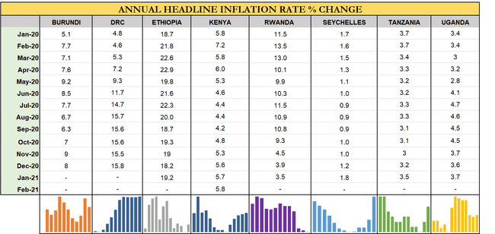
Has the crisis been inflationary?
Inflation typically remains weak during pandemics and declines in aftermath (Daly & Chankov, 2021)
Worries by some economists about long-term financing implications (e.g. Krugman 2021 vs. Wolf, 2020)
Source: National sources

Slide 13
Commodity price shifts in 2020 have generally helped the region…
% Change in Commodity Prices, by commodity group, 2020
Source: UNCTADStat

Slide 14





But worrying price trends in some sectors…
Rapid price increases in transport, housing and some food items
Worrying for households in urban areas given their importance
Ethiopia continues to struggle with persistent inflation
Some of the challenges behind this
Low import capacity
Currency depreciation
US dollar shortage
Low foreign exchange reserves
High input and fuel prices
Some exasperated by pandemic and Tigray conflict
Source: National Sources

Slide 15
Increased pressure on fiscal stability and debt sustainability
Overall Fiscal Balance, Excluding Grants (% of GDP), 2019 vs 2020
General Government Gross Debt (% of GDP)
 | 2019 | 2020 | 2021 | 2019-2021 pp-change
Eritrea | 189.4 | 184.7 | 175.6 | -13.8
Seychelles | 57.7 | 98.4 | 110.4 | 52.6
Burundi | 60.1 | 69.5 | 75.6 | 15.5
Kenya | 62.1 | 68.7 | 71.5 | 9.3
Rwanda | 51.0 | 61.0 | 66.0 | 15.1
Ethiopia | 57.7 | 55.3 | 56.0 | -1.7
Source: IMF WEO (April 2021)

Slide 16
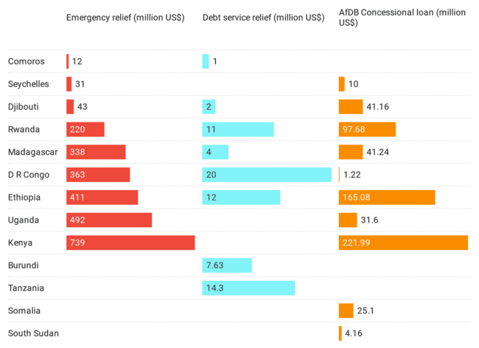
The region urgently requires more external concessional finance
COVID-19 financial support to Eastern Africa, USD millions
Source: IMF 2020, AfDB 2021

Slide 17

The Surprising Rebound in Regional Trade
Merchandise Trade in Eastern Africa 2020 (% change)
Exports
Imports
vs
Exports up in 9 of 14 Eastern African countries
Export growth was extremly strong in Rwanda, Eritrea, Djibouti Seychelles and Tanzania
Imports fell in half of countries. Sharpest declines in DRC and Madagascar, but more moderate in Ethiopia, Kenya and Tanzania
As a result, overall trade balances have generally improved
However, long-term cost in reduction in capital goods and intermediate imports

Slide 18
The region’s largest exporter remained resilient…

Slide 19



Caveats to a positive evaluation of regional trade recovery
Formal intra-EAC trade recovered, partially due to national and regional efforts.
However, the story is not all positive…
1
2
3
Informal cross border trade has not recovered; most borders remain closed to passenger travel
Evidence of structural shift in some countries’ exports away from diversified exports and towards the export of minerals
Challenges were more serious for landlocked countries

Slide 20
And services trade hit especially hard…
Tanzania trade in services more resilient…
…But still declined despite staying open
Source: National Sources

Slide 21
01
Economic Impact
02
Social Impact
03
SECTION 3

Slide 22
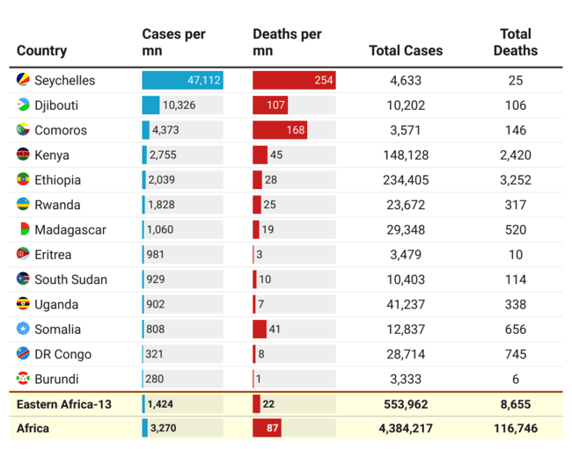







Health impacts and containment measures
COVID-19 Statistics as at 14 April 2021
Most countries register infection and death rates significantly below the continental average
Partially attributed to containment measures adopted early by some countries
Swift response reflects the fact that the region is no stranger to health crises
Burundi, Uganda and Rwanda cite Ebola virus containment measures as highly instrumental in the fight against COVID-19.
Source: WHO, OurWorldInData

Slide 23
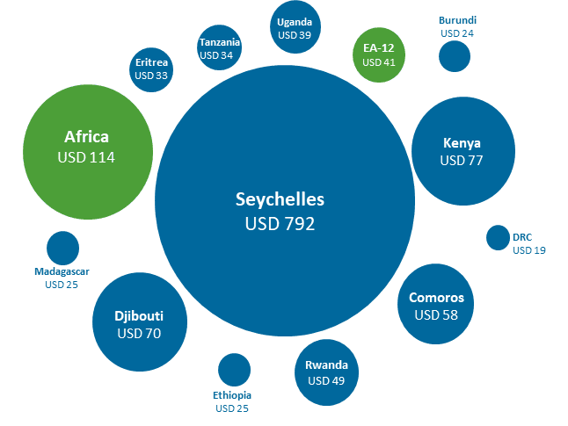

Crisis has highlighted gaps in regional health systems…
Public Health Spending per Capita, 2017
Most Eastern African economies spend less than USD50 per capita on health PER YEAR
Note: Latest available statistics are from 2006 – 2018
Source: World Health Statistics (2020), Global Health Expenditure database (2020)

Slide 24
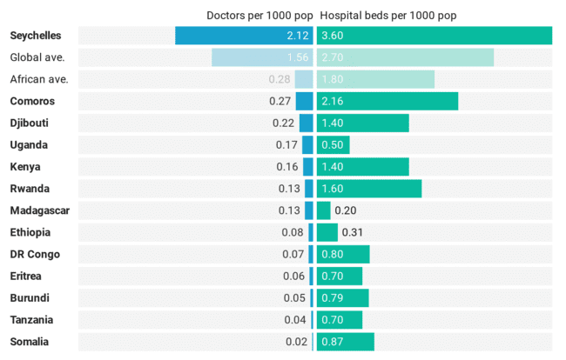
Need for both more doctors and more hospital beds…
Public Health Resources Density, latest available year
7 countries in the region are well below the African average of 1.8 beds
(EU rate is 5.1 beds per 1000 inhabitants)
Note: Latest available statistics are from 2006 – 2018
Source: World Health Statistics (2020), Global Health Expenditure database (2020)

Slide 25
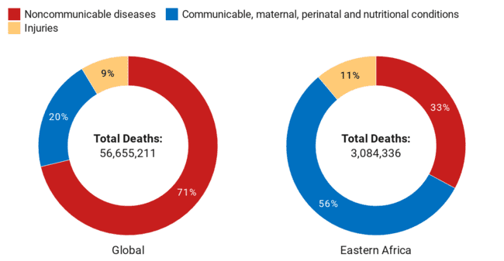
The deleterious impact of Covid on treatment of other diseases
Deaths by Cause, 2016
Communicable diseases the leading cause of deaths in Eastern Africa.
Perinatal and nutrition conditions account for more than half of deaths in the region
Likely to increase due to COVID-19 and the diversion of scarce medical resources to fight the current pandemic.
Could result in up to 400,000 excess deaths; AIDS-related deaths could go back to levels not seen since 2008
WHO forecasts a 50% disruption in access to anti-malarial treatment, leading to 100, 000 additional deaths in Africa this year
Source: WHO 2018

Slide 26
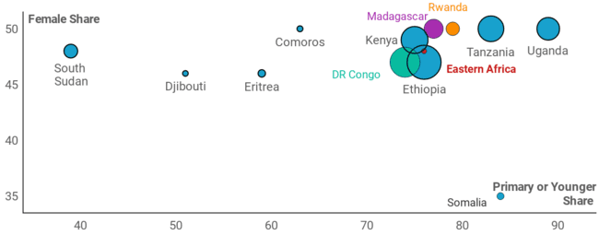

School closures affected 96 million learners in Eastern Africa
Across all affected learners in Eastern Africa,
79% are primary school-aged or younger
Share of Female and Young Students Among Total Impacted by School Closures
… slowing progress to SDG4 …
Note: Except for the Eastern Africa point, country bubbles are sized by the total number of students impacted
Source: UNESCO, UNICEF, World Bank

Slide 27
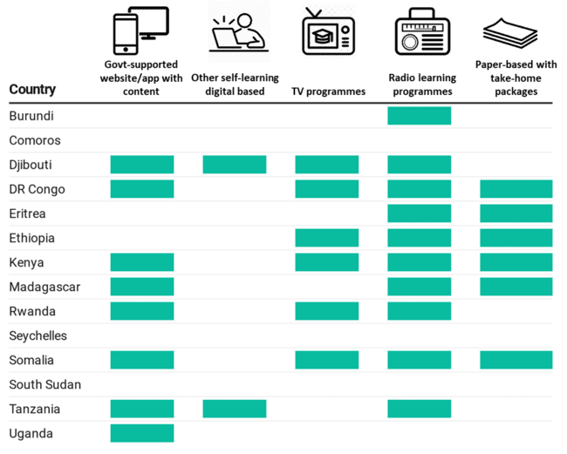
The need for digitalization
Digital gaps widen inequality in education access
  Significant portions of the world population did not have access to online education
More investment needed in ICT for social sectors
Source: UNECA analysis of UNICEF survey data (UNICEF, 2020b)

Slide 28
ECONOMIC IMPACT
01
02
SOCIAL IMPACT
CONCLUSIONS & RECOMENDATIONS
03

Slide 29
Conclusions
To Be Discussed!

Slide 30
Dr. Andrew Mold
Chief, Regional Integration & AfCFTA Cluster

