Slide 1

Rwanda Tea Sector: Growth, Challenges and the Path Forward
Presented by Alexis NKURUNZIZA
Traditional Commodities Division Manager/NAEB
National Agricultural Export Development Board

Slide 2

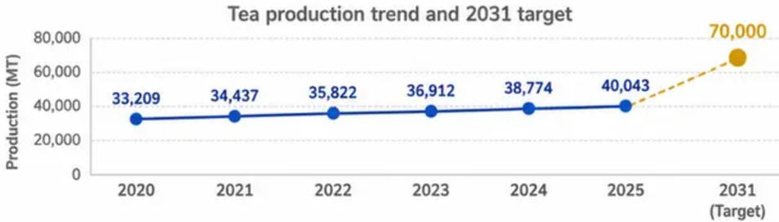
Sector Background and Growth Achievements
Production Growth: +21% in Five Years — Tea output rose from 33,209 MT in 2020 to 40,043 MT in 2025, targeting 70,000 MT by 2031.
USD 117 Million in Export Revenue (2025) — Tea is among Rwanda’s top foreign exchange earners, targeting USD 300 million by 2031.
~60,000 Households Supported Nationwide — About 59,984 farming households across 11 districts depend on tea for livelihoods.
36,854 Hectares Across 11 Districts — Cultivation spans Nyamasheke, Rusizi, Nyabihu, Rulindo and other key districts.
Green Leaf Price: RWF 432/kg — Up 4x Since 2012 — Farmer income improved from RWF 100/kg in 2012 to RWF 432/kg in 2026.in 2025 farmers were paid 72B Rwf.
Aligned with NST2 and National Development Goals — Tea growth supports exports, GDP, and inclusive rural development.
40,043 MT
Tea Production in 2025
USD 117M
Export Revenue in 2025
59,984
Farming Households Supported
National Agricultural Export Development Board

Slide 3













Production Structure and Value Chain
Plantation Coverage
36,855 ha / 11 Districts
Plantation Gap:
77M Seedlings Needed
Fertilizer Shortfall:
451 vs. 600 kg/ha Target
5,497 ha carry significant gaps, costing
33,146 MT of green leaf annually.
Infilling demands 77M high-yielding clonal
seedlings at RWF 45–65 each.
Smallholders dominate at 67.6% (24,905 ha);
industrial blocs hold 31% (11,516 ha).
Mature productive area: 28,470 ha;
immature: 8,384 ha.
Only 16,605 MT applied in 2025 —
a 33% deficit against the agronomic
recommendation. Coordinated via RTA
Fertilizer Fund with factory-backed
interest-free loans.
Yield Gap: 6,030 vs. 9,000 kg/ha
Labour Deficit: 13,865 Pluckers
Older pre-1990 estates yield 7,273 kg/ha; newer post-2000
estates lag at 4,080 kg/ha. Closing the gap requires
seedling renewal, full fertilizer application,
and focused research.
Only 18,435 pluckers active against a requirement of 32,300.
Hand plucking at RWF 65–100/kg is essential for quality,
making this shortage a direct production constraint.
National Agricultural Export Development Board
National Agricultural Export Development Board

Slide 4

















Quality Assurance and Marketing
QUALITY ASSURANCE
EXPORT & MARKETING
VALUE ADDITION
1. NAEB Quality
Assurance Framework
3. Export Channels
& Key Markets
5. Value Addition Gap:
Beyond Bulk CTC
Quarterly factory inspections, export
certificates via Irembo portal, and
enforcement of Rwanda Tea Brand regulations
ensure traceability, food safety, and
international compliance standards.
72% of exports flow through the Mombasa
Auction (EATTA); 28% via direct factory-
to-buyer contracts. Top destinations include
Pakistan, UK, Egypt, UAE, Sudan,
and Kazakhstan.
Over 95% of exports are low-margin bulk
CTC black tea. The 2031 target shifts
specialty teas, herbal blends, and branded
packaged products to 20% of total
exports by 2031.
2. Certification &
Capacity Building
4. Revenue Growth:
USD 117M to USD 300M
6. Domestic Market:
1–2% Targeting 10% by 2031
NAEB supports Rainforest Alliance, Fairtrade,
ISO, and Organic certifications. Annually,
7,500+ pluckers and 840 Capitas receive
hands-on training in quality and
compliance standards.
Export revenue reached USD 117M in 2025.
The 2031 target of USD 300M requires
market diversification, direct sales
expansion, and premium product
development.
Rwanda’s domestic tea consumption
remains critically low at 1–2%. The ‘Drink
Rwanda Tea’ campaign and cost-reduction
strategies aim to grow local consumption
to 10% by 2031.
👥
40,043 MT
USD 117M
59,984
Tea Production
Export Revenue
Households Supported
National Agricultural Export Development Board
National Agricultural Export Development Board

Slide 5
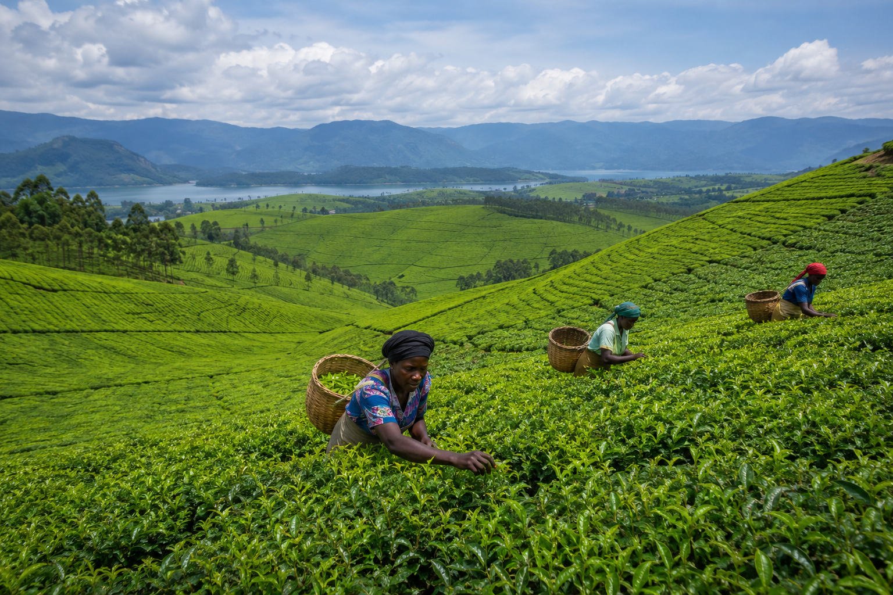


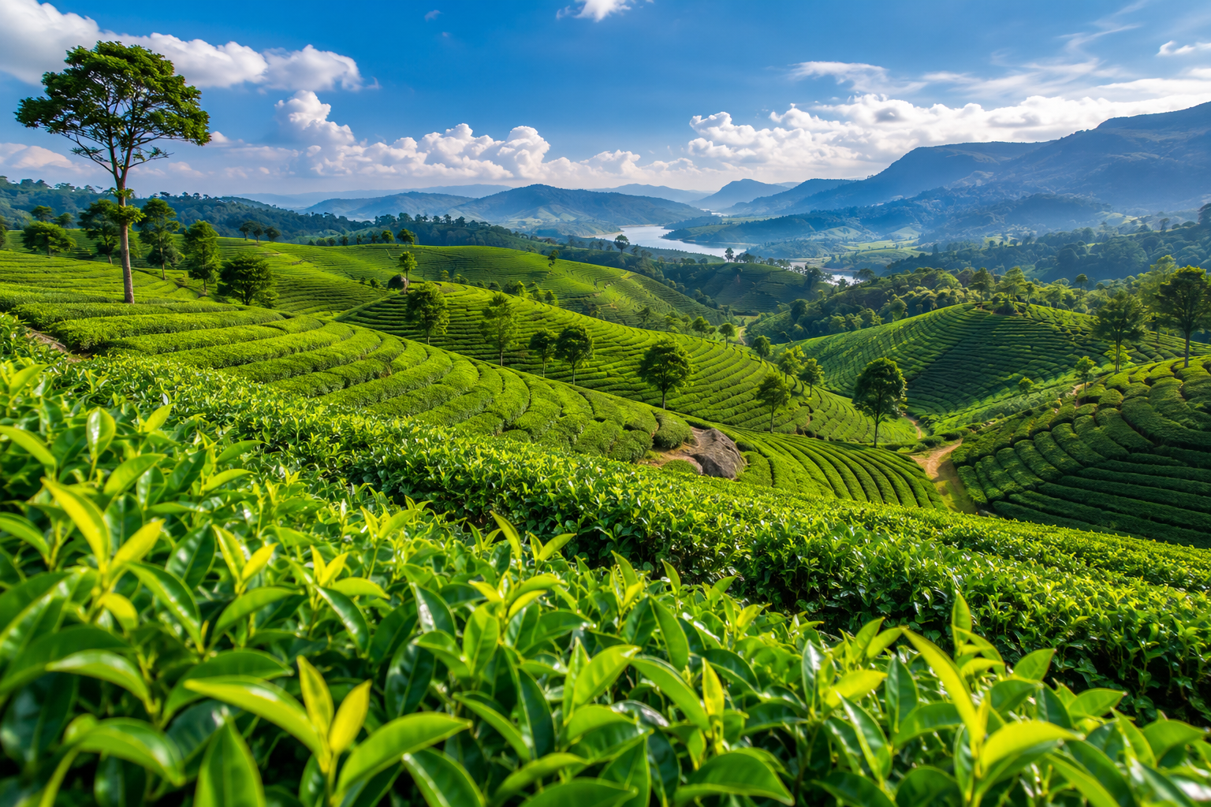

Vision of the tea sector
:
1. PILLAR 1 —
PRODUCTIVITY & SCALE
Expand to 46,854+ ha, raise yield to 9,000
kg/ha, close gaps with 77M seedlings, and
apply fertilizer at the recommended
600 kg/ha.
.
2. PILLAR 2 —
VALUE ADDITION & MARKET PREMIUM
Grow non-CTC specialty teas to 20%+ of
exports, expand domestic market to 10%,
and build Rwanda’s brand on quality
and traceability.
3. PILLAR 3 —
COMPETITIVENESS & SUSTAINABILITY
Rehabilitate 204 km of feeder roads, launch
a private-led Tea Research Institute, sustain
60,000+ jobs, and scale gender and
youth inclusion.
.
National Agricultural Export Development Board
National Agricultural Export Development Board
National Agricultural Export Development Board

Slide 6

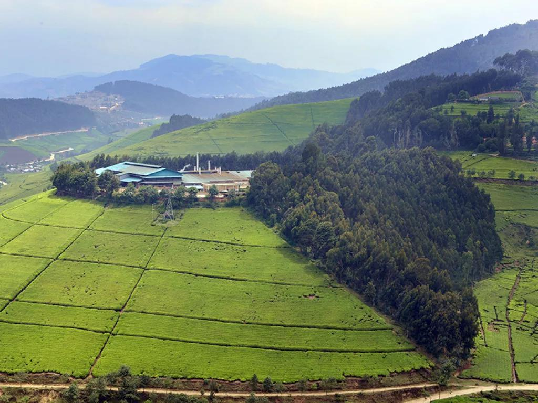
Partnership with MAFAP
NAEB, in partnership with MAFAP, is leading the development of the Tea Sector Strategy.

Slide 7
Thank you
National Agricultural Export Development Board

