Slide 1
Economic Policy Research Network (EPRN) Rwanda
Public Lecture on: Human Capital Development and employment promotion
@ UNILAK Rwamagana, 11/03/2020
By
Seth KWIZERA
Coordinator – EPRN Rwanda

Slide 2
Introduction
Creation of jobs is crucial to the achievement of economic development and social progress
The government vision is to create more jobs ,inclusive jobs and better jobs(the quantity and quality) and this has to be a joint responsibility (public private)
The Sustainable Development Goals (Goal 8.) states that there is a need to promote sustained, inclusive and sustainable economic growth, full and productive employment and decent work for all.
The National Strategy for transformation (NST) highlights the need to accelerate inclusive economic growth and development founded on the Private Sector, knowledge and Rwanda’s Natural towards the Economic Transformation of the country. Among the key strategic interventions

Slide 3
Job Creation Vision and Current Status
Vision 2020 targets the creation of 200,000 off-farm job a year:
National Strategy for Transformation (2018-2024) targets the creation of 1.5 million productive jobs in next 7 years
-New comers: 225, 000 fleshly join the Labour Market per year
-Current Job creation (2018): Economy generated 206,000 jobs annually
National Employment Program is articulated under EDPRS2 and then in NST1 as one of the strategies to increase productive jobs through better planning and coordination of employment initiatives

Slide 4
Positioning Employment in 7YGP
7YGP 2017-2024 targets the creation of 1.5 million productive and decent jobs in next 7 years
The 7YGP highlight the following job creation strategic interventions:
  Promotion and incentives to job rich projects in economic activities that are driving employment mainly (Agro processing, Horticulture, Light manufacturing, mining, construction, tourism and hospitality, knowledge based services; and creative arts;
  Supporting youth in business development services and access to start up capital;
  Increase TVET enrolment and quality;
  Monitoring job creation performance and enhancing coordination;
  Supporting a model project per village that creates jobs for youth.

Slide 5
Growth in Business and Employment
(Source: EICV 5 PPT)
.
NISR Establishment Census 2011, 2014 & 2017.

Slide 6
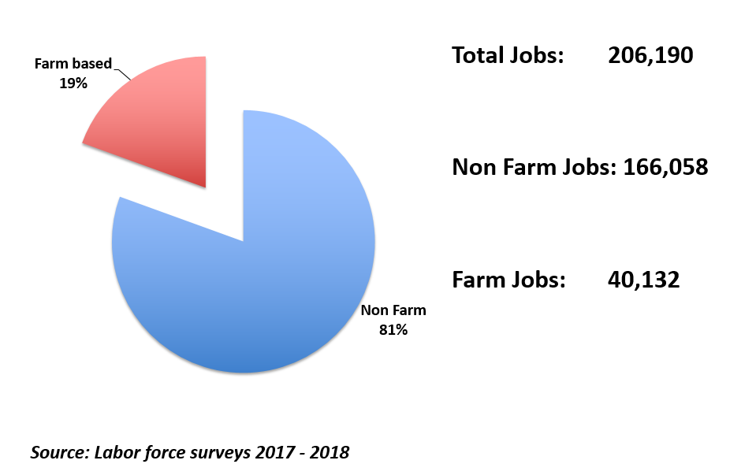
Net Jobs Created between 2017 and 2018
(Source: EICV 5 PPT)

Slide 7
Share of New Jobs by Industry
(Source: EICV 5 PPT)
.

Slide 8
Employment changes between 2017 and 2018
Number of jobs (main and secondary) , RLFS 2018
Economic activity | 2018 | 2017 | Net change
Agriculture forestry and fishing | 258,829 | 261,120 | (2,291)
Mining and quarrying | 63,506 | 48,797 | 14,709
Manufacturing | 199,650 | 157,241 | 42,409
Electricity gas stream | 6,157 | 9,702 | (3,545)
Water supply, gas and remed | 7,995 | 9,409 | (1,413)
Construction | 328,531 | 276,360 | 52,171
Whole sale and retail trade; repair | 492,120 | 487,020 | 5,101
Transportation and storage | 144,735 | 125,586 | 19,149
Accommodation and food services | 71,075 | 45,204 | 25,871
Information and communication | 13,827 | 11,223 | 2,604
Financial and insurance activities | 29,098 | 23,079 | 6,020
Real estate activities | 3,883 | 3,870 | 13
Professional, scientific and technical | 26,488 | 25,446 | 1,042
Administrative and support activities | 50,782 | 36,532 | 14,250
Public administration | 60,014 | 55,915 | 4,099
Education | 108,553 | 112,092 | (3,539)
Human health and social work | 48,909 | 49,558 | (649)
Arts, entertainment and recreation | 9,990 | 10,868 | (878)
Other services | 69,567 | 56,299 | 13,268
Activities of households as employers | 205,712 | 195,414 | 10,298
Activities of extraterritorial org | 17,174 | 9,673 | 7,501
Total | 2,216,596 | 2,010,407 | 206,190

Slide 9
Policy actions and Strategies to achieve 1.5million productive and Decent Jobs
Through Revised National Employment Policy the following broad interventions will be instrumental to achieve the overall policy objective to unleash Rwanda’s full employment potential:
Pro-employment macroeconomic framework and sectoral policies;
Enterprise development and private sector competitiveness;
Agricultural productivity and Rural development;
Linkage between education, skills development and labour market needs;
Labour mobility and migration;
Formalization of informal economy;
Strengthening labour market policies and labour market information system;
Social protection, working conditions and productive jobs;
Promotion of employment opportunities for specific groups.
Strengthen Coordination, Monitoring & Evaluation

Slide 10
Empowering Youth with Quality Jobs to Stimulate the Demographic Dividend in Rwanda
Interventions to enhance youth employment should focus on:
1. Strengthening the technical and social skills of youth to prepare them for employment and start businesses,
2. Improving economic infrastructure and business environment to stimulate growth of the private sector.
3. Reducing dependence of the development agenda on donor funding.

Slide 11
Underlying Challenges
Skills mismatch between education and labour market needs;
Limited entrepreneurship, and innovation support system;
The design of financial products not adapted to youth demand;
High cost of doing business for SMEs;
High underemployment rate and predominance of informal sector among youth.

Slide 12
Key strategies and policy actions to address underlying challenges
Put more focus on job creation in investment promotion and attraction in all sectors of the economy;
Strengthen the value chain systems to promote local SMES and link them with large industries and export;
Put more focus and incentives on attracting labour intensive and export oriented industries to foster job creation;
Improve skills development systems through aligning education curricula with the current and future needs of the labour market;
Strengthen systems to identify, attract and upskill youth with rare skills to respond to employers and investment needs;
Put in each village a MODEL INCOME AND EMPLOYMENT GENERATING Business by 2024

Slide 13
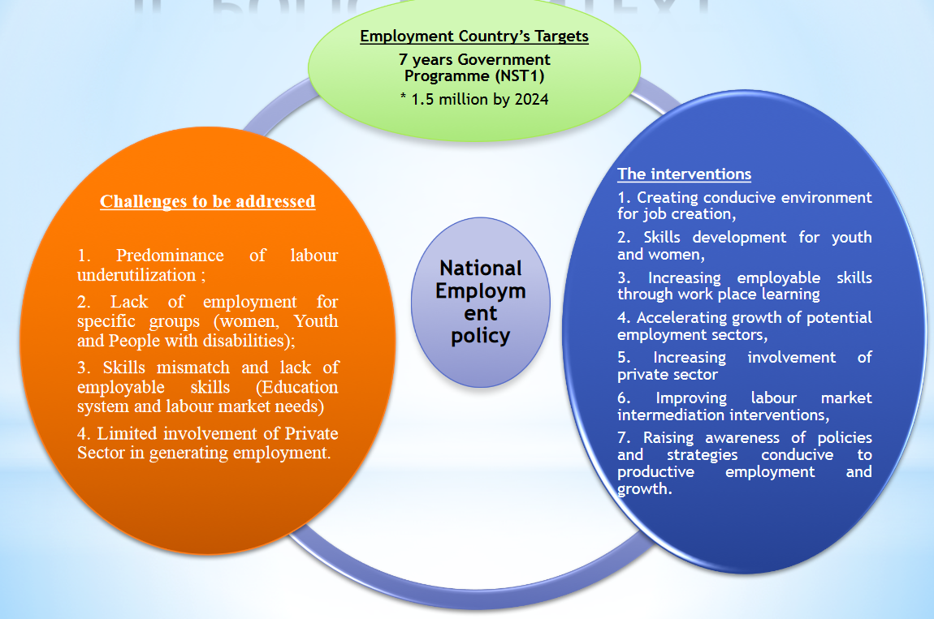
Solutions –cont’d

Slide 14
Stakeholder Expectations
The target of creating 1,500,000 productive and decent jobs cannot be achieved through fragmented and isolated interventions;
The Employment Policy calls for sustained, targeted and concerted efforts from all stakeholders i.e Government institutions, the Private Sector, Development Partners, the Private Sector and the Civil Society, Researchers among others.
It is well understood that the contribution of each and every here to achieve the Rwandans aspiration of creating 1.5 million productive and decent work.

Slide 15
Thank You

