Slide 1
Covid-19 and Inclusive Economic Recovery:
Experience and Lessons learnt from SMEs and financial sector
ECONOMIC POLICY RESEARCH NETWORK
By John Rwirahira
Access to Finance Rwanda

Slide 2

1. Experience of SMEs
2. Experience of Banks
3. Experience of MFIs
4. Effects of ERF
5. Lessons Learnt

Slide 3
Effects Covid-19 on the Rwanda’s Economy
The COVID-19 pandemic has caused an abrupt shock to the global economy.
In Rwanda, the measures put in place to curb the spread of the pandemic (including closure, suspension of domestic travel, cancellation of public gatherings, institution of teleworking, closure of schools, and places of worship and non-essential businesses) have had negative effects on the livelihoods of many Rwandans, especially those who earn their living on a daily basis.
Lockdowns has led to significant job losses due to business closures, with the unemployment rate rose to 18% by the end of 2020.

Slide 4
Effects of Covid-19 on the Rwanda’s Economy

Slide 5
Experience of SMEs

Slide 6
Business sectors and turnover
Sector | Average Annual turnover (RWF) 2019 | Average Annual turnover (RWF) 2020
Commerce & services | 54,7 million | 43,6 million
Agriculture ‎/ Livestock | 41 million | 24,6 million
Industry | 180 million | 137 million
Liberal professions | 16,2 million | 8,8 million
Art and craft | 11,7 million | 3,7 million
ICT | 12,3 million | 70,5 million
Financial sector | 158 million | 161 million
Tourism | 91,1 million | 72 million
Size | Average Annual turnover (RWF) 2019 | Average Annual turnover (RWF) 2020
Micro enterprises | 17 million | 500 thousand
Small enterprises | 18,1 million | 4 million
Medium enterprises | 49,2 million | 20,9 million

Slide 7
Production and supply-chain disruption
Access to input supplies

Slide 8
Business liquidity
Period covered by current financial liquidity to maintain operations (%)
Needed for assistance to cope with COVID-19 crisis
96 % of businesses stated needs for assistance

Slide 9
Experience of Banks

Slide 10
Major challenges faced by Banks during Covid-19 crisis

Slide 11
Effects of Covid-19 on Bank’s businesses

Slide 12
Experience of MFIs

Slide 13
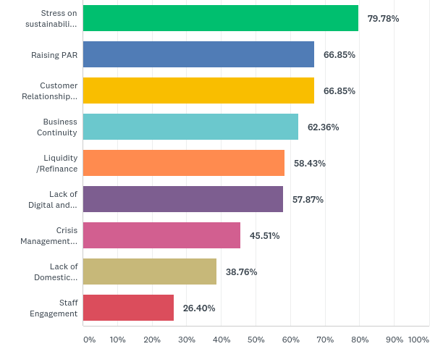
Biggest challenges for the MFIs in Covid-19 Time
Stress on sustainability
Raising Portfolio at risk
Customer Relationship Management
Business Continuity
Liquidity and Refinance
Lack of Digital banking and Mobile platform
Crisis Management Skills
Lack of Domestic refinance options
Staff Engagement

Slide 14
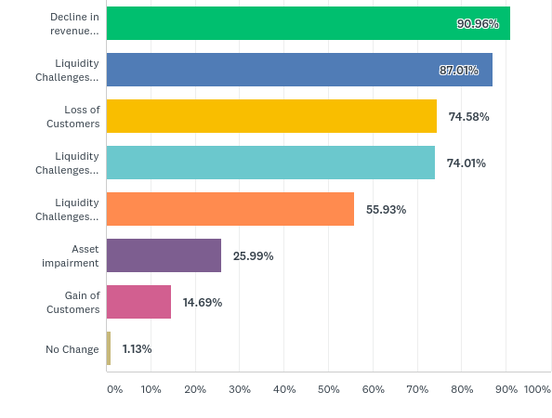
Covid-19 impact on MFIs businesses
Decline in Revenues
Stress on sustainability
Liquidity Challenges due to Deposit withdrawals
Raising Portfolio at risk
Customer Relationship Management
Decline in Customers
Business Continuity
Due to Reduced inflows/defaults in loan repayments
Liquidity and Refinance
Due to funding difficulties
Lack of Digital banking and Mobile platform
Assets Impairments
Crisis Management Skills
Gain of Customers
Lack of Domestic refinance options
Staff Engagement

Slide 15
Mitigation measures adopted by Banks and MFIs
Restructuring loan with repayment difficulties and easing repayment conditions
Granting moratorium period/ Granting grace period
Removing online transaction fees
Waiver of penalties for late repayment
Business continuity plan (incl. digital facilities for online transaction)
Etc.

Slide 16
Stress on sustainability
Raising Portfolio at risk
Economic Recovery Fund -Phase I
Liquidity and Refinance
Lack of Digital banking and Mobile platform
Crisis Management Skills
Lack of Domestic refinance options
Staff Engagement

Slide 17
Allocated and pre-approved amount (Frw)
Window | Allocated Amount | Pre-Approved Amount
Hotel Refinancing | 51,319,255,695 | 52,671,378,196
Working Capital | 12,300,000,000 | 11,842,839,496
Public Transport | 7,329,217,615 | 7,505,735,516
Education | 12,600,000,000 | 13,228,929,973
Public Transport Subsidy | 12,300,000,000 | 12,123,482,098
BDF | 5,000,000,000 | 5,300,000,000
TOTAL | 100,848,473,310 | 102,672,365,279
Customer Relationship Management
Business Continuity
Liquidity and Refinance
Lack of Digital banking and Mobile platform
Source: BNR, November 2021

Slide 18
Average number of employees in small, medium and large enterprises
Customer Relationship Management
Business Continuity
Liquidity and Refinance
Lack of Digital banking and Mobile platform

Slide 19
Effect of ERF on Business Operating Capacity

Slide 20
Perceived Effect of Covid-19 and ERF on
Business Turnover
Effects of Covid-19 | Effects of ERF
About 90% of businesses experienced decreased in turnover by at least 25% | 88% of businesses increased their turnover by at least 25%
85% of business decreased their profitability by at least 25% | 75% of business increased profitability by at least 25%
64.2% of businesses decreased ability to pay taxes | 31.4% increased capacity to pay taxes + 40.5% paying taxes with some difficulties

Slide 21
Lessons Learnt
Covid-19 has raised the needs to fast track digitization in the financial sector and beyond (i.e. need for the understanding customers digitization needs and establish internal mechanisms for addressing them)
Automation of Microfinance institutions is key for effective service delivery
Increase customer adoption of online and digital banking, technology and in particular digital transformation post COIVD -19.

Slide 22
Lessons Learnt
Think differently in terms of crisis management (clients' management, client centric products, and development of resilience products post crisis, etc.)
Increased Customer Relationship: The customers needed banks more than ever during crisis and vice versa. Hear their voices and needs, show empathy and put their needs first. Leverage on ERF

Slide 23
Lessons Learnt
Don’t forget the underserved such as:
    The Smallholder farmers:
    Integration in the national, regional and international value chain, access to finance (digitized and structured to match farm cash flows (banks, SACCOs etc.)
    Small scale traders:
    Small scale traders have access to digital tools and can benefit from transactions through mobile money but most of them are outside the formal banking system.
    Harness digital data for financial profile: promote open finance

Slide 24

THANK YOU

