Slide 1
A policy Dialogue about NST1- Creating 1,500,000 Decent and Productive Jobs: Challenges and policy actions on 18/09/2019
Presented by : MWAMBARI Faustin, Acting Director General of Labour and Employment/ MIFOTRA
EPRN POLICY DIALOGUE

Slide 2
I. Introduction
Creation of jobs is crucial to the achievement of economic development and social progress, and furthermore, acknowledged as the main route through which people get out of poverty.
The government vision is to create more jobs ,inclusive jobs and better jobs(the quantity and quality) will be achieved through implementing different policies and programs. The progress made in jobs creation come from joint effort between the Government Rwanda, Private Sector, Financial Institutions, Civil Society Organizations and NGOs.
The Sustainable Development Goals (Goal 8.) states that there is a need to promote sustained, inclusive and sustainable economic growth, full and productive employment and decent work for all.
The National Strategy for transformation (NST) highlights the need to accelerate inclusive economic growth and development founded on the Private Sector, knowledge and Rwanda’s Natural towards the Economic Transformation of the country. Among the key strategic interventions is to create 1,500,000 (214,000 annually) decent and productive jobs by 2024.

Slide 3
Job Creation Vision and Current Status
Vision 2020 targets the creation of 200,000 off-farm job a year:
National Strategy for Transformation (2018-2024) targets the creation of 1.5 million productive jobs in next 7 years
-New comers: 225, 000 fleshly join the Labour Market per year
-Current Job creation (2018): Economy generated 206,000 jobs annually
National Employment Program is articulated under EDPRS2 and then in NST1 as one of the strategies to increase productive jobs through better planning and coordination of employment initiatives

Slide 4
Positioning Employment in 7YGP
7YGP 2017-2024 targets the creation of 1.5 million productive and decent jobs in next 7 years
The 7YGP highlight the following job creation strategic interventions:
  Promotion and incentives to job rich projects in economic activities that are driving employment mainly (Agro processing, Horticulture, Light manufacturing, mining, construction, tourism and hospitality, knowledge based services; and creative arts;
  Supporting youth in business development services and access to start up capital;
  Increase TVET enrolment and quality;
  Monitoring job creation performance and enhancing coordination;
  Supporting a model project per village that creates jobs for youth.

Slide 5
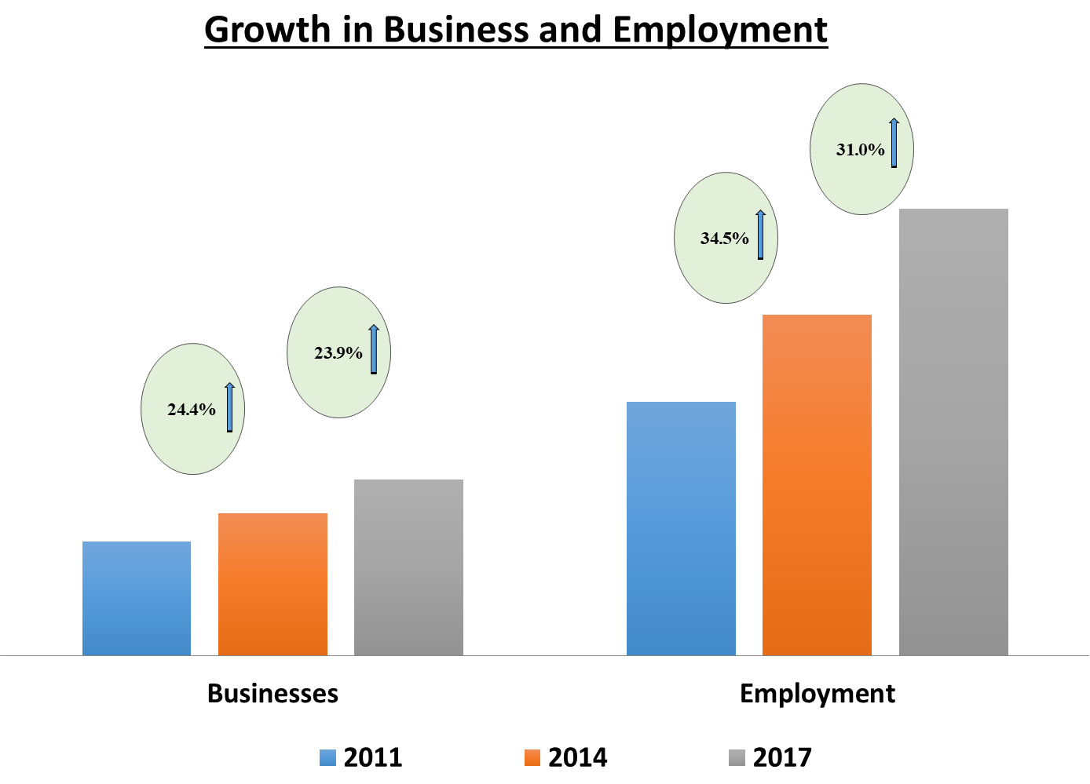
NISR Establishment Census 2011, 2014 & 2017.

Slide 6
Employment changes between 2017 and 2018
Number of jobs (main and secondary) , RLFS 2018
Economic activity | 2018 | 2017 | Net change
Agriculture forestry and fishing | 258,829 | 261,120 | (2,291)
Mining and quarrying | 63,506 | 48,797 | 14,709
Manufacturing | 199,650 | 157,241 | 42,409
Electricity gas stream | 6,157 | 9,702 | (3,545)
Water supply, gas and remed | 7,995 | 9,409 | (1,413)
Construction | 328,531 | 276,360 | 52,171
Whole sale and retail trade; repair | 492,120 | 487,020 | 5,101
Transportation and storage | 144,735 | 125,586 | 19,149
Accommodation and food services | 71,075 | 45,204 | 25,871
Information and communication | 13,827 | 11,223 | 2,604
Financial and insurance activities | 29,098 | 23,079 | 6,020
Real estate activities | 3,883 | 3,870 | 13
Professional, scientific and technical | 26,488 | 25,446 | 1,042
Administrative and support activities | 50,782 | 36,532 | 14,250
Public administration | 60,014 | 55,915 | 4,099
Education | 108,553 | 112,092 | (3,539)
Human health and social work | 48,909 | 49,558 | (649)
Arts, entertainment and recreation | 9,990 | 10,868 | (878)
Other services | 69,567 | 56,299 | 13,268
Activities of households as employers | 205,712 | 195,414 | 10,298
Activities of extraterritorial org | 17,174 | 9,673 | 7,501
Total | 2,216,596 | 2,010,407 | 206,190

Slide 7
National Employment Program 2015-2019
(NEP-‘’KORA WIGIRE”2015-2019)

Slide 8
Objectives of NEP- (Kora Wigire)
The ‘National Employment Programme’ (NEP- Kora Wigire) serves the following objectives:
Equipping the workforce with vital skills for employment and productivity,
Creating jobs that are adequately remunerative and sustainable across the economy with special focus on youth, women and PWD,
Provide a national framework for coordinating the planning and the implementation of employment interventions

Slide 9
NEP Pillars
Employability Skills Development (Led by MINEDUC/WDA&RP)
2. Entrepreneurship and Business Development (Led by MINICOM)
3. Labour Market Interventions(Led byMINALOC&RDB)
4. Coordination and Monitoring & Evaluation (Led by MIFOTRA&RDB)
Implementing Institutions:
MINICT,MIGEPROF,RDB,,WDA,RP,BDF,PSF,NIRDA,LODA,RCA,NRS,NCPD,Districts,NGOs

Slide 10
NEP-Interventions Priority Areas
Conduct a targeted massive short-term vocational training and apprenticeship /IBT, Up-grade skills and technology for craftsmen and artisans;
  17,000 benefited from the short term vocational trainings
Rapid Response Training; Priority given to specialized skills that are responsive to emerging investment opportunities and projects (training for jobs);
  5,500 benefited from the training and 93% employed
Mobilize establishments and Companies to host and mentor fresh HLIs Graduates for professional internship.
  7,500 graduated from internship and 59% get employed
  Mainstreaming internship in big investment projects. Eg. Roads Construction projects, irrigation, …
Pillar 1: Employability Skills Development

Slide 11
NEP-Interventions Priority Areas
Proximity Business development and Advisory Services using BDAs and voucher scheme for youth and women start ups;
  862 Proximity Business Development Advisers (2/sector)
  60,000 micro projects benefited from BDAs subsidized services and 76% accessed loans
Support bankable MSMEs projects to access finance through guarantee loan, matching grant and Quasi Equity Schemes through BDF Decentralized service in partnership with other financial institutions
  5,900 business projects supported through guarantee
  4,700 small projects for TVET graduates acquired start up toolkit subsidized loans
3. Upgrading skills and technology for existing craftsmen and Artisans-ICPCs/Udukiriro and MIR operators
  Support upskilling of 250 Udukiriro operators from 19 ICPCs
  On going machines leasing in (Ruzisi,Nyamagabe,Rubavu, Karongi,Kirehe, Kayonza,Bugesera, Gakenke,Rwamagana,Ngororero,Gisagara,Nyabihu)
Pillar 2: Entrepreneurship and Business Development

Slide 12
NEP-Interventions Priority Areas
Support self employment of special needs groups of Women Street Vendors (3,500), IWAWA graduates (270), PWDs (2,400), AGI (430).
2. Coordination and M&E of the implementation of NEP activities and mainstreaming employment in sectors
  Fields visit assessment and proposal of changes to address challenges
  Quarterly High level technical and Ministerial Steering Committee
  Joint planning between implementing institutions and districts
  In total, in last 5 years, it is estimated that NEP have contributed to create 126,191 Jobs (FY 2014/15=24,811; 2015/16=41,672 ; 2016/17= 36,206 ; 2017/18=23,502)
Pillar 3&4: Labour Market Intervention and Coordination

Slide 13
Other interventions under NST1
Undertaking sector skills audit to inform training programs:
  Energy
  Transport and Logistics
  Agro processing
  Mining
  Urbanization
2. Employment mainstreaming has been identified as a key intervention to address challenges hindering job creation and calls for all Government Entities and all Stakeholders to incorporate employment targets into their planning and budgeting processes as well as monitoring the resulting creation of jobs

Slide 14
Other interventions
3. In 2015, the Government of Rwanda adopted the Workplace Learning Policy in order to create systems, institutional structures as well as standards and regulations that ensure the full use and recognition of the country’s potential of training and learning at the workplace in order to increase the relevance and marketability of skills.
The interventions implemented under the Workplace Learning Policy have helped to train 825 people in dual training in 2018.

Slide 15
Policy actions and Strategies to achieve 1.5million productive and Decent Jobs
Through Revised National Employment Policy the following broad interventions will be instrumental to achieve the overall policy objective to unleash Rwanda’s full employment potential:
Pro-employment macroeconomic framework and sectoral policies;
Enterprise development and private sector competitiveness;
Agricultural productivity and Rural development;
Linkage between education, skills development and labour market needs;
Labour mobility and migration;
Formalization of informal economy;
Strengthening labour market policies and labour market information system;
Social protection, working conditions and productive jobs;
Promotion of employment opportunities for specific groups.
Strengthen Coordination, Monitoring & Evaluation

Slide 16
Underlying Challenges
Skills mismatch between education and labour market needs;
Limited entrepreneurship, and innovation support system;
The design of financial products not adapted to youth demand;
High cost of doing business for SMEs;
High underemployment rate and predominance of informal sector among youth.

Slide 17
Key strategies and policy actions to address underlying challenges
Put more focus on job creation in investment promotion and attraction in all sectors of the economy;
Strengthen the value chain systems to promote local SMES and link them with large industries and export;
Put more focus and incentives on attracting labour intensive and export oriented industries to foster job creation;
Improve skills development systems through aligning education curricula with the current and future needs of the labour market;
Strengthen systems to identify, attract and upskill youth with rare skills to respond to employers and investment needs;
Put in each village a MODEL INCOME AND EMPLOYMENT GENERATING Business by 2024

Slide 18
Stakeholder Expectations
The target of creating 1,500,000 productive and decent jobs cannot be achieved through fragmented and isolated interventions;
The Employment Policy calls for sustained, targeted and concerted efforts from all stakeholders i.e Government institutions, the Private Sector, Development Partners, the Private Sector and the Civil Society, Researchers among others.
It is well understood that the contribution of each and every here to achieve the Rwandans aspiration of creating 1.5 million productive and decent work.

Slide 19
Conclusion
As I conclude, I thank you for your presence in this dialogue and I request you to be part of this commitment of creating 1.5 million productive and decent jobs in your respective institutions.

Slide 20
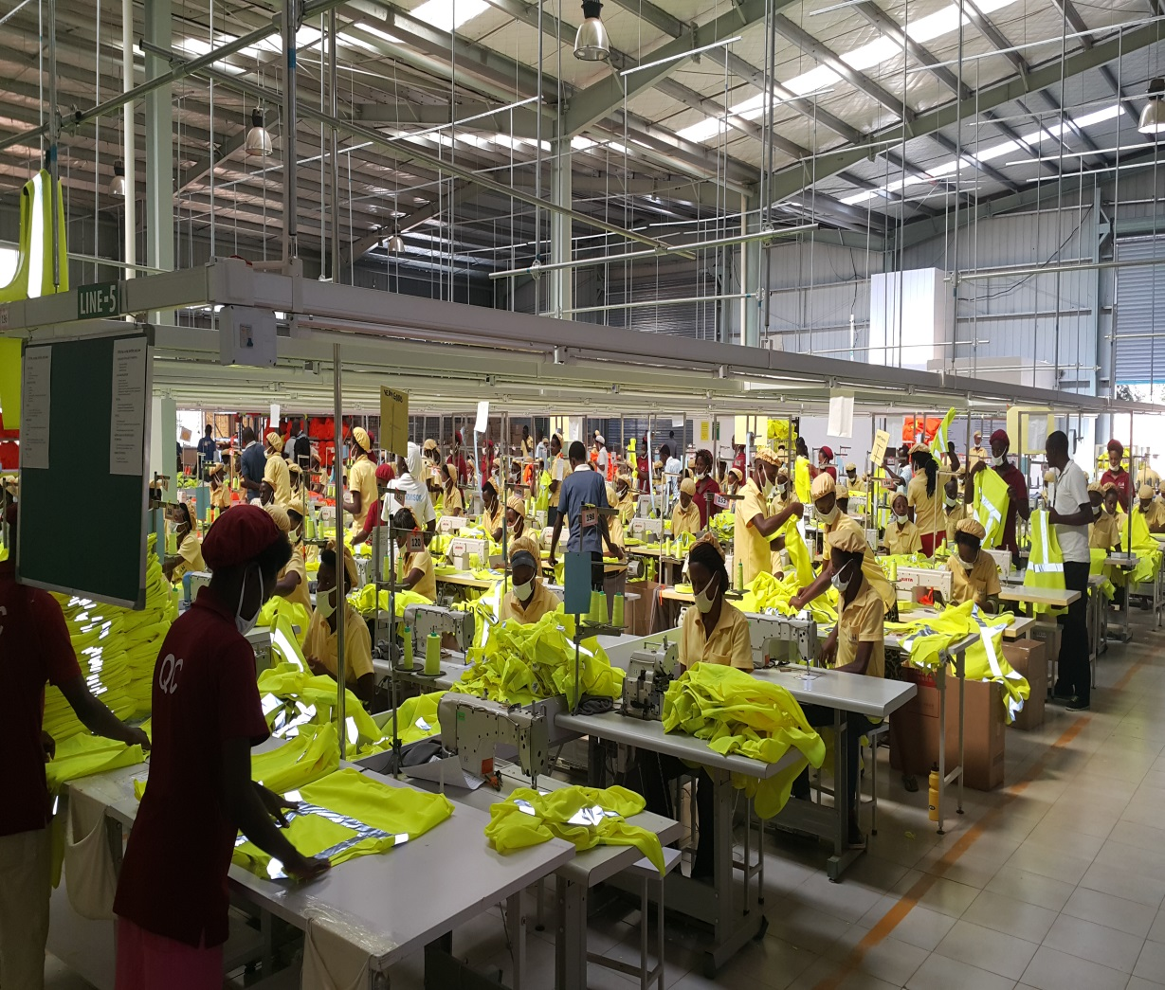
Thank you

