Slide 1
Rwanda Debt Status
&
Policies
Ministry of Finance and Economic Planning
EPRN POLICY DIALOGUE
By Amina Rwakunda, Chief Economist MINECOFIN and EPRN Deputy President of the Board

Slide 2
Presentation Outline
Debt Global Context
Rwanda Debt Status

Slide 3
1) Debt Global Context

Slide 4
Global Debt
Total gross debt in % of GDP (source: IMF)
Most indebted economies are the richer ones;
Emerging market economies debt is dominated by China’s debt;
LIC public debt is rising, in some cases reached levels close to those when countries sought debt relief.

Slide 5
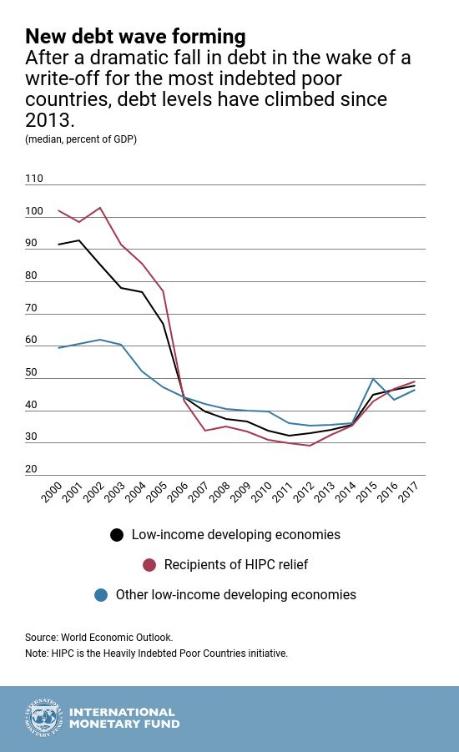
Africa’s Debt on the rise after multilateral debt relief initiatives (HIPC & MDRI)

Slide 6
Debt vulnerabilities are increasing - Causes
Scarce concessional financing(decline in aid, limited access to concessional money) while infrastructure needs and SDGs financing required are huge;
Low quality of public investments;
Weak macroeconomic conditions: recent volatility of commodity prices, as well as exchange rate, interest rates, fiscal slippages, subdued economic growth, low growth in tax revenues etc.;
Changing lenders landscape (share of bilateral and multilateral resources declined, some projects are not eligible for concessional financing, easy access to international market…) and growing interest bills;
Many countries have weaknesses in Public finances in general and limited improvement in debt management.

Slide 7
Debt vulnerabilities are increasing Ctd.
Debt Risk Status, 2008–18
Source: IMF Debt Sustainability Analysis Low-Income Developing Countries database.
Recent Developments and Outlook
Challenges
Macro Policies
Managing th Impact of Conflict
Boosting Intra-Regional Trade
Notes:
It is important for countries to implement these consolidation plans as debt vulnerabilities remain elevated.
7 countries are in debt distress, of which 6 are fragile (Republic of Congo, Eritrea, The Gambia, Sao Tome and Principe, South Sudan, Zimbabwe) and 2 are oil exporters (Republic of Congo, and South Sudan).
And 9 are at high risk of debt distress.
F: fragile, O: oil exporters.
Countries in debt distress in 2018: Republic of Congo (F, O), Eritrea (F), The Gambia (F), Mozambique, Sao Tome and Principe (F), South Sudan (F, O), Zimbabwe (F).
Countries at high risk of debt distress in 2018: Burundi, Cameroon, Cabo Verde, Central African Republic, Chad, Ethiopia, Ghana, Sierra Leone, and Zambia.

Slide 8
Debt vulnerabilities are notably elevated - Responses
Further fiscal adjustment;
Domestic resources mobilization strategy;
Recovery in output growth;
Public finance reforms;
Build capacity in debt management;
→ Strong economic growth and sound macroeconomic management are key to debt sustainability.

Slide 9
2) Rwanda Debt Status and Policies

Slide 10
Evolution and Composition of Public Debt in % of GDP
Notes:
Rwanda’s nominal debt-to-GDP at 49 percent- end June 2018.
However, Rwanda’s risk of debt distress remains low.
Key drivers of public debt accumulation for Rwanda includes :
1. Public investment drive
2. Extension of government guarantees

Slide 11
Composition and structure of PPG External debt stock

Slide 12
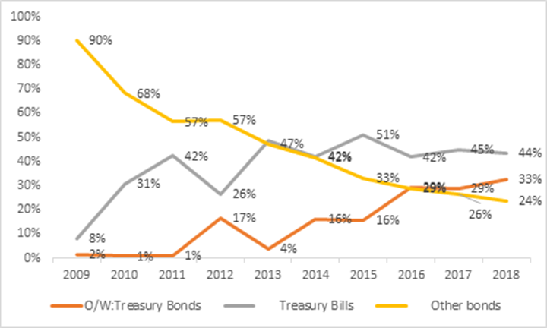
Composition and structure of PPG domestic debt stock, ctd.

Slide 13
Main Risks Associated to debt portfolio

Slide 14
Sustainability Indicators
Indicators | 2018 | 2019 | 2020 | 2021 | 2022 | 2023 | 2024 | Threshold
PV Debt/GDP | 27.7 | 32.5 | 30.4 | 31.7 | 30.6 | 30.2 | 24.7 | 50
PV Debt/Exports | 120.2 | 126.3 | 121.3 | 116.4 | 112.7 | 107.1 | 102.4 | 200
PV Debt/Revenues | 153.8 | 161.8 | 151.4 | 140.7 | 134.1 | 129.2 | 134.6 | 300
PV Debt service/ Exports | 7.2 | 7.5 | 10.8 | 11.4 | 8.1 | 17.3 | 6.5 | 25
PV Debt service / Revenues | 9.2 | 9.6 | 13.5 | 13.8 | 9.6 | 20.8 | 8.5 | 22

Slide 15
EAC Key Debt Indicators
EAC Debt Indicators as of End 2018 (source: AfDB: East Africa Economic Outlook) | Total External debt stock ($ billions) | Debt/GDP (%) | Debt Service/Exports (%)
Uganda | 12.5 | 45 | 17.1
Kenya | 42.7 | 47.6 | 70.7
Tanzania | 19.2 | 34.6 | 12.8
Burundi | 0.5 | 14.9 | 21.1
Rwanda | 3.9 | 41 | 7.9

Slide 16
Cost and risks indicators as of end April 2018
Redemption Profile – MTDS FY 2018-19
Notes:
Risks related to Rwanda debt portfolio:
Forex risk percent- 86.9% denominated in Fx (o/w: 60.9 is USD).
Refinancing risk + Cost (interest rates)– Treasury bills + Eurobond bills

Slide 17
Policies in Place to maintain sustainable debt levels
Keep a Low risk of debt distress as fiscal anchor.
Maximizing external concessional;
Careful prioritization during the projects selection process and their implementation;
Commercial loans will only be considered as a last resort, for profitable and forex generating projects;
Policy on issuance of Guarantees that can be extended to SoEs with strategic projects;
Development of domestic capital market (treasury bonds issuances/re-openings).

Slide 18
THANK YOU

