Slide 1




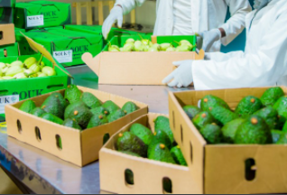
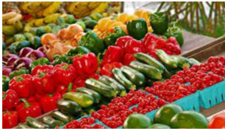
horticulture and Markets

Slide 2

Presentation OUTLINE
Background,
Study objectives,
Study methods
Study results
Conclusion and Policy Recommendations

Slide 3

Background
Globally, horticulture market size was valued at USD 20.77 Billion in 2021 and is projected to reach USD 40.24 Billion by 2026 at a compound annual growth rate of 10.2%. Europe is foreseen to predominate in the global market (TRIDGE, 2021). North America is presumed to hold the second-largest market share because of the expansion of greenhouses and the implementation of new agricultural practices in this area.
The market in the Asia Pacific is expected to grow at the highest compound annual growth rate during the period because of its rising discretionary income and population level. Significant advancement in the agricultural sector, as well as the growing penetration of sustainable horticulture practices, is among the crucial considerations influencing the market.
Rwanda horticulture exports contribute to 50% of non-traditional exports of Rwanda, part of which is regional export towards (mainly) the Democratic Republic of Congo, Burundi and South Sudan (TRAIDE Rwanda, Investment Opportunities Report 2020). The other part is exported to Europe especially UK, France, Belgium and Switzerland, Middle East like UAE and Japan. There are more than 44 registered horticulture exporters, (RDB, Horticulture Sector 2021).

Slide 4
Cont…)
Rwanda’s horticulture exports increased from US$ 5 million in 2005 to $US25 million in 2018. Major horticulture commodities exported includes; vegetables; Fruits; Nuts; Spices: and Flowers. Most produced fruits are avocados, mangoes, pineapples, passion fruit, bananas, and strawberry. Nuts include Macadamia and groundnuts. The most produced spices are Parsley, Chili, Lemongrass, Ginger, Garlic, processed pepper, Mixed spices, and Celery. Flowers include Roses, Zantedeschia flowers, Agapanthus, Calla lilies, Tuberoses, Alstroemeria and Ornamental sunflowers.

Slide 5
Cont…)
With the kind funding European Union through Ministry of Finance and Economic Planning to supported four-year project titled “Horticulture Value Chains Project (HVC)” in four districts of Rwanda namely: Nyagatare, Kamonyi, Rulindo, and Nyamagabe. The project in consortium with four implementing agencies, COCOF, DUHAMIC – ADRI, DUTERIMBERE ONG, commissioned mapping of potential buyers of horticulture produces.

Slide 6
STUDY OBJECTIVE
Main Objective of the study. Mapping of potential buyers for Rwanda’s horticulture produces at local, regional and international markets.
Specifically:
Identified potentials for intra-regional and extra-regional trading,
Provide horticulture trading status by selected crop,
established logistical constraints which hinder regional and international trading of horticulture produces from Rwanda,
Propose policy recommendations.

Slide 7
Study methods & Data sources
Cross-sectional study design
Primary data sources: Questionnaire administered to horticulture farmer cooperatives, government officials in 4 project districts, government institutions, private sector and other supporting agencies.
Secondary data sources.
NISR, Labour Force Survey Trends, August 2021
National Bank of Rwanda, Annual Report 2015
Based on GDP data from NISR National Accounts, 2021
TRAIDE Rwanda, Investment Opportunities in the Rwandan Horticulture and Floriculture Sector, 2020,
RDB, Horticulture Sector Report, 2021
OECD&FAO, Agricultural Outlook 2021-2030,
NAEB, Opportunities for Investors in Rwanda’s Horticulture Sector
TRAIDE Rwanda, Investment Opportunities in the Rwandan Horticulture and Floriculture Sector, 2020
USAID, 2019 – ISP Rwanda: Commercial Investment Opportunities in Agriculture Value Chains

Slide 8
Three selected crops that were highly imported by Botswana and South Africa

Slide 9
Top ten importing countries of avocado

Slide 10
Top importing Countries of tomatoes

Slide 11
Trade between EAC and EU

Slide 12
French beans
According to FAOSTAT (2021); Spain is the largest importer of green beans, estimated at 20% share of world imports in 2020, followed by the US and Belgium, making up 17% and 15% respectively. As is the case in many other fresh products, the Netherlands acts as an intermediary, making up 9% of imports and 5% of exports. Exports from North Africa flow to Europe from October, all the way to June.

Slide 13
Passion fruits
Passion fruits are in season from April to August and from October to December. These periods coincide with the low season in Kenya and South Africa. Combined, Kenya and South Africa supply 24% of all passion fruits imported by the European markets. Rwanda production can compete covering periods when Kenya and South Africa fail to meet demand.
Passion fruits are widely popular in Rwanda and neighboring countries, such as the Democratic Republic of the Congo and Uganda, which account respectively for 28 and 33% of monthly imports from Rwanda (RDB 2020).

Slide 14
Flowers
The United States is the largest flower importing country in the world, taking about 20% of all international flower import, followed by the Netherlands, Germany and the UK. Colombia and Ecuador are other world’s top flower importers, with 15% and 9% in accordance. Kenya (7,3%) and Ethiopia (4%) are also among the world’s top importers of floriculture products.
Rwanda mainly exports cut roses, and some smaller volumes of Arabicum, Agapanthus & White Arums. Moreover, pyrethrum is widely grown in the country.
https://blog.bizvibe.com/blog/top-flower-producing-countries

Slide 15
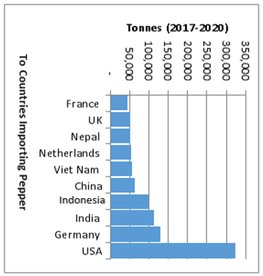
Top ten importing countries of pepper/chili

Slide 16
COVID-19 related Challenges

Slide 17
Market related constraints

Slide 18
Challenges faced by horticulture exporters
Products certification process is cumbersome and costly that majority of producers hardly afford.
Heavy international market regulations and standards pose special challenges to Rwanda exporters,
Inconsistent supply of horticulture
Limited cargo space as exporters uses commercial freights which limit the volume exported,
High freight charges,
Expensive packaging materials,
Horticulture financing remains,
Limited access to market information to guide their production choice.

Slide 19
Conclusion
The international markets offer potential for growth for Rwanda fruits, vegetables, and flowers exports. The EU and USA are the leading destination in the global fruits and vegetable trade, accounting for over half of the world’s imports. However, these markets present a huge competition from other geographical regions. The sub sector deserves good attention to unlock market potential for Rwanda growth and development.

Slide 20
Proposed Policy Recommendations
Partnership between private sector and government around research on seed value chains,
Inclusive financing model to horticulture value chains (production and supply chains),
There is a need to fix the issues horticulture export,
Investment in logistics (cold chains infrastructure, transport and packaging)
Inclusive insurance (production and supply chains to minimize risks,
Partnership between government and private sector on horticulture market linkages (selling points for horticulture produces from Rwanda in selected cities in Europe, Asia, EAC) where markets for vegetables and fruits are growing.
Consideration of gender equity in horticulture value chains,

Slide 21
END
Thank you for your attention

