Slide 1

Recent Economic developments
By Prof Kasai Ndahiriwe, BNR
EPRN POLICY DIALOGUE
20th November 2017

Slide 2
OUTLINE
  Global economy
  National economic performance
  Outlook

Slide 3
I. GLOBAL ECONOMY
In October 2017, the IMF revised up growth forecasts for the global economy to 3.6% from 3.5% forecast in July.
Source: Bloomberg & IMF, WEO July 2017
Source: Bloomberg & IMF, WEO July 2017

Slide 4
Recovery in Sub-Saharan Africa driven by increasing commodity prices
SSA GDP growth (%)
Source: Bloomberg & IMF, WEO July 2017
Source: Bloomberg & IMF, WEO July 2017

Slide 5
In EAC, economic growth remained resilient in the first half of 2017…

Slide 6
Main messages from the recent developments
  II. NATIONAL ECONOMIC PERFORMANCE
The Rwandan economic performance improved in 2017Q2
Expected good performance in 2017Q3
  Increasing turnovers of industry and services sectors
  Increase in commodity prices
  Agriculture season B good harvest
Notes:
Season B good harvest according to price expectation survey

Slide 7
  Leading indicators (CIEA) shows a continued improvement of economic activities
Good performance: 2017Q3>2017Q2>2017Q1
But lower on average compared to 2016
CIEA | 2016 | 2017
Q1 | 18.0 | 7.1
Q2 | 14.6 | 10.3
Q3 | 12.4 | 13.2
Jan.-Sep. | 14.9 | 10.3
Notes:
CPS: outstanding : +8.8% from 9.3%
New loans 4.1% from 11.5%

Slide 8
  II. NATIONAL ECONOMIC PERFORMANCE:
  ECONOMIC ACTIVITIES IN 2017
  B. Turnovers of industry and services:
  +14.6% from +11.8% Jan-Aug; +12.1% from 14.3% Jul-Aug
 | % change
 | 2016Q3 (2m) | 2017Q3 (2m) | Jan.-Aug 2016 | Jan.-Aug 2017
Total turnovers | 14.3 | 12.1 | 11.8 | 14.6
Industries | 25.0 | -1.7 | 12.7 | 7.6
Mining & Quarrying | -15.0 | 26.8 | -31.6 | 14.1
Manufacturing | 10.3 | 14.6 | 13.2 | 17.1
Energy Sector | 61.2 | 11.5 | 64.6 | 11.7
Construction | 54.5 | -32.6 | 11.6 | -9.2
Services | 10.6 | 17.3 | 11.6 | 17.1
Wholesale and Retail trade | 8.9 | 30.8 | 7.3 | 24.5
Petroleum distributors | 18.2 | 0.2 | 14.0 | 19.7
Transport and Storage | 15.7 | 21.6 | 18.3 | 16.4
Hotels and Restaurants | 16.6 | -4.2 | 16.2 | 0.4
Hotels | 9.5 | 10.0 | 10.8 | 7.4
Information and Comm. | -3.7 | 0.3 | 13.6 | -1.5
Financial & insurance | 14.4 | 13.1 | 25.7 | 10.9
Banks | 12.8 | 10.2 | 13.2 | 10.9
Real Estate Activities | 40.1 | -43.7 | 12.8 | -17.5
Industry sector ‘s good performance led:
  Mining supported by increase in prices:
    Cassiterite; +18.6%
    Wolfram: + 10.7%
  Good developments in Manufacturing:
    Increasing cement production
    Industrial products imports: +19.8% from 11.5%
  Energy sector still performing well due to recent new plants
Services sector’s good performance led:
  Trade;
  Petroleum companies
    Following increase in pump prices
    Increase in re-exports (+43.7% from +23.5%)
  Transport supported by
    Rwandair good performance following new aircraft & new destination (+60.6%)
  Banks

Slide 9
Trade balance developments
Trade deficit reduced by 22.6%, from USD 1302.10 million to USD 1007.0 million
Jan – September 2017 compared to the same period of 2016
Formal Exports +47.0% compared to 2.3%
Formal Imports -5.4% compared to -0.1%
Exports/Imports coverage from 24.8% to 38.6%.
 | 2015 | 2016 | Jan-Sept. 2016 | Jan-Sept. 2017
Formal exports | 558.7 | 598.7 | 430.71 | 633.01
% change | -6.85 | 7.16 | 2.3 | 47.0
Formal imports | 2311.2 | 2248.5 | 1733.46 | 1640.03
% change | -3.17 | -2.71 | -0.1 | -5.4
Trade deficit | -1752.5 | -1649.8 | -1302.7 | -1007.0
Imports cover rate | 24.2 | 26.6 | 24.8 | 38.6

Slide 10
Traditional Exports ► Value Share: 31.0% --- volume Share: 9.3%
Other Exports ► Value Share: 35.3% --- volume Share: 39.6%
Re-Exports ► Value Share: 33.7 % --- volume Share: 51.1%
Exports FOB in millions USD
Exports: % share

Slide 11
Consumer Goods ► Value Share: 33.5 % --- volume Share: 36.9%
Capital Goods ► Value Share: 28.7 % --- volume Share: 3.2 %
Intermediary Goods ► Value Share: 26.6 % --- volume Share: 44.3%
Energy and Lubricants ► Value Share: 11.3% --- volume Share: 15.7 %
Imports CIF in millions USD
Imports % share

Slide 12
Easing exchange rate pressures…
  Pressure on exchange rate continued to ease with 2.63% against USD on 17th Nov due to:
      Reduction in import bill;
      Reduction in demand for dollars by big companies like RwandAir;
      Improved export receipts in line with recovery in international commodity prices;
Expected depreciation of FRW(2017): 3% maximum

Slide 13
INFLATION DEVELOPMENTS
Headline and core inflation have eased…
Headline: 7.7% in 2017Q1, 6.2% in 2017Q2, 3.5% in 2017Q3, 3.6% in Oct.
Core: 5.5% in 2017Q1, 4.6% in 2017Q2, 3.1% in 2017Q3 and 2.9% in Oct

Slide 14
Monetary policy stance: overview
BNR maintained an accommodative monetary policy stance:
  The policy rate was reviewed down twice since 2016 from 6.5% to 6.25% in Dec 2016 and to 6% in June 2017.
  BNR aimed to:
  Encourage banks to continue supporting the financing of the economy;
  Improve banks liquidity.

Slide 15
I. Monetary developments
Outcome of the monetary policy stance…
M3 growth increased to 9.6% in September 2017 from 7.6% in Dec 2016
  Slowdown in economic activities

Slide 16
Monetary policy stance: hindrances
Slowdown in NAL and stock of CPS due to:
Increase in NPLs ratio: 8.2% by end Sept.17 from 7.5% by end Dec.16;
Lower demand of loans as result of subdued economic activities.

Slide 17
Interest rate developments…
Due to improved liquidity management, money market interest rates have been recently declining and remaining close to the KRR.
Market interest rates (% average)
 | 2012 | 2013 | 2014 | 2015 | 2016 | 2017
 |  |  |  |  |  | Q1 | Q2 | July | Aug | Sep
Lending | 16.70 | 17.32 | 17.26 | 17.33 | 17.29 | 17.03 | 17.11 | 17.60 | 17.30 | 17.33
Deposit | 8.85 | 9.93 | 8.24 | 8.24 | 7.91 | 7.48 | 8.11 | 7.66 | 7.67 | 7.86
Spread | 7.85 | 7.39 | 9.02 | 9.09 | 9.38 | 9.55 | 9.00 | 9.94 | 9.63 | 9.47

Slide 18
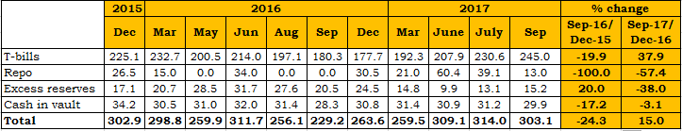
I. Monetary developments
Liquidity conditions developments
Banks’ most liquid assets (FRW billion, unless otherwise indicated)
Between December 16 and September17: Total most liquid assets: +15.0 % vs -24.3%;
Overall improvement was mainly caused by less demand on foreign exchange market due to good performance in external sector.

Slide 19
Money demand
Currency in circulation ratio declined since 2016 due to:
Ongoing modernization of payment systems
Slowdown in economic activities.

Slide 20
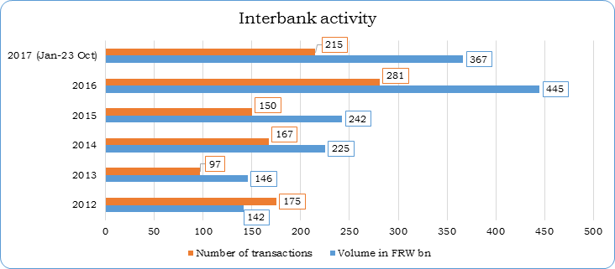
Monetary developments:
Interbank market
The interbank market remained active in 2017:

Slide 21
ECONOMIC OUTLOOK
Real GDP growth to improve
  Good agricultural production due to good weather ➔ improvement in food supply
  Improvement in services and industry sectors➔ rising trend of CIEA and turnovers
  Improvement in Credit to the private sector
Exchange rate pressures & International oil prices to remain low
Aggregate demand & inflation to remain subdued
Monetary policy likely to remain accommodative

Slide 22
THANK YOU

