Slide 1


Gwiza Project
Businesses that thrive
A Micro, Small and Medium Enterprises (MSMEs) Support Programme
In Response to Covid-19 in Western Province
Rwanda
Funded by
Implemented by

Slide 2
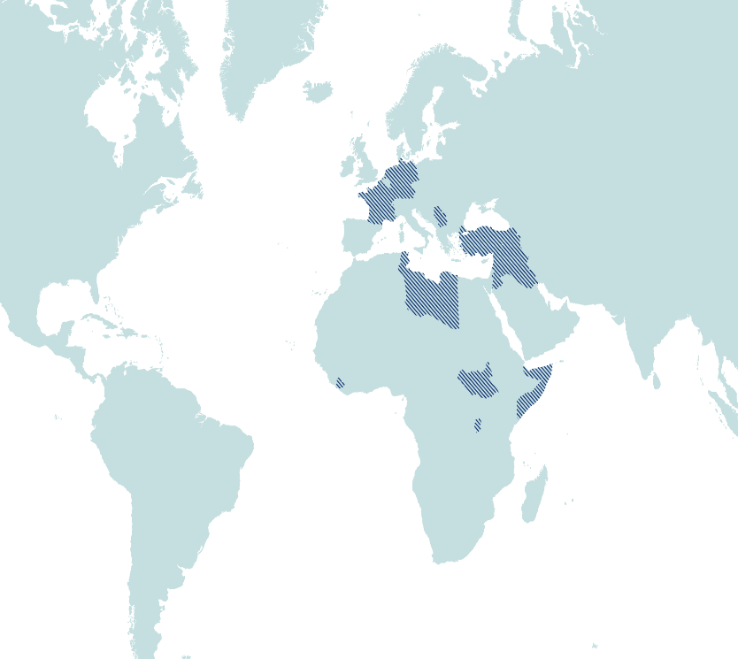
SPARK
INGO, founded in Amsterdam in 1994
Project organisation, active in 14 countries
SPARK is operating in Rwanda since 2011
Two pillars:
  Entrepreneurship (start-up & MSME development)
  Higher Education
Africa
Rwanda
Burundi
South Sudan
Somalia/Somaliland
MENA
Iraq (including Kurdistan Region of Iraq)
Jordan
Lebanon
Occupied Palestine Territories
Syria
Tunisia
Turkey
Western Europe
Kosovo

Slide 3
SPARK approach for Higher Education and Entrepreneurship Development activities
Skill up | Match up | Start up | Scale up
More entrepreneurs emerge by making curricula more market-relevant and introducing entrepreneurship training. | Enabling youth to access jobs through market-relevant (higher) vocational education and internships/ traineeships. | Jobs are created by supporting promising, high-potential entrepreneurs (startups) with coaching, access to finance & markets. | Jobs are created by scaling growth oriented SMEs through coaching and facilitating better access to finance & markets.

Slide 4
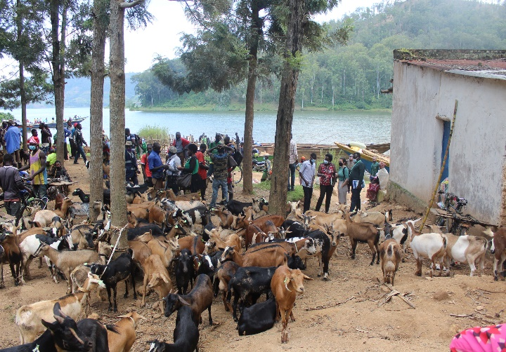
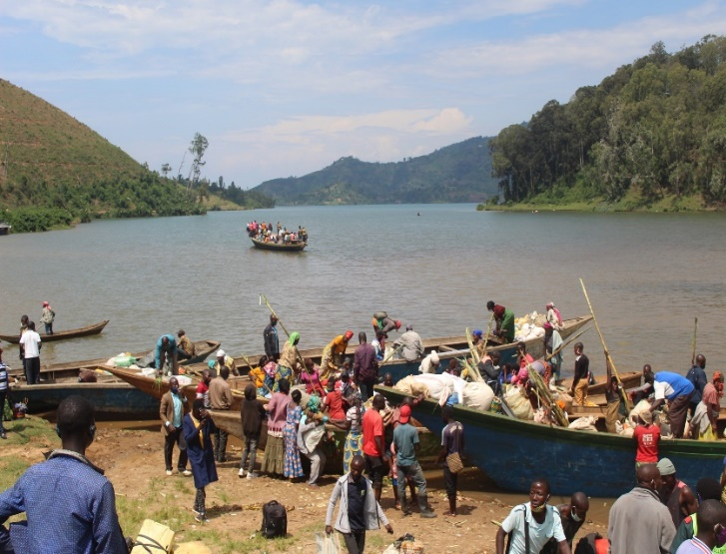
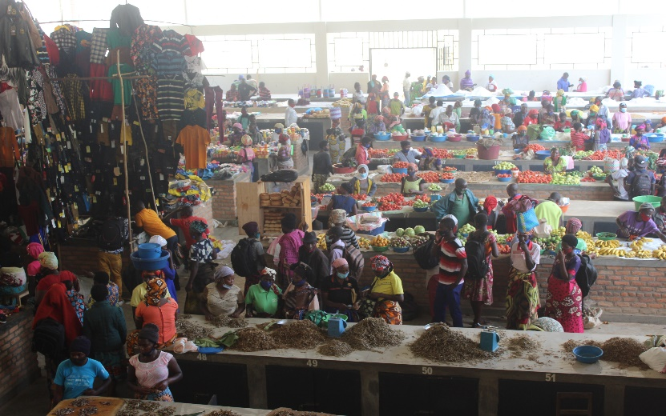
Why MSMEs ?
MSMEs play a crucial role in the national economy;
  up to 40% of the national income
  MSMEs account for approximately 98% of businesses in Rwanda
  According to the 2020 Rwanda Finscope Survey;
  800,000 MSME owners, 64% individual entrepreneurs and 36% business owners with employees
    511,639 individual entrepreneurs employ 1.2 million people,
    292,011 business owners with employees contribute to creating about 2 million jobs including owners.

Slide 5
Why MSMEs Support Programme in response to COVID-19?
    Limited access to finance (A2F) and Business Development Support continues to be a major obstacle to entrepreneurs when trying to start or grow their businesses.
    More negative effects due to the current context of COVID-19: Some Workplaces and businesses have been closed.
    Covid-19 is also putting at risk jobs and livelihoods through the economic turmoil it creates.
    Lockdowns have forced closures or reduced operations significantly. Companies are going bankrupt, consumers are restricting their spending, and manufacturers connected to global supply chains are experiencing severe disruptions. Some companies are facing a cash crunch, forcing them to scale back operations and lay off employees.
    MSMEs are not well equipped to survive this kind of economic recession and urgently need (additional) financing to support their working capital and need business coaching for individual support to ensure adequate use of the funding.

Slide 6
MSME’s Economic Relaunch After Covid-19 Project in the Western Province of Rwanda : 2022 - 2023
    SPARK in partnership with the Swiss Development Cooperation (SDC) is implementing a two-year MSME’s Economic Relaunch After Covid-19 Project in the Western Province of Rwanda.
    Through a Market System Development (MSD) approach; SPARK aims
      To provide COVID-19 Recovery support to transformative MSME’s in the Western Province of Rwanda
      To address constraints in capacity building, access to finance, and building resilience.
      To unlock systemic constraints to the survival and growth of MSME’s while creating job opportunities for youth and women.

Slide 7
Main target MSMEs and Industries/business sectors
    MSMEs with a yearly turnover of below RWF 20 million (~ $21,000 USD), to ensure not to duplicate ongoing available funds from the formal financial sector for SMEs with a turnover above RWF 20 million;
    Rural MSMEs, women and youth entrepreneurs,
    Health and safety equipment, agri-food, home-based businesses, retail and Cross Border Trade are prioritised.

Slide 8
Loan amount per borrower (MSME / Entrepreneur)
    Minimum RWF 250,000 (~ $250 USD) Maximum RWF 5 Million (~ $5,000 USD)
    Loans are in the form of unsecured finance (i.e. borrowers do not have to provide collateral/assets as a security), as it is covered by the SPARK LGF.
    This is not known by the borrowers and MFIs sign confidentiality agreement between partner (M)FIs and SPARK

Slide 9
Other Technical Assistance facility by SPARK
    SPARK is also offering Technical Support to the partner (M)FIs and to MSMEs on:
      Product development,
      COVID-19 Crisis Management training and coaching;
      A joint monitoring of LGF by SPARK business coaches and (M)FIs Loan officers;
      Engaging more local/internal BDS providers/ business support partners for continuous support of selected MSMEs and LGF borrowers

Slide 10
Programme Targets:
Overall Targets:
  650 loans disbursed for MSMEs to safeguard and expand their business operations;
  500 of MSMEs accessed loans through SPARK GF to counter COVID-19 challenges;
  400 of MSMEs scaled up in production, sales or additional employees recruitment;
  1000 of existing jobs safeguarded
  500 of jobs newly created

Slide 11
Project Components & Partners
Component 1: Access to Finance
Component 2: Technical Assistance
Component 3: Learning & Sharing
Urwego Bank Plc
Umutanguha FC Plc
Other (M)FIs in the region
Access to Finance Experts
Legal Services Advisor
Local BDS Providers and (Inter)national Experts
MSMEs/MSD Consultants
Markets /VC Actors
MSMEs Owners
Steering Committee,
Conflict & Contest Analyst
External Evaluators
Local Gvt /Districts
CBT Offices
Other Development Partners, etc..,

Slide 12
Management structure
SPARK Project Manager, Project Officer supported by Regional Hub on Program management, M&E and Finance and the SPARK A2F consultant
SPARK Business Coaches
and other TA providers
MFI's/Banks Management & credit officers
Level 2: Project Management team
Project Management, M&E and Risk Management
Steering Committee (SDC, MINICOM, Districts, MINECOFIN, MFIs, etc…)
Local Government (JADF, District officers, Chambers, etc.)
Level 1: Steering committee
Funders SPARK, SDC, (M)FIs and other BDS partners
Level 3: Implementers
LGF and TA
Technical Staff on-ground

Slide 13
Key Achievements
    Partner (M)FIs scored and selected
    Terms and Conditions for SPARK Loans Guarantee Facility (LGF)developed,
    Signing LGF agreements between SPARK and partner (M)FIs,
    MSMEs Support Ecosystem study and baselines conducted
    Key stakeholders and partners engagement
    Partnership and collaboration approved by districts in Western Province (Rusizi, Rubavu, Nyamasheke and Karongi)

Slide 14
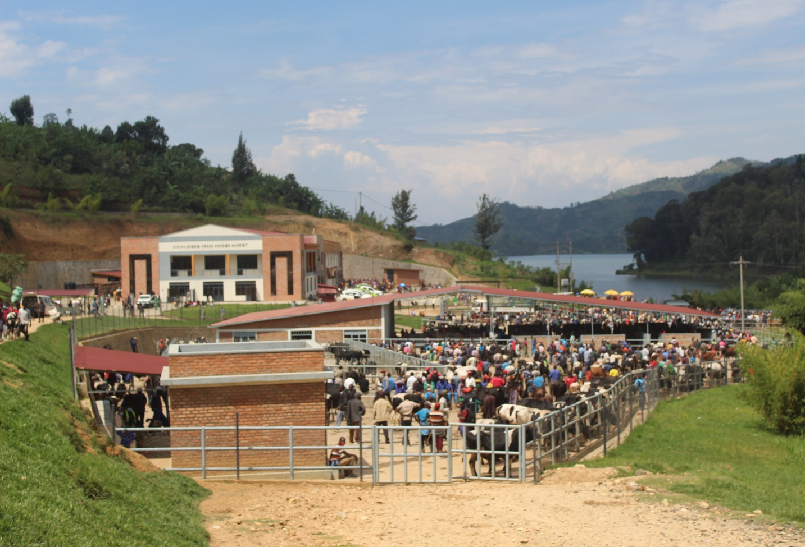
THANK YOU !!!

