Slide 1

Human Capital Development:
A key input to Rwanda’s economic growth
By Rolande Pryce, World Bank Country Manager, Rwanda
April 20, 2021

Slide 2
Outline
What is Human Capital?
State of Human Capital in Rwanda
Impact of the COVID-19 on Human Capital in Rwanda
How to Protect and Promote Human Capital Post-COVID
Role of the World Bank in Supporting Human Capital Development in Rwanda

Slide 3
Key Messages
Human capital is an essential pillar of Rwanda’s development strategy
Promoting human capital is critical for productivity and long-term growth
Rwanda’s human capital development faces important challenges that have been exacerbated by COVID
Urgent and bold actions are needed to protect and promote human capital in post-COVID world
Human capital is at the heart of the WB interventions in Rwanda.

Slide 4
Outline
What is Human Capital?
State of Human Capital in Rwanda
Impact of the COVID-19 on Human Capital in Rwanda
How to Protect and Promote Human Capital Post-COVID
Role of the World Bank in Supporting Human Capital Development in Rwanda

Slide 5
World Bank Definition of Human Capital
What is human capital and why does it matter?
“Human capital consists of the knowledge, skills, and health that people invest in and accumulate throughout their lives, enabling them to realize their potential as productive members of society. Investing in people through nutrition, health care, quality education, jobs and skills helps develop human capital, and this is key to ending extreme poverty and creating more inclusive societies.”

Slide 6
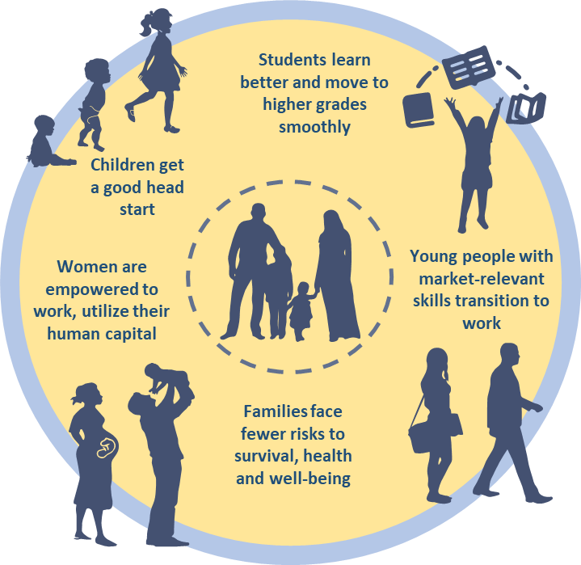

A Way of Thinking about Human Capital
The life-cycle approach captures development of from conception to adulthood
Human capital is critical for productivity and long-term growth:
  Education increases knowledge and skills which lead to higher productivity
  Well-educated and healthy people leverage knowledge and skills to adopt technology and innovate essential for productivity and growth
Notes:
Education is obvious in the life cycle
Good health in general is important in in Rwanda – adequate nutrition is a special challenge

Slide 7
Human Capital in Rwanda’s National Strategy for Transformation
Under Economic Transformation Pillar of National Strategy for Transformation (NST1)
  Support and empower youth and women to create business through entrepreneurship and access to finance.
  Working with private sector to Scale up the number of TVET graduates with skills relevant to the labor market.
  Ensure digital literacy for all youth (16 to 30 years) by 2024 through implementation of a national digital literacy program
Under Social Transformation Pillar of NST1
  Enhance the Demographic Dividend through Improved access to quality education
  Enhance the Demographic Dividend through ensuring access to quality health for all.
  Eradicate Malnutrition through enhanced prevention and management of all forms of malnutrition.
Notes:
What is human capital for Rwanda
Rwanda is currently implementing its National Strategy for Transformation (NST) covering 2017–2024. It is a further step toward Vision 2050, which calls for attainment of upper-middle-income status by 2035 and a much higher quality of life for Rwandans by the middle of the 21st century. Past successes, combined with a continuing sense of vulnerability, shape this audacious goal and unite national effort around it. The strategy builds on innovation, integration, agglomeration, and competition as key drivers for sustained, inclusive growth and focuses on six priority areas: (a) human capital development; (b) export dynamism and regional integration; (c) well-managed urbanization; (d) competitive domestic enterprises; (e) agricultural modernization; and (f) capable and accountable public institutions.

Slide 8
Outline
What is Human Capital?
State of Human Capital in Rwanda
Impact of the COVID-19 on Human Capital in Rwanda
How to Protect and Promote Human Capital Post-COVID
Role of the World Bank in Supporting Human Capital Development in Rwanda

Slide 9
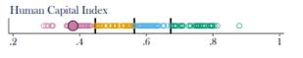
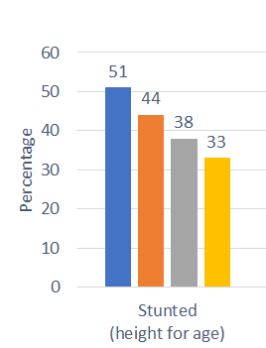
Context: Trends in Human Capital-Related Outcomes
Human Capital Index (HCI) 2020
HCI score (0.38) is lower than the Sub-Saharan Africa average and slightly higher than the average for low-income countries
High stunting rate (33%), expected years of school (6.9 years), and weak learning outcomes (358 on a scale of 300-625) main contributors to low HCI score
Gross secondary enrollment rate is only 43% and learning adjusted years of school is only 3.9 years
DHS 2019-2020 and other key national indicators
Stunting rate has fallen to 33% (38% in 2014-15), but progress is slow relative to Government's ambition of reducing stunting to19% by 2024. Stunting is highest in rural areas and among children aged 24-36 months. Stunting has also increased among infants, likely due to early start of complementary feeding
Total fertility rate (4.1) has barely changed since 2014-15 when it was 4.2 (8.6% of 18-yr-old girls and 15.4% of 19-yr-old girls begin childbearing)
Infant and child mortality achieved steep declines but are now stagnating, having only come down to 45 deaths per live births (U5) from 50 in 2014-15
Maternal mortality achieved steep decline: 98% of women attend at least 1 antenatal care check-up—however, only 47% attend at least 4 ANC visits
National Literacy rate (2018) is 77.6% for male and 69.4% for female population of 15 years and older.
Notes:
Rwanda’s education system has made significant progress in expanding coverage over the past 25 years. While Rwanda’s overall human capital index (HCI) in 2020 is lower than the average for Sub-Saharan Africa (SSA), it is broadly in line with expectations for a country with its income level. Detailed information on the underlying components shows, however, that the education-related indicators—especially expected years of school and learning-adjusted years of school—put the country in the bottom 25 percent of countries globally: children in Rwanda can expect to complete 6.5 years of pre-primary and basic education by age 18, which, when adjusted for learning, translates to 3.8 years—a learning gap of 2.7 years.

Slide 10
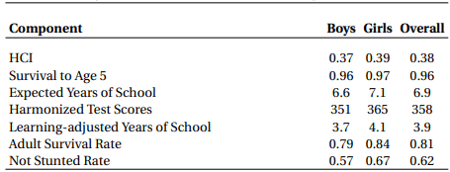
Rwanda’s Human Capital Index: Girls perform better than boys
Source: World Bank - Human Capital Project (HCP)

Slide 11
Outline
What is Human Capital?
State of Human Capital in Rwanda
Impact of the COVID-19 on Human Capital in Rwanda
How to Protect and Promote Human Capital Post-COVID
Role of the World Bank in Supporting Human Capital Development in Rwanda

Slide 12
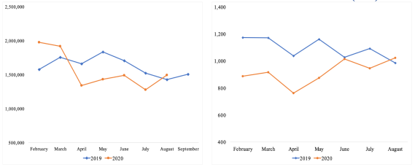
Rwanda’s Human Capital in the time of COVID-19 (1)
COVID has impaired health services
The pandemic reduced health facility visits
Led to reduced number of immunizations of children
However, health services disruption seems temporary
Declining household consumption and its impact on nutrition has the potential to increase stunting
Outpatient health facility visits for treatment
Patients newly initiated on antiretroviral treatment (ART)
Source: Ministry of Health, Rwanda
Source: Ministry of Health, Rwanda
Notes:
Outpatient department (OPD) visits - Per Capita utilization rate decreased by 3 percent from 1.56 in 2018/2019 to 1.51 in 2019/2020. This trend can be interpreted as the effects of the COVID-19 lockdown (MoH Annual Report, 2019/2020)

Slide 13
Rwanda’s Human Capital in the time of COVID-19 (2)
Learning losses are substantial
An estimated 3.5 million students were out of school for much of 2020
The closure of schools has led to substantial learning losses. Learning losses are more pronounced among girls and the poor
The productivity effect would likely be substantial for current students (from 10 to 30% of 2019 GDP over lifetime period)
Learning adjusted years of schooling
PV of lifetime earnings for all students
(schooling years)
(% of 2019 GDP)
0.2
10
0.6
30

Slide 14
Rwanda’s Human Capital in the time of COVID-19 (3)
Rwanda extensive social safety net (SSN) made a difference
REU-16 Simulations indicate that the expansion of social safety nets led to a 1.4 percentage point reduction in the poverty headcount ratio in 2020
The availability of strong agencies at central level and decentralized administrative apparatus facilitated the expansion of the social safety net once the pandemic hit
Poverty reduction due to social protection (percentage points)
Source: Microsimulation estimates results

Slide 15
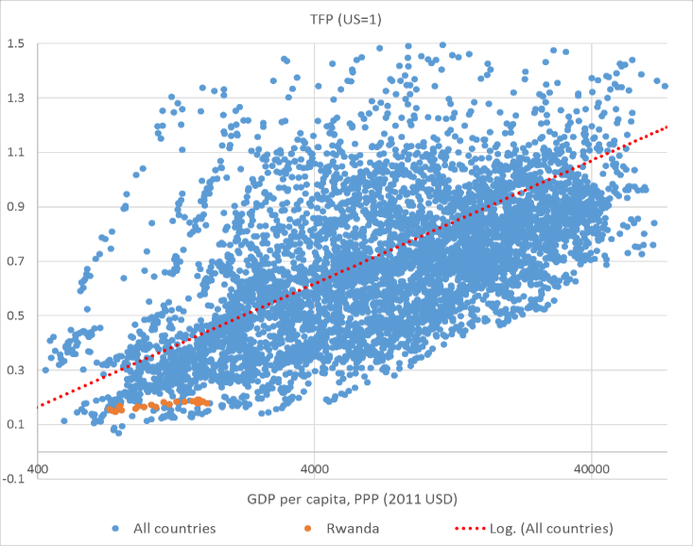
Poor Human Capital is a Major Challenge to Growth Fundamentals
Rwanda underperforms its peers with similar incomes in terms of both the level of TFP and its growth rate (before the crisis)
The pandemic likely exacerbated existing productivity challenges
Rwanda’s TFP vs global trends
Declining contribution of the productivity to growth
Source. Extracted from World Bank SCD
Notes:
Rwanda’s TFP vs global trends
Total factor productivity is the portion of output not explained by the amount of inputs used

Slide 16
Outline
What is Human Capital?
State of Human Capital in Rwanda
Impact of the COVID-19 on Human Capital in Rwanda
How to Protect and Promote Human Capital Post-COVID
Role of the World Bank in Supporting Human Capital Development in Rwanda

Slide 17
How to protect and promote human capital?
Exceptional measures are required to protect and promote human capital
The REU identifies measures in 3 policy areas:
Save Lives
Protect Poor and Most Vulnerable
Strengthen Policies, Institutions, and Investments for Rebuilding Back Better

Slide 18
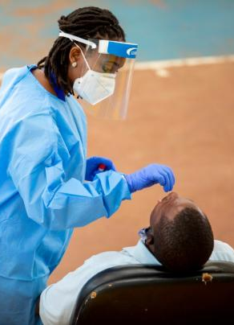
Saving Lives: Short term measures
Vaccine deployment is the top priority: The equitable deployment of COVID-19 vaccines will be a true game changer
The government should continue efforts to :
  Develop clear criteria for who will be prioritized for the vaccine,
  Provide training and technical assistance,
  Prepare for risk communication and community engagement
  It is also critical to strengthen efforts to protect the delivery of essential health and nutrition services to mitigate the risk of losing decades of progress

Slide 19
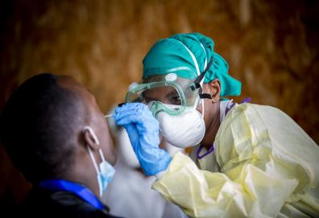
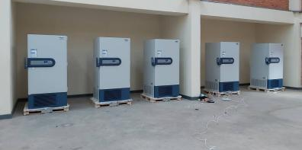
Saving Lives: Medium term measures
Investing in preparedness and health security
Despite important progress, Rwanda still has persistent gaps in disease outbreak preparedness and response capacity. Rwanda ranked 117 out of 195 countries on the Global Health Security Index,
To strengthen the country’s readiness level, It would be critical to fully finance and effectively implement the US$61.5 million National Action Plan for Health Security (2020-2024) prepared by the government,
Authorities need to prioritize domestic financing and then leverage donor and private sector support to ensure sustainability.

Slide 20
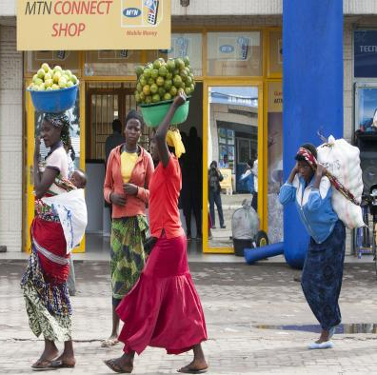
Protecting the poor and the most vulnerable (1)
Strengthen social safety nets
Increase overall coverage of social safety nets:
Further expansion in the coverage of the VUP, the gov flagship social protection program
with special focus on expansion of HC focused programs (e.g. nutrition and early childhood related)
Expanding social insurance to the informal sector
Improving targeting accuracy so social safety nets can be reach the ‘deserving’ poor and be more cost-effective:
EICV5 data analysis revealed that only 46% of households in “Ubudehe” 1 are actually poor,
Through a more objective targeting tool such as household welfare scorecard, the share of poor households in “Ubudehe” 1 identified as such (for social support) can reach and go beyond 73 percent.
Scaling up the use of digital cash transfers
could help create a more responsive, safe and efficient delivery of social protection
Provide incentives for voluntary savings, increase access to financial services

Slide 21
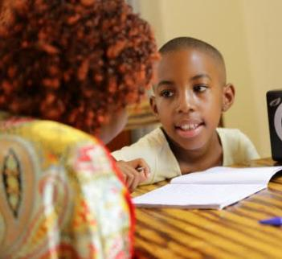
Protecting the poor and the most vulnerable(2)
Track and support reenrollment to ensure nobody is left behind:
Targeted interventions for girls, children with disability, and low-income families
Recover learning losses to prevent permanent impacts on the opportunities of children and youth:
Improved teaching and school leadership
Effective classroom assessment
Structured pedagogy with focused remedial and catch-up programs
Effective use of ICT for accelerated and multi-modal learning
Enhance skills could for future growth, through:
Improved digital skills for faculties and students
Greater access to tertiary education in priority skills (example, health care professionals).
Strengthen education systems with greater capacity:
Greater accountability for learning outcomes,
Increased focus on inculcating quality education leaders,
Improved linkages of instruction with economic priorities and private sector needs

Slide 22
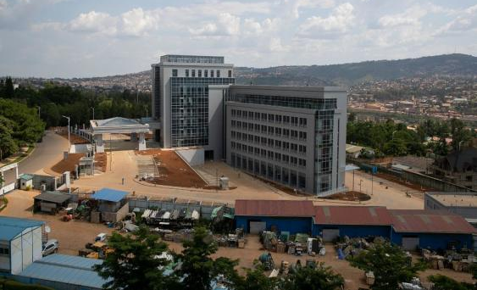
Strengthening policies, institutions, and investments for building back better
  Higher growth
  More inclusive
  More sustainable
  Expanding the role of the private sector - building on higher productivity supported by strong human capital

Slide 23
Measures to build back better (1)
Because of the pandemic, public debt rose from 58.1 % of GDP end 2019 to estimated 72% end 2020
Expansionary fiscal policies are necessary to mitigate the impact of the pandemic
However, over the medium-term, prudent fiscal management is critical to create fiscal space to support human capital development
Strong domestic revenue mobilization
Implementation of transparent and credible financial management practices
Flattening the debt curve is critical to create fiscal space to invest on Human Capital
Evolution of Public & Publicly Guaranteed Debt
(percentage of GDP)
Notes:
Flattening the debt curve

Slide 24
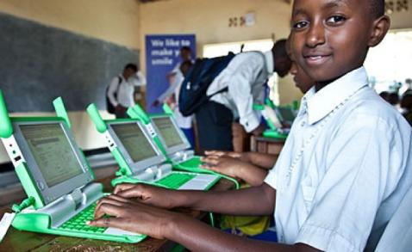
Measures to build back better (2)
Strengthening complementary infrastructures to boost human capital
A reliable supply of electricity and greater access to high-speed internet is key
It would not only increase the efficiency of remote learning but also help to reduce inequalities in access to better education tools.
More broadly, increasing access to broadband internet will be critical to accelerate the structural transition to a more productive, modern economy.

Slide 25
Outline
What is Human Capital?
State of Human Capital in Rwanda
Impact of the COVID-19 on Human Capital in Rwanda
How to Protect and Promote Human Capital Post-COVID
Role of the World Bank in Supporting Human Capital Development in Rwanda

Slide 26
Human Capital at the heart of THE World Bank Portfolio in Rwanda
Human Capital for Inclusive Growth Project
(DPO; $150 million)
Pillar 1: Promoting long-term fiscal sustainability
Pillar 2: Enhancing Coverage & Equity in Access to Critical Social Programs
Pillar 3: Enabling learning and development of children
Pillar 4: Strengthening decentralized capacity and accountability
Basic Education Project
(IPF; $210 million)
Teacher preparation, effectiveness
Better learning outcomes
School readiness
Adequate infrastructure
COVID-19 response – remote learning and back-to-school support
Stunting Prevention Project
(IPF; $55 million)
High-impact Health and & Nutrition (H&N) interventions
Stronger H&N delivery systems
Multisectoral community & HH level prevention, management
Students learn better and move to higher grades smoothly
Children get a good head start
Social Protection Project
(IPF; $103 million)
Gender, child, and nutrition sensitive safety net
CRVS including birth registration and certification systems
Stronger SP delivery systems and M&E
Skills Development Project
(PforR; $270 million)
Increased access to quality and relevant skills
Quality post-graduate capacity
Institutional reforms
Public private partnerships
Women are empowered to work, utilize their human capital
Young people with market-relevant skills transition to work
Families face fewer risks to survival, health and well-being
Rwanda COVID19 Emergency Response Project
(IPF; $45 million)
Effective COVID19 response
Strengthened national health systems for public health preparedness
Higher Education Centers of Excellence
(IPF-DLI; $20 million)
Quality post-graduate education
Collaborative research capacity
Increased research in regional priority areas
ONGOING HUMAN CAPITAL RELATED ASA PROJECTS
Enhancements in Safety Net Delivery Systems ($200,000)
Evaluation of Child-Sensitive SP ($600,000)
Rwanda Stunting Prevention and Reduction PASA – ($255,000)
Rwanda Reading: Books for early learning ($1 million)
Disability Inclusion in Education ($1.9 million)
Notes:
TOTAL Portfolio is 2.36B of which Human Capital is approximately 35%

Slide 27
Murakoze
Thank you

