Slide 1
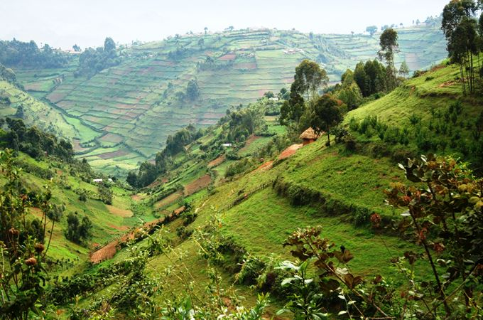

COVOD-19 and Economic Recovery
Greening the Recovery Process
Osten Chulu
Senior Economic Advisor – Inclusive Green Economy
UNITED NATIONS DEVELOPMENT PROGRAMME

Slide 2
RWANDA’S REMARKABLE TRANSITION 1994 - 2019
ECONOMIC GROWTH
Fastest growing economy in the world from being the 4th poorest country in the world in 1994.
-50.25%
9.4%
LIFE EXPECTANCY
Declined from 49 years in 1988 to 21,8 years in 1994. Now 69.1 years in 2019
21.8
69.1
1994
INFANT MORTALITY RATE
2019
196.3
Infant Mortality down from 196.3 per 1,000 births to 26.5 per 1,000 live births
26.5
$127
GDP PER CAPITA
$818
2nd highest per capita GDP growth in Africa in the past two decades.
57.85
LITERACY RATE
73.22
Improved from 57.85% in 1991 to 73.22% in 2018

Slide 3
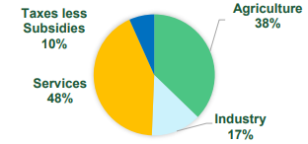
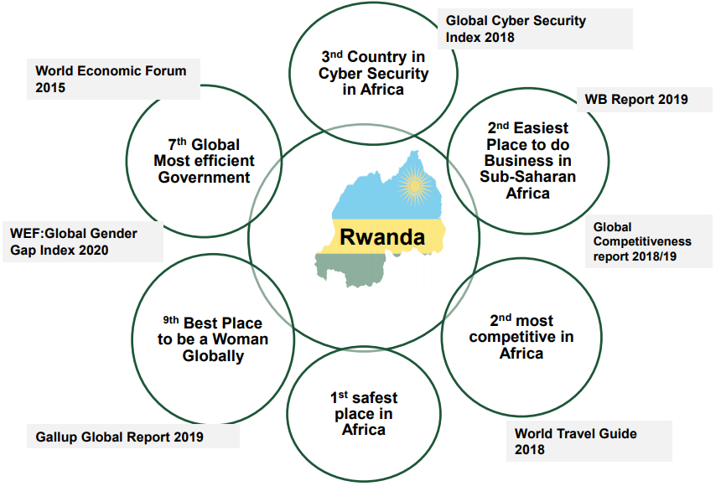
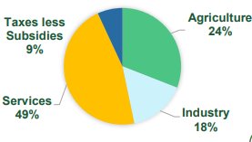
Economic Transformation and Business Environment
2005
Transformation towards services in the medium term
2019

Slide 4

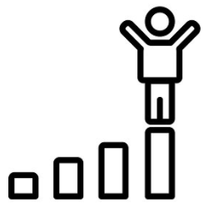



RWANDA’S VISION OF THE GOOD LIFE: TRANSION TO MIDDLE INCOME STATUS BY 2035
Quality of Life
Transformation for Prosperity
Modern Infrastructure and Livelihoods
International cooperation and positioning
Sustained food security and nutrition for all households and age groups
Universal, sustainable and reliable access to water and sanitation
Affordable, sustainable, reliable and modern energy
Universal access to quality heath care, education, financial services dignified SMART housing, Pensions, medical insurance and savings
Environmentally friendly and climate resilient surroundings, and
Sustained national security
Core Shared Values
Increased productivity and competitiveness while providing jobs
  Diversified tourism
  High value IT and tech services
  Business and financial services
  Logistics and aviation
  Agro-processing: advanced food industry, technology intensive agriculture with a commercial focus
  Scientific and technological innovations
  Construction industry
  Extractive industries
Modern SMART cities (optimal space utilization, connected cities, broadband, internet of things)
Green/Eco-friendly cities and neighborhoods
SMART towns and rural settlements
Modern transport facilities and services
Efficient public and private services
Self-determination, including self sufficiency, solidarity and dignity
Unity and Rwandan Identity/culture
Integrity
Equity (including Gender)
Transparency and openness
Accountability
Community participation
National stability
Regional integration – EAC, AfCTA
Multilateral and bilateral cooperation
Positioning abroad
Freeing Rwanda from aid dependency

Slide 5

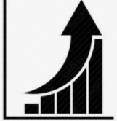






THE ECONOMICS TO ACHIEVE THE GOOD LIFE
THE POLITICS TO ACHIEVE THE GOOD LIFE
Visionary Leadership
High and Sustained Economic Growth of 10% to reach Middle Income status by 2035
Inclusive development model including gender equality, pro-poor growth, unity and solidarity
Build on Successful foundations e.g. ICT, Ease of Doing Business
Investment in Human Capital Development
Strong governance and strong bureaucracy
Investment in Natural Capital Development
Home grown solutions:- VUP Community Works, Girinka, Umuganda, etc.
Investment in Built Capital/Infrastructure
Stable national security
Investment in Financial Systems

Slide 6
Wealth Measures
ECONOMIC WELL BEING
HAPPINESS
Leisure
Non-market activity
Wealth
(Unemployment)
(Insecurity)
Family
Friends
Work Satisfaction
Communities
02
01
03
LIVING CONDITIONS
GDP
Environment
Health
Education
Inequality
(Expenditure) Sum of final Expenditures =
(Income) Sum of income payments and costs incurred in production =
(Production) Sum of gross value Added
04

Slide 7

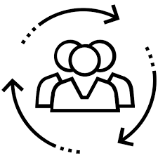



BUILT CAPITAL
Roads, Dams, Buildings, machinery and Equipment
HUMAN CAPITAL
Knowledge, Aptitude, Education and Skills
GDP
Wealth of Nations
+
=
=
INCLUSIVE WEALTH
NATURAL CAPITAL
Forests, Agricultural land, the Atmosphere, Oceans, Ecosystems, Subsoil resources
SOCIAL CAPITAL
Community, Shared Values, Vision, Shared Identity
+

Slide 8
Rwanda’s Development Conundrum: Tradeoff between Natural, Built and Human Capital

Slide 9



2020 COVID-19 Strikes

Slide 10
RWANDA’S ECONOMIC RECOVERY – COVID-19
Collaborative and integrated strategy
NATIONAL ECONOMIC RECOVERY PLAN (NERP)
Contain the pandemic and strengthen the health system
Mitigate the impact of the COVID-19 economic crisis on household income by scaling up social protection
Ensure a coordinated multi-sectoral response of Government
Support businesses and protect jobs
Ensure food self-sufficiency by increasing agricultural production
UN IMPACT
ASSESSMENT
UN IMPACT ASSESSMENT
GOVERNMENT, DPs AND UN ASSESSMENTS
INTERGRATED APPROACH
DEVELOPMENT PARTNERS SUPPORT TO NERP
Economy (Macroeconomic Impact)
Public Finances
Trade and Regional integration
Poverty and Human Development
Labour Markets
Food Security and Food Prices
Gender
Social Service Delivery
NATIONAL
ECONOMIC
RECOVERY PLAN
UN RESPONSE TO COVID-19
UN RESPONSE
COVID-19
ALIGNMENT TO NST1
Coordinated and Comprehensive Health Response
Safe-guard lives and livelihoods and addressing the Socioeconomic, Humanitarian and Human Rights aspects of COVID-19
Recovery that builds back better with more equal, inclusive and resilient and sustainable economies and societies.
Saving Lives, Protecting Societies, Recovering Better
UN JOINT PROGRAMME OF SUPPORT TO NERP
Notes:
National Preparedness and Response Pln

Slide 11
COVID-19 and Economic Recovery: The Road Ahead
COVID Strikes
Severe economic shocks.
GDP growth -3.4
Sectoral performance decelerates – apart from ICT and Health
Pre-COVID-19
Rwanda’s remarkable story 1994-2019
Strategies for Recovery
UN Socioeconomic Impact Assessment, National Economic Recovery Plan, Economic Recovery Fund, UN Joint Programme, WB, DPs
Solutions - implementation
Identifying who has been most affected and designing programmes to cushion the effects of COVID.
Address the challenges of financing the recovery process. Sizable amounts have been put on the table.
Success??
Return to pre-COVID levels of growth and development.

Slide 12
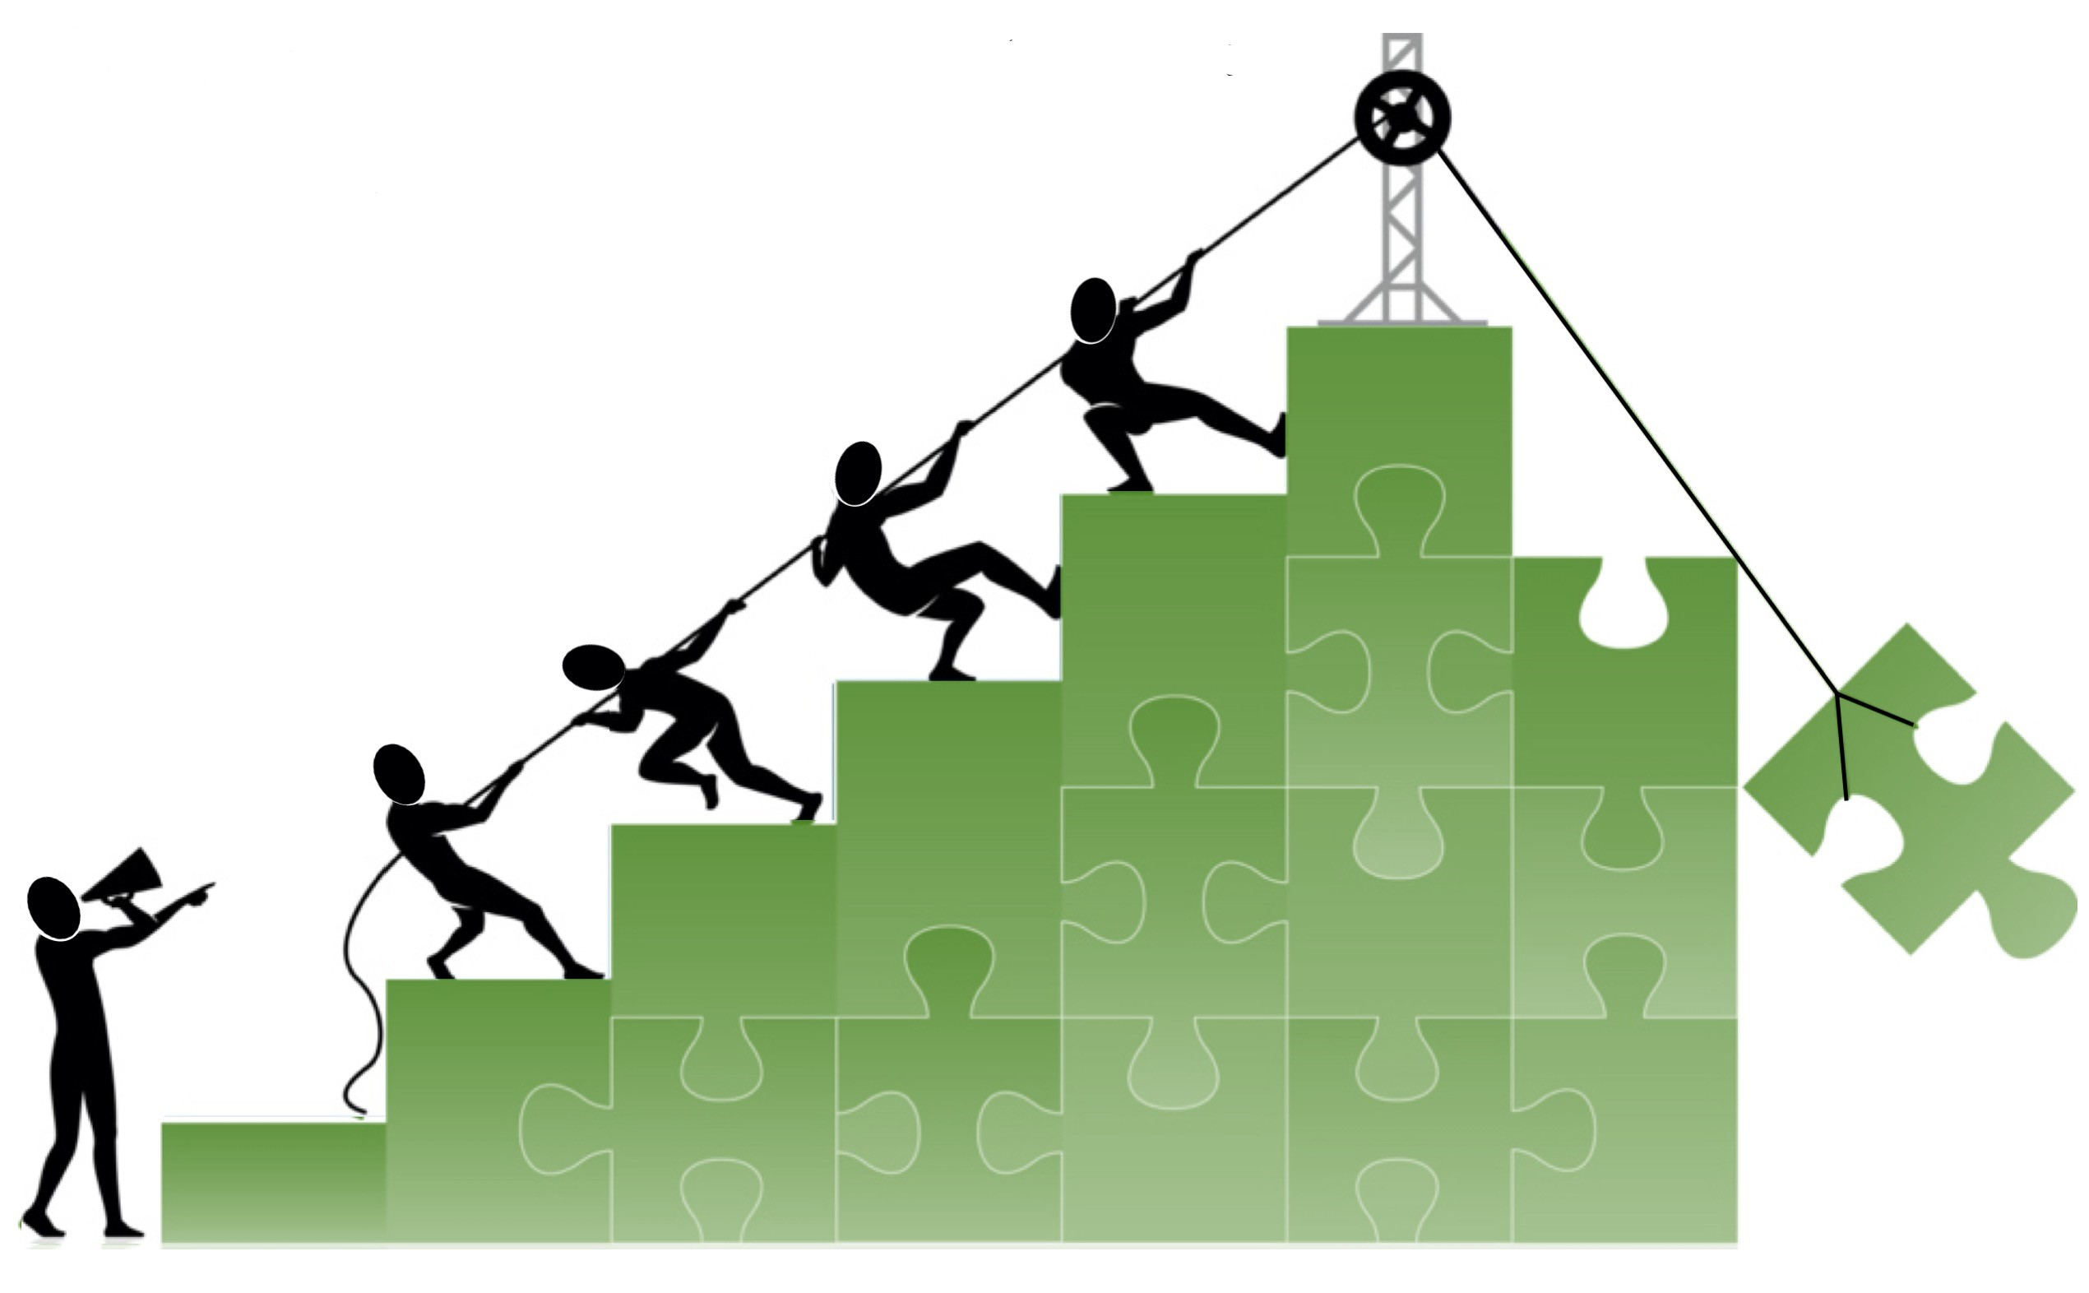
Build Back Better

Slide 13
Policy Challenges
01.
03.
Scope of the problem: Who is affected and how deep?
Social Protection difficult with reduced fiscal space. Who do we target and what are the exit strategies?
04.
02.
Agriculture is a great multiplier, but also causes damage to environment
Economics – measures of well-being and wealth. Needs deeper understanding

Slide 14
GOING BEYOND COVID-19: POLICY OPTIONS FOR 2035 and 2050 TARGETS
Draw-down on Natural capital continues, Environmental degradation, Soil loss continues
Heavy dependence on Natural Capital
Recover to Pre-COVID-19 Economic Growth Levels – maintain NST1 and NERP Goals
Agricultural Transformation and Intensification
Diminishing land holding size from 0.98 ha per capita.
Low Agric productivity, Food security compromised (Food import substitution strategy
Possible Outcome: Diminishing returns to Natural Capital
Long-Term
Present
Medium-Term

Slide 15
BUILD BACK BETTER
Alternative Scenario: Gradually reduce overdependence on Natural Capital and move to a Knowledge-based, market-oriented agriculture, Aggressive Conservation and Reforestation, Develop Sustainable Built and Human Capital
Trends in Natural Capital 2020
Re-generation of Natural Capital in the long-term
Transformation and mind-set change
Human Capital Development, Including Health and Education
Renewable Energy
Green Built Capital
Circular Economy, Green Jobs, Green Growth

Slide 16
WHAT WE IMPLEMENT NOW WILL LOCK US ONTO A PARTICULAR GROWTH TRAJECTORY
Positive Tipping Point
CURRENT STATE
THE FUTURE
WITH TIME
NERP and ERF already being implanted to assist Rwandans cope with the crisis and revive the economy
Development Partner/UN support to the NERP and ERF already in place, including expanded Social Security
We need to assess environmental Implications and opportunities
Measures implemented during the crisis determine the outcomes and livelihood position of Rwandans across the entire spectrum of economic endeavour.
In the likely situation where living with the crisis becomes the “new normal”, measures taken to increase the ability of individuals, businesses and the nation to cope over the long-term will determine the success of the transformation agenda
With time, actions set in motion become difficult to undo even after the crisis due to momentum generated
Positive tipping point only reachable by making conscious decisions to implement game-changing build-back-better measures withing the current window of opportunity provided by the crisis

Slide 17
WE NEED MORE THINKING
OUR IN-TRAY IS GROWING
VISIONS OF THE FUTURE
OUR POLITICS
Leaving no one behind?
GDP of the poor?
How do we ensure nature and wildlife are effective and legitimate land use options?
THE ECONOMICS TO ACHIEVE THEM
FIXING MULTILATERAL SYSTEM
How do we account for biodiversity risks and stop destruction of habitats?
Sustainability?
How do we ensure our multilateral systems are fit for purpose?

Slide 18
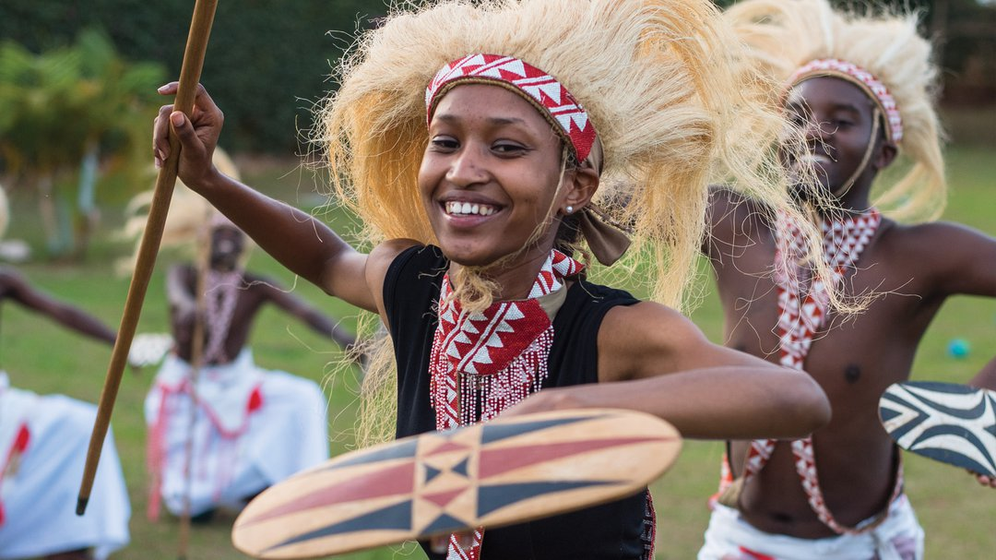
THANK YOU

