Slide 1
7th EPRN Annual Research Conference
Theme :
“Economic policy measures to enhance productive capacities post COVID-19 Crisis”
27th May 2021
Venue : Kigali Serena Hotel

Slide 2
Topic:
THE ROLE OF DIGITAL SOLUTIONS IN ECONOMIC RESILIENCE AND GROWTH IN RWANDA
By:
Dr. MUTEMBEREZI Fidèle
MBABAZI N. Christian
KAMUKUNZI Dominique

Slide 3
Content
Introduction
Evolution of the digital economy concept
Emergence of Digital Economy
Main components of the digital economy
Emergence of Digital Economy in Rwanda
Methodology and Source of data
Findings and Analysis
Conclusion
Recommendations
References

Slide 4
Introduction
Covid-19 pandemic has disrupted and impacted the daily lives of citizens in an unprecedented manner.
Governments continue to endeavor hard for protecting lives by imposing lockdowns, testing, segregation, and treatment.
As result, many businesses are forced to shut down and even businesses are reopened with restrictions. Traditional shopping became difficult to access and people move to online shopping.
This has resulted in increasing in business to customer (B2C) sales and increase in business to business (B2B) E-commerce.
The use of mobile money has shown its efficiency in looking about payment solutions.
During this pandemic period of time, it has been clearly shown that E-Commerce and E-payment can be an important tool (solution) for consumers (people, businesses, institutions and economy as whole).
This research focuses on assertion the role of E-Commerce associated with E-payment on economic resilience and growth.

Slide 5
Evolution of the digital economy concept
Since first coined in the mid-1990s, the definition of the digital economy has evolved, reflecting the rapidly changing nature of technology and its use by enterprises and consumers (Barefoot et al., 2018).
In the late 1990s, analyses were mainly concerned with the adoption of the Internet and early thinking about its economic impacts (with reference to the “Internet economy”) (Brynjolfsson and Kahin, 2002; Tapscott, 1996).
As Internet use expanded, reports from the mid-2000s onwards focused increasingly on the conditions under which the Internet economy might emerge and grow.
Definitions evolved to include analyses of different policies and digital technologies, on the one hand, and the growth of ICT and digitally oriented firms as key actors, on the other (OECD, 2012a and 2014).
With improved Internet connectivity in developing countries, and the expansion in the range of digital firms, products and services, studies of the digital economy have begun to include more substantial analysis of the situation in developing countries (UNCTAD, 2017a; World Bank, 2016).
This process is often referred to as digitalization, defined as the transition of businesses through the use of digital technologies, products and services (Brennen and Kreiss, 2014).

Slide 6
Emergence of Digital Economy
With digital technologies underpinning ever more transactions, the digital economy is becoming increasingly inseparable from the functioning of the economy as a whole.
The different technologies and economic aspects of the digital economy can be broken down into three broad components:
  i. Core aspects or foundational aspects of the digital economy, which comprise fundamental innovations (semiconductors, processors), core technologies (computers, telecommunication devices) and enabling infrastructures (Internet and telecoms networks).
  ii. Digital and information technology (IT) sectors, which produce key products or services that rely on core digital technologies, including digital platforms, mobile applications and payment services.
  The digital economy is to a high degree affected by innovative services in these sectors, which are making a growing contribution to economies, as well as enabling potential spillover effects to other sectors.
  iii. A wider set of digitalizing sectors, which includes those where digital products and services are being increasingly used (e.g. for e-commerce). Even if change is incremental, many sectors of the economy are being digitalized in this way.
  This includes digitally enabled sectors in which new activities or business models have emerged and are being transformed as a result of digital technologies. Examples include finance, media, tourism and transportation.
  Moreover, although less often highlighted, digitally literate or skilled workers, consumers, buyers and users are crucial for the growth of the digitalized economy.
  These components are being used in various ways as a basis for measuring the extent and impact of the digital economy.

Slide 7
Main components of the digital economy
The evolution of the digital economy is closely associated with progress in several frontier technologies, including some key software-oriented technologies, such as:
  Blockchain
  Data analytics
  Artificial Intelligence (A.I)
Other emerging technologies range from user-facing devices (such as computers and smartphones) to
  3D printers and wearable, as well as specialized machine-oriented hardware, such as
  Internet of Things (IoT),
  Automation and robotics
  Cloud computing.
Rapid advances in these increasingly converging technologies have been enabled by a surge in capacity – as well as considerable cost reductions – of data storage, processing and transmission.

Slide 8
Emergence of Digital Economy in Rwanda
Despite its small size, Rwanda has distinguished itself as a country that has “bet big“on digitization, as means to accelerate growth and reduce poverty.
Rwanda has already begun to chart an ambitious course for achieving rapid digital transformation. This includes investing heavily in the roll-out of digital infrastructure, piloting innovative schemes and partnership with non-profit and for-profit organizations to boost the nation’s digital skills base, expanding its public digital service capability and creating an enabling environment for digital service and business innovation.
Rwanda’s ICT sector has been growing rapidly over the last five years, witnessing a 12.7 percent value-added increase in 2014-2018.The World Economic Forum’s Networked Readiness Index subsequently rated Rwanda first among East African nations in terms of its readiness to exploit the opportunities offered by ICT to boost growth and competitiveness. World Bank 2020.
Rwanda’s digital development journey to date has been spearheaded by a government deeply committed to leveraging ICT as a cross-cutting enabler of economic growth, innovation and service delivery.
This commitment is reflected in the sheer number of related strategies and policy plans that the Government has adopted over the years, as well as sizable investments and ambitious initiatives launched that have sought to create an enabling environment for ICT adoption,
expand digital infrastructure, digital platforms and services,
promote further digital skills development,
foster a national culture of innovation and position Rwanda as a regional digital hub.

Slide 9
Methodology and Source of data
This area of research has few articles and papers due to the occurrence of COVID-19 pandemic.
Nevertheless, we have managed to collect and analysed data from National Bank of Rwanda, several references have been consulted in addition to compile important information related to this topic.
Descriptive and comparative analysis have been used as approaches in our methodology during this research and then, we come up with some findings we are about to discuss.
Here are the findings:

Slide 10
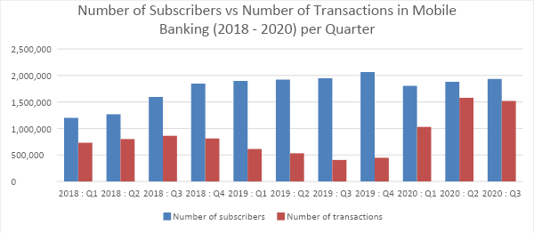
Findings and Analysis
Transactions in Mobile Banking
The above bar illustrates how the number of subscribers and number of transactions in Mobile Banking have been varying overtime during year 2018 and 2020. The arrangements are quarterly based. In 2018, there has been an increase in number of subscribers. In 2019, there was also a small change. The number of transactions has been increasing in 2018, however; in 2019, there was as decline. Moreover, in 2020, quarter two, the number of transactions in Mobile Banking has increased by 53% comparing to 2020, quarter one.

Slide 11
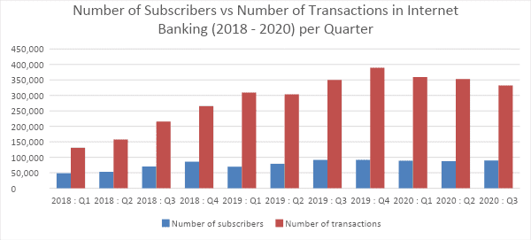
Transactions in Internet Banking
The above bar shows how the number of subscribers and number of transactions in Internet Banking have been changing overtime during year 2018 and 2020. There is a small variation in number of subscribers for above period. Nevertheless, there has been a significant increase in number of transactions. Moreover, in 2020, quarter two, the number of transactions in Internet Banking has decreased by 2% comparing to 2020, quarter one.

Slide 12
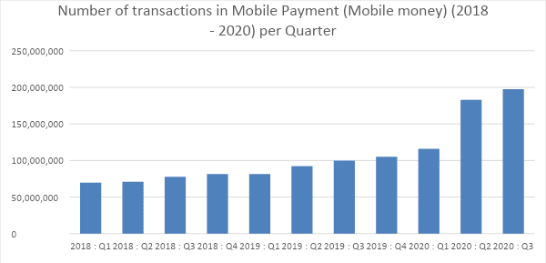
Transactions in Mobile Money
The overhead bar displays how the number of transactions in Mobile payment (Mobile Money) have been moving overtime during year 2018 and 2020. The bars are rising positively in the stated period, especially; in 2020, quarter two, the number of transactions in Mobile Money has increased by 58% comparing to 2020, quarter one.

Slide 13
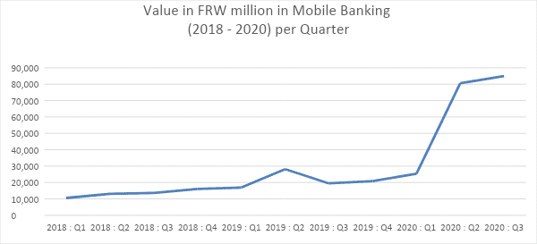
Value in Mobile Banking
The above graph demonstrates how the value in Mobile Banking have been trending actively during year 2018 and 2020. From 2018, there has been rising besides in 2020, quarter two, the Value of FRW in Mobile Banking has strongly increased by 218% comparing to 2020, quarter one.

Slide 14
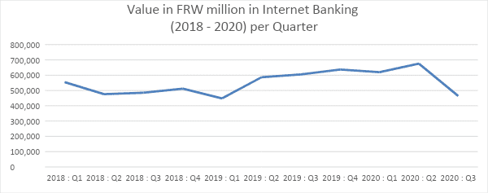
Value in Internet Banking
The above graph reveals how the value in Internet Banking have been fluctuating dynamically during year 2018 and 2020. There were up and downs in the whole period. In 2020, quarter two, the Value of FRW in Internet Banking has increased by 9% comparing to 2020, quarter one.

Slide 15
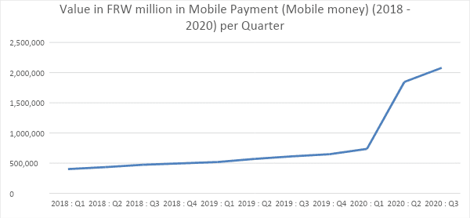
Value in Mobile Money
The above graph discloses how the value in Mobile Payment (Mobile Money) have been growing vigorously during year 2018 and 2020. From 2018 up to 2020 quarter one, the rise was slightly satisfactory, However, in 2020, quarter two, the Value of FRW in Mobile Money has increased by 151% comparing to 2020, quarter one.

Slide 16
Conclusion
The number of subscribers and number of transactions in mobile banking in (2018-2020), and number of transaction in Mobile Payment(Mobile Money) have persistently increased at high rate, 53% and 58% respectively in 2th quarter 2020 while in 2020, quarter two, the number of transactions in Internet Banking has decreased by 2% comparing to 2020, quarter one.
From 2018, there has been rising the value in Mobile Banking besides in 2020, quarter two, the Value of FRW in Mobile Banking has strongly increased by 218% comparing to 2020, quarter one.
The Value of FRW in Internet Banking has increased by 9% and the value of comparing to 2020, quarter one. However, in 2020, quarter two, the Value of FRW in Mobile Money has increased by 151% comparing to 2020, quarter one from these finding we pay affirm that
Digital solutions had had a profound impact during the COVID-19 crisis in Rwanda by enabling parts of the economy to continue functioning online and through remote working.
Focusing on digital technologies, it can accelerate the move to a smart economy and in the process to accelerate economic resilience and growth for the prolonged prosperity.

Slide 17
Recommendations
Place digital solutions at the core of the recovery strategy.
Boost infrastructure investments.
Double efforts to improve ICT skills and digital literacy.
Enabling digital competition.

Slide 18
References
Barefoot et al, 2018, Towards a Framework for Measuring the Digital Economy
Brennen and kreiss, 2014, Digitalization and Digitization
Knickrehm et al,2016, Acceleration of Digital Transformation as a Result of Launching Programs Financed from Public Funds: Assessment of the Implementation of the Operational Program Digital Poland
Manyika et al.2016, Defining, Conceptualising and Measuring the Digital Economy
Malecki, E. and Moriset, B. 2007: The digital economy: business organization, production processes and regional developments
Ojanpera et al,2016, Digital Connectivity and African Knowledge Economies
OECD2012, 2014,2016a, 2017a, G20/OECD INFE REPORT n adult Financial Literacy In G20 Countries
UNCTAD.2017, 2017a, World Investment Report 2017
UNCTAD,2019 Digital Economy Report
UNECA, 2017, Economic Report on Africa 2017
WTO 2018 annual report
World Bank 2016, The World Bank Annual Report 2016
World Bank 2020. Rwanda Economic update: Accelerating Digital Transformation in Rwanda

Slide 19
Thank you!
Comments & Questions

