Slide 1

Minimum Wage – a Global perspective

Slide 2
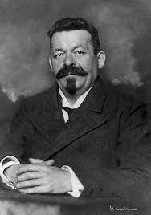
What is Friedrich Ebert Stiftung (FES)?
German organisation working on social justice and social democracy – freedom, justice and solidarity
In Rwanda our work focuses on
  Good Governance
  Gender Justice and Feminism
  Climate Crisis
  Youth Empowerment
  Social Dialogue and Labour Rights
Collaboration with CSOs, trade unions, researchers, government institutions, think tanks, local and international organizations based in Rwanda.

Slide 3
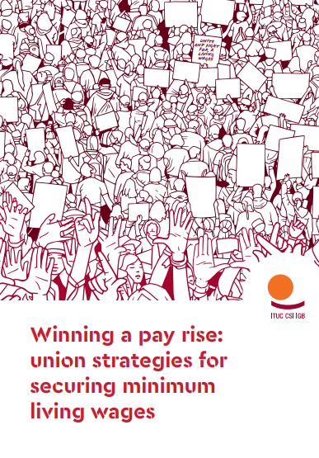
„Minimum Wage is a minimum pay rate that an employer is legally required to pay; a rate that cannot be reduced by collective agreement or individual contract. The primary objective is to protect workers against unduly low pay.“
5 MESSAGES ON MINIMUM WAGE

Slide 4
1. Minimum Wage as a factor for economic growth
Minimum wages are not detrimental to employment and growth
It can be a powerful economic stimulus
Decent wages contribute to more equity, higher welfare, more inclusive development and economic growth
Minimum wage as a tool to close the gender pay gap

Slide 5
2. A minimum wage is not a one size fits all
Processes of setting it up differ largely from country to country
Minimum wage must take into account the costs of living
Must be regularly updated

Slide 6
3. Minimum wage has to be a tripartite Process
Tripartite = involving employers, employees (through trade unions) and the government → SOCIAL DIALOGUE
Trade Unions have to be invloved given their strong linkage to the workers
REGULAR tripartite meetings are needed to adjust when needed
Regional frameworks may help, i.e. ILO C131
Enforcment mechanisms must be in place

Slide 7
4. Minimum Wage can go hand in hand with Collective Bargaining
Collective Bargaining Agreement (CBA): CBAs determine terms and conditions of work and regulate relations between employers, workers and their organizations at company level
Minimum wage does not undermine collective bargaining, but may strengthen and complement it
Minimum wage can provide the legal basis for CBAs

Slide 8
5. Minimum wage has to be rooted in a Rights based approach
Be careful not to exclude certain categories of workers and by that make them even more vulnerable
It has to support decent work
How do we cover informal workers?
    „Lighthouse Effect“

Slide 9
Thank you!
FURTHER READINGS:
- Minimum wages (Minimum wages) (ilo.org)
- Winning a pay rise: union strategies for securing minimum living wages - International Trade Union Confederation (ituc-csi.org)
- About FES Rwanda: Friedrich-Ebert-Stiftung Rwanda Office (https://rwanda.fes.de)

