Slide 1


Valuing control over income and workload:
A field experiment in Rwanda
Berber Kramer
International Food Policy Research Institute (IFPRI), Nairobi, Kenya
8th EPRN Research Conference
Kigali, May 27, 2022

Slide 2
Some difficult trade-offs for policymakers:
Introducing a new bean variety increases net household income but replaces a variety for which women used to control the proceeds, reducing their personal income. Roll out this new variety?
One climate information service helps both women and men save time, whereas another program reduces women’s workload more, but doesn’t help men save time. In which program to invest in order to maximize total welfare?
A women’s empowerment program creates new job opportunities for women, increasing their income, but also their workload. Can we consider this program to be empowering, and do we want to invest in this program?
Existing tools to measure program impacts on women’s empowerment capture changes in levels of empowerment, but how are these changes valued?

Slide 3
A tool to value changes in workload and income autonomy
Using lab-in-the-field experiments, we aim to measure how respondents value:
  changes in workload;
  changes in income autonomy; and
  how they manage trade-offs between them.
Field experiment has been implemented with 1000 respondents from 500 households spread across 4 cooperatives in Rwanda
Experiment repeated ahead of each major agricultural activity until the harvest phase (4 rounds).
We also administered survey modules to measure levels of women’s empowerment, such as IFPRI’s project-level Women’s Empowerment in Agriculture Index (pro-WEAI)

Slide 4
Experimental task #1: Valuing control over income
For these scenarios, do you prefer …
RWF 3,000 paid to yourself OR
RWF 2,500 paid to yourself OR
RWF 2,000 paid to yourself OR
…
RWF 1,000 paid to yourself OR
RWF 2,500 paid to your spouse
RWF 2,500 paid to your spouse
RWF 2,500 paid to your spouse
…
RWF 2,500 paid to your spouse
This first task elicits a respondents’ valuation of control over income (Almas et al, EJ 2018).
In the first choice, most participants will choose to be paid RWF 3,000 themselves
At a later choice, most will switch and choose a higher level of income paid to their spouse
How much income is someone willing to sacrifice in order to be paid him- or herself?

Slide 5
Experimental task #2: Valuing changes in workload
For these scenarios, do you prefer …
RWF 2,500 OR
RWF 2,500 OR
RWF 2,500 OR
…
RWF 2,500 OR
RWF 2,500 + 1 day of labor
RWF 2,000 + 1 day of labor
RWF 1,500 + 1 day of labor
…
RWF 500 + 1 day of labor
This second task elicits a respondents’ valuation of a change in workload (Agness et al, NBER 2021).
In the first choice, most participants will opt for the free labor
At a later choice, as the labor cost goes up, most will switch and choose not to pay for labor
How much is someone willing to pay to reduce his/her workload by a day?
And does this depend on whether the money is paid to the respondent, or to his/her spouse?

Slide 6
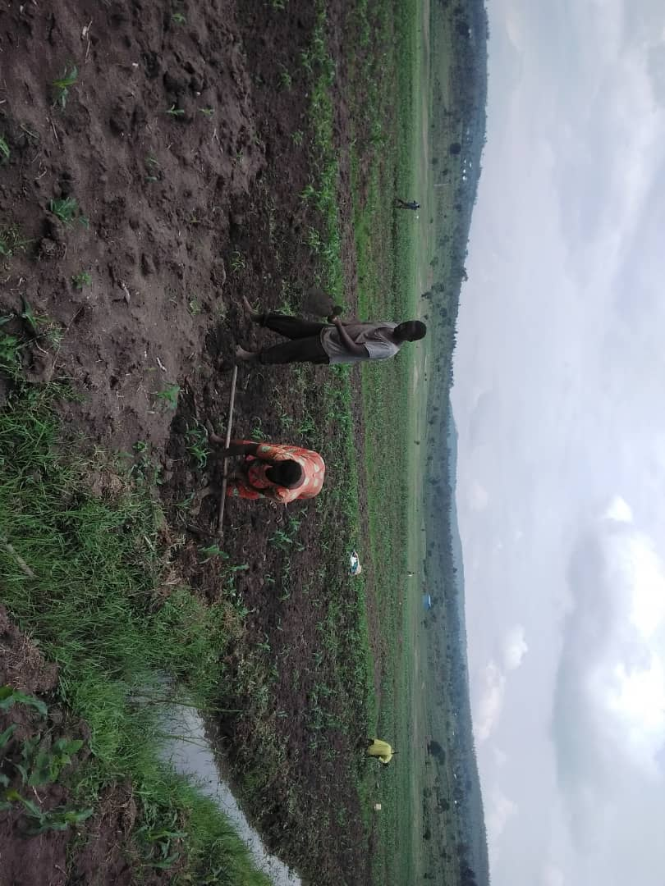


Variations in the experiment
All choices are made with payments being made either in cash or in kind (soap). This is varied across rounds.
We also vary whether participants choose which day the labor is provided (flexibility), versus whether we assign the labor on a fixed day.
Experiment is incentivized to elicit revealed instead of hypothetical preferences.

Slide 7
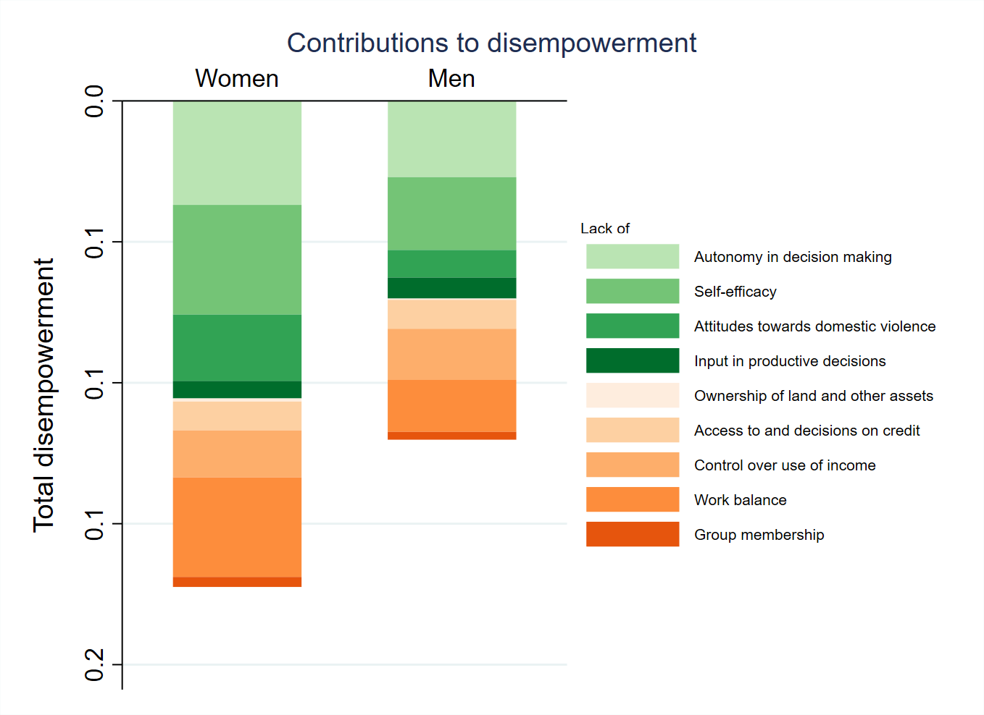
Findings regarding women’s empowerment
Overall, women are less empowered than men
Not driven by a lack of control over use of income
Main contributors to disempowerment:
Lack of autonomy in decision making
Limited self efficacy
High workload, especially for women, and in later rounds:
 | Round 1 | Round 2 | Round 3 | Round 4
Men | 0.338 | 0.372 | 0.384 | 0.402
Women | 0.498 | 0.646 | 0.620 | 0.654

Slide 8
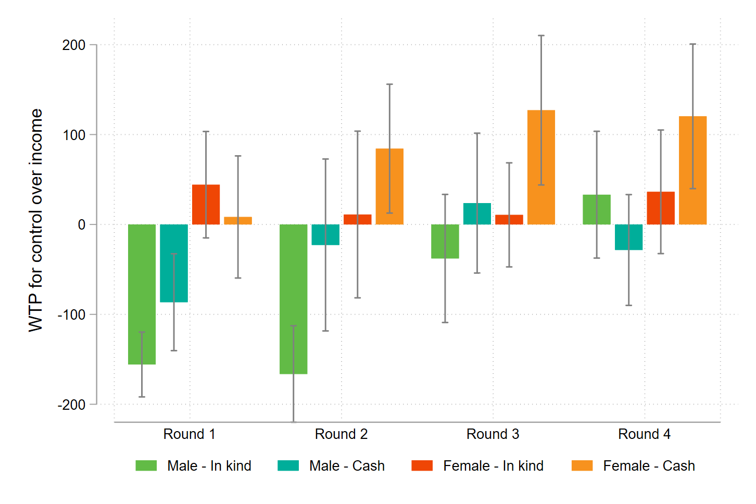
Willingness to pay for control over income
Women are willing to pay more for control over income than men
Receiving payments in cash increases willingness to pay, but not significantly so

Slide 9
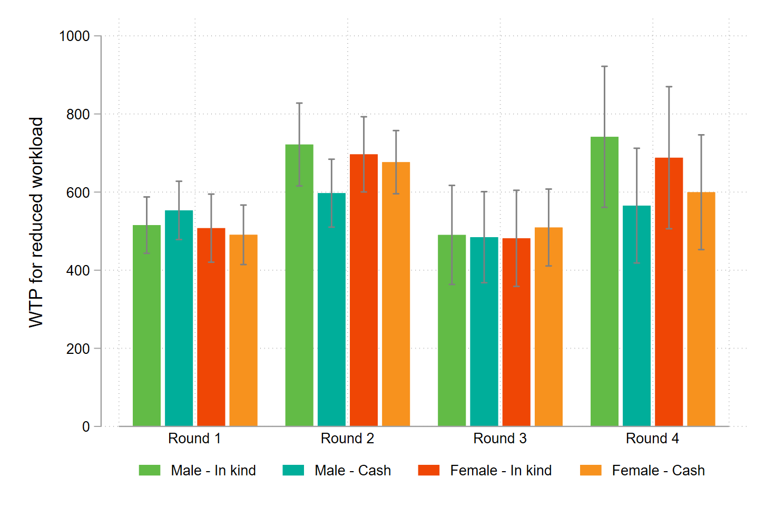
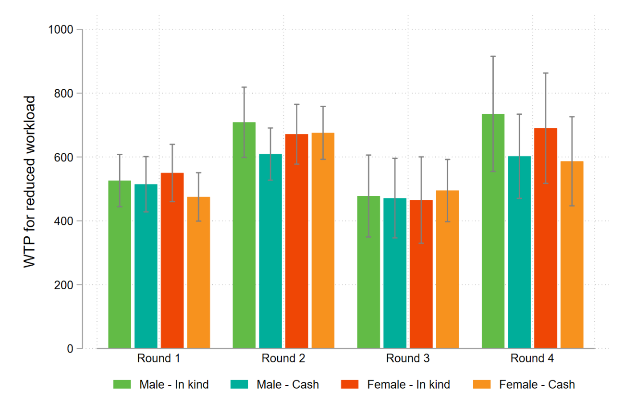
Willingness to pay for a reduced workload
Spouse income (no direct control over income)
Own income (direct control over income)
No significant differences in willingness to pay for women versus men
Regardless of whether respondent would control the income saved from not hiring any labor

Slide 10
Conclusion
How to value changes in important areas of empowerment, such as control over income or workload? We address this question using a lab-in-the-field experiment in Rwanda.
Surveys indicate that women are less empowered than men, with main contributors of disempowerment including a high workload but not a lack of control over income.
Experimental findings indeed find that women are willing to sacrifice more household income to gain control over income than their husbands, but the difference is modest.
We find that both women and men are willing to forgo significantly more personal and household income with the aim of reducing their workload.
Agricultural development programs that introduce time-saving practices and technologies have potentially greater positive welfare impacts for both women and men than programs increasing women’s control over resources.
Additional analyses find that survey-based measures of levels of control over income and work balance do not correlate well with the experimentally elicited valuations for the two. We will further investigate the linkages between these concepts through qualitative research.

Slide 11

Thank you!

