Slide 1
The best approach in the excise tax regime considering different circumstances in market price variation as well as revenue and health goals
Israel BIKORIMANA
Tax Modelling and Forecasting Specialist
MINECOFIN

Slide 2
.
This paper was done through financial support of the Economic Policy Research Network (EPRN) and International Centre for Tax and Development (ICTD)

Slide 3
Outline
Introduction
Market Structure for Rwanda
Issues around the current regime
proposed solutions

Slide 4
Introduction
Governments get resources to finance their spending mainly from taxes. FY 2017/18: 58.3% while on average since 2009/10 it is 49.3% of the tax to total budget.
Alcohol, Tobacco, Fuel, Telecommunication, and Sugar (sugar-sweetened beverages) are mostly excisable and are mandatory products category in EAC.
Excise duty is mainly associated with two key objectives:
First, serves as a tool for internalizing externalities. Externalities arise because market prices do not properly reflect the costs to society, in cases such as negative environmental or health effects.
Second, considered as a tool to raise substantial revenue for the government since often levied on goods and services characterized by low demand elasticity and a higher propensity to consume.
Tax incentives on basic need pauses some challenges since it is associated with deadweight loss, it is common for LDCs

Slide 5
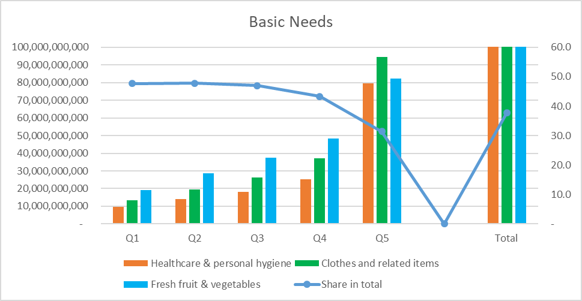
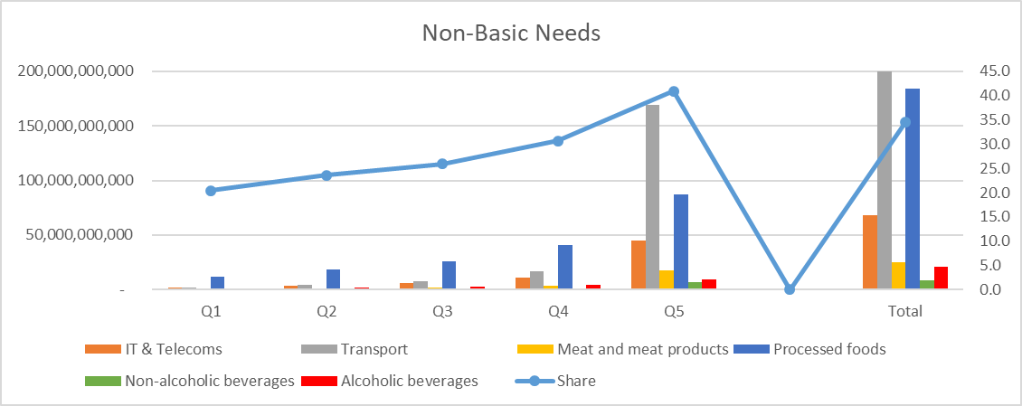
Introduction

Slide 6
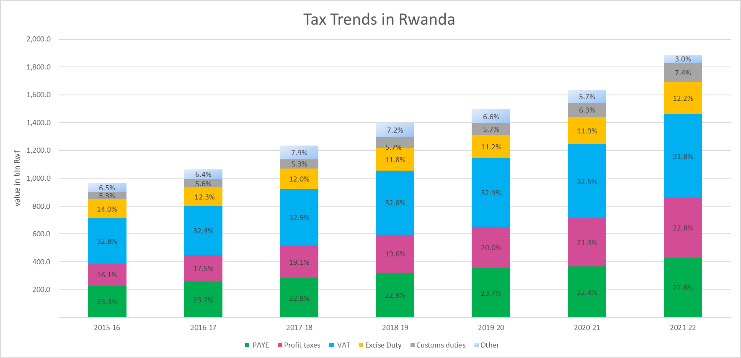
Current Tax Collection (Rwanda)

Slide 7
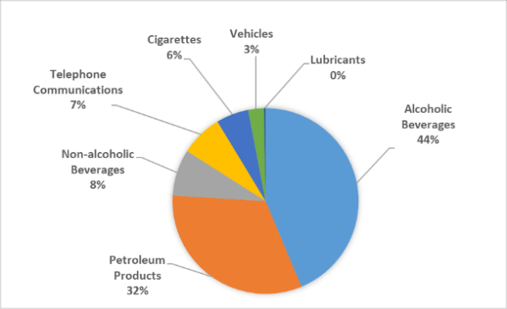
Excise contribution by products
Alcoholic product | Rate
Beer whole local material content, excluding water, is at least 70% by weight of its constituents | 30%
Other beers | 60%
Wine whose local raw material content, excluding water, is at least 70% by weight of its constituents | 30%
Other wines | 70%
Brandies, liquors, and whisky | 70%

Slide 8
Issues around the current regime
As stated above, all of Rwanda’s alcoholic excise taxes are ad-valorem (AV),
AV excises have the benefit of protecting revenues during inflation without legislated rate adjustments.
However, they provide less stable revenue, particularly on commodities whose market price fluctuates.
AV excises are also more vulnerable to under-invoicing especially for imported product;
AV excises discourage quality improvements by manufacturers.
AV excises may, therefore, not be as effective as specific excises at curbing the consumption of harmful products, and specific excises are levied based on units, volume, or weight, which can be easily observed and measured by tax collectors.
But does a specific taxation approach fit all circumstances?

Slide 9
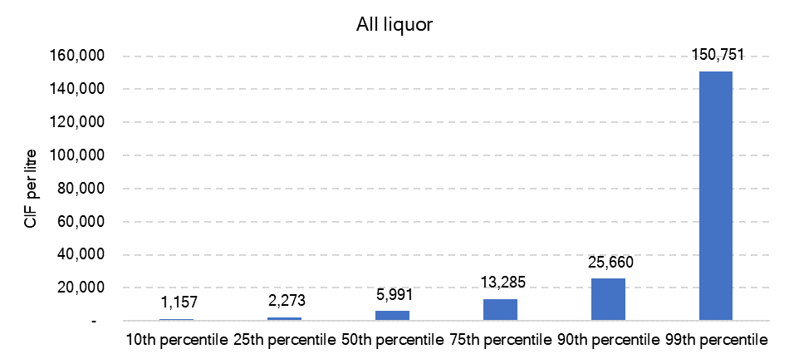
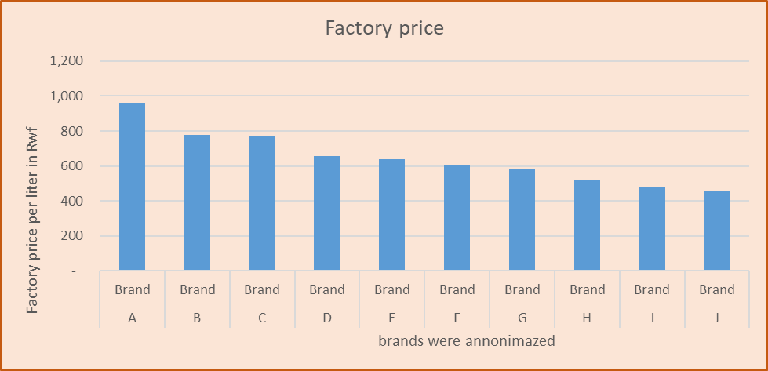
proposed solutions
Bellow figures illustrating variation in prices per brand for liquors and beer in Rwanda

Slide 10
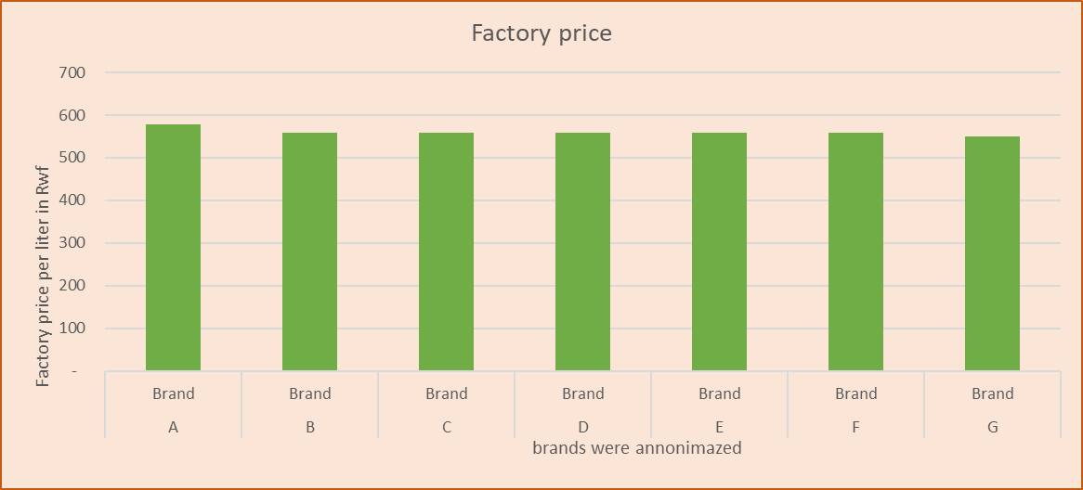
proposed solutions
The figure illustrating prices for soft drinks in Rwanda

Slide 11
Different policy approaches to choose from, with their pros. and cons
Ad valorem | Specific (volume-based) | Specific (content-based) | Hybrid ( ad-valorem + specific) more preferred option
Good for raising revenue from expensive products | Good for simple enforcement and regional harmonization | Good for targeting harmful consumption and giving firms a reformulation incentive | Good for raising revenue from both cheaper and expensive products
Does not need inflation adjustment | Needs inflation adjustment | Needs inflation adjustment | Do not need regular inflation adjustment
Gives a price advantage to cheaply produced alcohol/sugar | Discourages mass consumption of cheaper alcohol/sugar products | Gives price advantage to low alcohol/sugar products | The specific component Discourages mass consumption of cheaper alcohol/sugar products
Firms can evade by under-reporting price | Difficult for firms to evade | Firms can evade by under-reporting alcohol/sugar content | Evasion is less likely
Doesn’t link tax to consumption | Can incentivize reformulating drinks to have more harmful content per litre | Successful at reducing alcohol/sugar consumption in various contexts | It links tax to consumption
Better when there is high price variation in the market | Better when there is less price variation in the market | Better when revenue and health goals have equal weight | Balance price variation in the market and health goals
Require valuation of goods | Does not require a valuation of goods | Does not require a valuation of goods | Require valuation of goods
Cannot indicate smuggling | Indicate smuggling | Indicate smuggling | Indicate smuggling
Increase price difference between quality difference | Reduce price difference between quality difference | Reduce price difference between quality difference | Balance price difference between quality difference

Slide 12
Thank You!

