Slide 1
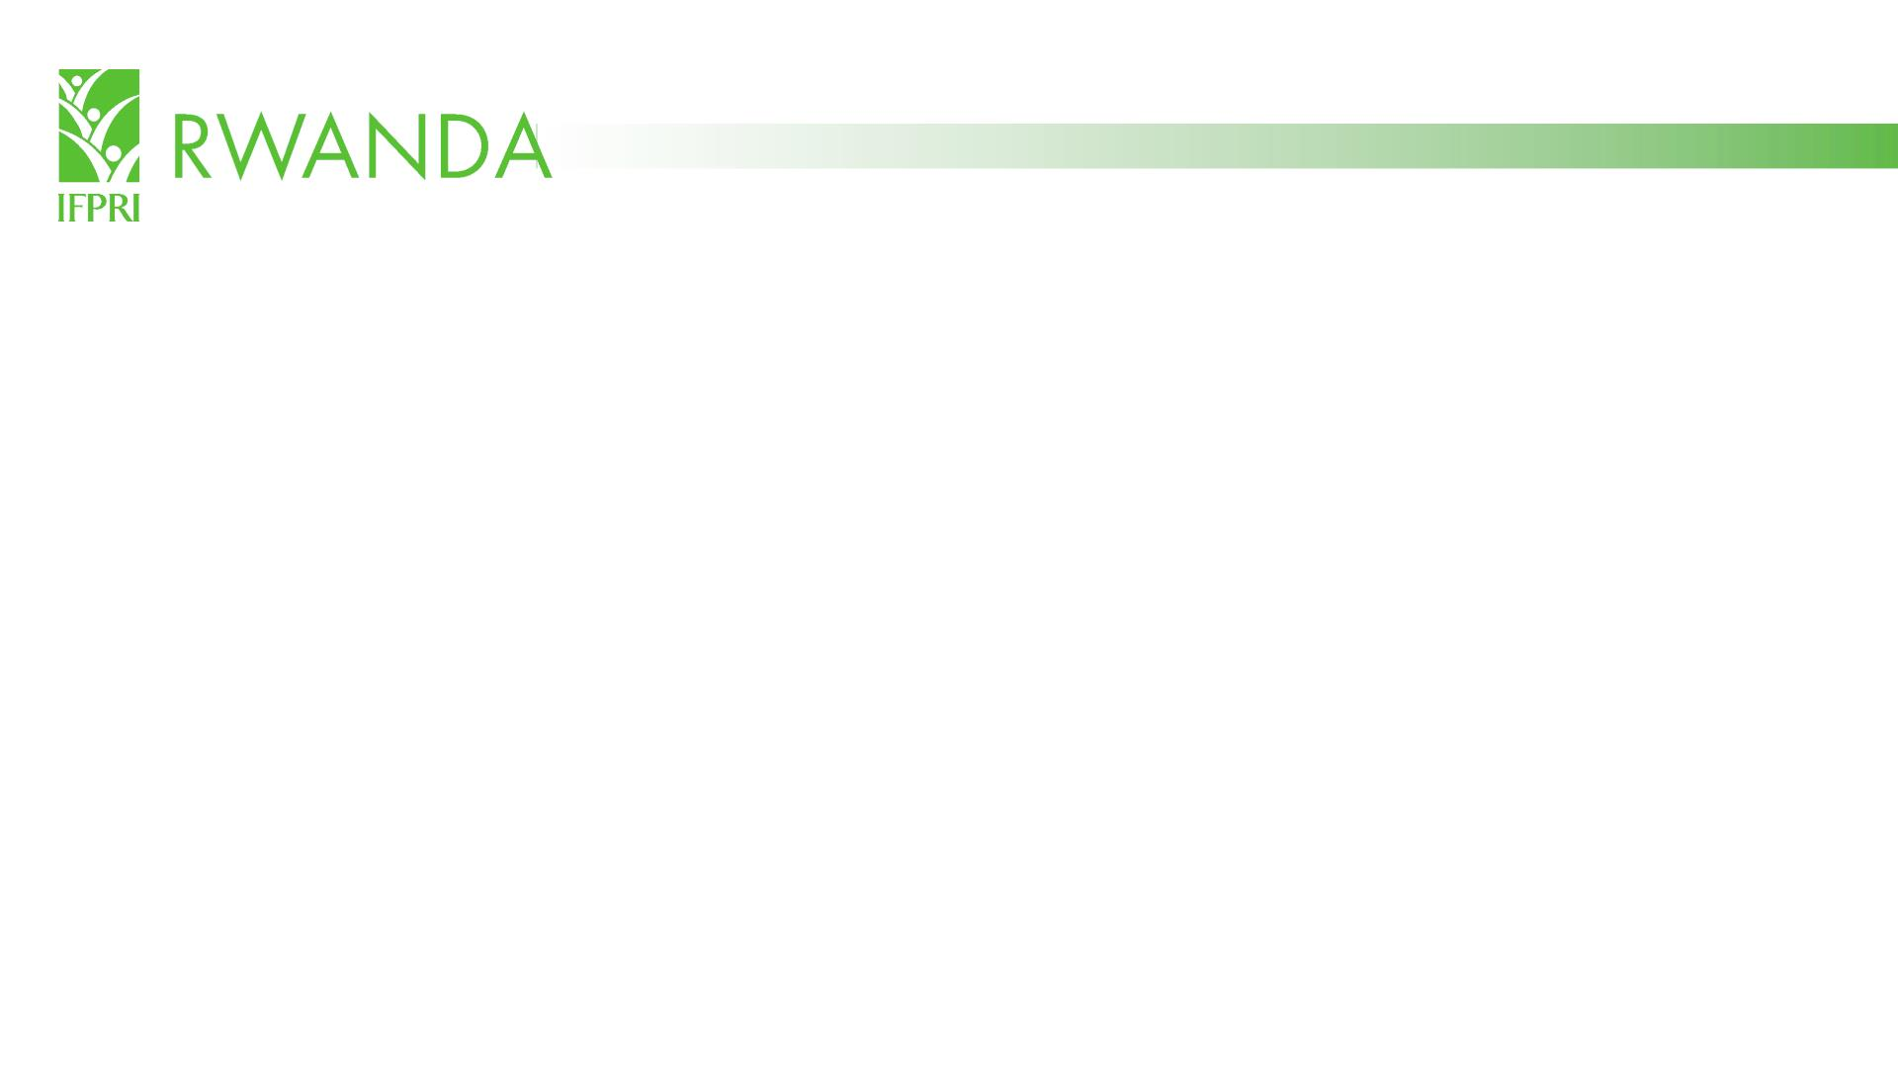
Public Investment Prioritization for Rwanda’s
Inclusive Agricultural Transformation:
Evidence from Economywide Modeling
Emerta Aragie, Xinshen Diao, David J. Spielman, James Thurlow, Serge Mugabo,
Gracie Rosenbach, and Gilberthe Benimana
International Food Policy Research Institute
May 27, 2022
Disclaimer: The analysis presented in this document is for discussion only and does not necessarily reflect the views of IFPRI or the Government of Rwanda.
Full working paper:

Slide 2

Motivation
1. How much does public spending on agricultural contribute to economic
growth, employment creation, poverty reduction, and diet quality
improvements under the current PSTA 4 allocations (2018-2024)?
2. What are the contributions of different types of investment to these
development outcomes?
3. Is there room to improve the allocation of public spending under PSTA 4 so the
same amount of spending can generate larger impacts on these outcomes?
4. If additional funds were made available to PSTA 4, where should these
additional funds be allocated to maximize returns to these outcomes?

Slide 3
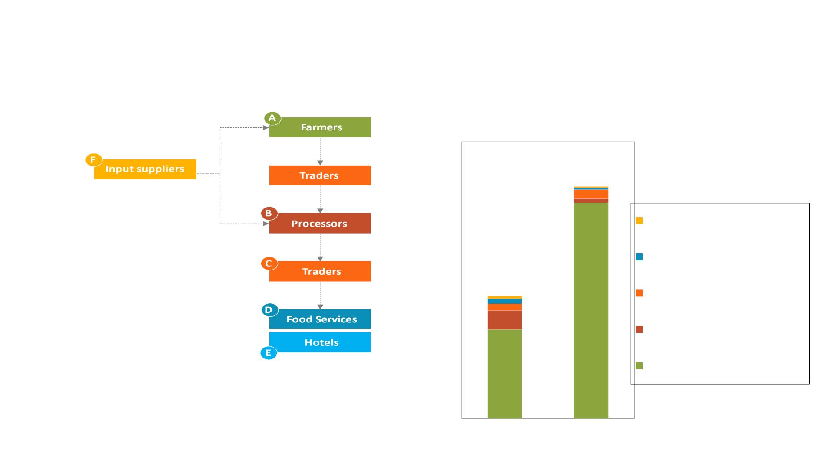
Context: Rwanda’s food system
Six components of the food system GDP
Food system’s share of national GDP
and employment in Rwanda (2019)
67%
Input supply (E)
Hotels & food services (D)
35%
Trade & transport (C)
62%
Agro-processing (B)
26%
Primary agriculture (A)
Food System GDP: Total value added generated by all
agricultural value chains
Food System Employment: Total number of workers
who are primarily employed in an agricultural value chain
GDP
Employment

Slide 4

Tools and methods: The Rwanda CGE model & 2017 SAM
Firm Surveys
IFPRI’s RIAPA-AIDA
National Accounts
(NISR)
Household Surveys (EICV5)
toolkit
Rural Investment and
Policy Analysis (RIAPA)
model
Social
Accounting
Matrix
Balance of
Payments (IMF)
Micro-
simulation
POV Poverty & Inequality
+
RIAPA
WIST
Women’s Inclusion
Agricultural Investment
Data Analysis (AIDA)
module
Government Financial
Statistics (MINECOFIN)
AIDA
DIET Dietary Quality
Investment
analysis
Public Agriculture Spending
(MINAGRI, MAFAP)
HDM Livestock Herd Dynamics
ASTI Agriculture Research
Project M&E & Sector Studies
Farm Surveys (EICV5, AHS, SAS)

Slide 5

Analysis
Part 1: Estimate returns to individual policies, investments & expenditures
o Which interventions in PSTA 4 are more cost-effective in promoting an inclusive
agricultural transformation?
o What are the synergies and trade-offs in targeting different outcomes in the
transformation process?
Part 2: Determine a more efficient allocation through marginal reallocation
(budget “rightsizing”)
o How could reallocating scarce public resources improve development outcomes?
Part 3: Determine the impact of a budget increase under a more efficient
allocation option
o What are the impacts on development outcomes given an increase in budget that is
allocated in a more efficient way?

Slide 6
Analytical procedure
§ Identify spending areas that relate directly to PSTA 4 priorities
§ Focus on key crops/crop groups and key investments types
§ Focus on synergies between expenditures and investments
o E.g., input subsidies ↔ irrigation and terracing
§ Measure marginal returns to different expenditure options
o The economic value of additional output created by each additional dollar spent
§ Assess the gains to four specific development outcomes
o Economic growth; employment creation; poverty reduction; diet quality improvement (see
Annex for details ►)
§ Simulate outcomes over a 15-year period (2018-2033)
o Costs and benefits are analyzed as cumulative outcomes over 15 years to capture both
short-term impacts of spending and long-term impacts of investments

Slide 7
Results are reported by “sector” and “investment” type for
the four development outcomes
Sectors
Investments
1. Maize
12. Other crops
13. Sugar
1. Small-scale irrigation
2. Marshland irrigation
3. Hillside irrigation
2. Rice
3. Irish potatoes
4. Beans
14. Livestock
15. Crop R&D
16. Livestock R&D
17. Electricity
18. Feeder roads
19. Education
4. Progressive terracing
5. Radical terracing
5. Soybean
6. Vegetables
7. Coffee & tea
8. Other cereals
9. Other RTBs
6. Coffee & tea
7. Agriculture + livestock R&D
8. Non-agricultural investments
Development outcomes: Economic growth, employment creation, poverty reduction,
and diet quality improvements

Slide 8
Results: Part 1

Slide 9
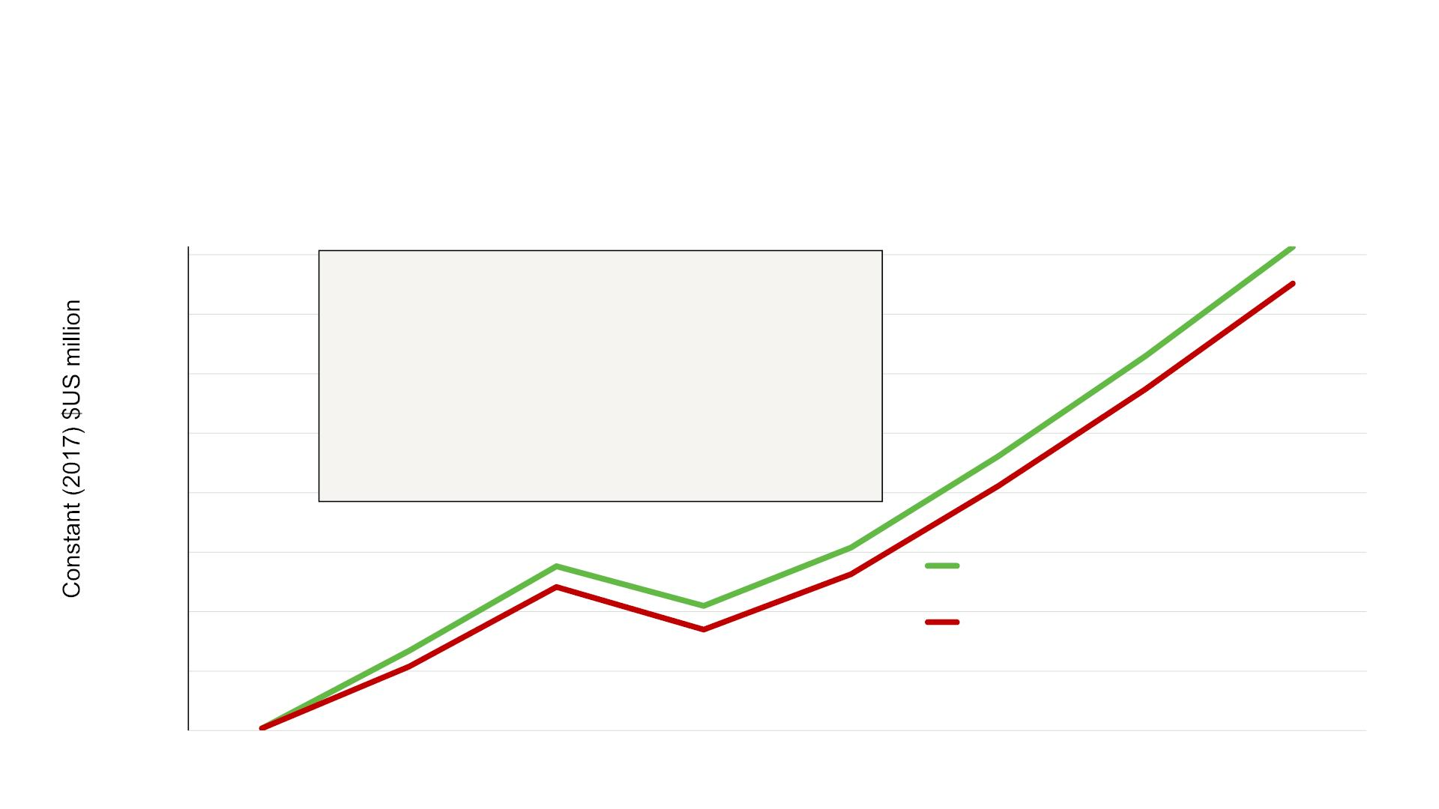
Public spending on agriculture contributes substantially
to GDP growth
GDP with and without $109 million in annual agricultural spending, 2018-24
(in constant (2017) US$ million)
12,450
Cumulative gains to GDP in 7 years:
$1.57b in total GDP
11,950
11,450
10,950
10,450
9,950
$1.17b from agriculture
$0.18b from off-farm food system
$0.22b from outside the food system
$2.05 GDP per dollar spent
With agricultural spending
9,450
Without agricultural spending
8,950
8,450
2017
2018
2019
2020
2021
2022
2023
2024

Slide 10
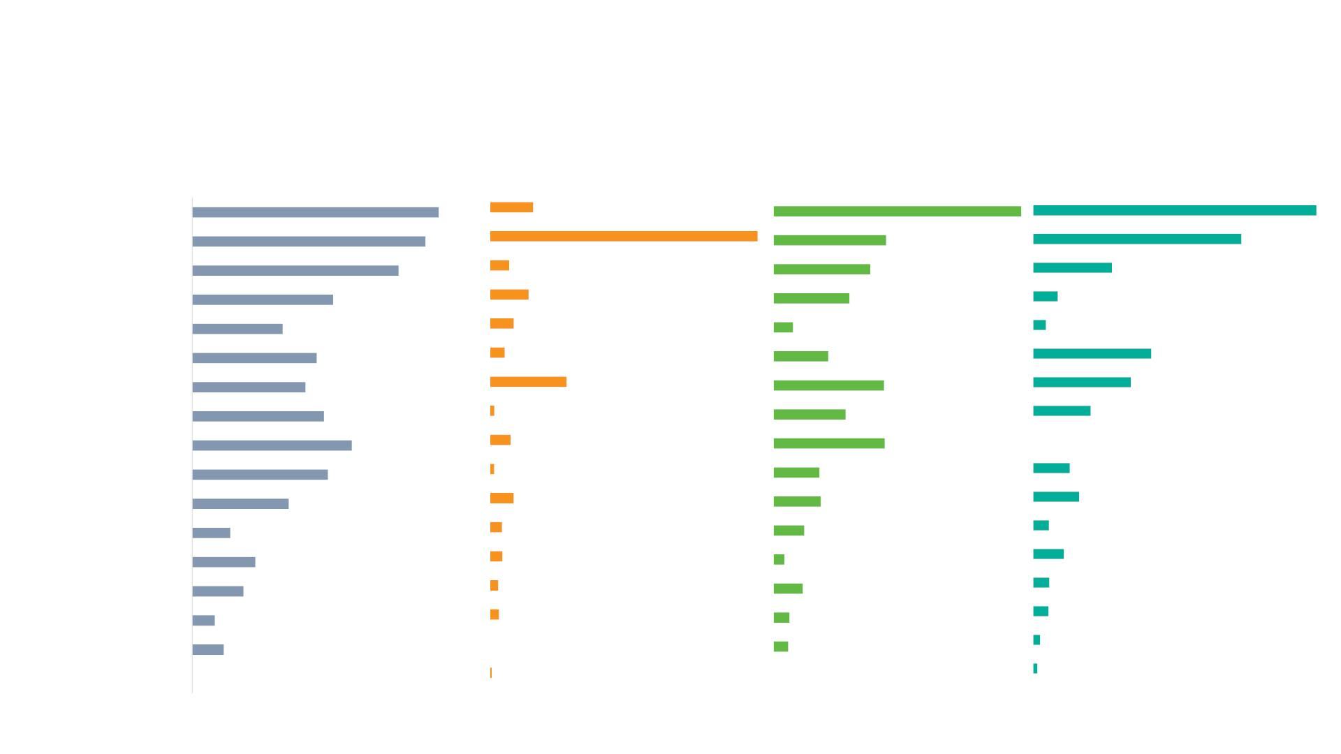
Normalized outcome scores for public expenditures, by
sector, based on development outcomes
GDP effect
Employment effect
Poverty effect
Diet quality effect
Vegetables
Livestock
1.00
0.95
0.84
0.16
1.00
1.00
1.00
0.45
0.73
Other RTBs
Maize
0.07
0.14
0.09
0.05
0.29
0.02
0.08
0.01
0.09
0.04
0.05
0.03
0.03
0.00
0.01
0.39
0.31
0.28
0.09
0.57
Other crops
Livestock R&D
Beans
0.37
0.08
0.04
0.51
0.46
0.53
0.65
0.55
0.22
0.42
0.45
0.34
Crops R&D
Irish potatoes
Electricity
0.29
0.20
0.45
0.00
0.19
0.13
Feeder roads
Coffee and tea
Education
Other cereals
Soybeans
Rice
0.39
0.15
0.19
0.16
0.12
0.06
0.26
0.04
0.11
0.21
0.12
0.06
0.09
0.07
0.05
0.13
0.06
0.02
Sugarcane 0.00
0.00
0.01

Slide 11
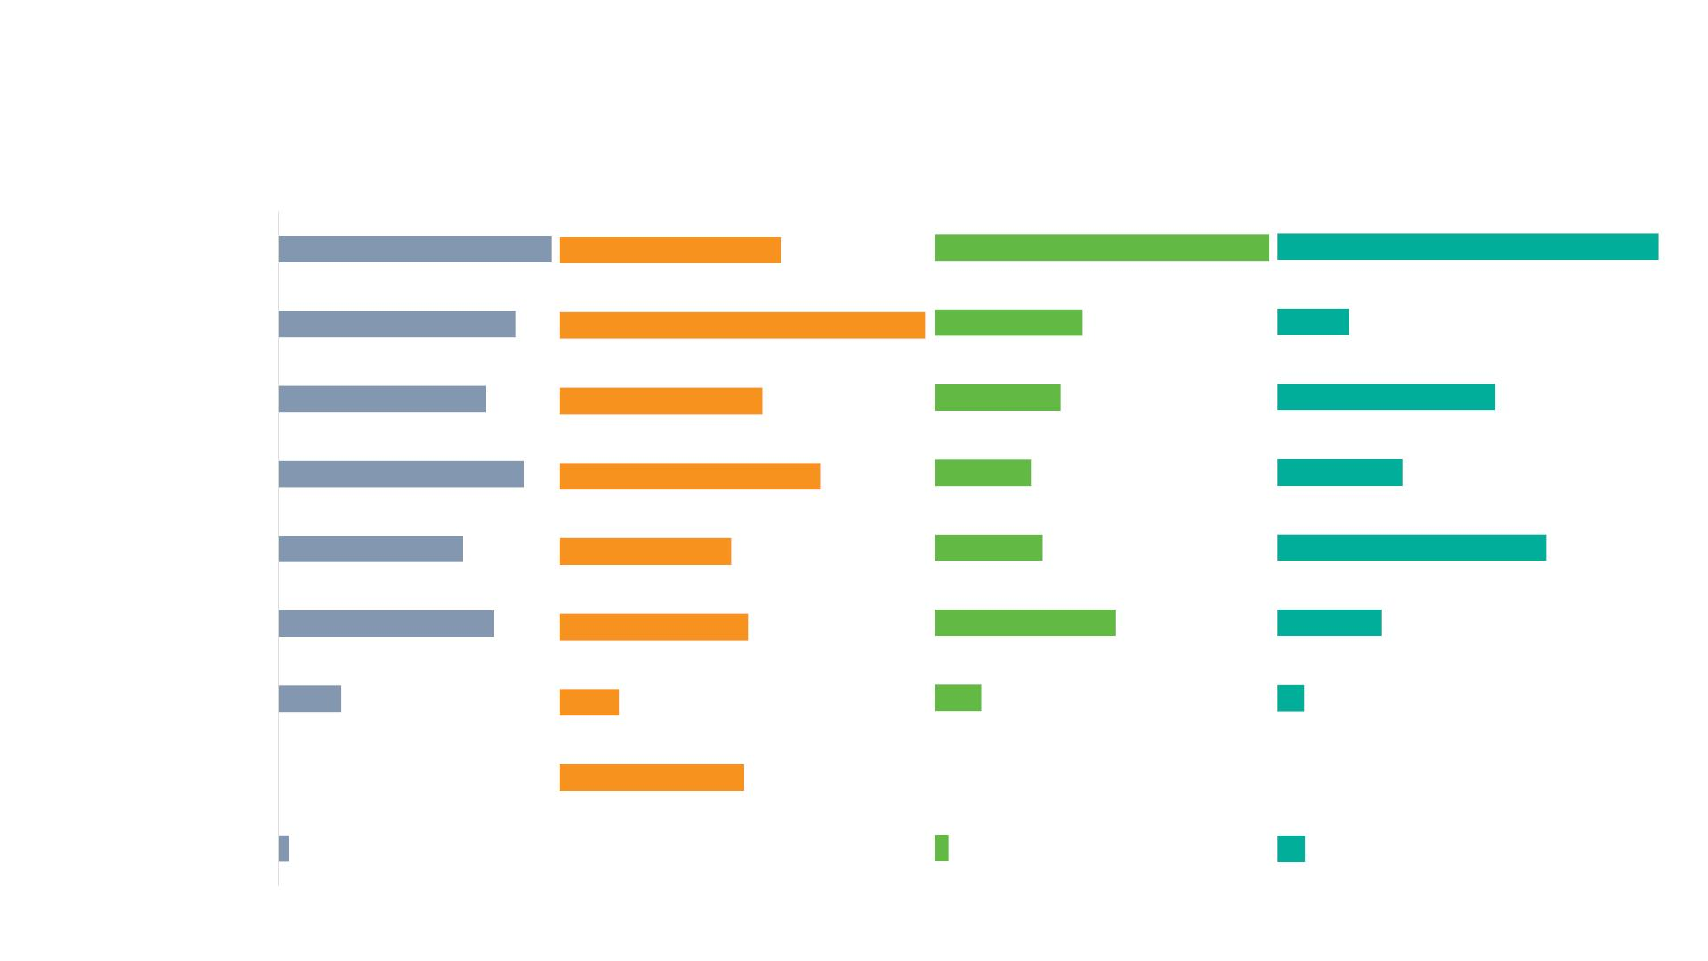
Normalized outcome scores, by investment type, based on
development outcomes
GDP effect
Employment effect
Poverty effect
Diet quality effect
Small-scale
irrigation
1.00
1.00
0.87
0.61
1.00
Radical terracing
Agricultural R&D
Nonagricultural
Livestock
1.00
0.44
0.38
0.19
0.76
0.56
0.57
0.90
0.71
0.29
0.33
0.67
0.47
0.32
0.70
Progressive
terracing
0.79
0.52
0.54
0.27
Marshland
irrigation
0.23
0.16
0.14
0.07
Coffee and tea
0.00
0.50
0.00
0.00
Hillside irrigation
0.04
0.00
0.04
0.07

Slide 12

Expenditure rankings based on total contribution to development
outcomes
Ranking, by sector
Ranking, by investment type
Vegetables
0.89
Small-scale irri
Radical terrace
Agri R&D
0.90
Coffee & tea
Potato
0.69
0.42
0.38
0.62
Crops R&D
Livestock
Livestock R&D
Other crops
Other rtbs
Other cereals
Beans
0.37
0.36
0.36
0.36
0.57
Non-agri
0.56
0.54
0.31
0.30
0.26
0.25
Livestock
Soybeans
Electricity
Maize
Progressive terrace
0.53
0.16
0.15
0.09
0.08
Marshland irri
Coffee & tea
Hillside irri
0.15
Feeder roads
Rice
0.13
Education
0.04
Sugar 0.00
* Composite scores are based on their contribution to achieving the four focal development outcomes. Rankings are calculated based on an equally
weighted average composite index for each of four development outcome indicators

Slide 13
Results: Part 2

Slide 14
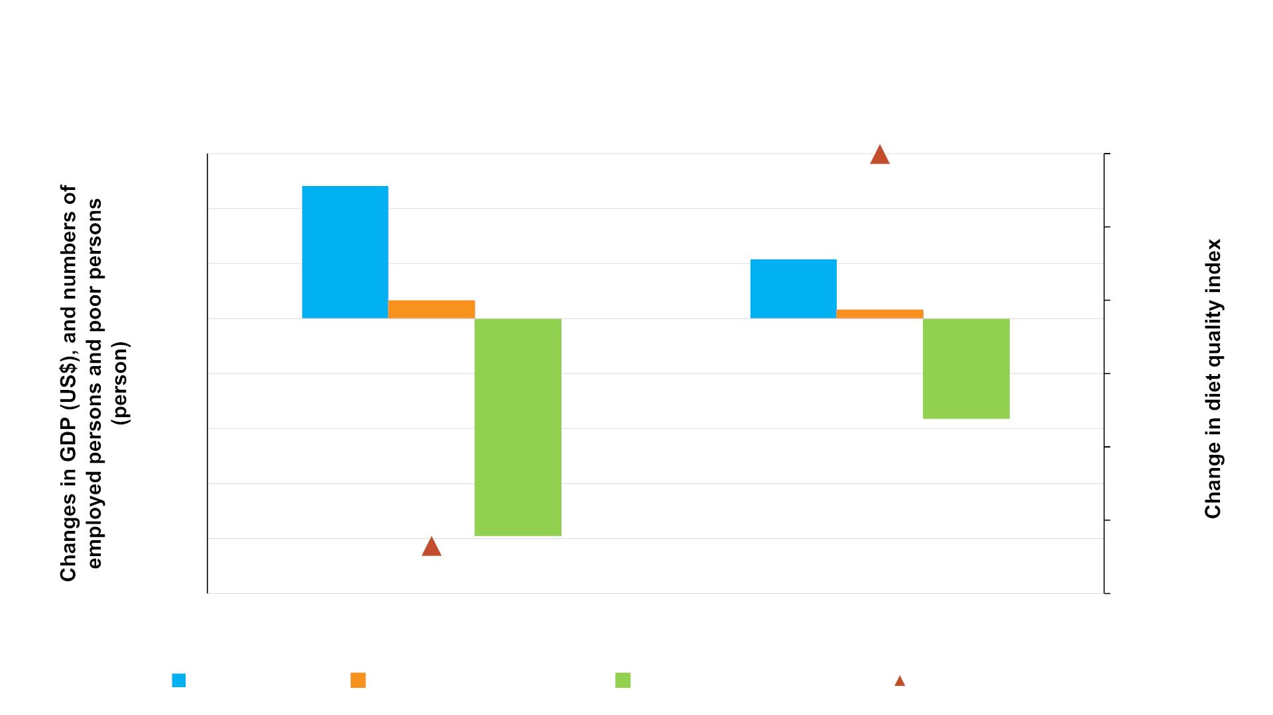
Gains from spending under new and current allocation, 2018-
2024 total, per dollar or per 1,000 dollar spent
6.0
4.0
4.82
-0.0003
0.0000
-0.1000
-0.2000
-0.3000
-0.4000
-0.5000
-0.6000
2.16
2.0
0.65
0.32
0.0
-2.0
-4.0
-6.0
-8.0
-10.0
-3.64
-0.5347
-7.90
New allocation
Current allocation
GDP (US$) Employed persons Number of the poor Diet quality index

Slide 15
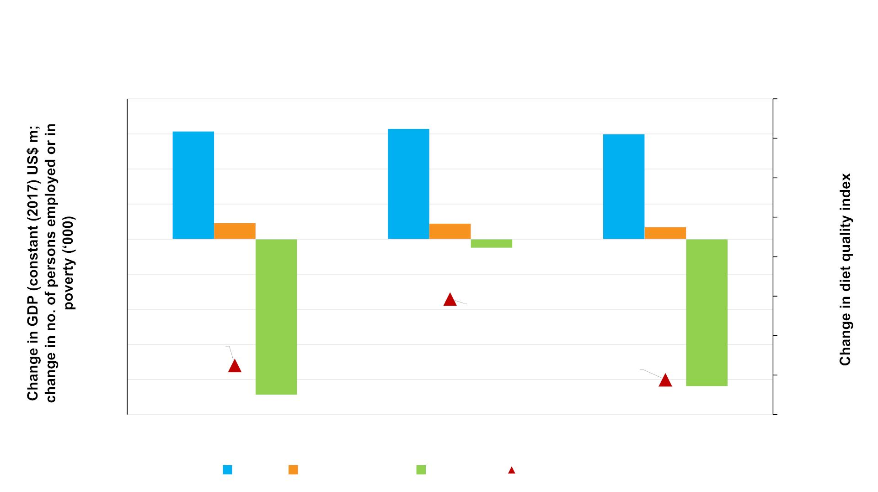
Gains from reallocating current agricultural spending at the
margin to improve effectiveness of PSTA 4, 2018-2024
200
150
100
50
0
154
157
149
-0.002
-0.004
-0.006
-0.008
-0.01
23
22
17
0
-12
-50
-100
-150
-200
-250
-0.0101
-0.012
-0.014
-0.016
-0.0135
-0.0142
-222
GDP or National
-210
Agiculture GDP or Rural
Food system GDP or Urban
GDP Employment Poverty Diet quality index

Slide 16
Results: Part 3

Slide 17
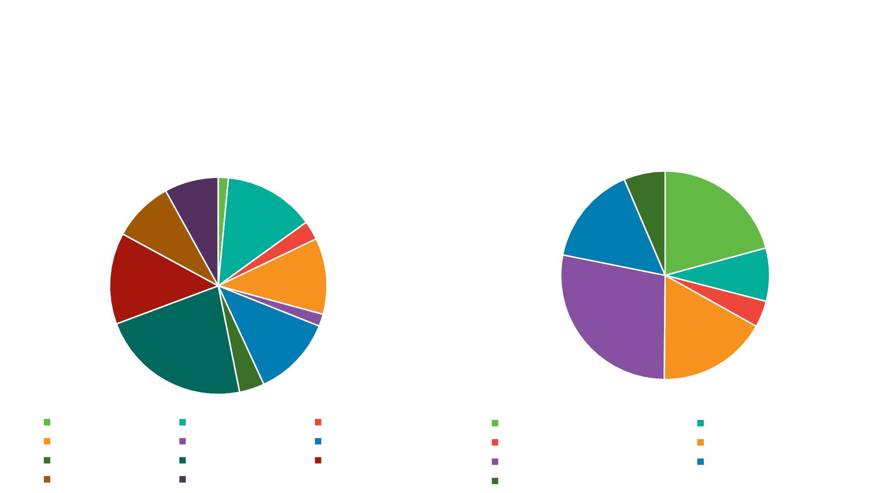
What if an additional 5% p.a. was efficiently allocated to
public spending on agriculture?
Allocation of an additional $170m in PSTA 4 funding to match with agricultural growth in
2018-2024 (% of total)
Additional spending allocation, by sector
Additional spending allocation, by investment type
6.0%
5.9%
1.1%
10.0%
6.7%
14.5%
19.5%
2.1%
10.1%
8.4%
7.7%
3.9%
1.3%
26.3%
8.9%
16.0%
16.6%
2.8%
Coffee and tea
Irish potatoes
Other cereals
Other crops
Maize
Rice
Vegetables
Beans
Agiculture R&D
Marshland irrigation
Small-scale irrigation
Radical terracing
Soybeans
Other RTBs
Livestock
Hillside irrigation
Progressive terracing
Nonagricultural

Slide 18
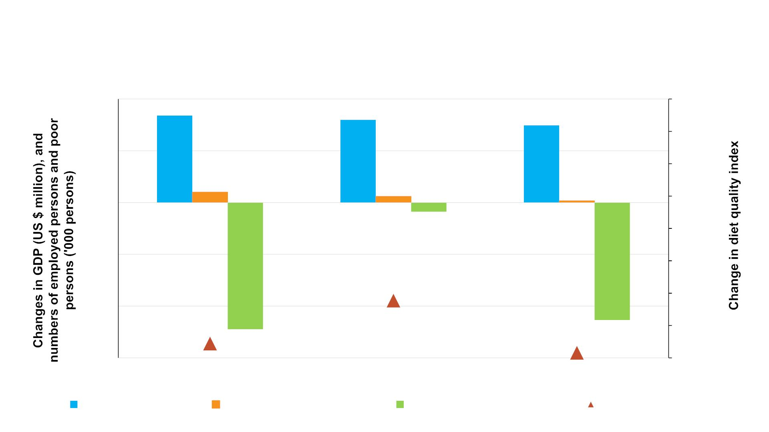
Gains from an additional $170m in public spending under a
new, more efficient allocation, 2018-2024 totals
1,000
840
799
-0.0100
746
-0.0200
-0.0300
-0.0400
-0.0500
-0.0600
-0.0700
-0.0800
-0.0900
500
102
60
17
0
-89
-500
-1,000
-1,500
-0.0723
-1,134
-0.0855
-1,223
-0.0884
National
Food System or Urban
Agricultural or Rural
GDP (US$ million) Employed persons ('000) Number of the poor ('000) Diet quality index

Slide 19
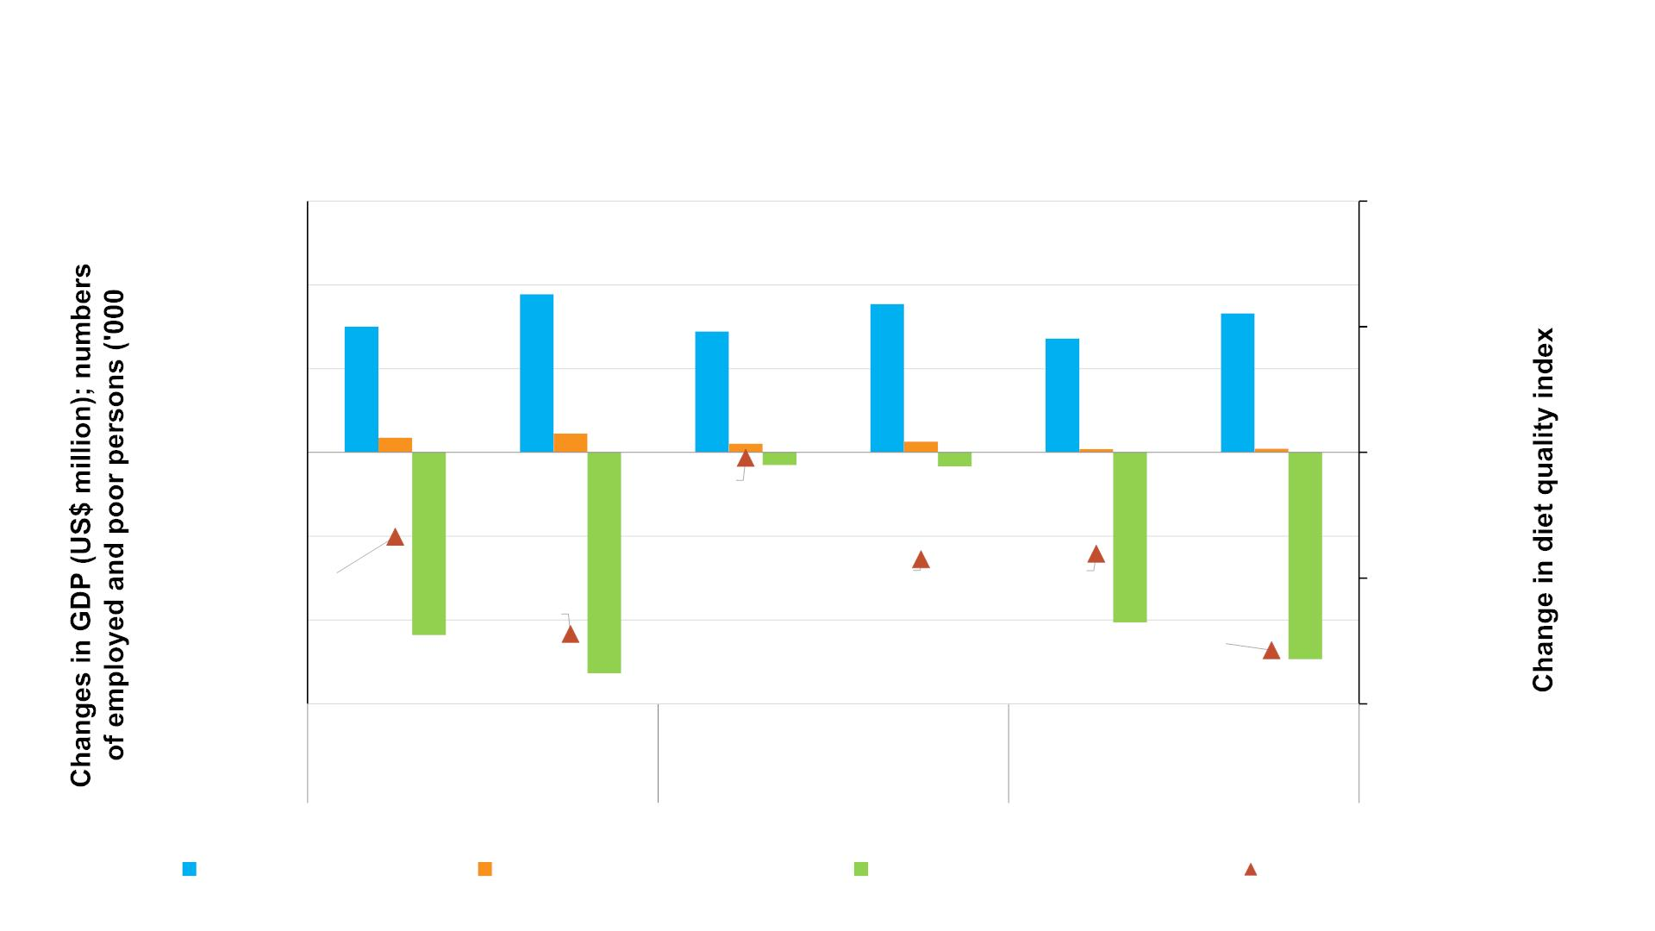
Gains from an additional in public spending @ $35m (+5%) and
$70m (+10%) in 2022-2024 under a new, more efficient allocation
600
400
200
0
0.0000
-0.0100
-0.0200
-0.0300
-0.0400
378
354
300
289
332
272
35
45
21
-0.0204
26
-33
8
9
-30
-200
-400
-600
-0.0267
-0.0285
-0.0281
-0.0344
-0.0357
-436
-406
-494
5% growth 10% growth 5% growth 10% growth 5% growth 10% growth
National Food System or Urban Agricultural or Rural
-527
GDP (US$ million)
Employed persons ('000)
Number of the poor ('000)
Diet quality index

Slide 20
Summary and conclusions (1)
§ Agricultural spending is, by and large, efficiently allocated in Rwanda: each
dollar spent is associated with $2.05 gains in GDP
§ Agricultural spending enables growth in employment opportunities outside of
agriculture and in rural non-farm activities, paving a way for economic
transformation
§ Agricultural expenditures are poverty-reducing, and diet quality enhancing,
especially among the rural households

Slide 21
Summary and conclusions (2)
§ No single expenditure option is the most effective in achieving all development
outcomes – economic growth, employment, poverty reduction, or diet quality
improvement
§ Expenditures and investments in high-value crops including vegetables, coffee
& tea, and Irish potato would help achieve broad development outcomes faster
§ Among investment types, small-scale irrigation ranks top in term of both cost-
effectiveness and contribution to development outcomes
§ Lower-cost approaches to costly investments such as hillside irrigation,
marshland development, and progressive terracing can improve the contribution
and impact of these investments

Slide 22
Summary and conclusions (3)
§ With a modest reallocation towards more efficient expenditures and
investments, total GDP in 2018-2024 would be $154 million higher
§ Additional gains can be achieved in employment, poverty reduction, and diet quality
§ Findings justify an increase in the budget allocated to MINAGRI which has been
stagnant (in constant prices) since PSTA 4 began in 2018
§ When additional public funds are allocated in favor of agricultural R&D, small-scale
irrigation, and terracing, returns to outcomes would be higher
§ Further improvements can be achieved with an increase in budget allocated to
agriculture in an efficient manner
§ Each additional $ spent generates $4.82 in GDP if allocated efficiently

Slide 23

Acknowledgements

