Slide 1

Green Financing for Sustainable Development and Resilience in Rwanda
Osten Chulu
Economic Advisor, UNDP Rwanda

Slide 2

Introduction & Context
Rwanda is highly vulnerable to climate change: projected +2.5 °C rise by 2050
70% of the workforce is in climate-sensitive sectors (agriculture, water, energy)
Estimated USD 11 billion required to meet NDC targets by 2030
Green finance is central to Rwanda’s Vision 2050 and NST 2 goals

Slide 3
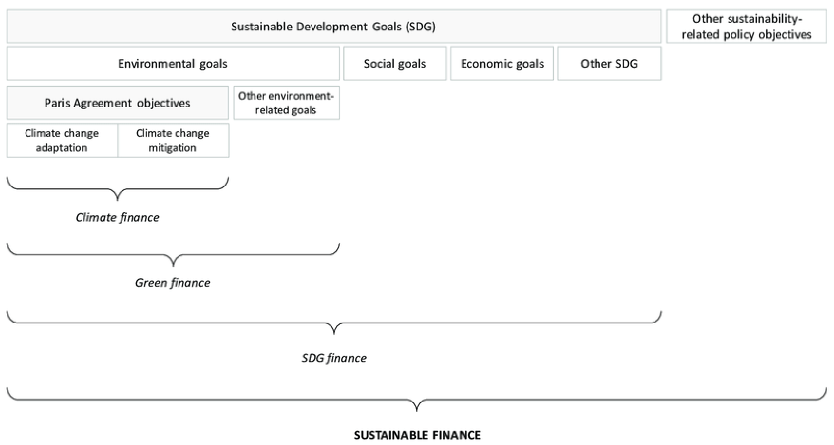
What is Green Finance?

Slide 4
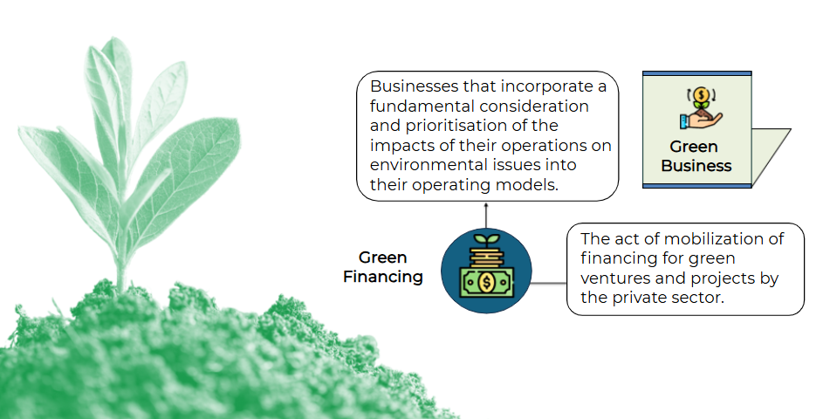
What is Green Finance?

Slide 5
Green Finance Definition
Use of financial products and services in green (or Eco-friendly) projects
  Loans
  Insurance
  Stocks
  Private equity
  Bonds
  Green Finance is more than climate finance, but includes land, forests, water, oceans, conservation, resilience etc.

Slide 6
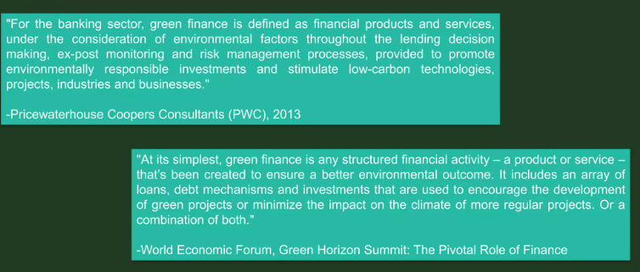
Green Finance

Slide 7
Green Finance
Green Finance
Financing public and private green investments in environmental goods and services and prevention of damage to the environment
Financing of public policies that encourage the implementation of environmental and environmental damage mitigation or adaptation projects and initiatives
Components of the financial systems that deal specifically with green investments: financial instruments for green investments and structured green funds

Slide 8
Where did Green Finance come from?
Investment in conservation evolved:
19th century: simple public sector financing
(taxes, fees, stamps and government spending)
20th century: mix of public & philanthropic finance
Last 25 years: growing involvement of the private sector
+ the development of new financial mechanisms
E.g. we can use tropical forest assets to generate revenues from operations in fields of sustainable timber, agriculture and ecotourism
Financial innovations: social policy bonds, crowdsourcing initiatives (online platforms to mobilize capital) – will transform raising capital

Slide 9
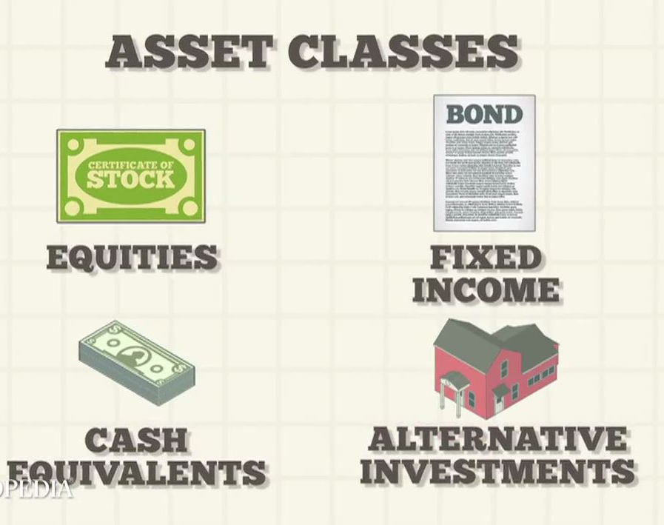
Green Finance: Asset Classes
Asset class - group of financial instruments:
with similar characteristics,
that behaves similarly in the marketplace,
and subject to the same laws/regulations
2 Asset classes / financial instruments
commonly used in green finance:
Equity (Stocks)
Debt Fixed Income)
+ risk management tool: Guarantees
Notes:
For the simplicity of the presentation, we will focus only on Main instruments used in Green Finance:
Equity, Debt and Guarantees
If you want to know it all, there are:
Financial assets: securities (stocks and bonds), derivative contracts, and currencies.
Real assets: real estate, equipment, commodities, and other physical assets.

Slide 10
Policy & Institutional Landscape
The Revised Green Growth and Climate Resilience is Rwanda’s anchor policy for low-carbon development (Shared Vision for Rwanda to be a developed, climate-resilient, and low-carbon economy by 2050.)
Rwanda Green Taxonomy defines eligible green investments
Sustainable Finance Roadmap guides ESG-aligned capital flows
Climate Finance Unit established in Ministry of Finance

Slide 11
Rwanda’s Experience in Green Financing (Some examples)
Rwanda Green Fund (FONERWA)
  Financed 40+ projects, mobilized over USD 200 million
  Focus areas: eco-tourism, reforestation, e-mobility, clean energy
  Created over 137,000 green jobs
  CO2 emissions reduced, ecosystems restored
Sustainability-Linked Bonds (SLBs)
  BRD issued East Africa’s 1st SLB (2023): USD 124 million
  KPIs: gender inclusion, ESG, green housing, MSME access
  Backed by IDA credit enhancement and oversubscribed
  Second SLB under development (USD 26 million)
Climate & Nature Finance Strategy (2024)
  Mobilizes capital for climate and biodiversity priorities
  Leverages carbon markets, biodiversity credits, green bonds
  Targets agroforestry, water systems, urban development
  Supports integrated, programmatic financing

Slide 12

Blended Finance & International Partnerships
Other Mechanisms
  IMF RSF: USD 48.5m for climate reforms
  Ireme Invest platform: greening Rwanda’s economy
  Partners: AFD, KfW, EIB, EU, IFC
  Blended finance used for energy, housing, biodiversity
  What is at stake?
  USD 2bn/year financing gap to 2030
  Local government capacity constraints
  Low institutional investor participation
  High climate project risk perception

Slide 13
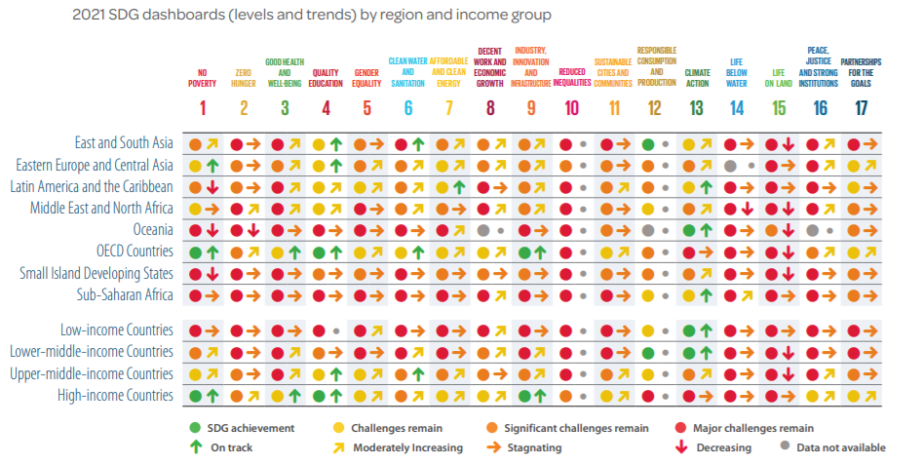
Potential Trade-offs between SDGs: “Prosperity SDGs vs Planet SDGs

Slide 14








1ˢᵗ Recommendation: Developing nature as an asset class
Strategic Challenge & Need Identified
Proposed Recommendations
Nature is being degraded at alarming rates across Rwanda.
Create a Rwanda Nature-First Pathway (RNFP) to advance towards recognizing nature as an asset class and establish an RNFP Task Force to leverage the country's nature-rich status.
There's a lack of enforcement strategies, particularly around deforestation.
Structural solutions are needed on a larger scale and at a faster pace.
Develop nature-related fund structures and investment vehicles, including drought funds and blended finance structures focused on nature preservation.
Expected Outcome
Increased conservation and reforestation of natural environments..
Explore possibilities for thematic bond issuances for nature conservation and develop high-integrity biodiversity credits and biodiversity-enhanced carbon credits markets.
Developed and deployed fund structures supporting nature-positive ventures.

Slide 15






2ⁿᵈ Recommendation: Building a green venture capital ecosystem (UNDPs Estimates)
Strategic Challenge & Need Identified
Proposed Recommendations
Companies struggle to secure finance to scale-up their businesses.
Create a US$100m Green Business (micro) Investment Fund by 2025, focused on providing microfinancing and support services to green start-ups and SMEs.
There's a pressing gap in available funding for small and microfinance needs.
There's a lack of patient forms of capital and impact capital to support early-stage growth.
Implement a comprehensive technical assistance program for green entrepreneurs, helping them scale up skills, capacity, and knowledge as they grow.
Expected Outcome
Increased deal flow into the venture capital stage of green business development.
Develop a structured capacity building and skills development programme for financial institutions to enhance their knowledge of sustainability and green finance practices.
At least 1,000 green entrepreneurs will have received training through the Fund by 2030.

Slide 16




3ʳᵈ Recommendation: Promoting and developing the local voluntary carbon market
Strategic Challenge & Need Identified
Proposed Recommendations
Carbon markets in Rwanda are currently weak and underdeveloped.
Establish a Rwanda Carbon Hub to support businesses benefiting from voluntary carbon projects, providing knowledge, capacity building, and assistance in transactional structuring and project engineering.
Carbon trading has occurred without proper arrangements backed by legislation and regulations.
There's a general lack of knowledge inhibiting growth in the sector.
Promote the creation of multi-stakeholder partnerships to support growth in the voluntary carbon market sector, ensuring coordination and knowledge transfer among market actors.
Expected Outcome
Increased support for project developers in developing high-quality, bankable projects.
Collaborate with local and multilateral institutions to provide legal clarity on definitions and regulations within the local carbon markets, supporting the growth of the sector.
Increased collaboration between providers of capital and local companies using voluntary carbon markets.

Slide 17

4ᵗʰ Recommendation: Financial and green capacity building
Strategic Challenge & Need Identified
Proposed Recommendations
There's a general lack of financial knowledge and structuring abilities hindering green business growth.
Implement a comprehensive capacity-building programme aimed at developing knowledge and execution capabilities in key green sectors, assisting both companies and financial institutions moving into the green space.
Limited understanding of green issues, definitions, practices, and opportunities exists.
There's an absence of a stable pipeline of bankable green projects or companies.
Develop supportive infrastructure to promote green enterprises, including a taxonomy and legal frameworks that define green business and investment, and create incentives for establishing and supporting green businesses.
Expected Outcome
Development and rollout of a capacity-building programme focused on financial understanding and execution capabilities.
Establish mechanisms facilitating increased collaboration between local actors in the green space to identify and develop more young businesses that can support Rwanda's NDCs and green priorities.
Rollout of a taxonomy defining green businesses and associated activities.

Slide 18


5ᵗʰ Recommendation: Promoting the insurance markets to increase risk appetites and expand access to finance for green businesses
Strategic Challenge & Need Identified
Proposed Recommendations
Smallholder farmers struggle to access credit from formal financial institutions.
Conduct a comprehensive market assessment to scope out relevant insurance products based on market feedback, including detailed price discovery and cost-benefit analysis of product cost versus price advantage.
Specialized insurance products for green sectors remain underdeveloped and poorly distributed.
Climate-related risks are increasing, impacting the viability of innovative green businesses.
Build insurers' ability to expand their range of products to include critical green sectors such as renewable energy and agriculture, promoting their use to reduce enterprise-level risk and overall financing costs.
Expected Outcome
Deeper penetration of insurance products supporting green enterprises in Rwanda.
Implement capacity building and knowledge sharing initiatives, particularly for harder-to-reach market segments like smallholder farmers, to raise awareness of available insurance and credit tools.
Development of detailed recommendations on the role of third-party funding structures.

Slide 19
Thank You
EPRN
Tel: 0788357648
info@eprnrwanda.org
www.eprnrwanda.org

