Slide 1

IFPRI’s Rwanda Strategy and
Support Program--Overview
International Food Policy Research Institute
Kigali, Rwanda
June 8, 2023
Contact: James Warner (PhD), Team Leader
j.warner@cgiar.org

Slide 2
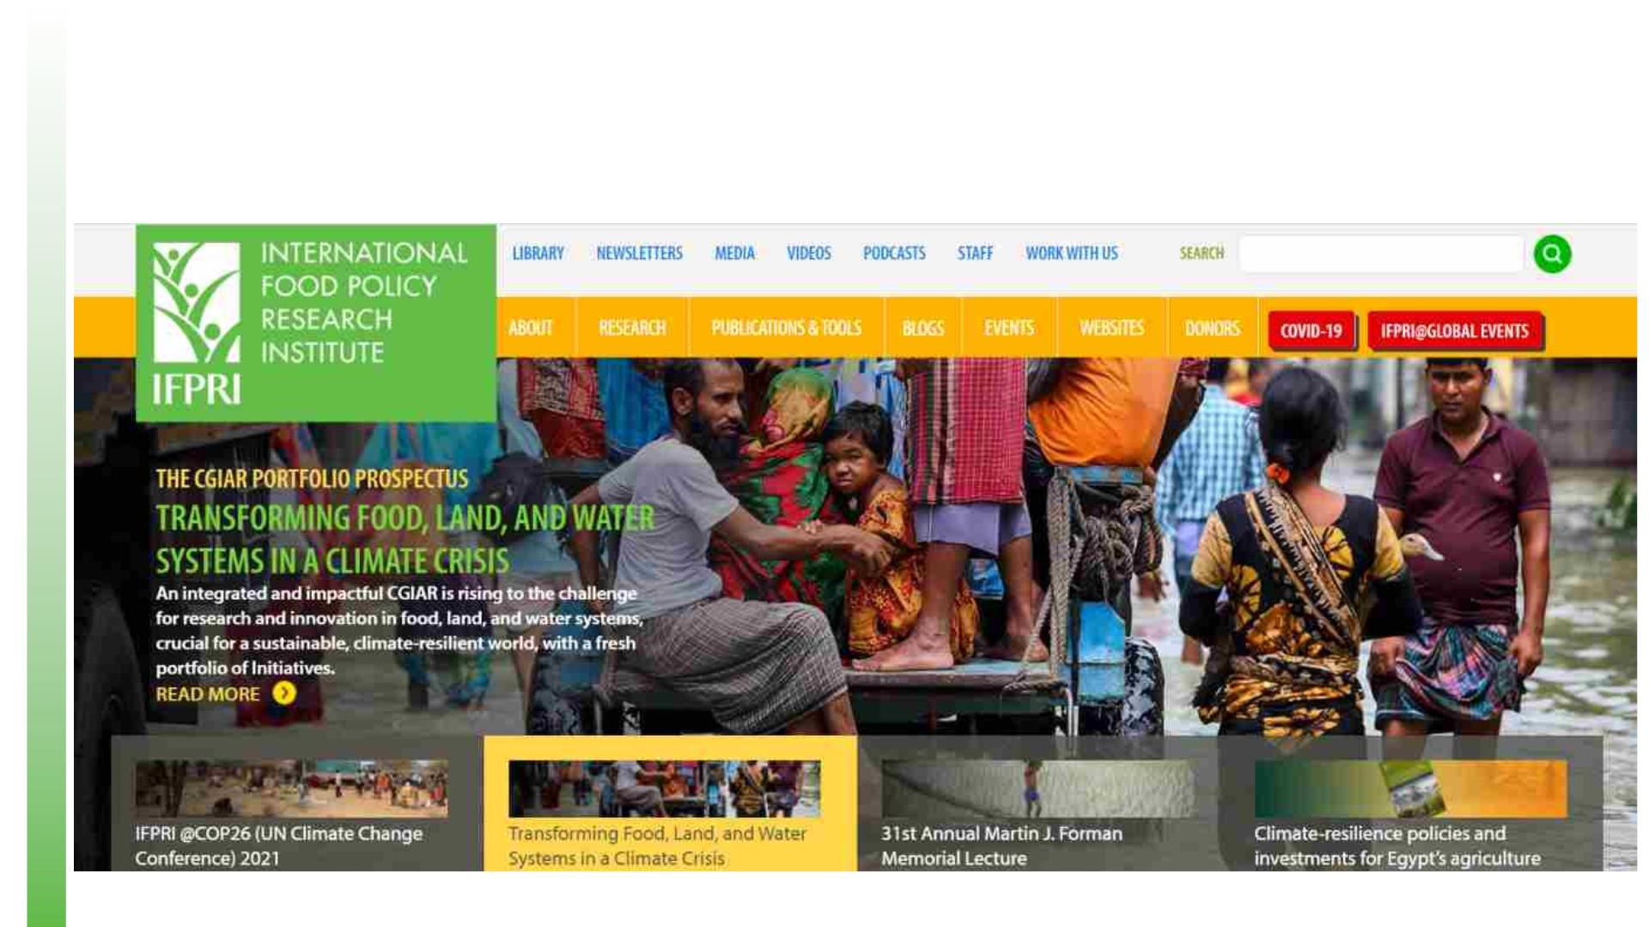
International Food Policy Research Institute (ifpri.org)

Slide 3

The International Food Policy Research Institute
IFPRI’s vision is a world free of hunger and malnutrition. Its mission is to
provide research-based policy solutions that sustainably reduce poverty and
end hunger and malnutrition.
IFPRI provides research-based policy solutions to sustainably reduce
poverty and end hunger and malnutrition in developing countries.
Established in 1975, IFPRI currently has more than 500 employees working
in over 50 countries. It is a research center of CGIAR, a worldwide
partnership engaged in agricultural research for development.

Slide 4
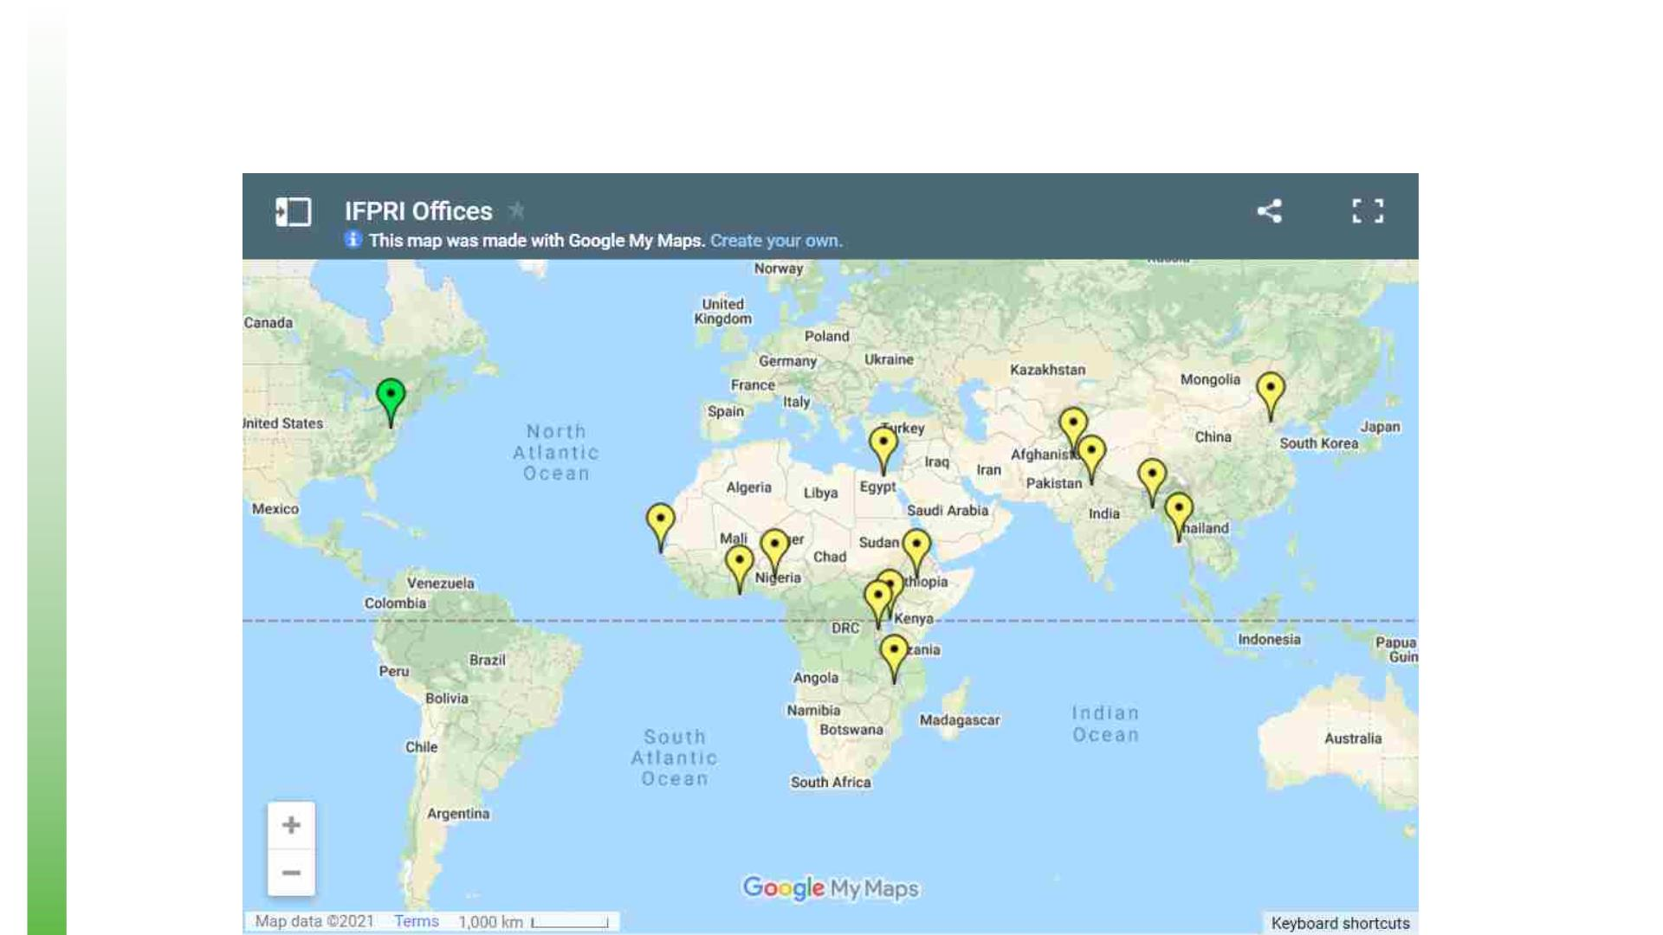
International Food Policy Research Institute

Slide 5
The Rwanda Strategy Support Program
Partnership | Capacity development | Policy analysis
The Rwanda Strategy Support Program (Rwanda SSP) is an
initiative aligned with the Government of Rwanda's vision for
accelerating agricultural transformation and rural development
throughout the country.
• Collaborative policy analysis
• Capacity development and knowledge sharing

Slide 6
The Rwanda Strategy Support Program
Partnership | Capacity development | Policy analysis
§ Collaborative policy analysis focused on prioritizing agricultural
transformation, increasing agricultural productivity, improving nutrition,
strengthening food systems and the rural nonfarm economy, and fostering
broad-based economic growth and development in Rwanda
§ Capacity development and knowledge sharing to undertake timely and
relevant policy analysis, communicate actionable findings to policymakers and
their development partners, and build linkages for knowledge sharing across
research, government, civil society, and other stakeholders

Slide 7
IFPRI Rwanda– Provide Technical Analysis for PSTA5 inputs
and identify research gaps
1. How can MINAGRI best allocate their budget to reach their targets?
2. How can we sustainably intensify and modernize agriculture?
3. How can the agriculture sector best contribute to reaching nutrition goals?
4. How can we strengthen the entire agri-food system (value chains, exports,
etc.)?
5. How can we ensure agriculture policies are inclusive of everyone (e.g.
women, youth, all agri-food system actors along the value chain)?

Slide 8
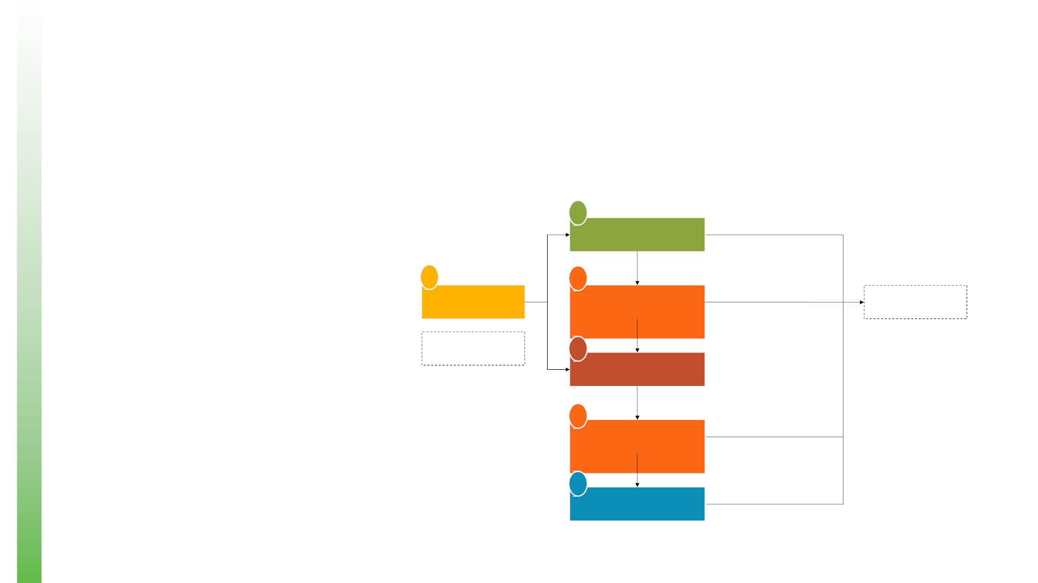
Emerging issue in Agricultural Policy—“Systems” Thinking
Agrifood system (AFS). For many, Components of an agrifood system
it is a complex network of actors,
connected by their differing roles in
A
supplying, consuming, and
Primary agriculture
governing agrifood products and
jobs.
Consumption of own-
produced goods
E
C
Can we define an agrifood system
that is measurable with actual
country data and statistics in order
to assess the performance and
evolution of the system?
Input supply
Imports
Trade and transport
Agro-processing
Trade and transport
Food services
Demand
Purchase of primary
agricultural goods
B
C
D
Purchase of processed
agrifood goods
Purchase of ready-made
foods outside of home

Slide 9

Thank you

