Slide 1
FINANCING FOR SUSTAINABLE DEVELOPMENT
AND RESILIENCE
Osten Chulu
UNDP Rwanda

Slide 2
KEY CONCEPTS

Slide 3
WHAT IS FINANCING?
Financing is the process of providing or raising funds for business activities, making purchases, or investing.
Put simply, financing allows companies or individuals to purchase products or invest out of their immediate reach
It is a way to leverage the time value of money (TVM) - to put future expected money flows to use for projects started today.
TVM is the concept that a sum of money is worth more now than the same sum will be at a future date due to its earnings potential in the interim. (Investopedia)
Financing is usually associated with debt instruments…..

Slide 4
WHAT IS DEVELOPMENT?
An event constituting a new stage in a changing situation – e.g. converting land to a new purpose by constructing a building or making use of its resources.
Development is the act of getting better by expanding, enlarging, or refining.
Development is not purely an economic phenomenon but rather a multi-dimensional process involving the reorganisation and reorientation of entire economic and social system.
It can be at individual, household, community, regional, country level all the way up to the global level.

Slide 5
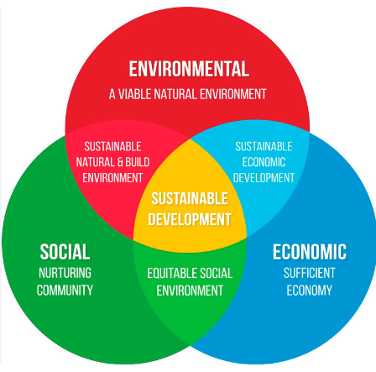
WHAT IS SUSTAINABLE DEVELOPMENT?

Slide 6
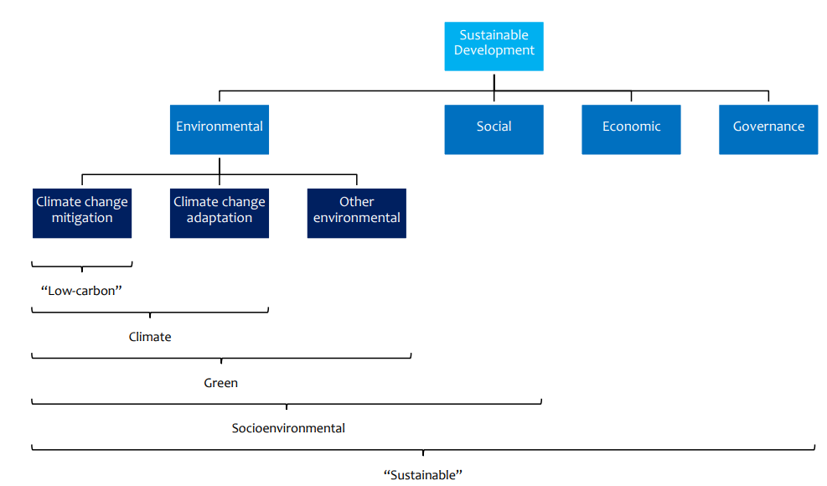
BROAD TERMS IN SUSTAINABLE FINANCE

Slide 7
FINANCING FOR DEVELOPMENT

Slide 8


IMPORTANCE OF SUSTAINABLE DEVELOPMENT FINANCING
Sustainable development aims to meet present needs without compromising future generations.
Critical for addressing poverty, inequality, and environmental challenges.
Environmental issues: Quality and functioning of the natural environment and natural systems including biodiversity loss; greenhouse gas emissions, renewable energy, energy efficiency, natural resource depletion or pollution; waste management; ozone depletion; changes in land use; ocean acidification and changes to the nitrogen and phosphorus cycles.
Social issues: Rights, well-being and interests of people and communities including human rights, labour standards, health and safety, relations with local communities, activities in conflict zones, health and access to medicine, consumer protection; and controversial weapons.
Governance issues: Management of investee entities. Issues include board structure,size, diversity, skills and independence; executive pay; shareholder rights; stakeholder interaction; Disclosure of information; business ethics; bribery and corruption; internal controls and risk; management.

Slide 10
Resource Mobilization Strategies
Diversification of revenue sources – some examples
Taxes and non-tax sources
Diaspora Bonds
Green Bonds
Sovereign wealth funds
Sustainability-Linked Bonds or Sustainability Bonds
Concessional loans
TBs and SWBs
Enhancing Domestic Resource Mobilization (DRM) RRA?
Leveraging PPPs
Innovative Financing Mechanisms – Carbon?

Slide 11

ENHANCING DRM
Improving tax collection efficiency.
Capacity in RRA and other institutions
Prudent use of collected resources
Efficiency gains
Combating tax evasion and illicit financial flows (IFF).
Big ticket item in Africa $50 bn annually – double the ODA coming to Africa
Promoting financial inclusion and literacy.
Rwanda is at 96%
Banked individuals remains at 22%

Slide 12
Post COVID-19 Financing Requirements to meet SDGs | 2020 – 2030 Annual Average Percent of GDP
Health and education | 5.9
Infrastructure | 15.4
Total Additional Spending | 21.3
Financing Sources: | 21.3
Domestic revenue growth of 7 per year from 2023 | 4.2
Spending Reallocation 1% of GDP towards SDG projects and boosting spending efficiency | 1.5
Leveraging Private Finance – Money and Capital markets, Foreign Private Capital (FDI), PPP, Blended Finance, Diaspora, Climate | 1.9
ODA – UN recommended target of 0.7% of GNI, $200 billion | 13.7

Slide 13
INTERNATIONAL COOPERATION AND AID EFFECTIVENESS
Aligning aid with national priorities.
1
NST 2 Priorities and Vision 2050. SDGs and 2063?
Enhancing the effectiveness of international aid.
2
DPAF in Rwanda is an annual assessment tool
Promoting South-South cooperation.
3
Learning is becoming a major activity for institutions such as RCI

Slide 14
LEVERAGING REGIONAL INTEGRATION
Benefits of regional economic integration.
It's just cheaper…
It’s just more efficient
Role of frameworks like the African Continental Free Trade Area (AfCFTA).
Let’s make it work – it’s not a short-term thing
Enforce all the protocols.. Or risk what??
Success stories of regional integration in Africa. ECOWAS, EAC

Slide 15
WHAT ABOUT RESILIENCE?
Building resilience to shocks!
Importance of economic diversification.
Strengthening social safety nets and infrastructure.
Enhancing disaster preparedness and response.
Developing robust financial systems.
Promoting access to credit and insurance.
Creating contingency and sovereign wealth funds.

Slide 16
INVESTING IN HUMAN CAPITAL
Importance of education and healthcare.
Skills development and vocational training.
Examples of successful human capital investments.

Slide 17
REGIONAL AND INTERNATIONAL COOPERATION
Benefits of regional and international cooperation.
Collaborative efforts in research and technology transfer.
Role of international organizations and frameworks.

Slide 18


