Slide 1

Economic Recovery Plan: mitigating impact of COVID-19 in Rwanda
August - 2020

Slide 2
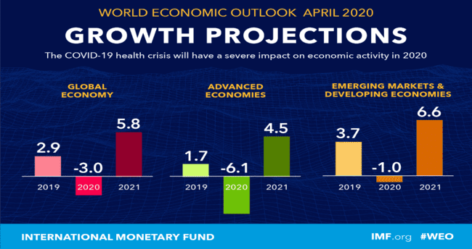
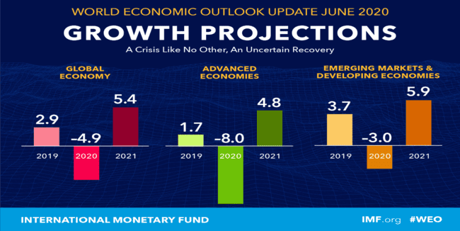
  Global Economic Context
The CoVID-19 pandemic has had a more negative impact on economies than expected, most countries are painting a gloomier outlook than previously envisaged; global growth for 2020 is now projected to be – 4.9% compared to -3% in April, 2020.
Sub Sahara Africa is now projected to contract by some 3.2% (from -1.6% projected in April, 2020) reflecting weaker external environment, falling revenues and limited fiscal space. IMF advices that regional policy should remain focused on safeguarding public health, supporting people and businesses hardest hit by the crisis, and facilitating the recovery.
- EAC: 5.7% (2019), 1% (2020), 3.7% (2021)→ GDP 2020 per country: KE: -0.3%, UG: 1.8%, TZ:1.9%, BU: -5.5%)
- Rwanda: 9.4% (2019), 2% (2020), 6.3% (2021)

Slide 3
Rwanda - Revision in Macroeconomic Projections
 | 2019 | 2020 before COVID-19 | 2020 After COVID-19
GDP | 9.4% | 8% | 2%
Tax revenues loss compared to pre-COVID-19 targets (in FY) | - 78 billion Frw (loss in FY2019/20) |  | - 261 billion Frw (loss projected in FY 20/21)
Fiscal Deficit (% of GDP in FY) | -9.0% | -5.6% | -9.1%
Exports | 3.8% | 10.8% | -27.2%
Imports | 9.7% | 7.4% | -16.4%
Remittances | -0.5% | 12% | -74.6%
FDI | 9.9% | 21.4% | -67.3%
Travel | 9.6% | 10% | -81.6%

Slide 4
  Economic developments after the lockdown – Composite Index of Economic Activities (CIEA) and Turnovers
Since the end of the lockdown, we observed a pick-up in economic activity, although still timid. But the evolution of the index in coming weeks should tell us more about the economic recovery.
% change yoy | Apr-20 | May-20 | Jun-20 | Q2 2020 | Jan.-June 2020
Real CIEA | -19.1% | -15.1% | 8.4% | -8.8% | -1.8%
Total turnovers | -32.5% | -17.7% | 6.5% | -14.9% | -7.0%
Industry | -21.3% | 2.3% | 30.7% | 2.9% | 9.6%
Services | -36.6% | -24.0% | -1.2% | -20.8% | -12.5%

Slide 5
Strategic priorities for recovery
Health spending to contain the epidemic
Ensure a Coordinated Multi-sectoral response of Government to quick start and boost economic activity
Scale up Social Protection
Economic Recovery Plan - priorities
Support for Businesses and Protect jobs.
Ensure Food Self-Sufficiency

Slide 6
ERP – key Interventions
Fiscal and monetary policies
To provide timely stimulus to the economy: increase in spending, fast-tracking and bringing forward projects in infrastructure, fast-tracking procurement process, paying on time, liquidity support to the financial sector etc.
To provide relief and support to most impacted sectors/population: tax measures, change in policies,
Agriculture
To increase agriculture production: more inputs and seeds, on time distribution, more cultivated areas etc.
Support to agricultural export products: secure and subsidize air freight, secure new markets/demand
Social protection
To providing support (food, cash transfer, health, public works etc.) to affected households/casual workers by increasing the number of beneficiaries of classical Social Protection instruments already in place
Private Sector support
Tax relief to protect jobs
Injection of liquidity
Economic recovery Fund to support hard hit businesses etc.
Technology & Innovation
Government to use existing investment at full potential;
Increased investment in digital infrastructure
Reinventing the workplace to stop the spread of the virus as well as enhance overall employee productivity with technology.
Driving the adoption of ICT for all businesses and citizens.

Slide 7
ERP – key Interventions
Infrastructure
Critical productive sector that catalyzes broader economic growth and provide jobs:
Construction and rehabilitation of feeder roads to connect production use areas such as farms, mining concessions, processing plants.
Construction and rehabilitation of paved major roads;
Water and sanitation projects including water treatment plants, water production, and extension of water network;
Accelerate Affordable Housing program to build thousands of housing units to create jobs and demand for the local producers of construction materials;
Accelerate the school construction program across the countries;
Facilitate quick start of new private investment.
Mining
Sector is known to have positive impacts in stimulating job creation, especially in the rural areas which in turn spurs economic growth and hence contributes to Government revenues:
Boost production: to allow some mining companies to resume operations with enhanced Healthy and safety measures of employees and extension of formal authorization for expired promising mining and trading licenses for a short period while expediting their licenses application files;
Jobs Creation and Investment attraction: reorganizing small scale mining operators, consolidating many of them into collective investment groups and expedites licensing their new collective companies;
Mineral hub focusing on processing and trading: facilitate outsourcing of minerals to boost value addition and export. The regional mineral importation will supply the local market for either export or processing in Rwanda. This will also add value to jobs creation.
Access to affordable locally made mining equipment in a bid to professionalize small scale mining: RMB will establish a mechanism bringing together the mining companies and local equipment manufacturers.

Slide 8
THANK YOU

