Slide 1

Economic Recovery Fund (Phase I and II)
EPRN Policy Dialogue
July 23, 2021

Slide 2
The Economic Recovery Fund (ERF)
Introduction
To provide a framework for the government’s response to the pandemic, an Economic Recovery Plan (ERP) was established in April 2020. The ERP includes measures to strengthen social protection and assist firms affected by the pandemic, along with the adoption of fiscal policies to support growth.
As part of the ERP, the Government of Rwanda established an Economic Recovery Fund (ERF) to support economic activity and businesses most significantly affected by COVID-19 so that they can survive, resume operations and safeguard employment, thereby cushioning the economic effects of the pandemic.
The Economic Recovery Fund prioritizes sectors including tourism and hospitality, trade, manufacturing, transport, agriculture, education, health, real estate, information and telecommunication, and micro businesses.
The Government of Rwanda planned to extend the Economic Recovery Fund under the project “The Access to Finance for Recovery and Resilience (AFIRR)”. This important project will provide significant resources to help further capitalize the Economic Recovery Fund, promoting investment in priority growth sectors, supporting jobs and reinforcing Rwanda’s financial system’s crisis preparedness.

Slide 3
  The Economic Recovery Fund
  Main objective: to support businesses in the sectors hit hardest by the pandemic so they can survive, resume work/production and safeguard employment.
  Fund Amount: more than USD 350 million mobilized.
  Source of funds: USD 100 million GoR seed fund, World bank (IDA) USD 150 million , Asian Infrastructure Investment Bank (AIIB) USD 100 million, USAID USD 3 million.
  Purpose of the Economic Recovery Fund: to support affected businesses by the COVID-19 crisis through:
    Loan restructuring for the tourism sector (hotels);
    Working capital for large companies;
    Working capital + loan guarantee for SMEs and Micro-businesses.
  Operational guidelines and directives to guide its implementation were issued by MINECOFIN, BNR (fund manager for loans deployed through commercial banks and MFIs) and BDF (fund manager for loans deployed through SACCOs).
  .
Notes:
Monetary and fiscal measures so far in place don’t support Micro or informal activities while they are facing trade-off between food and business survival thus reducing their income. Those individuals or households close to the poverty line and there is a need to protect their jobs and stimulate consumption at household level.

Slide 4
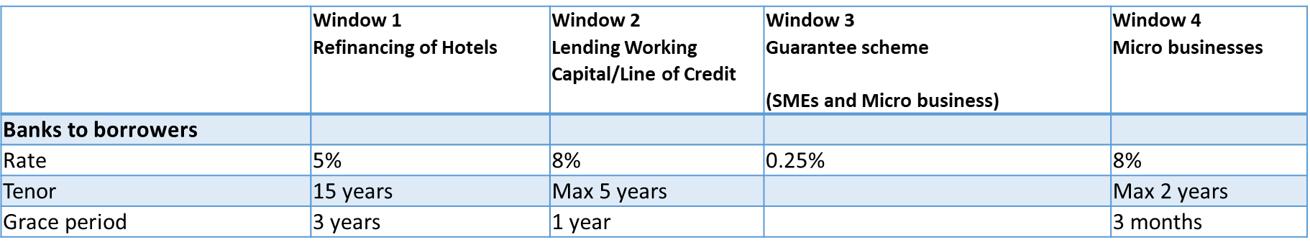
  The Economic Recovery Fund (Phase 1, July 2020 – June 2021: Frw 100 billion)
  Loan terms:
  Governance structure:
ERF High level steering committee that provides policy level guidance to the technical committee on the implementation and monitoring of the Fund.
ERF Technical committee that assesses the performance of the fund and recommends measures to the High level steering committee to improve the effectiveness and efficiency of the Fund.
Notes:
Monetary and fiscal measures so far in place don’t support Micro or informal activities while they are facing trade-off between food and business survival thus reducing their income. Those individuals or households close to the poverty line and there is a need to protect their jobs and stimulate consumption at household level.

Slide 5
ERF Phase 1 - Implementation Status
ERF1 Hotels refinancing support: FRW 50 billion
Eligible and approved hotels: 149 hotels for FRW 42.884 billion
  139 hotels have already received the loan-refinancing.
  Total disbursed amount to banks: FRW 42.719 billion or 96.6% of approved funds.
II. Working Capital: FRW 51 billion working capital to large, medium, small and micro businesses;
Large and SMEs: banks have submitted to BNR 205 applications (amounting to FRW 15.071 billion) of which 142 applications approved for 10.415 million and 113 applications worth FRW 9.737 billion have been disbursed;
Microbusinesses: 229 SACCOs have approved 2,972 applications worth Frw 2,79 billion representing 76.9% of total applications and Frw 2.29 billion disbursed;
Guarantee scheme: BDF approved 85 applications for guarantee worth Frw 609,770,505.
Notes:
The combined impact of external pressure from a deterioration of the global economy and the effects of restrictions measures to contain the spread of the virus indicate that economic activities will slowdown in 2020.

Slide 6
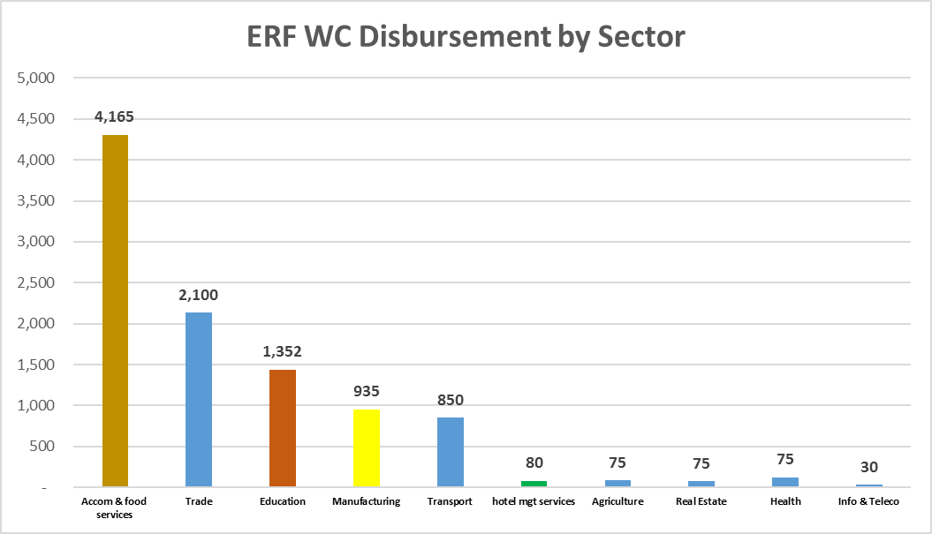
ERF Phase 1 - Implementation Status (Working Capital)

Slide 7
ERF Phase 1 - Implementation Status (Microbusinesses)
MICRO BUSINESSES: ERF SACCO REFINANCING STATUS PER DISTRICT
Districts | Number of saccos in the District | Number of Saccos applied | Number of beneficiaries Applied | Amount requested | Number of sacco approved | Number of beneficiaries Approved | Amount Approved
TOTAL KIGALI CITY | 35 | 10 | 111 | 110,470,000 | 10 | 85 | 80,970,000
KICUKIRO | 10 | 3 | 28 | 27,500,000 | 3 | 23 | 19,000,000
GASABO | 15 | 6 | 73 | 72,970,000 | 6 | 54 | 53,970,000
NYARUGENGE | 10 | 1 | 10 | 10,000,000 | 1 | 8 | 8000000
SOUTHERN PROVINCE | 101 | 69 | 1114 | 1,052,327,900 | 65 | 813 | 739,911,400
GISAGARA | 13 | 5 | 52 | 52,000,000 | 3 | 14 | 7,000,000
HUYE | 14 | 4 | 43 | 40,800,000 | 4 | 17 | 15,050,000
NYAMAGABE | 17 | 13 | 261 | 250,050,000 | 13 | 186 | 177,409,500
MUHANGA | 12 | 12 | 277 | 251,800,000 | 12 | 241 | 196,540,000
RUHANGO | 9 | 7 | 79 | 75,700,000 | 6 | 57 | 58,800,000
NYARUGURU | 14 | 14 | 206 | 199,100,000 | 14 | 156 | 152,650,000
KAMONYI | 12 | 8 | 148 | 139,261,400 | 7 | 115 | 108,105,400
NYANZA | 10 | 6 | 48 | 43,616,500 | 6 | 27 | 24,356,500

Slide 8
ERF Phase 1 - Implementation Status (Microbusinesses)
MICRO BUSINESSES: ERF SACCO REFINANCING STATUS PER DISTRICT
Districts | Number of saccos in the District | Number of Saccos applied | Number of beneficiaries Applied | Amount requested | Number of sacco approved | Number of beneficiaries Approved | Amount Approved
WESTERN PROVINCE | 97 | 68 | 1,465 | 1,418,786,000 | 66 | 1,118 | 1,057,215,500
RUBAVU | 12 | 7 | 206 | 212,000,000 | 5 | 123 | 129,000,000
NYAMASHEKE | 15 | 15 | 287 | 277,300,000 | 15 | 209 | 189,378,000
NYABIHU | 12 | 8 | 221 | 213,260,000 | 8 | 179 | 174,530,000
RUTSIRO | 13 | 8 | 286 | 274,500,000 | 8 | 187 | 173,959,500
NGORORERO | 13 | 7 | 131 | 122,200,000 | 7 | 101 | 94,300,000
RUSIZI | 19 | 15 | 251 | 241,790,000 | 15 | 249 | 230,790,000
KARONGI | 13 | 8 | 83 | 77,736,000 | 8 | 70 | 65,258,000
NORTHERN PROVINCE | 89 | 55 | 849 | 709,188,000 | 52 | 562 | 519,133,000
GICUMBI | 21 | 18 | 188 | 171,860,000 | 18 | 162 | 147,255,000
GAKENKE | 19 | 14 | 196 | 172,928,000 | 14 | 136 | 123,428,000
BURERA | 17 | 6 | 75 | 65,950,000 | 3 | 6 | 5,500,000
RULINDO | 17 | 6 | 71 | 68,250,000 | 6 | 57 | 50,550,000
MUSANZE | 15 | 11 | 319 | 230,200,000 | 11 | 201 | 192,400,000
EASTERN PROVINCE | 95 | 38 | 662 | 655,924,600 | 36 | 394 | 391,027,050
KAYONZA | 12 | 7 | 115 | 115,250,000 | 7 | 100 | 99,250,000
RWAMAGANA | 14 | 3 | 38 | 37,000,000 | 3 | 20 | 23,000,000
BUGESERA | 15 | 3 | 44 | 43,500,000 | 3 | 13 | 13,000,000
NYAGATARE | 14 | 10 | 251 | 247,495,500 | 8 | 95 | 91,917,000
KIREHE | 12 | 7 | 162 | 160,679,100 | 7 | 116 | 115,079,100
GATSIBO | 14 | 4 | 20 | 20000000 | 4 | 19 | 18500000
NGOMA | 14 | 4 | 32 | 32,000,000 | 4 | 31 | 30,280,950
TOTAL | 417 | 240 | 4,201 | 3,946,696,500 | 229 | 2,972 | 2,788,256,950

Slide 9
ERF Phase 2 - Allocation
ERF2 to be launched in August 2021: more than USD 250 million
  Investments for recovery: USD 150 million → focus on Manufacturing sector and related value chains
  working capital: USD 10 million (criteria: sector based)
  Microbusinesses: USD 8 million
  Risk sharing: USD 30 million
  Refinancing: USD 37.5 million
  Institutional and firm’s capacity strengthening
Fund Managers:
BDF (guarantee to SMEs and large companies and investment and working capital to microbusinesses): on lending to SACCOs – SACCOs to Clients (interest rate:8%)
BRD (investment and working capital to SMEs and large companies): direct lending and on lending to commercial banks – Commercial banks to clients (interest rate 8%)
(More information after the launch of the ERF Phase 2)

Slide 10
THANK YOU

