Slide 1

 | Rwanda Governance Board Urwego rw’Igihugu rw’Imiyoborere Office Rwandais de la Gouvernance
Citizen participation and Inclusive Economic Growth
Dr. Félicien USENGUMUKIZA
Head/ Research and Monitoring, RGB
EPRN/IPAR, HIGH LEVEL POLICY DIALOGUE
Lemigo Hotel, 26th May 2017

Slide 2
Why Inclusive economic growth matters?
Growth is inclusive when it creates economic opportunities along with ensuring equal access to them.
Apart from addressing the issue of inequality, the inclusive growth may also make the poverty reduction efforts more effective by explicitly creating productive economic opportunities for the poor and vulnerable sections of the society.

Slide 3
Why Inclusive economic growth matters? (Cont’d)
Inclusive growth is both an outcome and a process
Societies based on equality tend to perform better in development. For instance, countries with more equal income distribution are likely to achieve higher rates of poverty reduction than very unequal countries.
Inclusive growth ensures that everyone can participate in the growth process, both in terms of decision-making for organizing the growth progression as well as in participating in the growth itself.
Inclusive growth implies participation and benefit-sharing.
Participation without benefit sharing will make growth unjust

Slide 4
Qualities of Government for Economic Growth and Democratic participation
Economic liberalism
Private ownership, investment, equity
Political pluralism
Democracy, participation, decentralization
Social development
Human rights, law, judiciary, press, social protection
Administrative accountability
More transparency, less corruption
aimed at economy, efficiency, effectiveness

Slide 5
Summary of the Rwanda Governance Score Card 2016
1 | Rule of Law |  |  |  |  |  |  |  |  |  |  |  |  |  |  |  |  |  |  |  |  |  |  |  |  |  |  |  |  |  |  |  |  |  |  |  |  |  |  | 79.68
 | Performance of the Judiciary |  | 75.02 |  |  |  | Performance of the Prosecution |  |  |  |  | 91.80 |  |  |  | Access to justice |  |  |  | 76.48 |  |  | Performance of The Legislature |  |  |  |  |  |  |  |  | 72.27 |  |  | The use of ICT in Justice Service |  |  |  | 82.85
2 | Political rights and Civil Liberties |  |  |  |  |  |  |  |  |  |  |  |  |  |  |  |  |  |  |  |  |  |  |  |  |  |  |  |  |  |  |  |  |  |  |  |  |  |  | 81.83
 | Democratic Rights and Freedoms | 83.10 |  | Vibrancy of Non-State actors in policy formulation |  |  |  |  | 67.33 |  | Rights to Media Freedom |  |  |  | 85.85 |  |  | Political parties Registration and operations |  | 74.93 |  |  | Access to Public Information |  |  |  | 78.21 |  |  | Respect for human rights |  |  |  | 85.60 |  |  | Core international human rights conventions |  | 97.78
3 | Participation and Inclusiveness |  |  |  |  |  |  |  |  |  |  |  |  |  |  |  |  |  |  |  |  |  |  |  |  |  |  |  |  |  |  |  |  |  |  |  |  |  |  | 76.48
 | Citizen participation |  |  | 61.93 |  |  | Decentralization |  |  |  |  |  | 77.20 |  |  |  | Civil society participation |  |  |  | 72.45 |  |  | Gender equality in leadership |  |  |  |  |  |  |  |  | 83.72 |  |  | Power sharing |  |  | 87.10
4 | Safety and Security |  |  |  |  |  |  |  |  |  |  |  |  |  |  |  |  |  |  |  |  |  |  |  |  |  |  |  |  |  |  |  |  |  |  |  |  |  |  | 92.62
 | Maintaining security |  |  | 94.44 |  |  | National security |  |  |  |  |  |  |  |  |  | 99.73 |  | Personal and Property Safety |  |  |  |  |  |  |  |  |  | 89.20 |  |  |  | Reconciliation, social cohesion and Unity |  |  |  |  |  | 87.11
5 | Investing in Human and Social Development |  |  |  |  |  |  |  |  |  |  |  |  |  |  |  |  |  |  |  |  |  |  |  |  |  |  |  |  |  |  |  |  |  |  |  |  |  |  | 74.88
 | Education |  |  |  |  | 79.98 |  |  | Health |  |  |  |  | 80.51 |  |  |  | Social Protection |  |  |  |  |  |  | 63.38 |  |  | Environmental resilience |  |  |  |  |  |  |  |  |  |  | 80.44
6 | Control of Corruption, Transparency and Accountability |  |  |  |  |  |  |  |  |  |  |  |  |  |  |  |  |  |  |  |  |  |  |  |  |  |  |  |  |  |  |  |  |  |  |  |  |  |  | 86.56
 | Incidence of corruption |  |  |  |  |  | 86.13 |  |  | Control of Corruption |  |  |  |  |  |  |  |  |  | 87.77 |  |  | Transparency and accountability |  |  |  |  |  |  |  |  |  |  |  |  |  |  |  | 85.78
7 | Quality of Service delivery |  |  |  |  |  |  |  |  |  |  |  |  |  |  |  |  |  |  |  |  |  |  |  |  |  |  |  |  |  |  |  |  |  |  |  |  |  |  | 72.93
 | Service delivery in Local Administration |  |  |  |  |  |  |  | 74.30 |  | Service delivery in Justice Sector |  |  |  |  |  |  |  | 75.75 | Service delivery in Social Sector |  |  |  |  |  |  |  |  |  |  | 68.20 |  |  | Service delivery in Economic Sector |  |  |  |  | 73.47
8 | Economic and Corporate Governance |  |  |  |  |  |  |  |  |  |  |  |  |  |  |  |  |  |  |  |  |  |  |  |  |  |  |  |  |  |  |  |  |  |  |  |  |  |  | 76.82
 | Macro-economic indicators |  |  |  | 79.59 |  |  | National Capital and Export Promotion |  |  |  |  |  | 53.03 |  |  |  | Business Environment Promotion |  |  |  | 83.14 |  |  |  | SMEs Development and Cross-border Trade |  |  |  |  |  |  |  |  | 78.36 |  |  | Private Sector Promotion | 90.00

Slide 6
Real governance and development issues:
Case of Rwanda
    Home grown solutions (Mediation committees, One Cow per family, Umuganda, Umushyikirano, Inteko z’abaturage, Gacaca, Ubudehe, Imihigo, etc)
    Citizen centered ownership
    Transformational leadership
    Sustaining peace and social cohesion
    Dignity and self worth

Slide 7
Citizen-centered Governance The Case of Citizen Report Card (CRC)
The Citizen Report Card (CRC) is an annual publication which aims to ascertain the levels of community satisfaction with regard to services rendered;
The research is based on a sample of 11,000 households. The survey covers all the 30 districts of the country and the respondents are disaggregated by sex;
The research covers14 sectors of the service delivery at local governance ;
In the framework of promoting Good Governance principles and accountability, It was decided that 10% of CRC findings contribute in Districts performance evaluation.

Slide 8
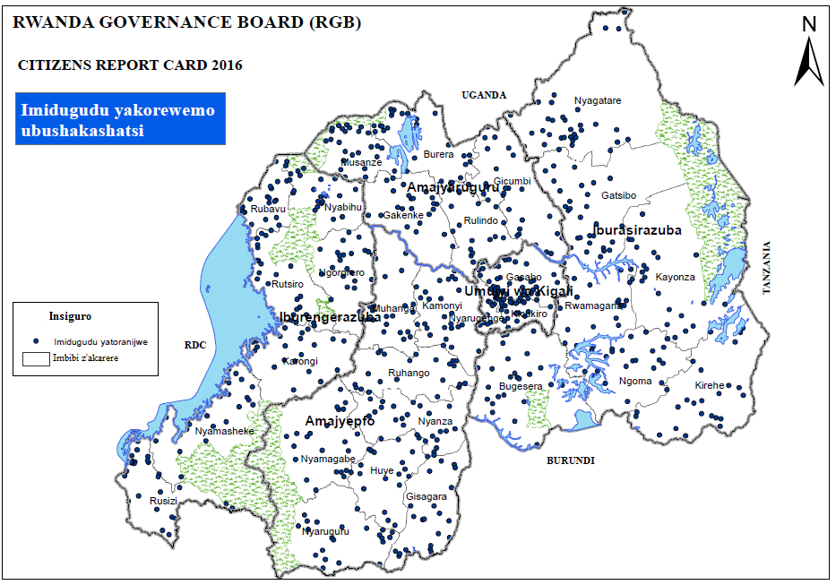
Representation of Villages sampled countrywide - GPS

Slide 9
Summary of CRC findings in 2015 and 2016
Indicator | CRC2015 | CRC 2016
Education | 63.4% | 73.2%
Agriculture | 55.3% | 48.4%
Livestock | 58.0% | 54.2%
Local Administration | 74.3% | 75.9%
Justice | 76.7% | 62.7%
Governance and Social Cohesion | 89.4% | 89.1%
Health | 77.4% | 74.9%
Hygiene and Sanitation | 64.8% | 58.6%
Social protection | 62.2% | 61.2%
Infrastructure |  | 53.1%
Land | 64.7% | 67.3%
Security | 86.5% | 90.0%
GBV and common violence | 86.9% | 80.7%
Citizen Participation | 51.0% | 58.9%
AVERAGE | 71.1% | 67.7%

Slide 10
Level of Citizen Participation in some government programs
Source: CRC 2016

Slide 11
Citizen participation and Inclusiveness in Government programs

Slide 12

Rwanda’s Economic Development is based on clear and good defined programs
Rwanda contributed in the preparation of SDGs
“The major aspiration of Vision 2020 is to transform Rwanda’s economy into a middle income country...this will not be achieved unless we transform from a subsistence agriculture economy to a knowledge-based society, with high levels of savings and private investment.”
EDPRS II
MDGs, 2015
Vision, 2020
Good Governance and a Capable State
Productive and Market oriented Agriculture
Regional and International Economic Integration
HRD and Knowledge based Economy
A Private sector-led Economy
Infrastructure Development

Slide 13

EDPRS I was focusing on three flagships aiming at poverty reduction
This flagship aims to address extreme poverty and vulnerability in the rural area. It has thee components: public works, encourage dvpt. of cooperatives and SMEs and social service
Sustainable Growth
for Jobs and Exports
Vision 2020 Umurenge
The EDPRS priorities of the strategy are embodied in three flagship programmes
This flagship aims to boost growth by enhancing competitiveness, private sector investment and innovation, agricultural productivity, exports and ICT competences
Governance is emphasizing on national unity and reconciliation, decentralization, rule of law, efficient of public administration and fight against corruption
Governance

Slide 14
The basic goal of EDPRS 2 is better quality of lives for all Rwandans through rapid economic growth and accelerated poverty reduction.
EDPRS II
Economic Transformation
Rural Development
Productivity and Youth Employment
Accountable Governance

Slide 15
Citizen participation is having a positive impact on Economic performance
Indicator | Status in 2000 | Current status | Proposed target
Average GDP growth rate (%) | 6.2 | 5.9 | 11.5
GDP per capita in US$ | 220 | 729 | 1240
Percentage of population under poverty line | 60.4 | 39.1 | 20
Gini- Coefficient | 0.454 | 0.448 | 0.35
Access to clean water (% of population ) | 52 | 84.8 | 100
Life expectancy (years) | 49 | 66.7 | 66
Agricultural population (%) | 90 | 71.6 | 50
Literacy rate (%) | 48 | 86.2 | 100
Urban population (%) | 10 | 14.8 | 35
Access to electricity (% of population) | 2 | 24 | 75

Slide 16
Rwandan Economic Growth is an indicator of Economic Transformation
Economic Growth 2000-2016

Slide 17
Rwandan Economic Growth is an indicator of Economic Transformation

Slide 18

Citizen participation in Global Agenda
Sustainable Development Goals (SDGs)

Slide 19
Objectives of the SDGs consultations
The main objective of the SDG consultations was to acquire inclusive and participatory opinions on governance, peace, and rule of law, from national and sub-national stakeholders, including grassroots communities. The aim was to inform the process for indicators of the post-2015 SDGs to align with national policies and priorities.

Slide 20
Methodology
This methodology incorporated both quantitative and qualitative research technics.
All the parties involved worked collaboratively on the data collection especially for the qualitative phase to ensure that all the relevant information areas were covered.
Quantitative research entailed desk research while qualitative phase entailed video recording and note taking in the specified regions.
Quantitative Approach
Qualitative Approach
Video Coverage/Filming and Note Taking of consultations.
Translations and transcription of films.
Desk Research; Review of pre existing data on governance, targets and indicators
Report Writing

Slide 21
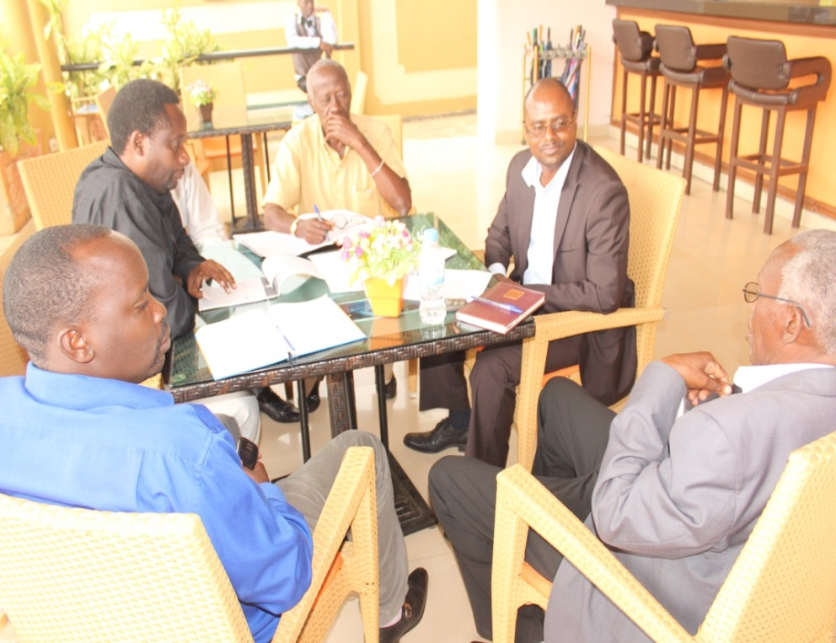
Video Coverage and Note taking participants (Project Stakeholders)
10 JADF Members including 2 executive committee, 2 private sector, 2 international FBO/NGO, 2 FBO, 2 local NGO
3 District officials (Mayor, Vice-mayor, Director of good governance
2 youth representatives (District level)
2 women representatives (District levels)
3 Security (Army and Police-District levels)
3 council members
1 persons with disabilities representative
I Umudugudu (village) representative
I cell representative
2 sector executive secretary
5 Mediators committee
1 MAJ
10 others (2 hospital,2 schools, 2 political parties, 2 cooperatives, 2 media)

Slide 22
Citizen participation through Homegrown initiatives as a key pillar of Good Governance in Rwanda

Slide 23
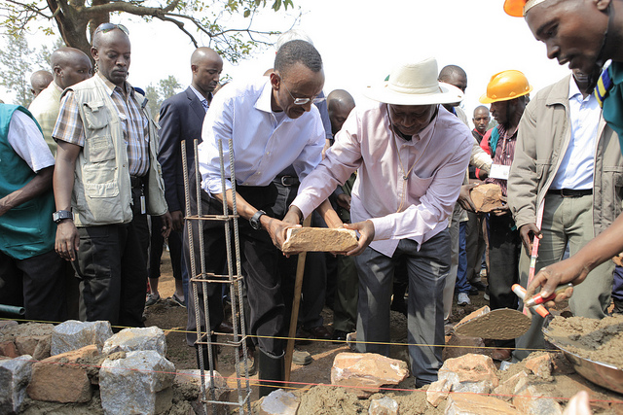
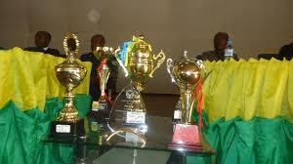
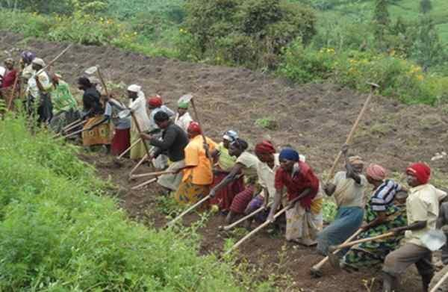
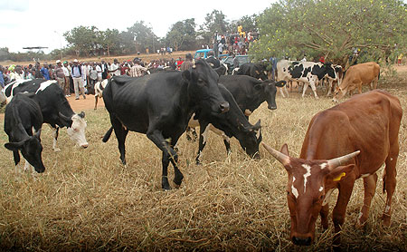
Some applied HGIs in socio-economic transformation of Rwanda
Public Works (Umuganda)
Performance Contracts (Imihigo)
Participatory socio-economic development mechanism (Ubudehe)
One Cow per Family (Girinka)

Slide 24
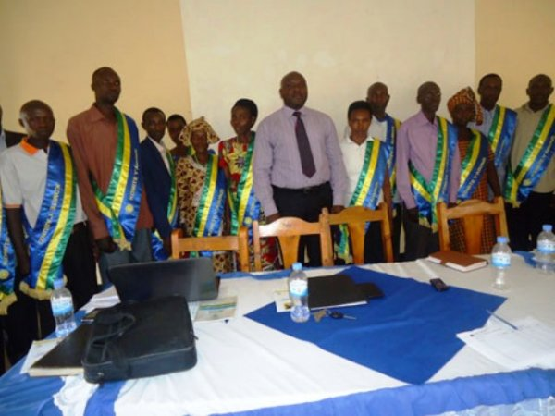
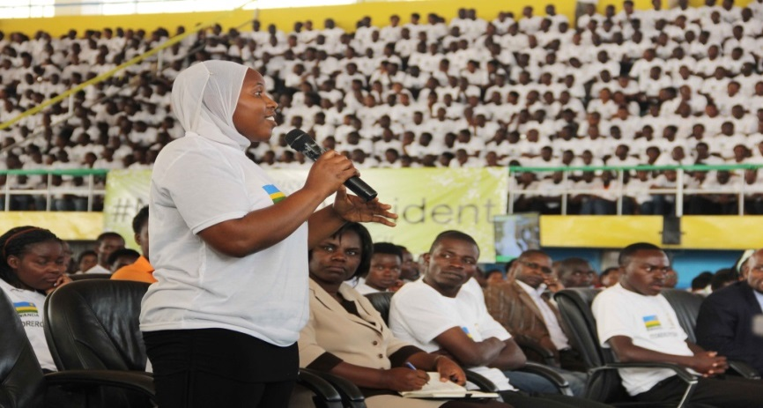
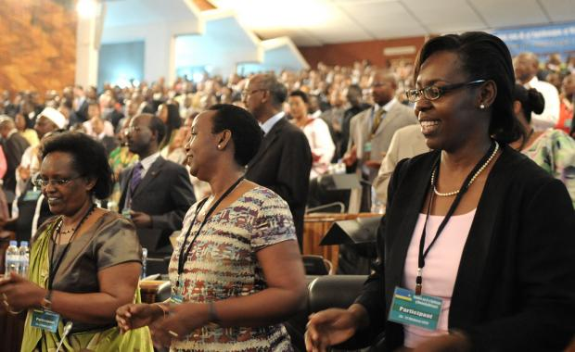
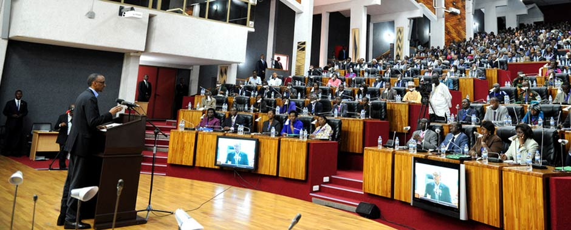
Some applied HGIs in socio-economic transformation of Rwanda
Mediation Committees (Abunzi)
School of Civic Education (Itorero)
National Leadership Retreat
(Umwiherero)
National Dialogue
(Umushyikirano)

Slide 25
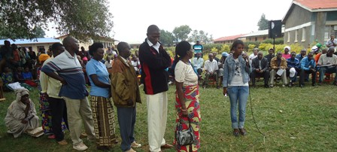
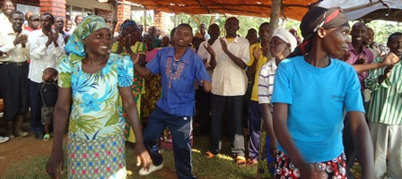
Governance Month as an evidence of Citizen participation
Engaging all governance stakeholders: Governors and governed
Informed transparent decision
Outcome for Citizens
Effectiveness&
Efficiency from clear roles
Promoting Values for good governance

Slide 26
Key Governance Outputs in Rwanda driven by Home-grown initiatives
Economic Growth in last decade
(2000 -2016)
8%
Uplifted from
poverty level
in 5 years
1 million
Access to justice 80%
Universal Access to Health Insurance 96%
Aspiration to Rwandaness
Ubunyarwanda 98%
HGIs
Resilience of Rwandans
Transformational Leadership
Gender parity in leadership:
63.7% of Women in the parliament- (World record)
Secondary School Completion
82%
Easy Doing Business :
46/188
Net primary Enrollment
95.9%
Access to 9YBE 97%
Public confidence in security organs 96%
Timely assets declaration
97%

Slide 27
… and some areas need more efforts for better improvement.
Balance of Payment Deficit
Regional and international Security
Rural Development
Population Growth
Challenges
Urbanization and Land Management
Income distribution
Youth employment
Infrastructure

Slide 28
Thank you for your Attention!

