Slide 1
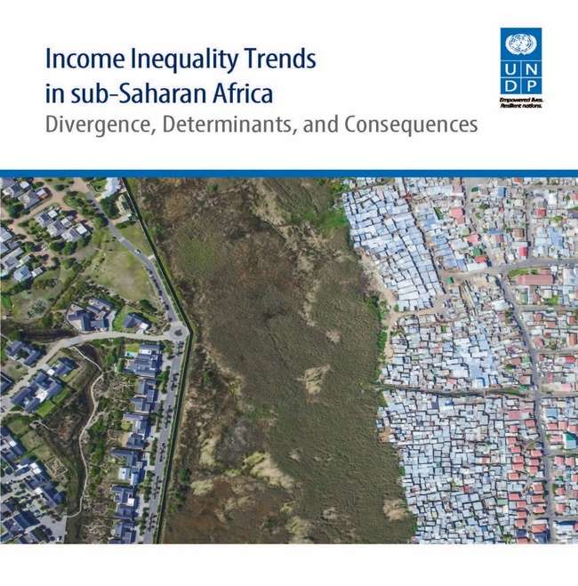
Presented by:
Yemesrach Assefa
Economics advisor, UNDP
Edited by: Ayodele Odusola, Giovanni A. Cornia,
Haroon Bhorat and Pedro Conceicao

Slide 2
Outline of the Presentation
Why focus on inequality
Global trends
UNDPIs Insights on Trends of Inequality in Sub Saharan African
Key drivers of Inequality
Looking ahead
Policy recommendations

Slide 3

Why focus on inequality
Inequality can no longer be treated as an afterthought: Inequality in Africa has received limited attention from research, policy and political perspectives as opposed to the case in other regions;
Multiplier effect of inequality on other SDGs (Goal 10 embodies the spirit of Agenda 2030) : Growing inequality, between and within nations, is inimical to progress towards poverty eradication and prosperity; and peace and security; as well as social cohesion and human development.
Helping to understand the ‘last mile’ of exclusion and to identify possible drivers of the SDGs achievement and how to operationalize its overarching objective of leaving no one behind by 2030
Highlight the scarcity and inconsistency of data on inequality in SSA; and
Identify possible accelerators of progress in addressing inequality.
Notes:
We have reached at a tipping point
We need to focus and debate on how the benefit of economic growth are distributed.
There doesn’t have to be a trade-off between growth and equality.

Slide 4
Global trends: rising inequality almost everywhere, but at different speeds
Source: WID.world (2017). See wir2018.wid.world for data series and notes.
Notes:
The gap between rich and poor keeps widening. Growth, if any, has disproportionally benefited higher income groups while lower income households have been left behind.
Lower income people have been prevented from realising their human capital potential, which is bad for the economy as a whole.

Slide 5
Global trends: Middle East is the most uninequal while Europe is most equal
Source: WID.world (2017). See wir2018.wid.world for data series and notes.
Notes:
The gap between rich and poor keeps widening. Growth, if any, has disproportionally benefited higher income groups while lower income households have been left behind.
Lower income people have been prevented from realising their human capital potential, which is bad for the economy as a whole.

Slide 6
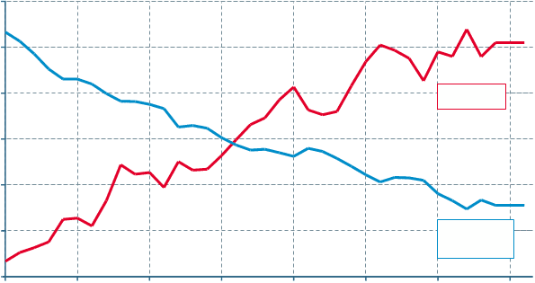
Global trends: National policies and institution shape inequality trends

Slide 7
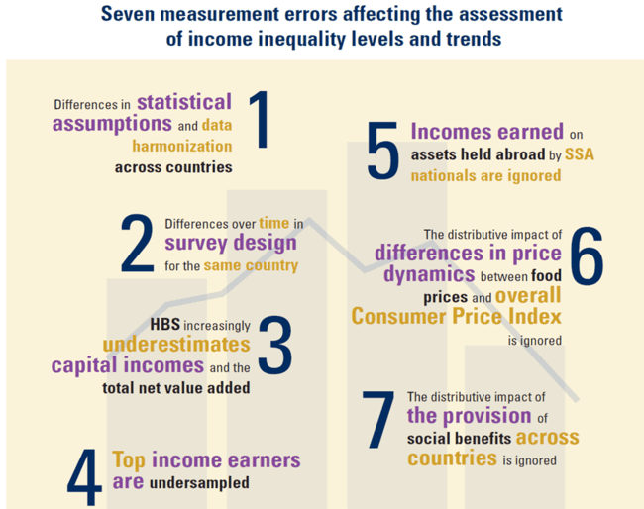
UNDP Book on Income inequality trends in SSA
Adopts an eclectic, analytic approach, comprising:
Country case studies
Analysis of key sectors and policy areas
Micro-econometric decompositions
Econometric macro panel regressions
Statistical documentation, leading to the development of Integrated Inequality Dataset for SSA (IID-SSA) and other related indices
Notes:
This book highlights the key areas where inequalities are created and where new policies are required, including: the consequences of current consolidation policies; structural labour market changes with rising non-standard work and job polarization; persisting gender gaps; the challenge of high wealth concentration, and the role for redistribution policies.

Slide 8
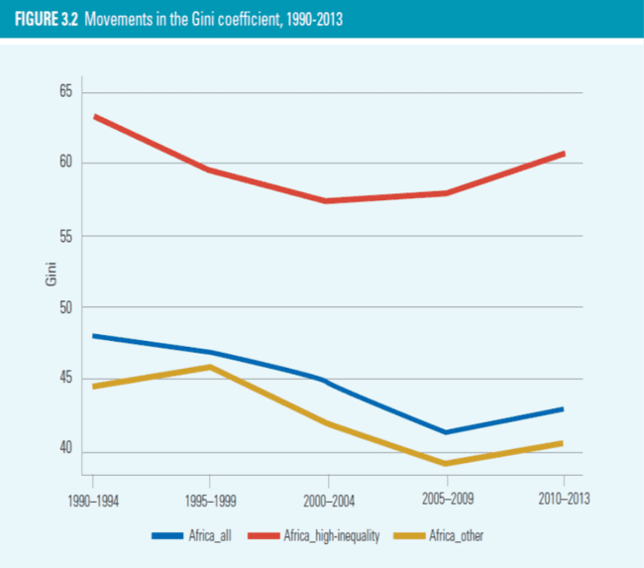
Trends of Inequality in Sub Saharan African Key Findings: Inequality in SSA is showing sign of raising
GOOD NEWS! Income inequality declined in SSA by 3.4 Gini points between 1990 and 2013 – from 0.475 to 0.441 …BUT rose by 0.6 points (2008-2010) because of the global financial crisis.
Under-sampling of top income earners make the
true Gini to be underestimated by 2.0 to 5.0 points in SSA
Notes:
World Inequality report shows that Sub-Saharan Africa is a particular case: we did not have any country with consistent income inequality data over the past decades
If we look at the trends in in the % share of the top 10% of the population, the trend is such that in the middle east, sub-Saharan africa, and brazil, income inequality has remained relatively stable, at extremely high levels

Slide 9

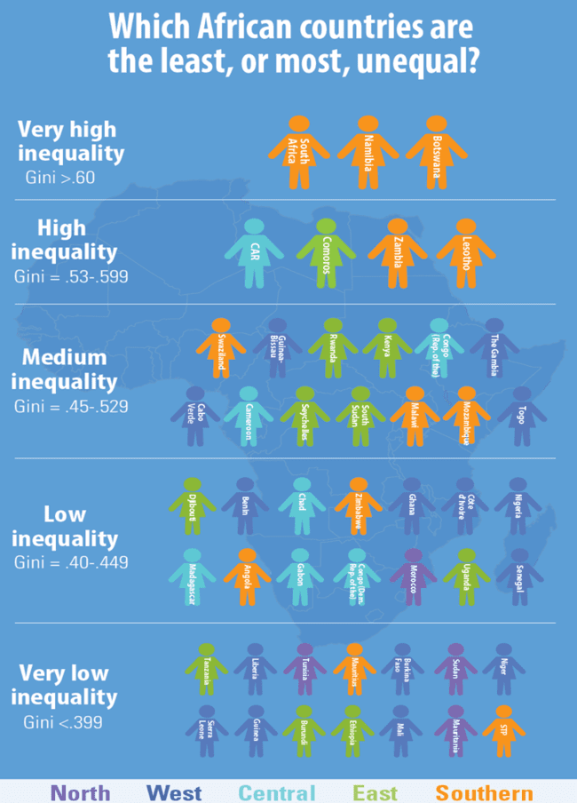
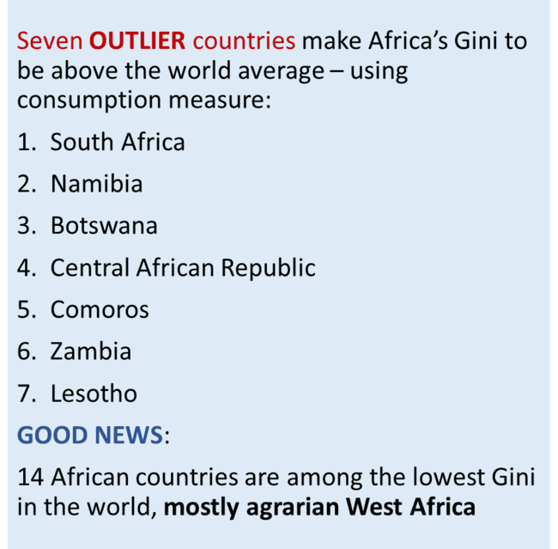
Trends of Inequality in Sub Saharan African Key Findings: Magnitude and trends vary across

Slide 10
Structural drivers of inequality: are multi-dimensional and complex
Inequality is a by-product of regressive taxes, unresponsive tax structure, and inadequate investment in health education and social protection for the marginalized.
Liberalization of policies of the 1980s and 1990s, volatile ToT, FDIs exacerbated income polarization while remittances are equalizers
Social protection programme is beneficial as it has an overall inequality-reducing effect
Discriminatory social norms especially for women
Other drivers include:
Weak distributional effectiveness of fiscal policies - declined in 59.2% of countries – regressive taxation
Unresponsive wage structure
Rising FDIs in extractive industries

Slide 11
Looking forward: Inequality has substantial impacts on global poverty and the achievement of SDGs
High level of inequality and its level overtime explains the low poverty-reducing power of growth in Africa
Growth often occurs in sectors characterized by:
low absorption of unskilled labour, high earnings inequality & high capital share in total income
Inequality hinders social cohesion and trust
Although vertical inequality does not cause conflicts, inequality intensity, ethnic and religious polarization trigger violence and conflicts.
There is hope! Raising inequality is not definite and its impact can be managed: national policies and institutions matter.
Message Four: Extreme inequality is detrimental to growth and development
Source: WID.world (2017). See wir2018.wid.world for data series and notes.

Slide 12
Looking ahead Developmental impacts go beyond increasing poverty to loss of human development
Intergenerational inequality prevents access to assets, education and opportunities for the marginalized groups
Income inequality in Africa is path dependent – low-inequality nations tend to experience decline while high-inequality countries often experienced a rise or stagnation.
Enhanced productivity in agriculture is an important factor in labour reallocation to other sectors.
Overlapping inequalities in health, education, work, political participation and security perpetuate exclusion
Loss to human development due to inequality is as high as 33% in SSA and highest globally.

Slide 13
What can we learn from Good country cases that offer lessons to others
Burkina Faso succeeded in reducing income inequality and poverty for two decades consecutively, with increased agricultural productivity, enhanced fiscal distributional effectiveness and improved remittances.
Ethiopia offers a good example of fast growth, rapid poverty reduction and stable inequality – thanks to agricultural-led industrialization, egalitarian land distribution and well-targeted social protection.
Malawi’s social protection in agriculture (Starter Pack Programme) to poor farmers contributed to substantial decline in inequality during 1993-2005.

Slide 14
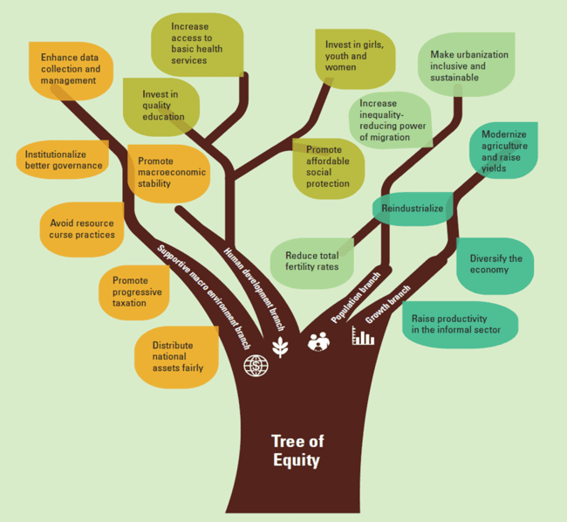
Policy Recommendations: Policies that help reduce poverty are not necessarily the same as those that help reduce income inequality
Promote inclusive growth anchored on macroeconomic policies
Accompany demographic transition with complementary polices-social protection, inclusive urbanization and industrialization policies etc
Invest heavily in human development
Adopt sound governance and macroeconomic environment – e.g., Progressive taxation and fiscal citizenship
Message Five: There is no one silver bullet to addressing inequality in Africa
Notes:
1. Modernize agriculture + farm yields; reverse deindustrialization (value chains in agric and extractives) raise productivity and working conditions of the informal sector, including agriculture
support growth in sectors dominated by the bottom 40% of the population.
2. Strong and well-targeted social protection ; Increased inequality-reducing power of migration through productive use of remittances; Make urbanization inclusive and sustainable.
3. 3. Invest heavily in human development, driven by
Affordable and well-targeted social protection for the marginalized
Expand quality and skill-based education
Increase access to basic and quality health services
Invest in girls, youth and women
4. Adopt sound governance and macroeconomic environment premised on:
macroeconomic and financial stability
Progressive taxation and fiscal citizenship
Institutionalize sound economic governance that prevents and sanctions corruption
Ensure fair distribution of national assets across groups and regions
Avoid resource curse practices
Enhance data collection and management

Slide 15
Key Messages
Divergence in income levels and trends across regions, groups and countries
Drivers of income inequality are multi-dimensional and complex
Inequality generates development paradoxes, which make development management more complex
Extreme inequality is detrimental to growth and development
There is no one silver bullet to addressing inequality in Africa
Policies that help reduce poverty are not necessarily the same as those that help reduce income inequality, which underpins complementarity of policies

Slide 16

THANK
YOU

