Slide 1

A Food systems’ Perspective on PSTA-4
Prof. Alfred R. Bizoza,
University of Rwanda
May 27, 2022
I

Slide 2
Outline of the presentation
Introduction
Priority areas of PSTA-4
Food Systems: Game Changers
Concluding Remarks

Slide 3

Introduction
Successive pre-summit phases till September 2021:
  Independent Dialogues organized by interested organizations, individual or Civil Society Organizations but still connected to the Summit;
  Member State Dialogues organized by national governments; and
  Global Summit Dialogues- aligned with key global events on major issues like climate change, environment, health, economies and jobs, humanitarian aid and water.
These dialogues have created the space needed to gather diversified viewpoints, reveal the potentials of working together, and identification of national efforts for sustainable food systems by 2030.

Slide 4
Introduction (2)
For the case of Rwanda, key results from the entire process of the Food Systems Summit of 2021 include:
  Pathways for Rwanda’s Food Systems Transformation in Support of the SDGs 2030 Agenda, particularly SDG 1 (end extreme poverty), SDG 2 (zero hunger, improved nutrition, and sustainable agriculture), SDG 8 (decent work and economic growth), SDG 13 (climate action), and SDG 15 (terrestrial ecosystems, forests, and land). These are documented in the National Dialogues Report.
  Results from the landscape analysis done under Food Systems Transformative Integrated Policy Initiative (FS-TIP) project.

Slide 5
Food systems are beyond agriculture
Food systems around the world are expected to deliver on a “triple challenge”.
The first requirement is to ensure food security and nutrition for all.
The second is to provide livelihoods to farmers and others in the food chain, and promote rural development.
The third is to do all this while ensuring sustainable environment– i.e. using natural resources sustainably (including protecting valuable ecosystems and biodiversity) and reducing greenhouse gas emissions

Slide 6
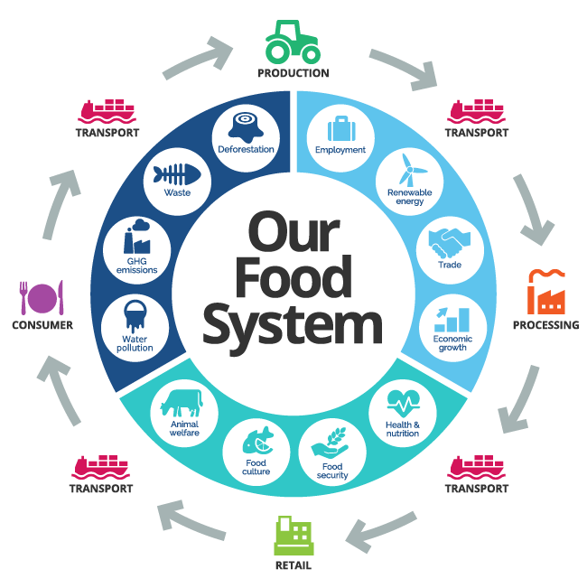
Food systems are beyond agriculture

Slide 7
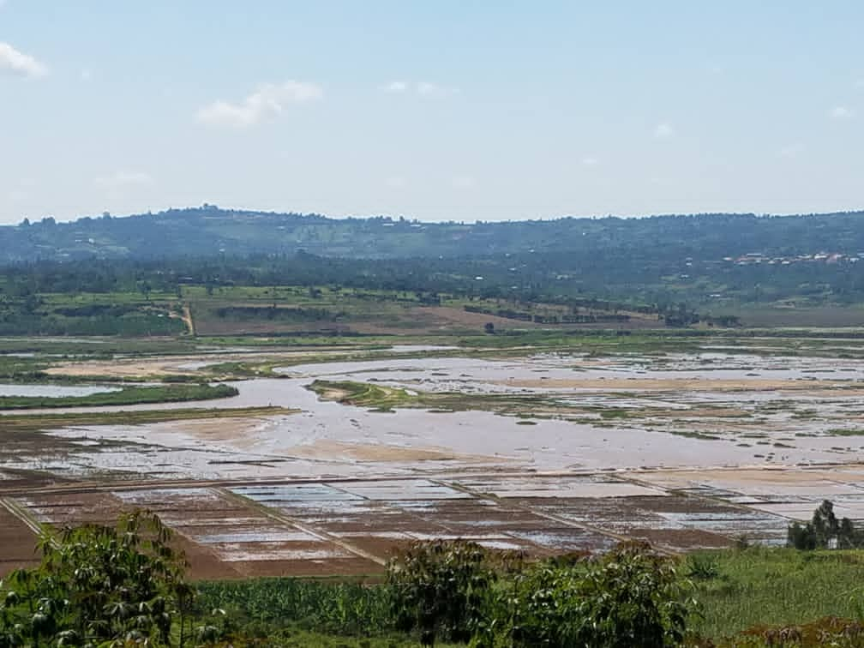
Major challenges in Rwanda’s FS
Yield gaps of major crop and livestock commodities
Diet quality and Nutrition Security: Limited production diversity to meet population's nutritional needs
Prices of nutritious foods are still high, coupled with the low purchasing power of farmers,
Livelihood’s equity: Limited income and income growth for farmers are making agriculture unattractive with increasing urban migration.
Environmental resilience: High vulnerability to climate change

Slide 8
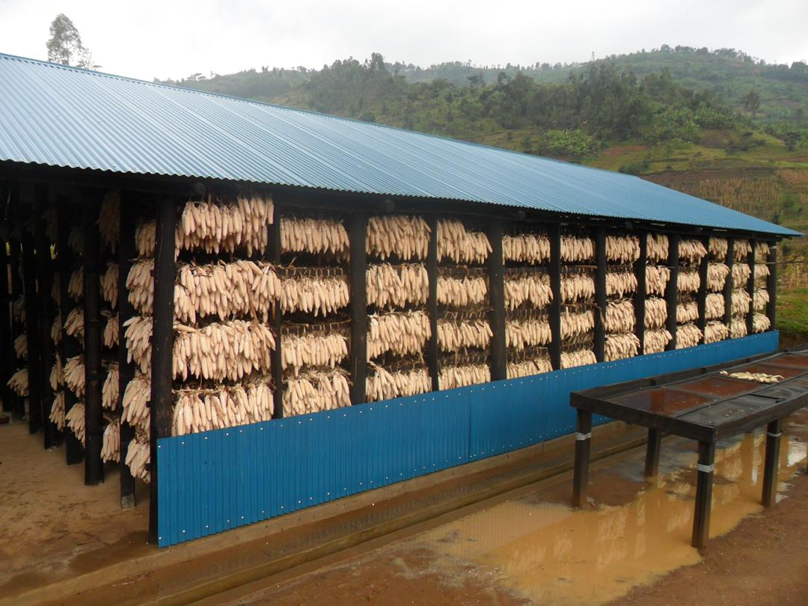
Major challenges in Rwanda’s FS
Financing and investment: Too little financing channeled towards food production and agro-processing
Vulnerable groups: A gap in addressing challenges faced by vulnerable groups in rural areas
Infrastructure capacity: Under-developed supply chains due to weak logistics infrastructure and limited private sector investment: High losses & lower food quality.

Slide 9
Priority areas of PSTA-4
  Innovation and Extension
  Productivity and Resilience
  Inclusive Markets and Value Addition
  Enabling Environment and Responsive Institutions

Slide 10
Food systems: Game Changers
Game Changers on
Nutritious foods (3a)
Game Changers on
Food and Environment
Food systems transformation
Game Changers
Decent Livelihoods
What potential multiplier effects of game changers on food systems ?

Slide 11
What is a Game Changer?
The choice of the game changers is driven by three main criteria:
the potential of the program to accelerate impacts and achievement of both national and sector level goals,
the ability of the programme to address the gaps observed in relevant food systems sub-sectors,
it presents a room to integrate the food systems approach.
N.B. The logic is not to repeat existing programmes or interventions rather combine those strategies and programmes in a manner that responds to the challenge of inclusive and sustainable food systems in Rwanda. The following chart depicts this reasoning in the prioritization of food systems programmes.

Slide 12
National goals
(Vision 2050, NST1
Food Systems programmes/Flagships
Sector Strategic Plans
Figure 1: Food systems’ integrated approach

Slide 13
Identified game changers
  Game Changer #1: Nutritious Food Programs.
  Game Changer #2: Food Waste and Loss Management
  Game Changer #2 : Inclusive Markets and Food Value Chains.
  Game changer #4: Sustainable and resilient food innovation systems.
  Game changer #5 Inclusive innovative financing/investment.
  Game changer #6: Effective mainstreaming of youth and women in food systems.

Slide 14
Priority game changers/ Indicative Priority programmes
Game changer | Priority Programmes
Game Changer #1: Nutritious Food Programs. | School feeding programme Early Childhood Development Programme (ECD) Social food safety nets
Game Changer #2: Food Waste and Loss Management. | Enabling environment for private sector led food loss and waste management
Game Changer #3: Inclusive Markets and Food Value Chains. | National strategic Diversified food reserves Improved market access Food safety programs
Game changer #4: Sustainable and resilient food innovation systems. | Climate resilient and regenerative agriculture Knowledge exchange and customised extension services.
Game changer #5 Inclusive innovative financing/investment | Inclusive and innovative financing schemes for small scale farmers Public Private Partnerships (PPPs) for investment in food systems (Processing, transport, storage/upstream components of value chains).
Game Changer #6: Youth and women Empowerment | Entrepreneurship Skills development Access to finance
.

Slide 15
Concluding remarks
Food systems is increasingly considered globally as an integrated approach in the agriculture sector
Agro-ecology and regenerative agriculture need to be integrated in the sector planning
The on-going mid-term review of the PSTA-4 will need to integrate these game changers and accommodate the food systems approach towards sustainable agriculture transformation.

Slide 16
THANK YOU FOR YOUR ATTENTION

