Slide 1
Economic Impact of COVID-19
EPRN Public Lecture

Slide 2
Presentation Outline
Global Context
Economic impact of COVID-19
Government’s response: Economic Recovery Plan

Slide 3
  PART 1. Global Context
Key highlights

Slide 4
Global context: COVID-19 Pandemic

Slide 5
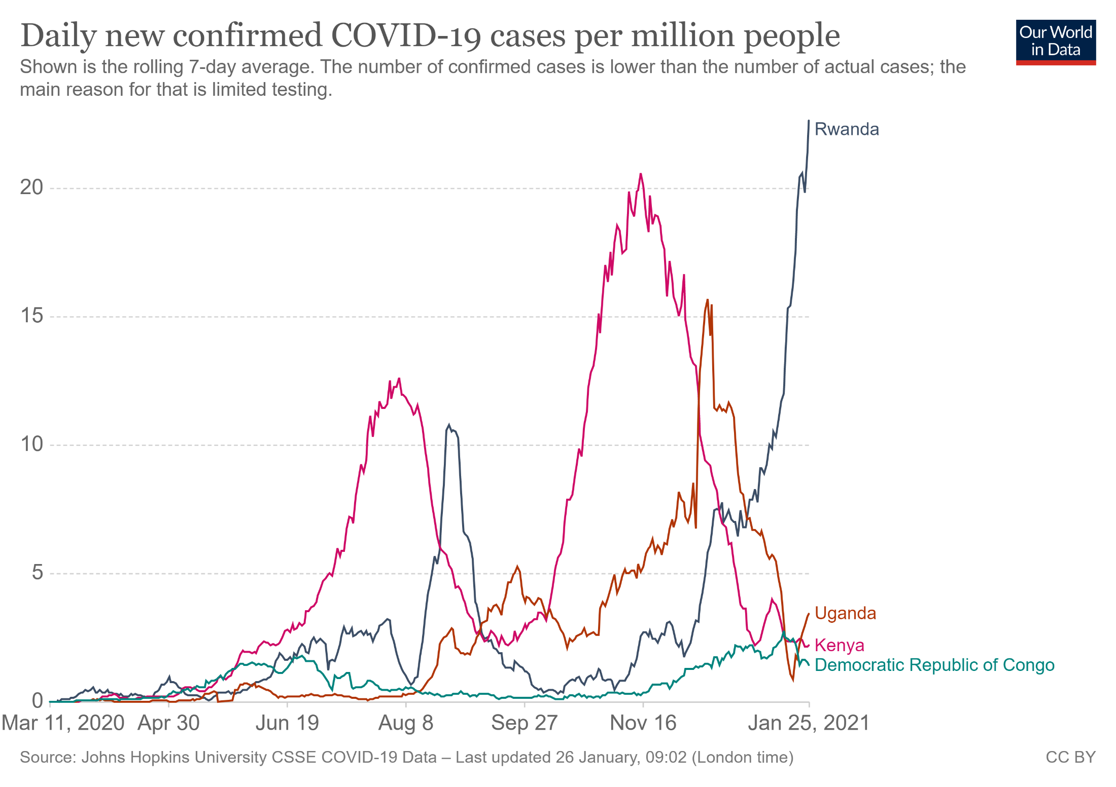
Global context: COVID-19 Pandemic (cont.)

Slide 6
International Economic Environment: World Economic Outlook (IMF, Oct. 2020)
The October IMF improved outlook for 2020 is due to better–than expected growth in advanced economies and China as well as signs of a more rapid recovery as lockdowns were relaxed.

Slide 7
International Economic Environment: World Economic Outlook (IMF, Oct. 2020)

Slide 8
  PART 2. Economic Impact of COVID-19
Key highlights

Slide 9

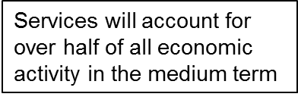
Rwanda’s Development Hat Trick
Rwanda’s development hat trick over last two decades
GDP Per Per Capita (US$)
Rapid economic growth and macroeconomic stability: resilient to shocks;
Important poverty reduction;
Reduced inequality and increased access to services: health, education, financial inclusion;
Economic Transformation
2005
Sustained economic growth has lifted more than
1 million people out of poverty
5
2019

Slide 10
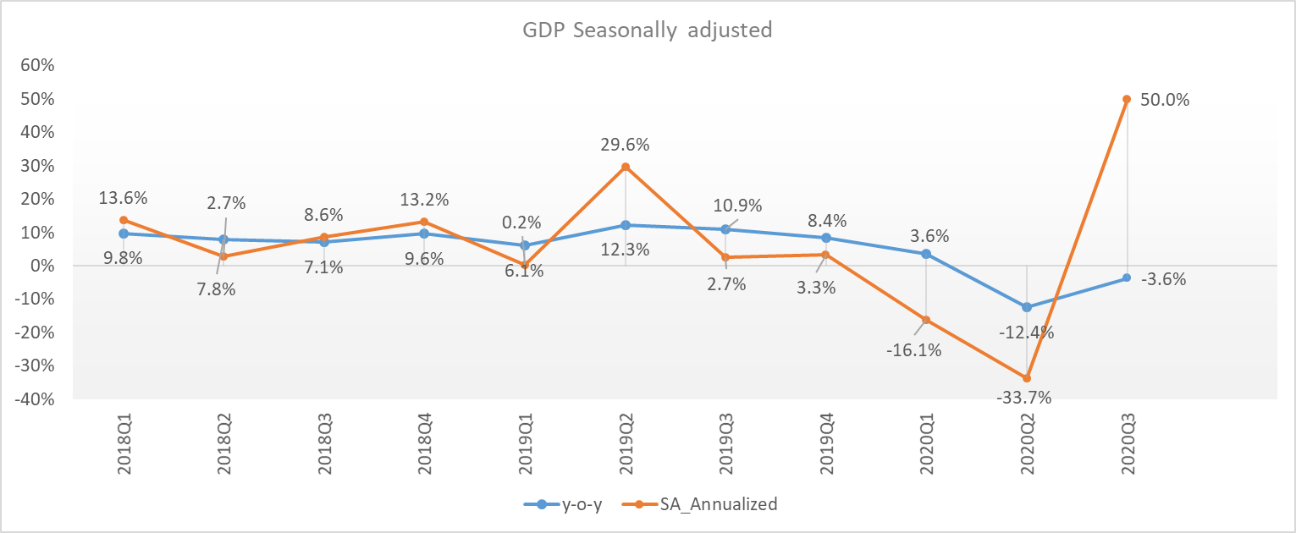
GDP
GDP dropped by 12.4% year-on-year in Q2 2020 and 3.6% in Q3.
The decline in GDP of quarter 2 was mainly due to the following sub sectors: transport, trade, education, construction, exports, hotels and restaurants, and agriculture.
Seasonally adjusted data shows how deep the recession was in Q2 and how important is the recovery afterwards.

Slide 11
High Frequency Indicators
The CIEA continued to pick up following further reopening of some economic activities and recorded a performance of 10.4% and 7.2% in September and October respectively.
We can note also note a recovery in nominal turnovers with 8.7 percent compared to -14.9 percent in Q2.

Slide 12
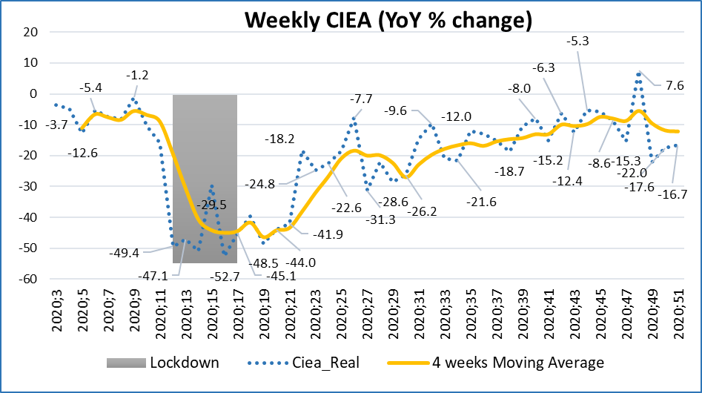
  Weekly Composite Index of Economic Activities (CIEA)
Weekly CIEA for the period of January 2020 - 27^{h} of December 2020 compared to the same period in 2019.

Slide 13
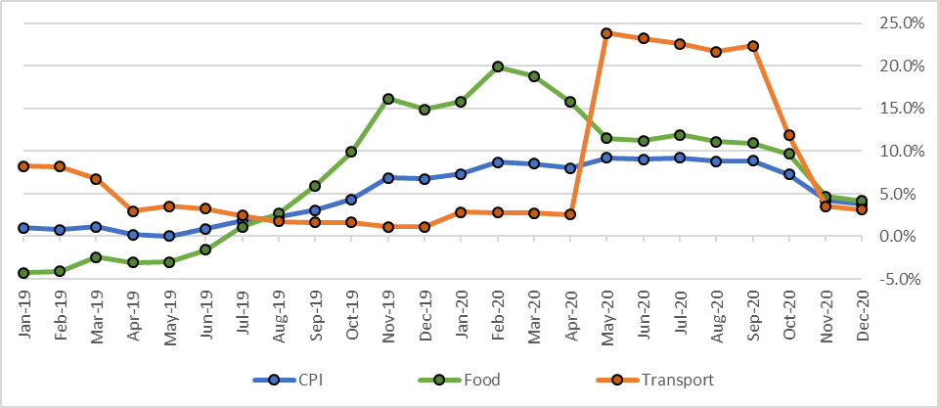
Inflation
Annual inflation decelerated to 3.7 percent in December 2020 from close to 10% in May-September driven mainly by the decrease in transport inflation, food and non-alcoholic beverages and alcoholic beverages (10.2% vs 20.6% in October).

Slide 14
Employment
After a drop in May 2020, employment is back to its level pre-COVID 19.
Trade, manufacturing, accommodation and food service activities highly contributed to the employment growth between May and August 2020 due to reopening of some activities.
However, this is not the case for all sectors as employment in arts, entertainment and recreation as well as education for example is taking longer to recover.
Unemployment rate: 13% in Feb; 22% in May; and 16% in August 2020.

Slide 15
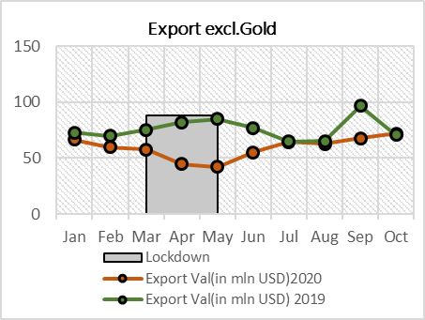
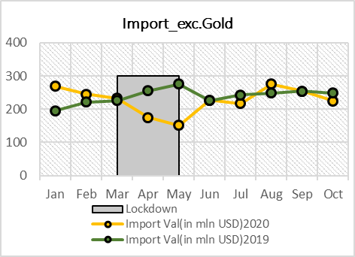
External Sector
  Rwanda formal trade deficit widened by 6.0 percent in January-October 2020 compared to the same period last year.
  Almost all export categories showed a decline resulting in a 29.1 percent and 11.9 percent decrease in value and volume respectively of all export.
  Import has increased by 14.3 percent in value and 5.0 percent in volume, despite a decrease in import of Capital Goods and Energy and Lubricants by 7.2 percent and 32.9 percent respectively.

Slide 16
Public Debt
Rwanda’s debt is sustainable. Although this year, the risk status of debt has shifted from low to moderate, as a result of lower projected macroeconomic performance ( COVID-19 pandemic)
External Debt stock remains essentially concessional, (81% of total external debt).
DEBT SUSTAINABILITY INDICATORS in PV terms
 | DSA June, 2020 |  |  |  |  | THRESHOLDS
 | 2019 | 2020 | 2021 | 2022 | 2023
PV of public debt to GDP | 30.5 | 34.0 | 37.7 | 38.2 | 38.5 | 55
PV of debt to Exports | 137.1 | 259.3 | 177.9 | 169.2 | 143.9 | 240
PV of debt Service to Exports | 7.5 | 22.6 | 12.0 | 11.2 | 20.3 | 21
PV of debt Service to Revenues | 8.2 | 19.2 | 15.3 | 14.9 | 31.0 | 23

Slide 17
  Impact of COVID-19 on Key Macroeconomic Indicators

Slide 18
  PART 2. Government’s Response
Economic Recovery Plan

Slide 19
Lessons Learned From COVID-19 Crisis
Food security: Having enough food production has allowed us to manage the pandemic and the lockdown without facing the problem of food shortage. Our strategic reserves were used to support urban households in most need, while the rural population had enough food. It is now imperative to increase our agriculture production and food processing capacity.
A digital economy is a resilient economy: digital technologies have become a critical enabler, connecting people and ensuring continuity of activities: working from home, contactless payments, remote learning, meetings, e-commerce etc. We need to scale up investment in ICT, both in hard and soft infrastructure, and accelerated ICT literacy among our population;
Saving: Rwandans need to adopt a culture of saving and be better prepared for shocks such as COVID-19;
Strong macroeconomic fundamentals and strong institutions and systems: These are the prerequisites to confront shocks such as COVID-19;
Regional cooperation and Regional integration: COVID-19 is a reminder for Africa to accelerate the regional and continental integration and cooperation to promote intra-regional trade and investments;
Good governance and connection between the Leadership and the citizens: has facilitated Citizens compliance with lockdown/health measures.

Slide 20
Timeline of Rwanda’s key policy response to COVID-19
January 2020: High temperatures screening at the airport and land borders;
March 2020:
  COVID-19 taskforce (health, social and economic) was constituted and social distancing and handwashing/sanitizer measures were in place; testing started before the first COVID-19 case on 14 March, systematic tracing followed, national lockdown was instituted on March 20 and wearing a mask became mandatory;
  Economic and social responses: food relief, central bank liquidity packages in place, loans restructuring, tax relief measures introduced, charges waived on digital payments etc.
30 April, 2020:
  Some key activities reopened: construction projects, mining operations etc.
  Adoption of the Economic Recovery Plan and Economic Recovery Fund;
1 June, 2020: End of six weeks of lockdown, institution of curfew, wearing mask is mandatory;
Jan 18 2021: 2 weeks lockdown in Kigali
COVID-19 cases as of 25 January 2021: 13,311 confirmed, o/w 8,681 recovered and 177 died.

Slide 21
Strategic Priorities For Economic Recovery
Health System Strengthening to contain the epidemic
Ensure a Coordinated Multi-sectoral response of Government to quick start and boost economic activities
Scale up Social Protection
Economic Recovery Plan – Key Interventions –
Support for Businesses and Protect jobs.
Ensure Food Self-Sufficiency

Slide 22
ERP – Key Interventions
Health System Strengthening is our number one priority to stop the spread of the virus.
Fiscal and monetary policies
COVID-responsive Budget 2020/21 to support the recovery:
Increase of 7.5% despite the crisis;
development budget higher than recurrent budget (1st time)
        external resources mobilized and under mobilization.
Fiscal stimulus to the economy: increase in spending, fast-tracking and bringing forward projects in infrastructure, fast-tracking procurement process, paying on time, liquidity support to the financial sector etc.
Relief and support to most impacted sectors/population: tax measures, change in policies etc.
Agriculture
To increase agriculture production: availability and on time distribution of inputs, increased cultivated areas etc.
Support to agricultural export products: secure new markets/demand
Social protection
Providing support (food, cash transfer, health, public works etc.) to affected households/casual workers by increasing the number of beneficiaries of classical Social Protection instruments already in place.

Slide 23
ERP – Key Interventions (contd.)
Health and safety is our number one priority to stop the spread of the virus.
Private Sector support
Tax relief to protect jobs;
Public spending to stimulate domestic demand;
Revision of the investment code underway to promote investment;
Economic recovery Fund to support hard hit businesses:
Strengthened public-private partnership in COVID-19 economic response.
Infrastructure
Accelerate implementation of critical infrastructure projects that catalyze broader economic growth and provide jobs:
Fast-track implementation and bring forward infrastructure projects to create jobs and boost demand for goods and services produced by the private sector.
Technology & Innovation
Increase investment in digital infrastructure;
Reinvent the workplace to stop the spread of the virus as well as enhance overall employee productivity with technology;
Driving the adoption of ICT for all businesses and citizens.
Mining
Positioning Rwanda as a Mineral Processing Hub: Facilitate outsourcing of minerals to boost value addition through processing and export;
Modernization of mining activities: reorganizing small scale mining operators, consolidating many of them into collective investment groups and expedites licensing their new collective companies; access to mining equipment.

Slide 24
  The Economic Recovery Fund
  Main objective: to support businesses in the sectors hit hardest by the pandemic so they can survive, resume work/production and safeguard employment.
  Fund Amount: more than USD 200 million will be needed.
  Source of funds: USD 100 million GoR seed fund. More funds to be mobilized from development partners, international organizations, and foundations.
  Purpose of the Economic Recovery Fund:
    The fund will support affected businesses by the COVID-19 crisis through:
    Loan restructuring for the tourism sector (hotels);
    Working capital for large companies;
    Working capital + loan guarantee for SMEs and Micro-businesses.

Slide 25
  The Economic Recovery Fund
  Fund allocation (GoR funds)
 | Amount | Share
Amount in Frw | 100,782,211,930
Hotel Refinancing | 50,391,105,965 | 50%
Working Capital: Large Corporate | 30,234,663,579 | 30%
Working Capital: SMEs | 15,117,331,790 | 15%
SME Guarantee Scheme | 3,023,466,358 | 3%
Working Capital: Micro businesses | 2,015,644,239 | 2%

Slide 26
  The Economic Recovery Fund
 | Window 1 Refinancing of Hotels | Window 2 Lending Working Capital/Line of Credit | Window 3 Guarantee scheme (SMEs and Micro business) | Window 4 Micro businesses
Fund manager | NBR | NBR | BDF | NBR
BNR to Banks/BDF
Rate | 0% | 3% | 0% | 0%
Tenor | 15 | 10 | 10 | 10
Grace period | 5* | 3 | 10 | 3
Banks to borrowers
Rate | 5% | 8% | 0.25% | 8%
Tenor | 15 years | Max 5 years |  | Max 2 years
Grace period | 3 years | 1 year |  | 3 months
  Economic Recovery Fund Steering Committee
Decide on the allocation of additional funding as and when it becomes available;
Assess performance of the Fund (which banks have assessed the Fund, which borrowers, which sectors etc.)
Consider allocation of Funds amongst banks based on usage;
Assess and advise when terms and conditions may need to be reviewed.
  Operationalization of the Fund: June 2020

Slide 27
THANK YOU

