Slide 1
Digitalisation and State Capacity: evidence from Tax
Digital Reforms in Africa
Dr Fabrizio Santoro (ICTD/IDS)

Slide 2
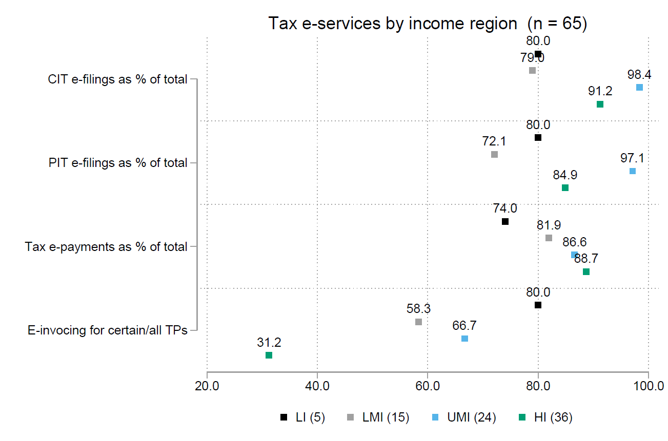
Background
Tax administrations in SSA are strongly digitalising themselves (Okunogbe and Santoro 2023)
First wave of technologies (ITAX, EFDs, e-filing), proven to be impactful in raising revenue (IMF, ICTD)

Slide 3
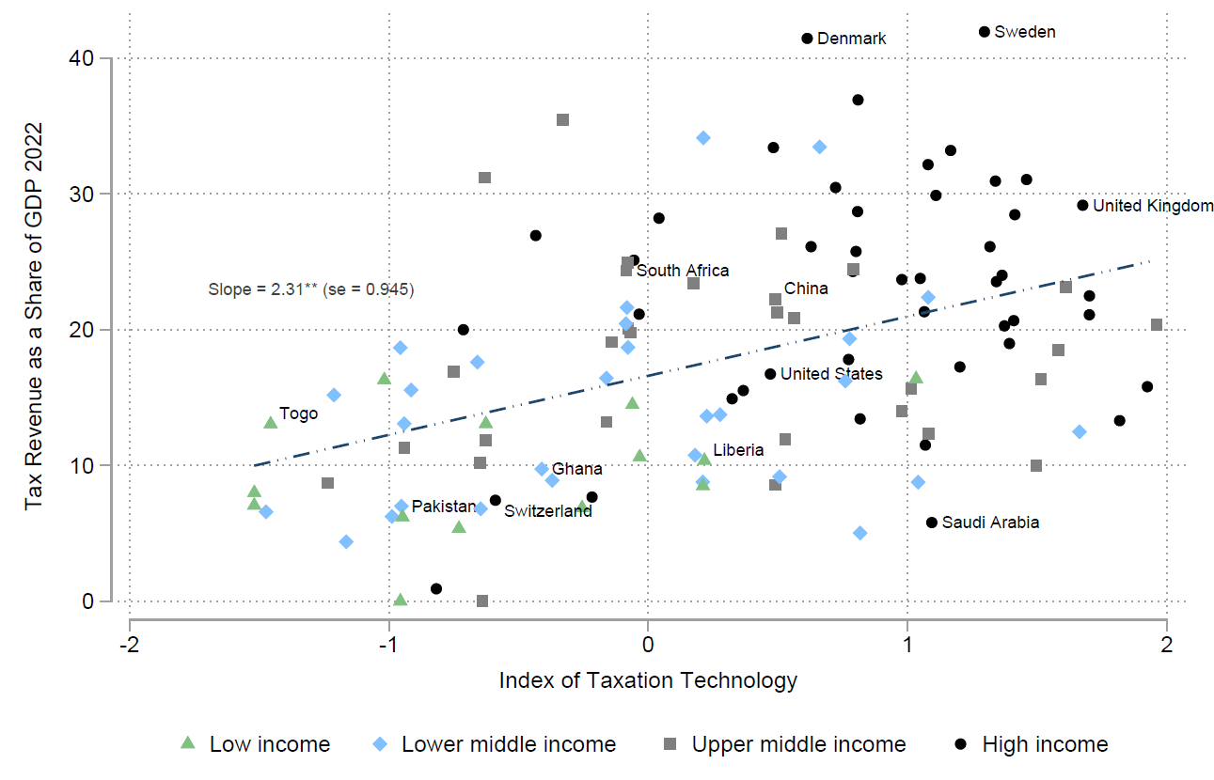

Slide 4



Digital Public Infrastructure (DPI) and Tax program
ICTD’s DPI and Tax programme explores the intersections between DPI deployments and tax administration in lower-income countries
Digital ID systems
Digital payments
Data exchange systems
Others emerging...

Slide 5
What is DPI? The philosophy
“At Co-Develop, we understand digital public infrastructure (DPI) to be society-wide, digital capabilities that are essential to participation in society and markets as a citizen, entrepreneur, and consumer in a digital era. Because it is essential, DPI should be guaranteed by public institutions to be 1) inclusive, 2) foundational, 3) interoperable, and 4) publicly accountable, as it is deployed in countries around the world.” (Eaves & Sandman, 2024)
more

Slide 6
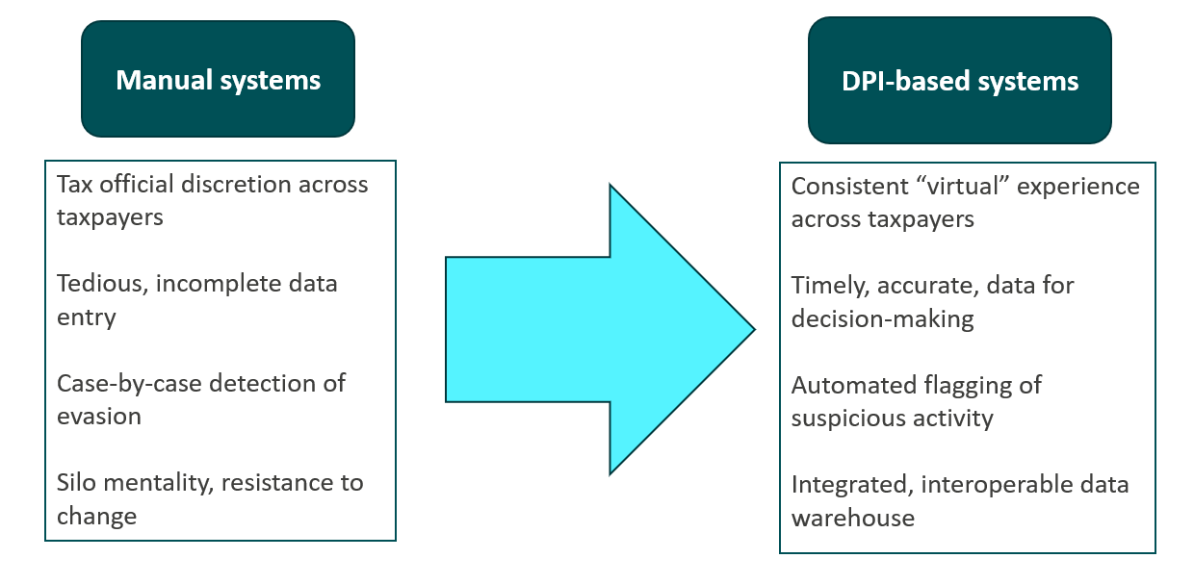
DPI can provide an approach to transform tax administration in SSA

Slide 7
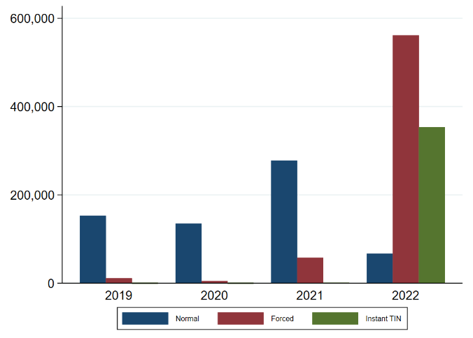
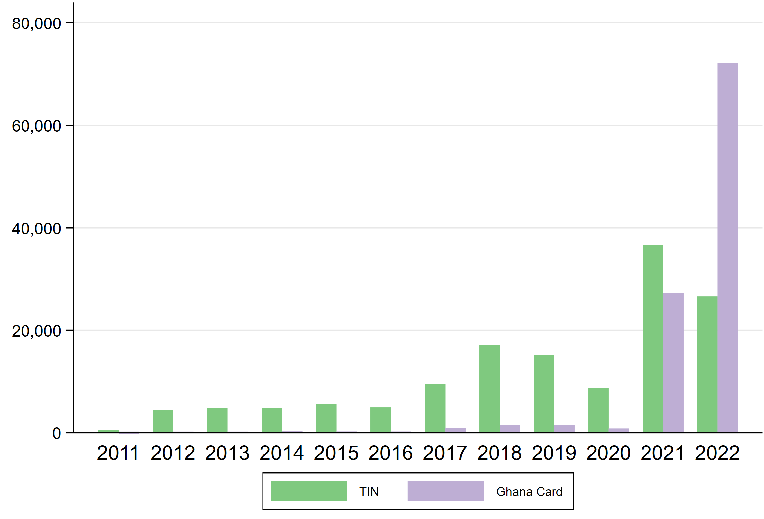
ID system integration with taxpayer registration
In Uganda and Ghana, integration brought huge increases in registration numbers (Scarpini et al 2024)
Previously unreached TP categories – rural, female, younger, informal entities (Santoro et al 2024)
But only mixed evidence on revenue impacts – compliance and capacity gaps
Also data quality concerns (outdated, not relevant, etc.), while for some info quality largely improves
Uganda
Ghana

Slide 8
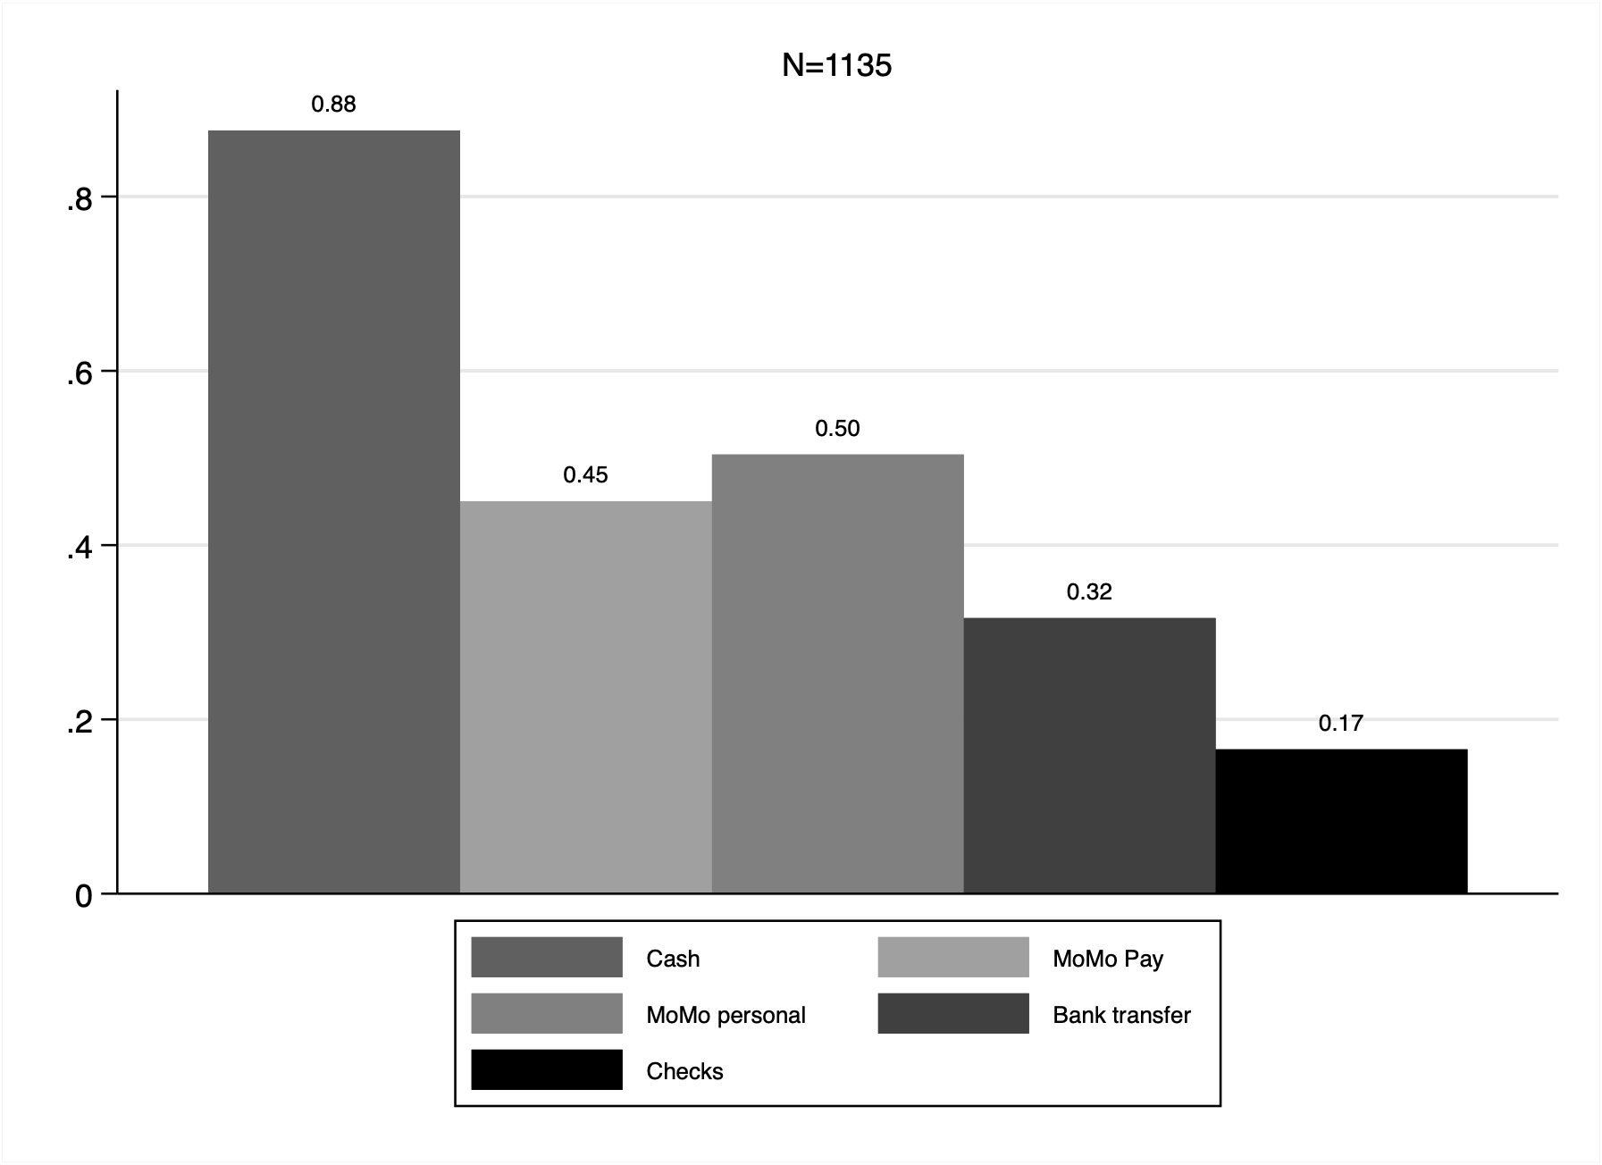
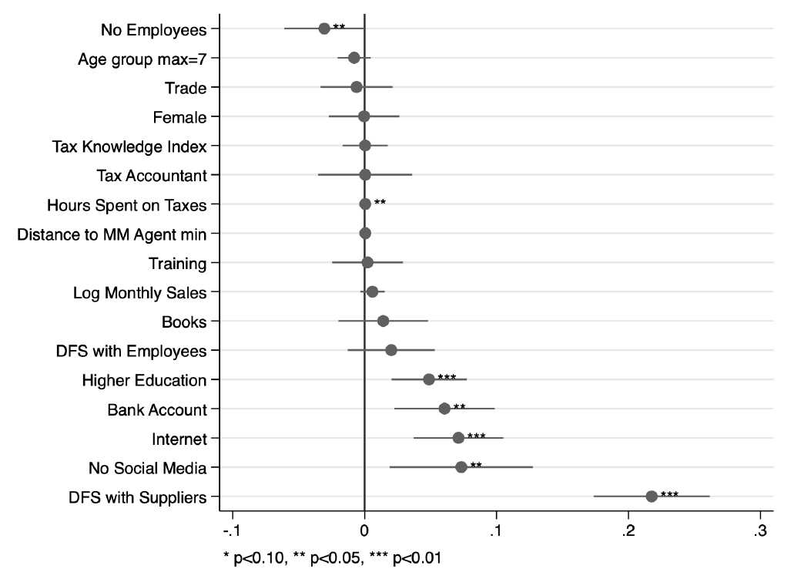
Digital merchant payments as a medium for tax compliance
Adoption depends on a range of factors: usage in the supply chain, IT-readiness, know-how and fin. inclusion
  Similar digital divide as for other tax e-services (Santoro et al 2023)
Cash still remains king (Bernad et al 2023)
Fiscal incentives (Gh) and fees removal (Rw) effective for adoption (Bernad et al 2023, Scarpini et al 2024)
Only limited, short-term, positive impact on compliance – strategic offsetting when filing

Slide 9
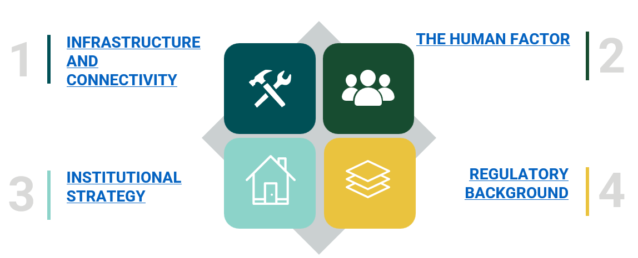
Preconditions to unlock full potential of DPI

Slide 10
Ways forward for policy and research
Change the culture and reposition the tax administration also as a "data warehouse"
  Invest in improved data quality of the taxpayer file (it’s a public good)
Expand the tax administration's data sharing arrangements with third parties (i.e., banks, customs authority, land registry, credit card companies, utilities, company registry, etc. through MoUs or law amendment)
  Clarify permitted use of tax data
  Create APIs to enable data interchange, allowing for open query of taxpayer info without compromising personal data
Invest in ecosystem partners (i.e., the app developers that will build linkages to the tax administration)
Establish a data partnership with universities, think tanks, international organizations, and others to leverage data science and research skills in order to better utilize tax data
Create incentives for adoption and usage (IDs, DMP)
Aim for an inclusive and equitable tax system
Get the preconditions right!

Slide 11
Thank You
Dr Fabrizio Santoro
f.santoro@ids.ac.uk

Slide 12
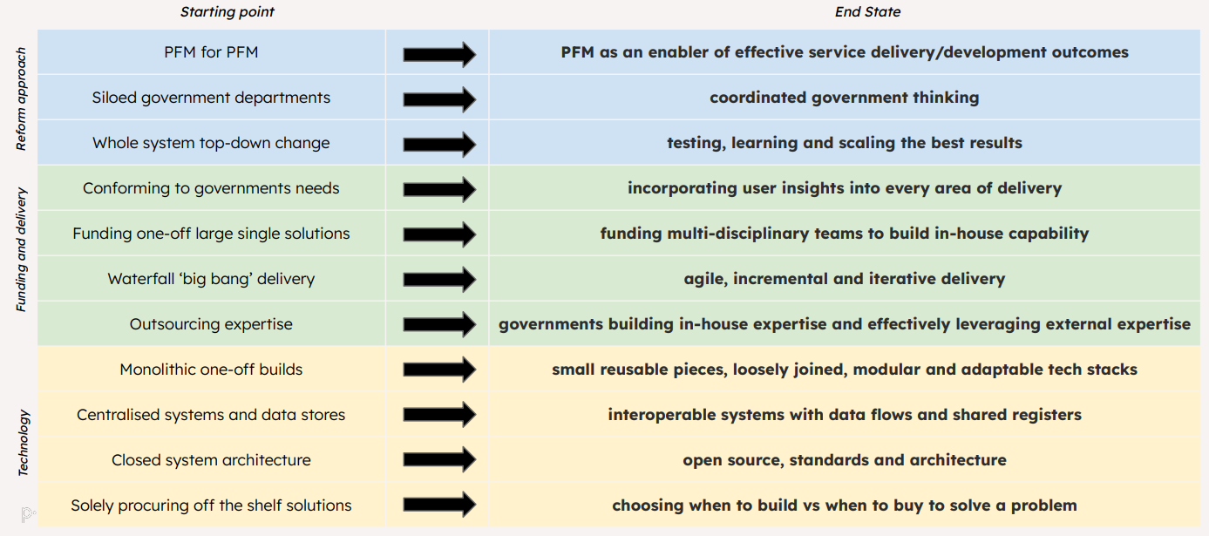
Broader conceptual shifts for PFM (ODI/public.digital)
back

Slide 13
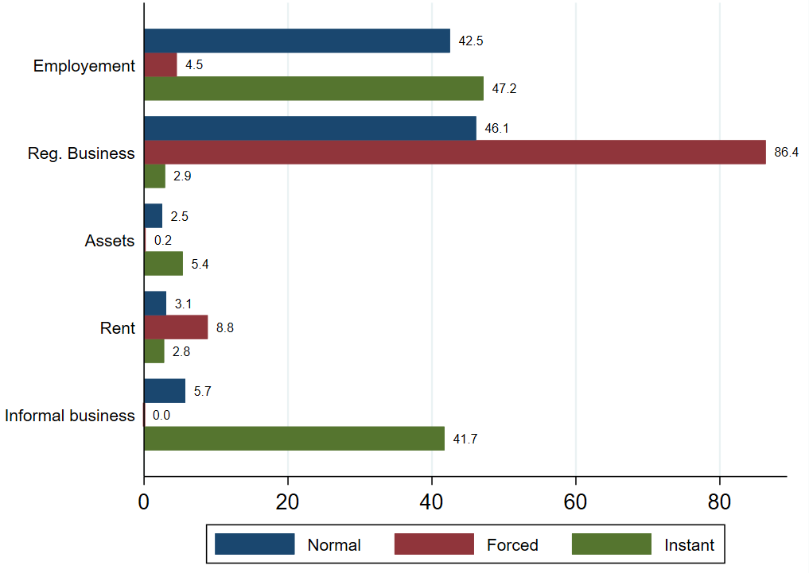
back

Slide 14
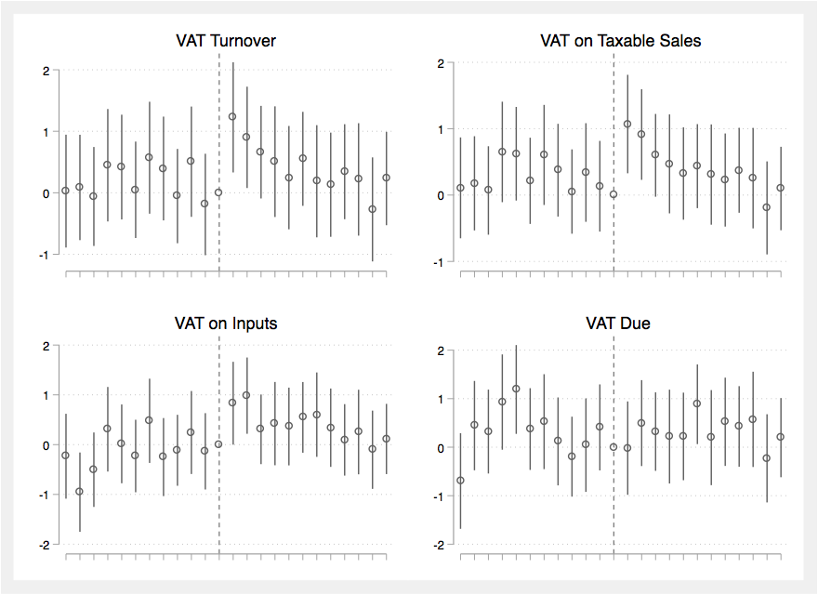
back

