Slide 1
Demographic Human Capital DGE model
for high-growth scenarios for Rwanda, 2016-50 futuRwa
By
Thierry Kalisa (MINECOFIN-Rwanda), Arend Kouwenaar (GIZ)
The 6th EPRN Annual research conference
Theme: “Building Productive Capacities for Structural Economic Transformation”

Slide 2


D-DGE Model for high-growth scenarios for Rwanda
Rationale long-term growth model
Model blocks—Production function at center
Specification Demographic Dynamic General Equilibrium model
Demographic module
Education and health modules
DGE block, incl. public (infrastructure) capital
Baseline and Policy scenarios: High-income 2018-50
Conclusion: importance of comprehensive tool
Human & public capital
Population, capital and debt dynamics

Slide 3
I. Rationale/features
  Combine demographic, human/public capital and debt dynamics in DGE model for long-term growth scenarios
  Ground model in economic (growth) theory and provide practical application to underpin LT strategies (linked to Rwanda databases, other projection tools)
  Quantify growth contributions of factors: human capital (H), public (infrastructure) capital (Kpu), and traditional growth factors (K, L, La, TFP)
  Explore role of human/public capital ‘produced’ by government (endogenous growth features): can raise levels of output, even if not the steady-state growth rates (in practice: a sequence of shifting steady states)
  Assess key macro constraints and impact of alternative policies on growth, budget cost, and trade-offs between policy objectives
  Capture education and health: key to social protection schemes—enhance productivity & growth, in addition to human well-being & social cohesion.
Notes:
While in many countries long-term strategies comprise macroeconomic and fiscal projections, the economic growth model is typically implicit, without quantification of possible growth contributions from factors of production. Often ambitious growth targets implicitly rely on high gains in total factor productivity (TFP) which if not materialized may lead to lower-than-planned growth performance.
“Endogenous growth” features in a neoclassical growth model:
--HC and public capital investment raises H/Y and Kpu/Y ratios, and temporarily raise growth rates
--for a given investment (savings) effort relative to GDP, the stocks of HC and Kpu can rise faster than Y, but not permanently
→ the growth rates of HC and Kpu stabilize at the growth rate of Y, i.e., they return to previous steady state growth rate
--as the effort comes from a given investment (savings) effort relative to GDP and with diminishing returns, human (public) capital accumulation cannot drive growth permanently (as can exogenous labor force growth and TFP growth)
--nevertheless:
(i) they allow a permanent mark-up of the steady-state growth as driven by labor and TFP, ie induced human (public) capital accumulation
(ii) more important is that H (Kpu) investments raise capital stocks and output growth rates temporarily
→ hence in practice the model projects a sequence of changing steady states and transition paths between them, as structural variables and policies continue altering the growth path: domestic savings; population/EAP/labor force; human capital and public capital investment, etc.

Slide 4
II. Model blocks
  Demographic module D-
  projects population, age structure, participation rates, labor force L
  has simplified structure compared to “full” demographic models
  Education module—“producing” Human education capital He
  links targets for education indicators to number of school years s produced and average education level of the work force
  links education level to education spending and to macro productivity
  Health module —“producing” Human health capital Hh
  links targets for health coverage to life expectancy le of work force
  links health outcome to health spending and to macro productivity
  Economic block: DGE
  links growth, public investment Kpu, debt sustainability (post-HIPC scaling-up)
  macro production function, consumption, investment, capital inflows, debt, reflecting behavior, relative prices (real interest rate, real exchange rate)
Notes:
Different from Buffie et al (2012) and many (25) country studies: (a) demographic module; (b) education/health modules; (c) analyzes feasible growth scenarios, which are a sequence of changing steady states as policies and exogenous changes continuously (e.g. domestic savings, govt investment, human capital, labor force etc.)—unlike Buffie et al which analyses deviations from steady state.
HC and Kpu can shift output upward (level), growth rate (path) is unchanged.

Slide 5
II. Macro production function
  Y sector value added excluding government (treated separately)
  L labor force excl. govt workers (LGe, LGh,..) producing human capital
  χ return on public investment through project and sector Cost-Benefit Analysis
Notes:
Constant returns to scale in private factors (K, L, La); increasing in all factors (incl. public capital, Kpu) α + β + (1-α-β) + χ > 1
Output-public capital elasticity, χ , derived inter alia from Cost-Benefit Analysis (CBA)
φe semi-elasticity of output vis-a-vis average schooling in years; instead of linear (constant rate of return), the function is likely quadratic
φe s + φe’ $s^{2}$, φe’ < 0 or stepwise linear for 0-4, 4-8 and 8-12 years of average schooling

Slide 6
II. Growth accounting past, 2000-16
.
Notes:
1/ Factor shares add to one, but their combined contribution to GDP is 0.87, the remainder being government value added (wages, indirect taxes).

Slide 7
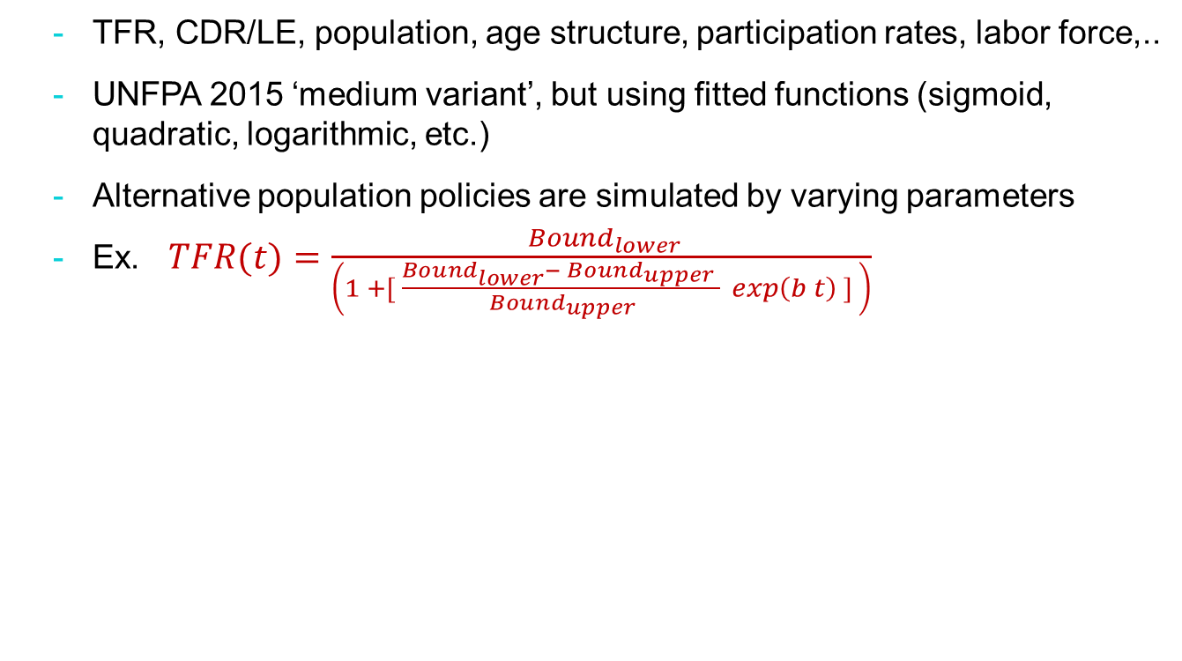
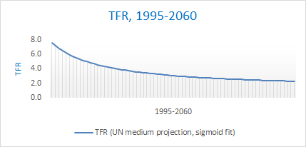
III. Specification D-DGE model—demographic block (example)

Slide 8
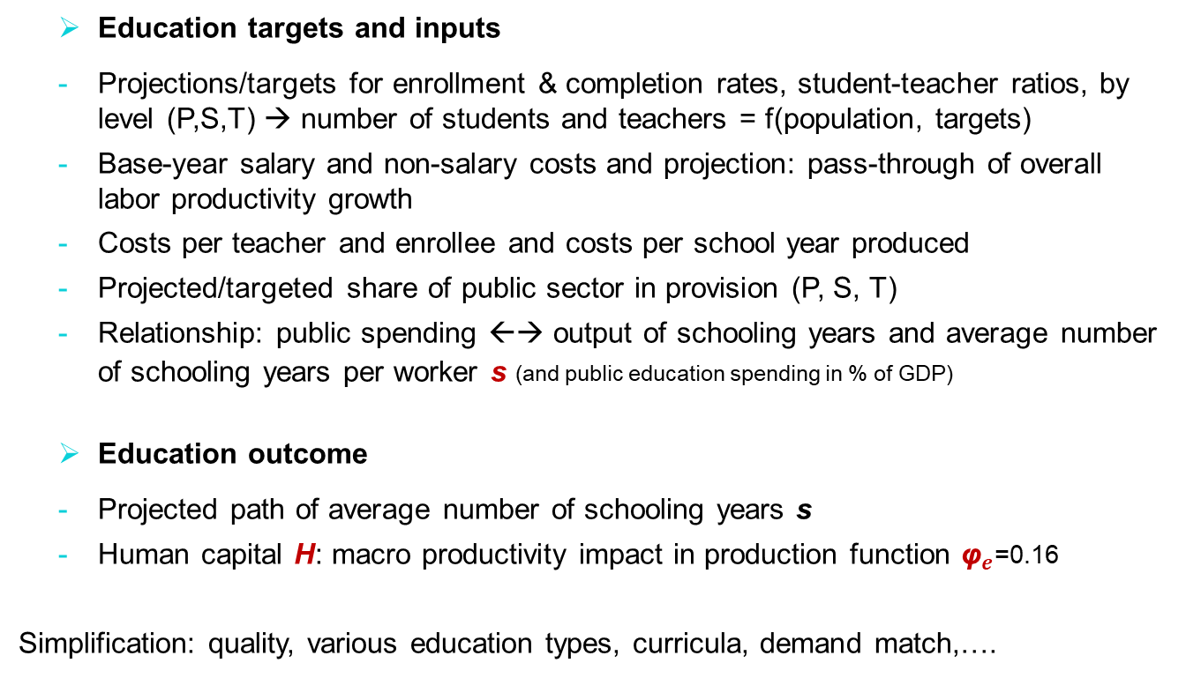
III. Specification D-DGE—education block
Notes:
For each school level (primary, secondary, and tertiary), the model derives the number of teachers required for the projected school-age population, targeted enrollment rates, completion rates and student-teacher ratios, and projected share of public education provision.
Making assumptions on salary and other costs, we derive total public spending, number of schooling years produced, and costs per year of schooling.
based on MINEDUC targets 2017
Shares of public are projected to remain constant from 2016: primary 95%, secondary 83% and tertiary 43%.

Slide 9
III. Specification D-DGE—education block
Education targets and inputs
Notes:
Based on MINEDUC targets 2017
Cost per SCHOOLyear produced may not be constant: for higher average schooling, the cost of producing schooling likely increase, especially for tertiary
Example: d S = d s (L) + d L (s) : 1 mln years = 0.08 year (5mln) + 0.15 mln (4 years) , for L 5mln, growth labor force dL/L is 3%
the growth in school years is d S/S = 1 /(4 years x 5 mln) = 5%

Slide 10
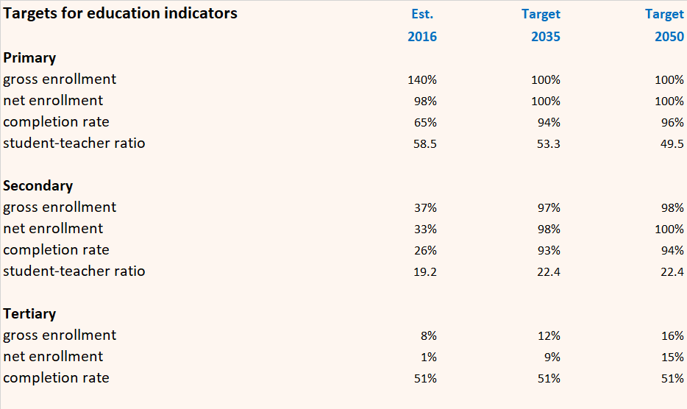
III. D-DGE—education block: illustration
.

Slide 11
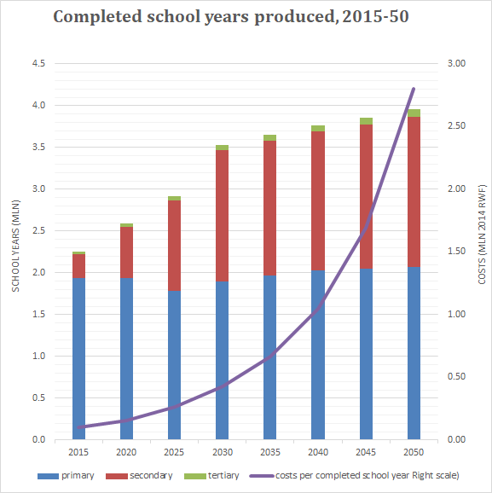
III. D-DGE—education block: illustration
.

Slide 12
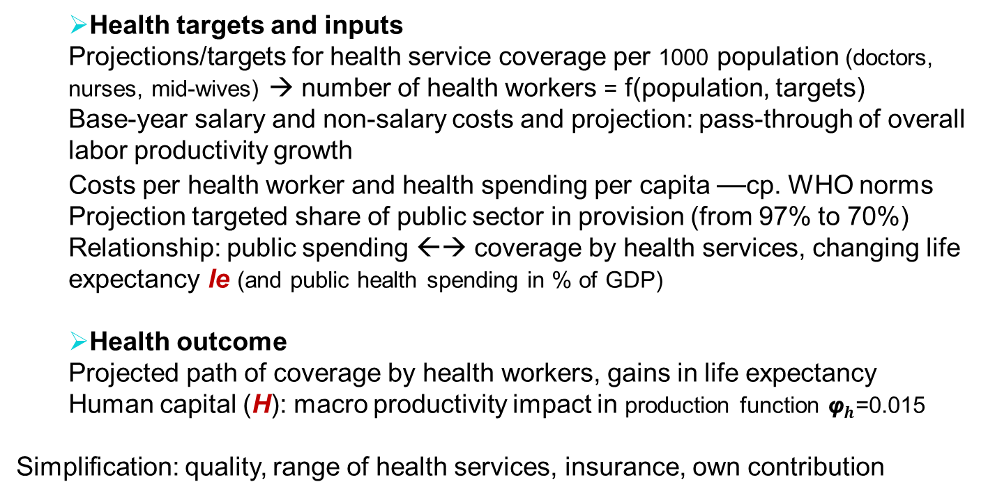
III. D-DGE model—health block

Slide 13
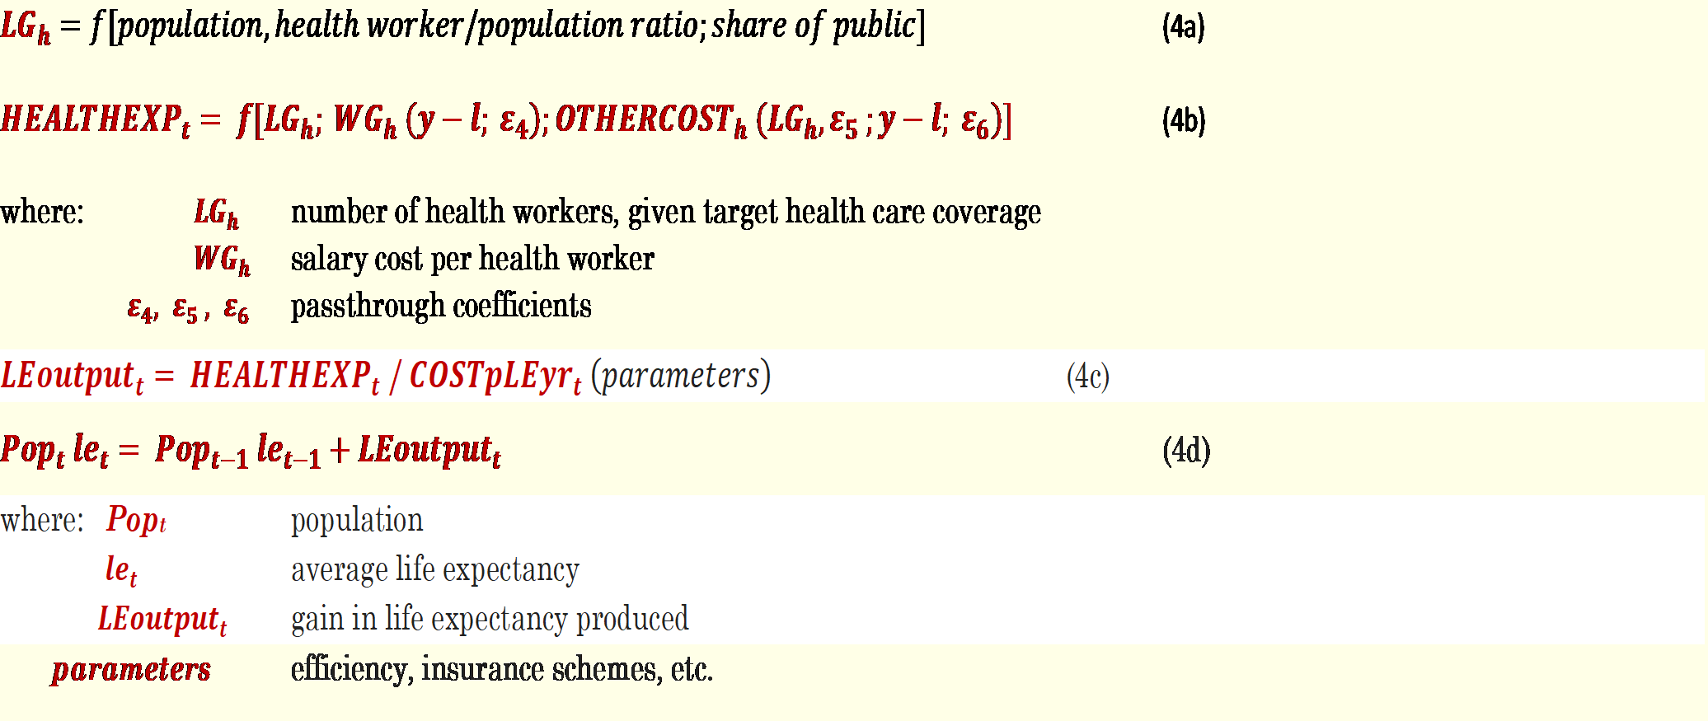
III. Demographic DGE model—health block

Slide 14
III. D-DGE model: main economic blocks
  Production/supply (one sector)
  Cobb Douglas (cf. growth accounting), see slide 5
  Output is split between (Non)Tradables in CET function of RER (external block); T are 40% of output in 2016 (exports, consumption import substitutes)
  Demand: private savings and consumption
  Savings is a function of per capita disposable income (after tax and external factor payments, transfers), determines national savings
  Parameters are semi-elasticities vis-à-vis p.c. income, real interest rate (deposits, RIR), share of EAP in population, positive, increasing in pc income
  Demand: private investment
  Private investment follows from dynamic optimization: desired investment is function of Marginal Product of Capital (MPK) relative to cost of capital: real interest rate (RIR) plus depreciation (δ ), and adjustment costs
  Investment curve downward-sloped in RIR and its level determined by past productivity of capital, as influenced by public capital (Kpu) and TFP

Slide 15
III. DGE model: main economic blocks
  Private capital inflows
  Capital inflows are positive function of foreign-domestic RIR differential subject to capital mobility parameter
  Foreign interest rate includes risk premium which declines with country reputation but increases as stock of foreign capital (debt, FDI) increases
  Savings-investment equilibrium
  Private national savings & private capital inflows both upward-sloping in RIR, and investment demand downward-sloping, determine equilibrium by variation in RIR, after deduction of government net debt issuance
  An upward shift in investment demand—e.g., as MPK increases thanks to government investment—raises interest rates, inducing higher domestic savings and capital inflows
  An increase in government domestic borrowing reduces net supply of domestic savings, raising interest rate and depressing private investment

Slide 16
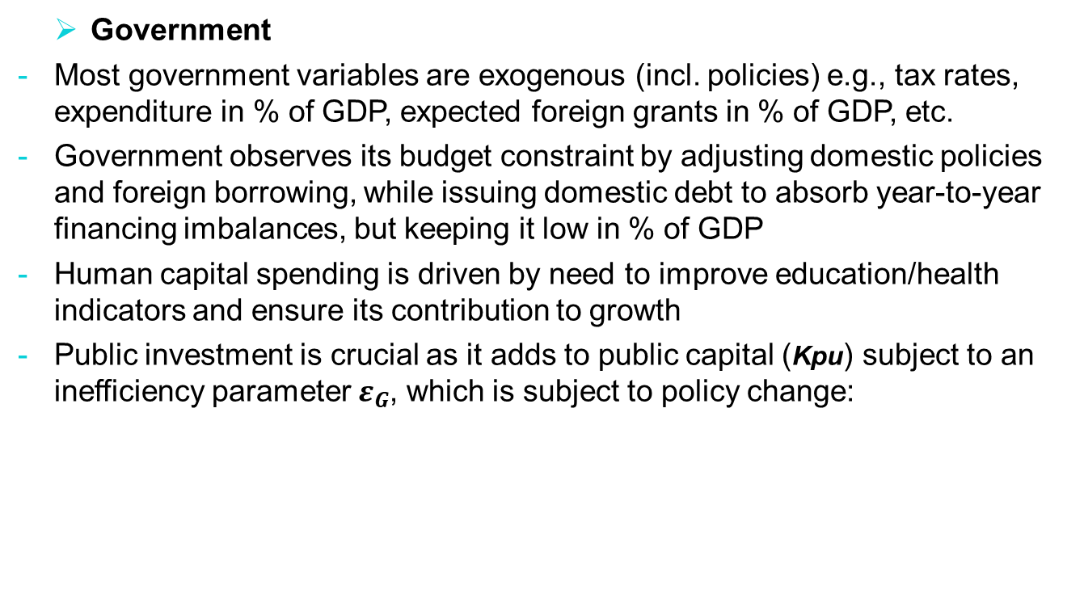
III. DGE model: main economic blocks

Slide 17
III. DGE model: main economic blocks
  Supply and demand for tradables
  Supply of tradables is determined as share of total output according to CET function of relative prices (RER)
  Demand for tradables is based on CES functions, shares in demand being functions of RER, for each demand category i (consumption, investment)
  External equilibrium
  With net supply of tradables increasing function of RER and private capital inflows increasing function of domestic RIR (minus expected RER depreciation), external equilibrium is obtained through variation of RER
  Dynamic equations update factor supplies and debt stocks
  Each factor is ‘updated’ each period based on private investment, labor supply, human capital, public investment, land, …
  Similarly for public & private debt stocks, including RER valuation change
  this completes the D-DGE specification

Slide 18
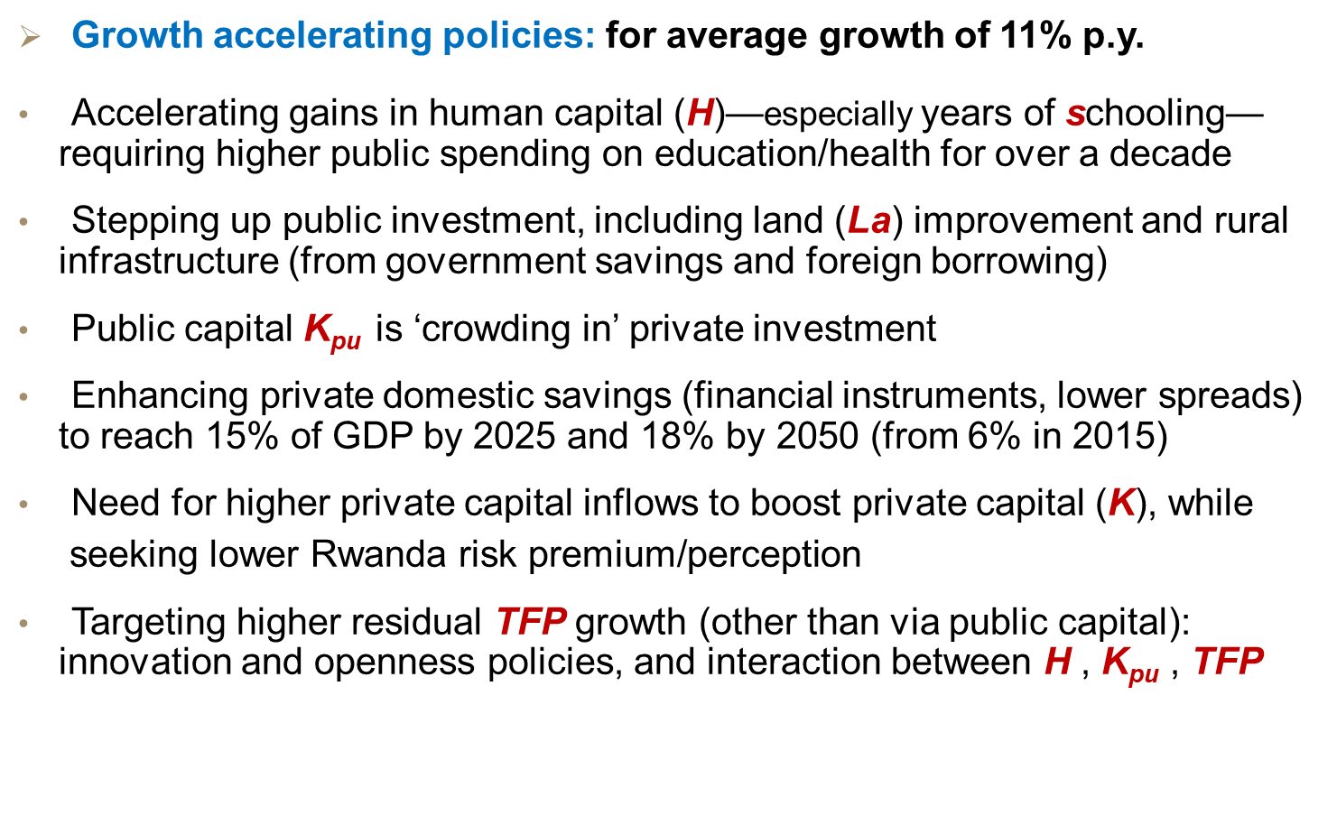
IV. Policy scenarios: ‘High-income 2050’

Slide 19
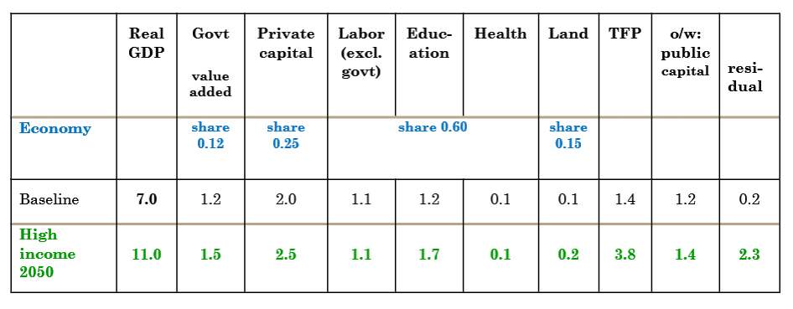
IV. Policy scenarios: ‘High-income 2050’
  Growth accelerating policies

Slide 20
IV. Policy scenarios: ‘High-income 2050’

Slide 21
IV. Policy scenarios: ‘High-income 2050’
  Fiscal policies
  Higher public spending on human capital (plus 2.5-3.0% of GDP)
  Higher spending on public teachers and health workers—producing human capital—also boosts government direct contribution to growth
  Public investment to 11½% of GDP in 2030-35, stabilizing at 11% after
  Higher spending in part matched by more government “adjusted” savings (excl. human capital spending)
  Fiscal deficits around 5½% of GDP, continued reliance on foreign concessional borrowing
  Domestic financing kept low: avoiding crowding out private investment; absorbing fluctuations in external flows (stock kept below 5% of GDP)

Slide 22
IV. Policy scenarios: ‘High-income 2050’
  Fiscal policies—education spending
  Human capital in education is driven by public policies to improve enrollment, completion, quality, teacher salaries etc. → “produce more completed schooling years” and increase average level of education
  Public education spending up from 3.8% in 2016 to almost 6% of GDP by 2030, in line with rising enrollment targets and teacher real salaries (just below growth of economy-wide output per worker), and declines thereafter as school-age population slows
  A large part of the spending increase is from tertiary—gross enrollment doubling to 16% between 2016 and 2050 (MINEDUC projections), with share of public provision kept unchanged (at below 50%)

Slide 23
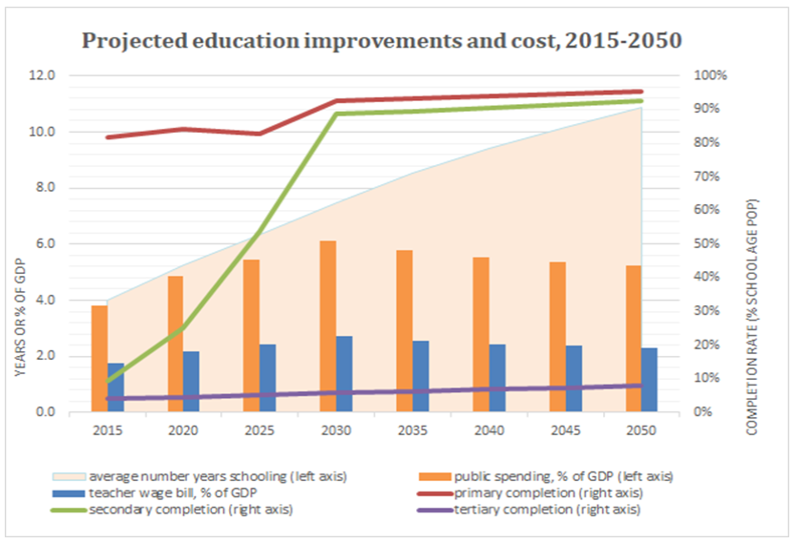
IV. Policy scenarios: ‘High-income 2050’
.

Slide 24
IV. Policy scenarios: ‘High-income 2050’
  Fiscal policies—health spending
  Human capital in health is driven by policies to continuously improve coverage by health services, to a large extent remaining public, on efficiency and equity grounds
  Public health spending up from 2.8% of GDP in 2016 to 4.8% of GDP by 2050, reflecting rising health coverage and increasing costs per health worker (just below growth of economy-wide output per worker)
  Combination of the two rising trends means that public health spending keeps going up in percent of GDP
  Large increase in per capita spending in constant US$ (WHO norm)
  Projected path depends crucially on share of public provision: assumed to decline from 97% in 2016 to 70% by 2030 and stay at that level thereafter

Slide 25
V. D-DGE model for Rwanda: conclusion
  Growth of 11% py is feasible albeit ambitious, with: stepped-up investment in HC & public capital (incl. land); private savings mobilization; and sustained reliance on foreign borrowing on favorable terms
  Sizable growth contributions from those factors would leave a realistic 2¼% to come from TFP, enabled by the trio ‘human, public capital and openness’

Slide 26
V. D-DGE model for Rwanda: conclusion
  Returns on alternative policies
  education: gains in average schooling of EAP has high macro growth effect and highest rate of return on investment
  health: gains in health worker coverage and life expectancy has a bit lower returns, as life expectancy gains have been already substantial
  investment in public capital has high macro growth effect, and rates of return well above cost of borrowing; highest return: improving investment efficiency
  savings: measures to encourage saving, improve financial intermediation and efficiency (reducing spread) have relatively low costs and high macro growth effect via private investment
  openness: DFI/private inflows allow faster growth of capital (& TFP gains), but trade-off with RER depreciation (& associated TFP gains in tradables)

Slide 27
V. D-DGE model for Rwanda: conclusion
  Comprehensive tool to underpin long-term strategies
  combining demography, human/physical capital with DGE, founded in theory
  quantifying macro constraints and trade-offs between policies
  Capturing part of social protection—human capital
  assessing growth impact & costs of access to education & health services
  ‘produced’ human capital lifts output levels, but—with diminishing returns—not growth rates, but exogenous TFP growth is ‘marked up’ by HC investment
  human capital—joint with public capital/innovation policies—likely fosters TFP need for HC expertise to capture this complexity
  Capturing public capital-growth-debt sustainability
  assessing growth impact of public capital (χ output-Kpu elasticity, 0.13), complementary to private factors; need for project/sector CBA to assess χ
  DGE analyzes trade offs: ex. between ΔKpu-enabled growth and debt

Slide 28
Thank You

