Slide 1
INCREASED RISK OF TAX AUDIT AND TAX COMPLIANCE
By Dr. Daniel TWESIGE, Dr Rutungwa Eugene, Prof. Gasheja Faustine, Dr Kadhafi Isaie Misago and Dr Shema

Slide 2
This paper was done through financial support of the Economic Policy Research Network (EPRN) and International Centre for Tax and Development (ICTD)

Slide 3
INTRODUCTION
Economic sovereignty is the goal of any country. This can be achieved by increasing the share of tax to GDP.
Increasing the share of tax to budget and GDP requires three distinguished but complementary policies :
  Widening the tax base through creation of different economic activities and taxes
  Increasing the tax rates and introducing new taxes
  Developing strategies to enhance tax compliance

Slide 4
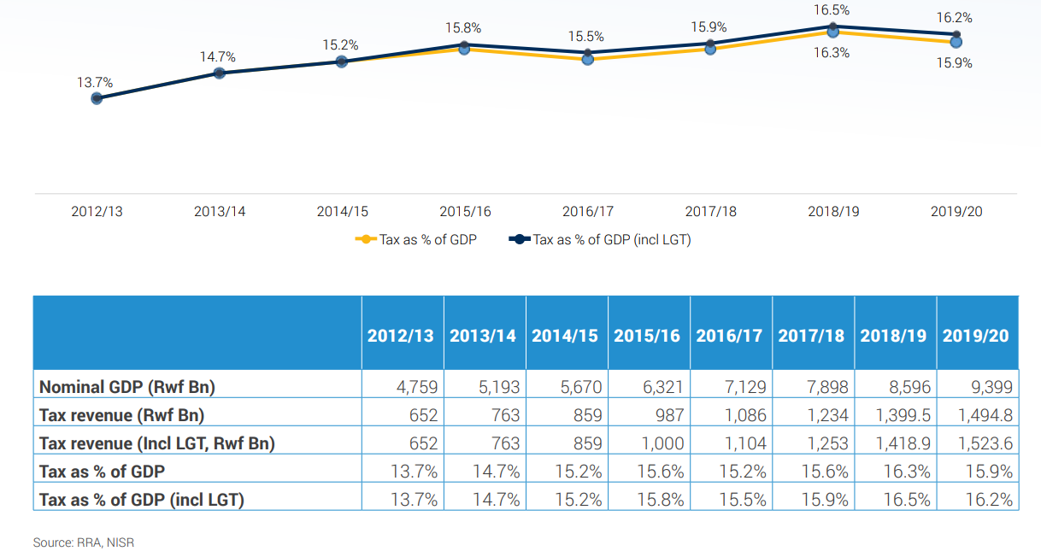
BACKGROUND: TAX TO GDP RATIO

Slide 5
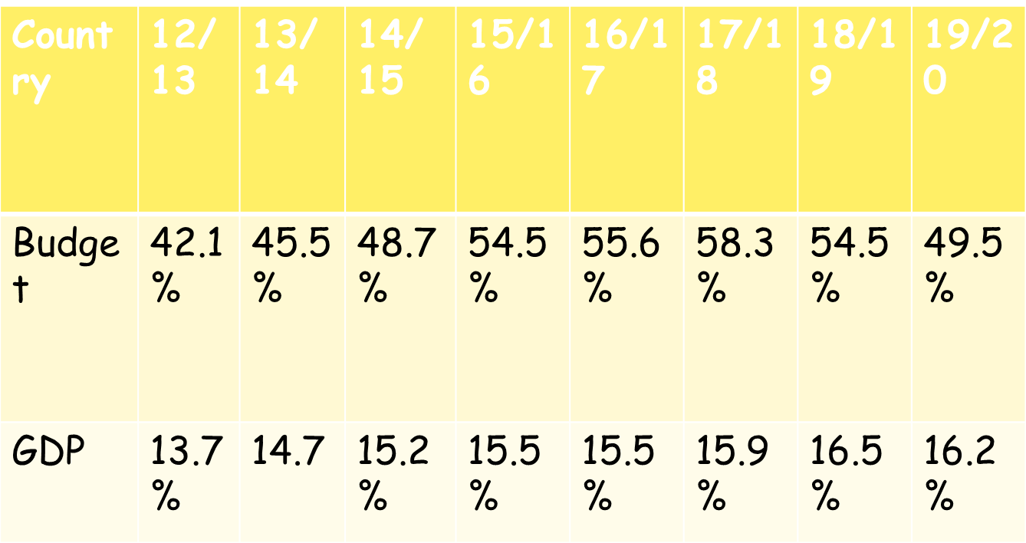
Tax to budget

Slide 6
BACKGROUND-2
Willingness of taxpayers to pay tax has been one of major challenges facing the tax administrators across the globe since the creation man.
Biblically, the story of joseph, king Solomon, Luke 20:19 etc
Previous scholars Oyebaola & Fabrizio (2023), Giulia and christopher (2021), …have highlighted challenges of tax compliance

Slide 7
Research questions
What factors influences the beheviour of taxpayers towards tax compliance at both corporate and individual level
Does tax audit and investigation procedures provided in the law influences tax compliance

Slide 8
Research gap
Previous scholars (khlif &Achek,2015, Ziad et al. 2013, Hanafiah et al. 2019, Jing-Nie, et al. 2020 …..) have highlighted different factors
Tax knowledge, tax audit, tax rates, corruption, role of tax authority, government spending …..
Prior studies have not exhaustively looked at beheviour taxpayers at as per the size and form business and how gender influences the beheviour of tax payers
Tax audit procedures have not been tested on how the contribute to tax compliance
Thus current study filled those two gaps

Slide 9
Material and methods

Slide 10
Research design
Research design ; Quantitative that combined both descriptive and correlation research
Population and sampling ; Taxpayers within Kigali where a sample of 401 taxpayers were selected
Data collection; Primary data collected using a closed ended questionnaire
Data analysis: Descriptive statistics (mean & standard deviation) and inferential statistics (MANOVA and the independent t-test) and ordinal regression

Slide 11
Results and Discussions

Slide 12
First hypothesis (H1):There a statistical difference in the beheviour of taxpayers across categories
Micro taxpayers
Small taxpayers
Tax education, tax fairness & economic factors
Tax education, tax penalties, Gvt spending, economic factors

Slide 13
Tax audit, government spending, tax rates tax knowledge, tax education and tax penalties
Tax audit, tax penalties, role of tax authority, tax education, tax knowledge
Firm size contributes 43.7% of the variation in compliance
Medium taxpayers
Large taxpayers
Pillai’s trace test

Slide 14
Hypothesis 2(H1): There is a statistical difference in the beheviour of taxpayers across gender and form of business towards compliance
Male taxpayers
Female taxpayers
Tax rates, tax education, tax penalties, roles of tax authority and tax knowledge
GVT spending, corruption, fairness of tax rates and tax knowledge

Slide 15
Form of business organisation
Gender
Pillai’s trace test was 48.8%
Pillai’strace test was 47.4%

Slide 16
Hypothesis 3 (H1): There is a statistical significant effect between tax audit and tax compliance
Pseudo R-square
P-Values
Cox and Snell 78.0%
Contradictory audit, compressive audit and issue rated audit P-value was 0.000 audit without notice P-value 0.014 and desk audit P-value 0.071

Slide 17
Conclusion and policy recommendations

Slide 18
Hypothesis 1: There is a mean difference in the beheviour of taxpayers towards tax compliance but they converge at tax education, tax rates and tax audit
Hypothesis 2: There is a mean difference between female and male taxpayers at both individual and corporate level but also converge at tax education and tax rates
Hypothesis 3: Tax audit is a major catalyst when influencing the beheviour of taxpayers

Slide 19
Policy recommendations
Tax education should be uniform across taxpayers
The beheviour of taxpayers is different across taxpayers. Thus compliance policies should be designed to capture different taxpayers

Slide 20
Thank You!

