Slide 1
SOCIAL AND ECONOMIC PERSPECTIVES OF 6 WEEKS COVID 19 CONFINEMENT IN EAST AFRICA
DISCUSSANT
Herman Musahara

Slide 2
Scope
COVID 19 – pandemic
RESPONSE- short vs long term
SOCIAL DIMENSIONS
ECONOMIC DIMENSIONS
6 WEEKS CONFINEMENT/nation/hhs/indiv
EAST AFRICA -Integration

Slide 3
SOCIAL
DEMOGRAPHICS
GENDER DIMENSIONS
FAMILY
CHILDREN/SCHOOL
FOOD CONSUMPTION
SOCIAL CONSUMPTION
SOCIAL MEDIA

Slide 4
FAITH AND PRAYER
SOCIAL TRAVEL
MARRIAGE AND WEDDING CEREMONIES
FUNERALS AND CUSTOMS
HYGIENE AND CLEANLINESS PRACTICES
CULTURE .. Washing hands, social distance, hugging, sneezing,sanitising
POVERTY
etc

Slide 5
MEDICAL SHOCKS
Mortality
Fatality
Infection
Recovery
S-I-R model
Epidemiological curve

Slide 6
ECONOMIC
DEMAND RESPONSE/SHOCKS
SUPPLY RESPONSE/SHOCKS
MEDICAL SCHOCKS
EXOGENOUS EFFECTS
ENDOGENOUS EFFECTS
TOURISM AND HOSPITALITY
TRADE Exports and Imports
INDUSTRY AND BUSINESS
TAXATION

Slide 7
FDI AND LOCAL INVESTMENT
EMPLOYMENT
GOVERNMENT EXPENDITURE
MACROECONOMIC POLICY
MONETARY POLICY
BALANCE OF PAYMENTS
DEBT
COMMODITY PRICING
BANKS AND CREDITORS
SMEs
informal sector

Slide 8
Flattening the curve

Slide 9
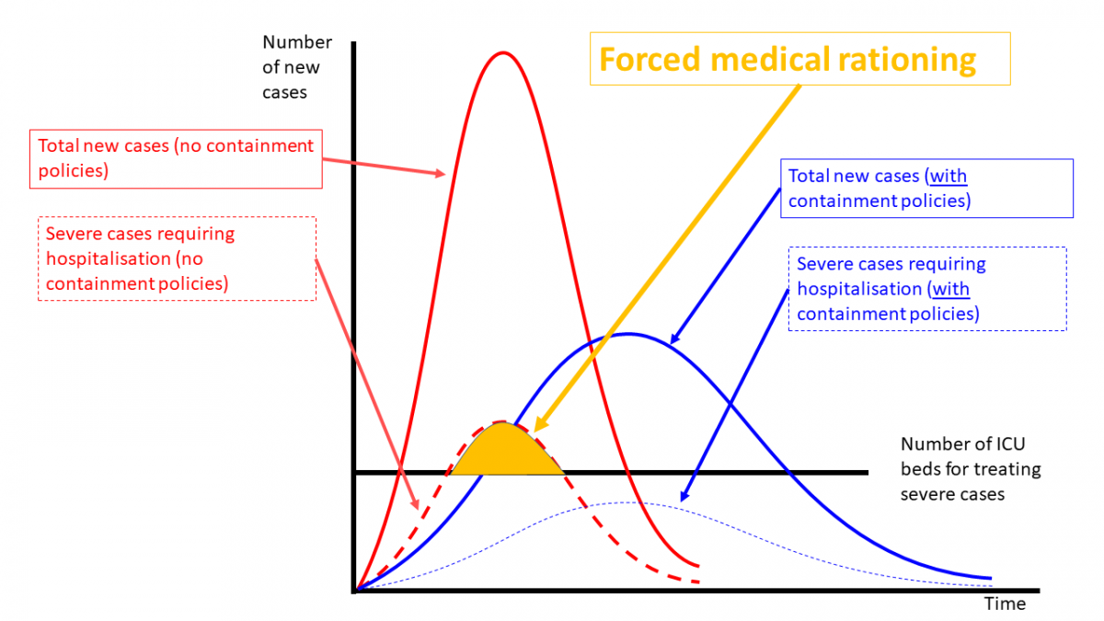
EAST AFRICAN CONTEXT
REGIONAL INTEGRATION
FREE TRADE AREA?
CROSS BORDER TRADE
CROSS BORDER SOCIAL INTERACTION
AVIATION INDUSTRY KAA,Rwandair
VARIATION IN CONFINEMENT
VARIATION IN TRENDS

Slide 10
SHAPES AND EFFECTS
V SHAPED
U SHAPED
L SHAPED
WWW SHAPED
RECURRENCE
RECESSION

Slide 11
ISSUES OF CONTAINMENT
MASKS USE ISSUE
CULTURE AND COVID 19…JAPAN
VACCINE AND AFRICA
CURE
LIVING WITH THE VIRUS
HOARDING COMMODITIES
PRICING DURING AND AFTER CONFINEMNET
USE OF IT DURING AND AFTER CONFINEMENT

Slide 12
EAC
RWANDA,KENYA,UGANDA,TANZANIA,BURUNDI and SOUTHERN SUDAN
177 MILLION PEOPLE
22 MILLION LIVE IN URBAN WHERE THERE IS HIGH RISK
GDP 193.7 BILLION EST
TANZANIA AND RWANDA GETS 10% PLUS OF GDP FROM TOURISM
TOURISM EMPLOYS MORE THAN 1 MILLION IN TANZANIA
TOURISM EARNS MORE THAN $ 1.5 BILLION TO KENYA ABOUT $400 MILL TO RWANDA
FAST GROWTH

Slide 13
STATUS 28/4
Burundi 15
Kenya 363
South Sudan 6
Rwanda 207
Tanzania 299
Uganda 79
EAC 969
Africa 1500
CHINA
Italy
USA

Slide 14
RWANDA
12 million
Avaerage growth of economy before COVID 19 9% plus
Coherent plan for growth NST1,Vision 2050 SDGs
> 200 cases of infections
> 80 recovered
> 90 under treatnmnt
1 case of ICU
No death
6 weeks lockdown
Guma Murugo campaign

Slide 15
Recap of effects
Family planning dangers
GBV?
Unemployment up
Social protection expenditure
6 weeks with drop of arrivals
Meetings( international )
Hotel occupancy
Intra province movement ban
Cross border trade stopped
Infrastructure development
Salary cuts
SMEs
Incomes

Slide 16
DISCUSSIONS OF IMPLICATIONS NOW
HOW LONG THE PANDEMIC/WHERE
WHAT IS THE ROLE OF EXTERNAL
REGIONAL OR SHARED ACTION
POSSIBLE POLITICAL DIFFERENCES ON POLICY
EXISTING ASYMMETRIES
SHORT AND LONG TERM DIFFERENCES

Slide 17
ANECTODES
Blackness and COVID
COVID AND SPIRITUALITY IN EA –God’s anger,power of prayer, closure of churches
COVID AND AGE
COVID and IK
LOCKDOWN asap is the best response ? Cp China, Korea, Japan, US, Italy, Spain
COVID and the jet setters
Covid knows no boundary equally affects the wealthy and powerful

Slide 18
HEADLINES
Trump and WHO
Africa in the Pandemic..impact, health systems, capacities, vaccine testing, financing
Oil prices
Truck driving across borders
COVID 19 and regional integration
Rwandair 8-63 % net salaries
High gov officials for go aprpril salaries
Rwanda government assists the most vulnerable

Slide 19
DISASTER –YES-BUT WHAT CAN I DO? WHAT CAN WE DO?
Talk
Pray
Write
Advocate
Research
Invest
Wait and see

Slide 20
QUESTIONS
What is the level of awareness of the pandemic and degree of response?
What are strategies for the post confinement period?
What are the asymmetries in response at global, regional,(RECs) and national?
What are lessons we draw from a pandemic at all levels?
How socio economic data on the COVID 19 discourse be obtained and used by professionals like journalists?

Slide 21
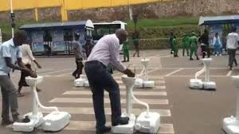
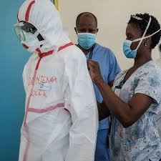
THANK YOU

