Slide 1




1
9/24/2011
Funded by
the European Union
Research on climate resilience and agro-ecological practices
in NYAGATARE, KIREHE, NYARUGURU AND NYAMAGABE DISTRICTS OF RWANDA
DISSEMINATION OF FINDINGS’ REPORT
Rwandan CSOs engage in Climate Resilient agriculture and sustainable energy initiatives (CRA project)
THE 8th EPRN Annual Economic Research Conference
By
Vincent SINDUHUNGA
CCOAIB

Slide 2
RESEARCH CONCEPTUAL FRAMEWORK
Public institutions
(Public Policies and strategies)
Non State actors
(skills and information)
Farmers
AEPs adoption (knowledge and adoption)
Sustainable food-energy system

Slide 3
INTRODUCTION
Research title | Research on climate resilience and agro-ecological practices
Period | June to October 2021
Owner | Consortium led by CCOAIB including OXFAM and Duterimbere NGO
Research team | Mr. Raphael Rurangwa (Team Leader) Dr. Pascal Rushemuka , Dr. Alain Ndoli Mr. Rumenera Philippe
Scope | Country: Rwanda Districts: Nyamagabe and Nyaruguru (Southern Province) Kirehe and Nyagatare (Eastern province) Focus: Agroecology, Climate resilient practices and Food-energy system
Approaches and Sample population | Quantitative and qualitative approaches 400 HH (random sample) 20 KIs (at national and district level) + 8 FGDs

Slide 4
WHY AGROECOLOGICAL PRACTICES (AEPs)?
Current regain of interest of agroecological practices is motivated by:
Unsustainability of the current food production system (recognized to be a major contributor to climate change)
Pressing need to achieve resilient agriculture compatible with climate change adaptation.

Slide 5
AEPs and FOOD SYSTEM
Energy is directly and indirectly embedded in food production and preparation FAO. (2014)
It is estimated that at a global level, food production and its supply chain consume about 30% of total energy (FAO’s water, food, energy nexus, 2014).
However, Agro-ecological practices can present a good opportunity to address the concern for energy to be used in this sector.
This can be done through integrating tree, crop, livestock, biogas and solar energy

Slide 6
KEY STUDY FINDINGS

Slide 7
POLICY FRAMEWORK
The findings from policies’ review have revealed that the agroecology and climate resilient aspects are considered at policy level.
The concern for agriculture sustainability coupled with the urgent need for addressing the issues of climate change are the main drivers for integration of agroecology, climate resilient and food energy practices into key national development policies

Slide 8
NON STATE ACTORS’ VIEWS
Lack of promotion of the EAPs in actual farming system
Lack of evidence-based recommendations from the research demonstrating the impact and benefits of the EAPs, which would inform and motivate farmers to adopt the EAPs
Current climate change and agroecology policies are not well known among the communities

Slide 9
PUBLIC INSTITUTIONS
There is limited enforcement of the conservation agriculture or AEPs
There is no inclusion of EAPs in the performance contracts for agronomists
Policy dialogues would enhance adoption of the AEPs

Slide 10
AEPs ADOPTION BY FARMERS
14.3% of respondents were found with required knowledge,
14% had used agroecological practices in the last 10 years,
13.9% were still applying the practices at the time of interviews (i.e. year 2021).
If adequate knowledge is provided to farmers, adoption rates are expected to be high and consistent.

Slide 11
AEPs ADOPTION BY FARMERS
In terms of knowledge and practice, results have shown that top 5 high ranked AEPs in the decreasing order are:
Crop rotation,
Organic fertilizers,
Land terracing,
Agroforestry, and
Eco-friendly chemical fertilizers.
The lowest ranked AEP were cultural, biological control, and push and pull.

Slide 12
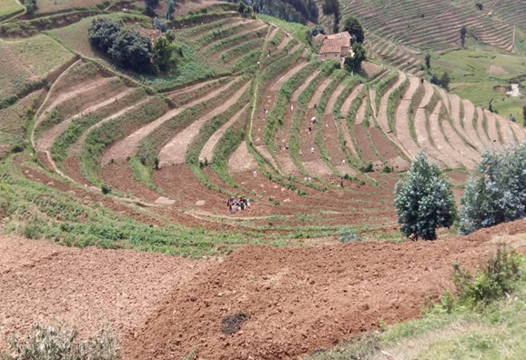
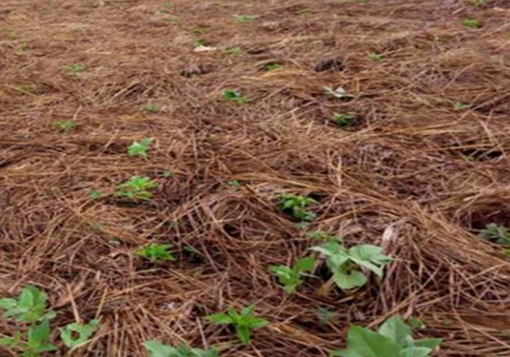
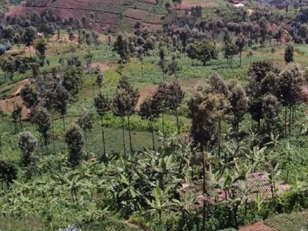
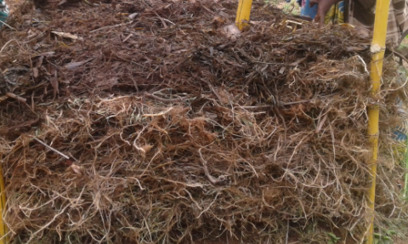
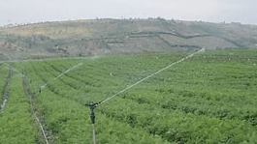
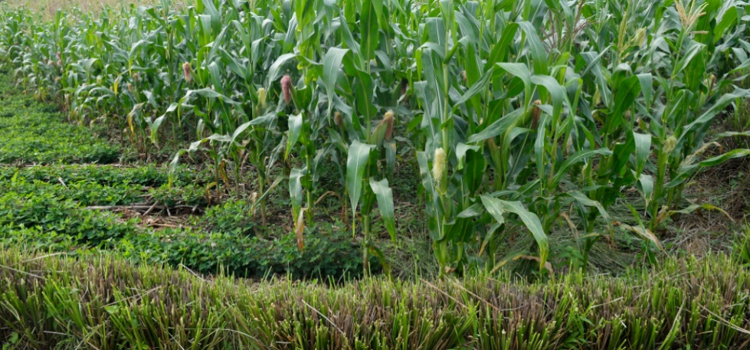

Slide 13
ADVANTAGES OF USING THE AEPs
AEPs | Increased soil fertility | Improved crop productivity | Improved soil water retention | Improvement in HH nutrition | Increased level of adaptation to CC effects | Decreased incidence of crop pest and diseases | Reduction of losses to farmers | % of HH
Crop rotation | 178 | 235 | 33 | 158 | 4 | 32 |  | 34.2
Organic fertilizers | 185 | 198 | 84 | 116 | 8 | 24 |  | 32.9
Agroforestry | 65 | 44 | 60 | 40 | 12 | 19 |  | 12.8
Terracing | 56 | 69 | 56 | 39 | 5 | 9 |  | 12.5
Eco friendly chemical fertilizers | 47 | 79 | 11 | 33 | 1 | 3 |  | 9.3
Contour Planting | 33 | 30 | 44 | 16 | 15 | 19 |  | 8.4
Cover crops/mulches | 52 | 40 | 32 | 13 | 4 | 13 |  | 8.2
Recycled harvested rain water | 18 | 27 | 17 | 17 | 2 | 3 |  | 4.5
Conservation on tillage | 19 | 18 | 17 | 5 |  | 7 |  | 4.2
Intercropping | 11 | 18 |  | 16 |  | 5 |  | 4

Slide 14
Farmers’ preference of AEP in Nyamagabe, Nyaruguru, Kirehe, and Nyagatare Districts

Slide 15
MITIGATION MEASURES TO ADDRESS FARMING PRACTICES CHALLENGES
Mitigation measures | Frequency | %
Supplementary irrigation | 77 | 24.7
Adapted crops | 86 | 27.6
Earlier maturing crop varieties | 76 | 24.4
Crop diversification | 10 | 3.2
Rearing livestock | 12 | 3.8
Practicing off farm activities | 88 | 28.2

Slide 16
CONCLUSION
Rwandan climate change and agroecology related policies are well developed
Climate change effects are negatively impacting small holder farmers
Agroecology is not well known and adopted by smallholder farmers
Farmers praised to promote (i) crop rotation, (ii) organic fertilizers, (iii) terracing, (iv) agroforestry, and (v) eco-friendly chemical fertilizers.
Farmers recommend only what they know and have experienced.
Additional AEPs could be welcomed if proper extension is provided

Slide 17
CONCLUSION
Firewood is the most dominant source of cooking energy in rural areas (97% of households) seconded by crop residues (22.4% of households)
Charcoal was the first source in urban areas (55.6%) seconded by firewood (49.5%).
Compared to Eastern province, districts in the southern province (Nyamagabe and Nyaruguru) do not have adequate access to LPG (Gas)

Slide 18
RECOMMENDATIONS
POLICY LEVEL
To institutionalize the AEPs for its scaling up (MINAGRI and MoE);
To develop a solid extension system for AEPs that goes hand in hand with the existing extension system for CIP to harmonise Crops productivity and soil conservation (MINAGRI & Districts).

Slide 19
RECOMMENDATIONS
IMPLEMENTATION LEVEL
To promote AEPs through extension and action research approaches (RAB, districts, CSOs and FOs));
To advocate for the effective enforcement with incentives of AEPs (CSOs and FOs);
To support farmers to develop agroecological products’ markets for premium prices (Minicom, MINAGRI, Districts, PSF and CSOs and FOs).

Slide 20
You can access detailed findings’ report on: www.ccoaib.org www.urubuga.org

Slide 21
MURAKOZE CYANE
THANK YOU VERY MUCH
MERCI BEAuCOUP

