Slide 1

ECA
The Potential Benefits for Rwanda from the AfCFTA –
An Overview
Dr. Andrew Mold
Officer-in-Charge
Office for Eastern Africa, UNECA
EPRN Conference 25 Feb 2020

Slide 2

ECA
1. What are the Main Arguments in Favour of the AfCFTA?

Slide 3

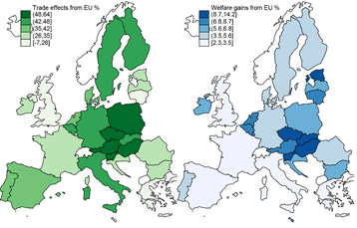
The Cost of non-Europe
ECA
Lessons from the Single Market Programme…
Single Market increased trade between EU members by 109% on average for goods and 59% for services (Mayer et al., 2018)
Trade impact of the Single Market more than 3X larger than effect of standard RTA tariff removal
Associated welfare gains from EU trade integration estimated to reach 4.4% for average European country
The effect of European integration on trade in goods and welfare
Source: Mayer et al. (2018)

Slide 4
Demand-side Perspectives
ECA
Tapping the rapidly growing markets in Africa
Enormous opportunity of a continental market
Consumption accounts for over 80% of GDP
Source: UNdata.
Source: IMF.
UNECA.ORG

Slide 5
Local Production VS Imports
ECA
Yet a significant part of consumption still met by imports
Eastern Africa trade performance (USD billion)
UNECA.ORG
Source: UNCTADStat.

Slide 6
Local Production VS Imports
ECA
… and is being driven by manufactured goods
Trade balance as a share of GDP by product groups, 2017
UNECA.ORG
Source: UNCTADStat.

Slide 7
Firm Profitability
ECA
Yet profits surprisingly high in diversified activities
Our region accounts for 15% of African GDP, but less than 5% of the top 200 companies
Most of the top firms are in the ICT and utilities sectors, and in Kenya and Tanzania
Net profits margin of ICT and agribusiness is particularly high
Net profit margin of the top 500 African companies in Eastern Africa
Source: Calculated from data from Jeune Afrique 2018.

Slide 8
ECA
2. What our modeling says about the consequences for Eastern Africa

Slide 9
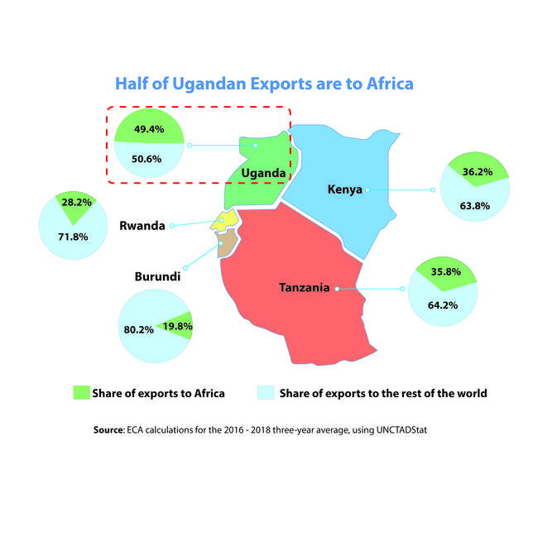
The African Market is already the major one…
Distribution of Exports by Destination
Source: ECA; UNCTADstat

Slide 10
Exports Efficiency of the EAC
ECA
Intra-EAC trade is at around half of its potential
 | To the EAC Actual Potential Ratio % exports (A) exports (B) (C) |  |  | To Africa Actual Potential Ratio % exports (A) exports (B) (C)
Burundi | 10 | 16 | 63 | 21 | 34 | 62
Kenya | 1,260 | 2,430 | 52 | 2,860 | 5,270 | 54
Rwanda | 108 | 171 | 63 | 219 | 345 | 63
Tanzania | 626 | 1,640 | 38 | 1,588 | 3,330 | 48
Uganda | 666 | 947 | 70 | 1,441 | 2,007 | 72
Total | 2,660 | 5,204 | 51 | 6,129 | 10,986 | 56
Note: A is actual (observed) exports (in US$ millions); B is potential (maximum) exports (in US$ millions), and C is the ratio between A and B (i.e. (A/B-1)*100).

Slide 11
Effects of the AfCFTA on East Africa
ECA
The Potential Benefits of AfCFTA on East Africa
A Computable General Equilibrium model – Global Trade Analysis Project (GTAP) – was used to measure the static effects of the AfCFTA on East Africa
Version 10.0, with 2014 baseline data
Liberalization is assumed to be complete (i.e. 100%)
Standard closure, but fixing wages to reflect high unemployment rates prevalent on the continent

Slide 12
Large Potential Gains
ECA
Large potential gains from the AfCFTA
Increase intra-African exports of Eastern Africa by more than US$ 1 billion
Chief beneficiary sectors are labour-intensive ones
Job creation of 0.7 to 2.0 million
Consumer welfare gain of US$ 1.8 billion
Change in Eastern African exports to the rest of Africa by sector
Source: UNECA calculations based on GTAP.

Slide 13
Small Fiscal Costs
ECA
Big gains at little cost?
 | Tariff revenue loss as a share of total tariff revenue | Tariff revenue loss as a share of total government revenue
Tanzania | 6.2% | 1.3%
Ethiopia | 6.1% | 0.7%
Uganda | 8.4% | 0.6%
Kenya | 3.2% | 0.6%
Rwanda | 4.0% | 0.3%
Note: Tariff revenue is the sum of import tariff rate times the value of imports by the type of import and source.
Source: UNECA calculations based on GTAP 10.0 database.
UNECA.ORG

Slide 14

Effects of the AfCFTA on East Africa
ECA
Partial Equilibrium Analysis tells a Similar Story
 | Change in the value of Intra-African exports (US$ thousands) | Compared to base year
Uganda | 198,546 | 21%
Kenya | 188,227 | 10%
Tanzania | 171,780 | 17%
Madagascar | 93,186 | 47%
Rwanda | 56,010 | 22%
Ethiopia | 10,718 | 10%
D.R. Congo | 9,843 | 1%
Seychelles | 3,963 | 7%
Somalia | 2,988 | 31%
Djibouti | 716 | 5%
South Sudan | 401 | 8%
Eritrea | 55 | 1%
Burundi | 39 | 0.4%
Comoros | 28 | 1%
Source: UNECA calculations based on WITS

Slide 15
Effects of the AfCFTA on East Africa
ECA
Over one-third is manufactured products
Product Code | Product Description | Change in the value of Intra-African exports (US$ millions) | Share in the total change in intra-African exports
5 to 8 | Manufactured Products | 235 | 37%
0 | Food and live animals | 176 | 28%
3 | Mineral fuels, lubricants | 148 | 23%
1 | Beverages and tobacco | 54 | 8%
2 | Crude materials, inedible, except fuels | 14 | 2%
4 | Animal and vegetable oils, fats and waxes | 7 | 1%
Total |  | 634 | 100%
Source: UNECA calculations based on WITS

Slide 16
ECA
3. Simulation Results for Rwanda

Slide 17
Intra-African Exports
ECA
Highest exports growth among the EAC Partner States
 | Change in Value of Intra-African Exports (US$ million) | % change
Rwanda | 56.0 | 22%
Uganda | 198.5 | 21%
Tanzania | 171.8 | 17%
Kenya | 188.2 | 10%
South Sudan | 0.4 | 8%
Burundi | 0.04 | 0.4%
UNECA.ORG
Source: UNECA calculations based on WITS.

Slide 18
Intra-African Imports
ECA
Smaller increase in imports
 | Change in Value of Intra-African Imports (US$ million) | % change
Kenya | 68.2 | 5%
Uganda | 31.3 | 3%
Rwanda | 10.9 | 2%
Burundi | 2.9 | 2%
Tanzania | 14.1 | 1%
UNECA.ORG
Source: UNECA calculations based on WITS.

Slide 19
Intra-African Exports
ECA
Significant increase in exports from Rwanda to D. R. Congo
 | Change in the value of Intra-African exports (US$ thousands)
D. R. Congo | 56,013
Ghana | 23
South Africa | 14
Eritrea | 12
Tunisia | 6
Mozambique | 2
Zambia | 1
Botswana | 1
Sierra Leone | 1
Burundi | -15
Uganda | -19
Kenya | -29
UNECA.ORG
Source: UNECA calculations based on WITS.

Slide 20
Intra-African Exports
ECA
Manufacturing & food sectors main beneficiaries
Increase in Intra-African Exports by Top Products (US$ million)
UNECA.ORG
Source: UNECA calculations based on GTAP.

Slide 21
Intra-African Imports
ECA
Notable increase in sugar and textiles imports
Increase in Intra-African Imports by Top Products (US$ million)
UNECA.ORG
Source: UNECA calculations based on GTAP.

Slide 22
ECA
4. Where Next?

Slide 23


In conclusion…
Regional Integration is not a one-way street
AfCFTA implementation a catalyst for change?
Won’t in itself solve all developmental problems!

Slide 24





For more information, see our forthcoming report…
Opportunities with the AfCFTA
USD1.8 billion
Eastern Africa welfare gains
USD1 billion+
New intra-regional exports
2 million+
Good, new jobs
Other benefits
…in services and labor-intensive manufacturing

Slide 25

For more info, see:
Upcoming ARIA IX
Follow the conversation: #COM2019
More: www.uneca.org/cfm2019

