Slide 1
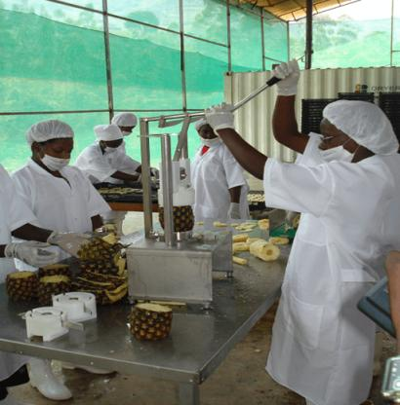

OXFAM’S OBSERVATIONS ON ENHANCING PRODUCTIVE CAPACITIES in Rwanda IN THE AFTERMATH OF the COVID-19 CRISIS
7th EPRN ANNUAL RESEARCH CONFERENCE
“Economic policy measures to enhance productive capacities post COVID-19 Crisis”
MAY 27TH 2021

Slide 2
OXFAM AREAS OF FOCUS FOR PRODUCTIVE CAPACITIES 2015 - 2022
SUSTAINABLE LIVELIHOODS
Human capital (farmers’ increased income, access to market, increased supply capacities, value chains development, horticulture sub-sector for export potentials)
Structural changes (organic farming, certification to ease export, agroecology farming, planting materials’ business model)
Private sector (Enterprise dvpt, financial institutions, saving/lending groups)
GENDER JUSTICE AND WOMEN’S RIGHTS
Human capital (Fight against GBV, women’s unpaid care work, economic empowerment of SGBV victims)
RESILIENCE STRENGTHENING AND LOCALISATION
Human capital (response to crisis, farmers’ resilience to climate change and disease outbreak)
Energy (biodigesters for rural cooking and lighting, youth skills for renewable energy, provision of clean water during crisis and in refugees’ settings)
Institutions (Strengthening local organizations’ capacity & coalition building)
Institutions (Strengthen the capacity of IOSC, teenage pregnancy laws/policies, technical assistance to MIGEPROF)
Notes:
Under livelihoods, market systems for income growth and reduce inequalities (the inequality enlarged by COVID-19), special consideration of vulnerable populations including farmers, women, SMEs, aggregators and processors in national recovery plan and other financing

Slide 3
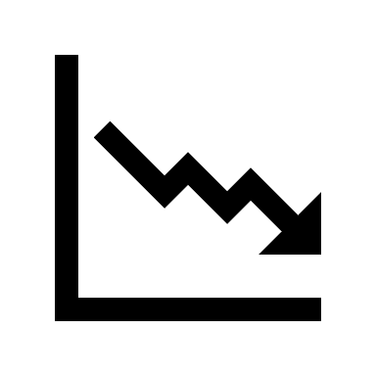





PRE-COVID-19 EXISTING VULNERABILITIES
Prior to COVID-19, already women-owned businesses were 5.9 percentage points more likely to have closed their businesses than male-owned businesses. In the Sub-Saharan African countries, 34% of male-owned SMEs were temporarily closed compared to 43% of female-owned SMEs (WB,2020)
Women have always played significant roles in production and post-harvest processing yet, these roles are often informal, unacknowledged, or under-resourced. Conversely, in transportation, marketing and sales, women are underrepresented playing limited roles that keep them from gaining from the most profitable portions of the agriculture value chains.(OXFAM,2020)
Women bear the brunt of the unpaid care work, and therefore undervalued, time and labor-intensive care work for the family, spending over four times as much time as men collecting water and firewood and caring for children, the sick and the elderly. Poverty then trickles down to their daughters who are often required to support their mothers in undertaking chores at home, hence perpetuating the cycle of poverty.(OXFAM, 2018)
Majority of the poor in Rwanda’s population depend directly on access to natural resources, and they are vulnerable to environment-related shocks, such as droughts, heavy rainfall, landslides and floods. Environmental degradation, lack of access to, or competition over natural resources, are environmental factors that negatively affect their livelihood opportunities.(SIDA, 2019)

Slide 4
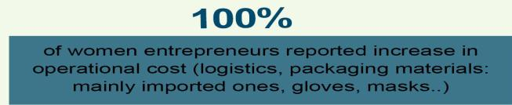
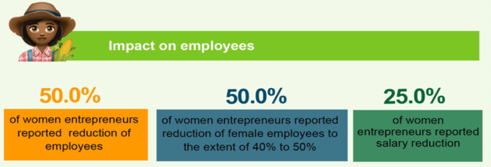
COVID-19 IMPACT ON SMES ESPECIALLY THOSE OWNED BY WOMEN
Extracts from the internal assessment of COVID-19 impact on Oxfam supported enterprises July 2020
negative impact on disrupted domestic supply & access to market.
could only operate at 25% of their normal production capacity. Their big markets being schools, hotels and other closed businesses, the enterprises lost major customers and significantly reduced on labor force.
smes with existing access to export markets, have not been able to ship orders.
For those with perishable produce, the loss was even higher and more significant.
Selected findings from Oxfam’s assessment of supported enterprises in four districts of Rwanda – April 2021

Slide 5
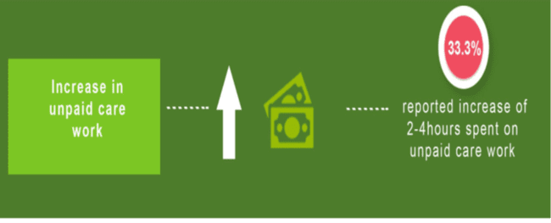
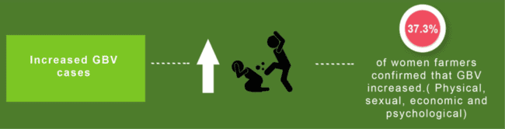
COVID-19 IMPACT ON WOMEN’S RIGHTS AND GENDER EQUALITY
Some findings from Oxfam’s assessment of supported enterprises in four districts of Rwanda – April 2021
While home curfews and limiting interactions with others does maximize safety from COVID-19, for some women in the country, having to stay home means welcoming an entirely different problem of the inescapable and inevitable violence waiting to be unleashed from an intimate partner or a close family member. Studies have shown that over 33% of rapes of Gender based Violence (GBV) victims took place in the victim’s home and 81.9% of perpetrators are known by the victims.
Extracts from Oxfam’s
Digital Rapid Assessment on Status of Gender Based-Violence (GBV) during COVID-19 lockdown
June 2020

Slide 6
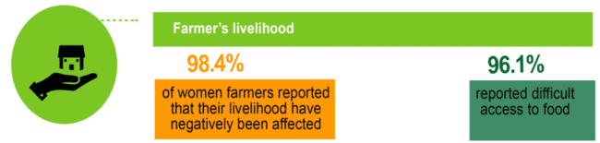
COVID-19 IMPACT ON FARMERS’ RESILIENCE AND VULNERABILITY TO EXTERNAL SHOCKS
Selected findings from Oxfam’s assessments and surveys done at different stages during the pandemic crisis between 2020 and 2021

Slide 7
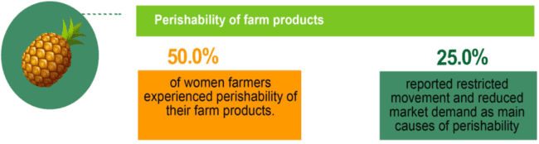
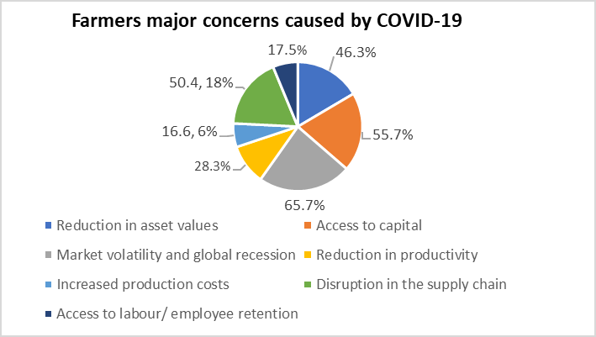
COVID-19 IMPACT ON AGRICULTURAL VALUE CHAINS’ ACTORS
Selected findings and extract from Oxfam’s assessments and surveys done at different stages during the pandemic crisis between 2020 and 2021
Muhanga Food Processing Industries (MFPI) is one of the main processors of soy-based products in the southern province of Rwanda. With Oxfam’s support, MFPI planned to increase annual sales of 150% between 2019 and 2020. With movement restrictions, social distancing and total lockdowns, MFPI could only operate at 25% of its normal production capacity. Their big market was schools which were closed. Thus, the company lost its major clients. They were forced to reduce their human resources and could only fully employ 10 staff out of 35 contracted staff.

Slide 8
Oxfam assessment of impact on aggregators dec 2020- jan 2021 4 districts
Investment in fixed assets is limited for aggregators operating in the horticulture value chains as less than 5% of them have their own or leased Cold Storage or Greenhouse.
The decreased demand of produce (90%), lack/loss of capital (83%), and damaged stores (76%).
Notes:
The proportion of aggregators having their own or leased Collection Center is only 27.6%; only 18.3% have their own or leased warehouses. They are 14.4% who have pack house, and only 11.5% who have office buildings.
The lack of packing equipment is one of specific challenges faced in the aggregation business. Few aggregators have invested in sorting tables (only 24%), 8% have their own washers (8%) while 2% have their own receiving belts.

Slide 9
OPPORTUNITIES AND QUICK WINS
Actions and plans to improve women smallholder farmers and women owned enterprises’ access to finance and capacity to increase their income (SGBV victims’ economic empowerment, agriculture financing)
Support a women-focused economic recovery plan for rural areas with tailored solutions and support (e.g. mainstreaming fight of SGBV in ERP; services to reduce unpaid care work)
Support development of value chains where farmers’ vulnerability is still high and capacity to recover from shocks is unlikely (e.g horticulture, post harvest facilities)
Intensify transfer of knowledge & agriculture practices Build farmers’ resilience to external shocks (organic farming, agroecology)
EPR -Prioritise sustainability of interventions rather than one-time actions since the effects of the pandemic will continue to be felt years after it has been controlled.
Notes:
Financing: The agriculture financing is critical as majority of Rwandans ( nearly 70%) employed in agriculture sector to boast agriculture exports, employment, increase GDP and economic growth. Actions and plans to improve women smallholder farmers and women owned enterprises’ access to finance and capacity to increase their income (SGBV victims’ economic empowerment, agriculture financing). There is a need of enough capital to acquire particularly the appropriate packaging materials.
Specific strategies for inclusive market systems for income growth and reduce inequality which has been enlarged by COVID-19

Slide 10
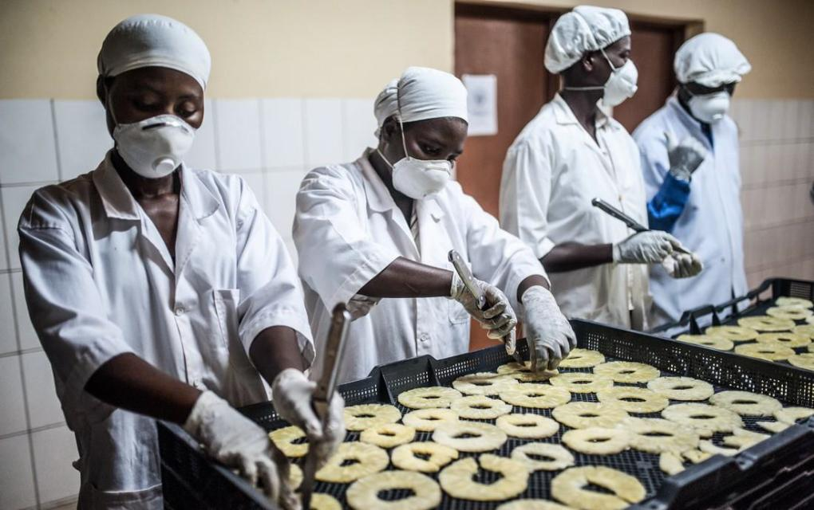
THANK YOU !!

