Slide 1

Inflation Policy Dialogue
Agriculture Policies for Mitigation of Inflation
Patrick KARANGWA (PhD)
Director General of Agriculture Modernization/MINAGRI
Presented during the Policy dialogue on inflation organised by EPRN (www.eprnrwanda.org )
23 FEB 2023

Slide 2
Seasons 2022 A and 2023A Context
Severe drought, that affected many parts of the country mostly in the Eastern Province and Southern Province
Hiking of fertilizer prices on the global market
Cost of transport hiked
While agriculture production had consistently achieved a growth rate of 5% on average and at times 7%, 8%, 10%, growth rate decelerated over seasons 2022A – 2023A
  Agriculture production does not increase by randomly
  Increased use of inputs, especially fertilizers, is critical
  Increase in area under agriculture
  Availability of water for the crops and livestock
  Improvements in extension and coordination

Slide 3
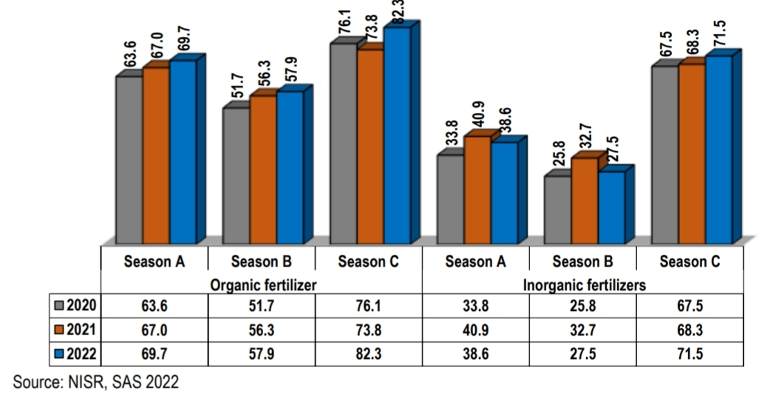

Slide 4
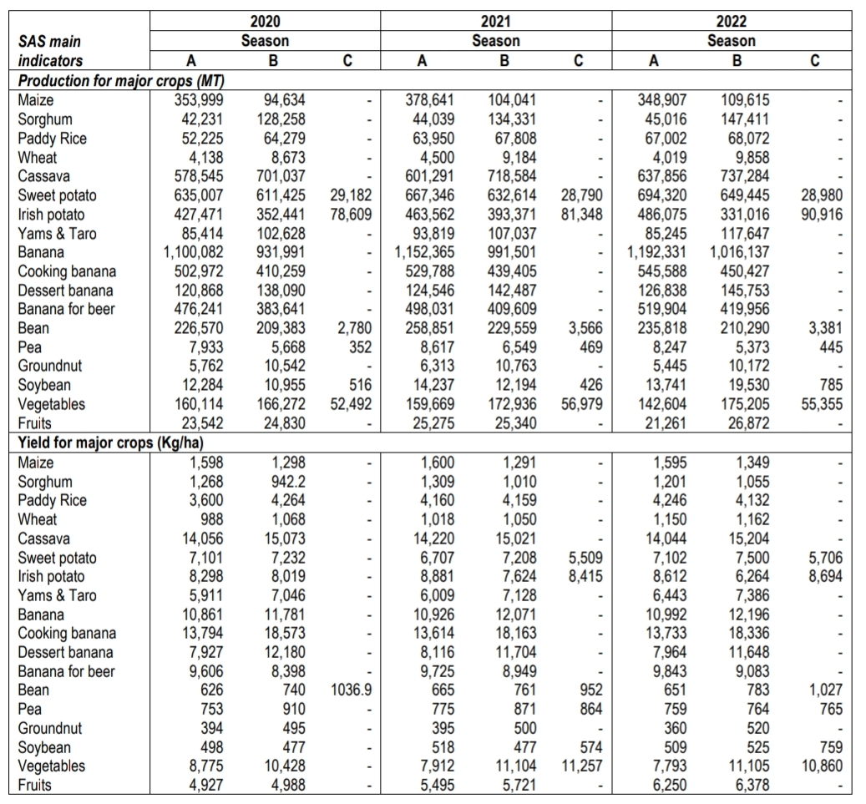

Slide 5
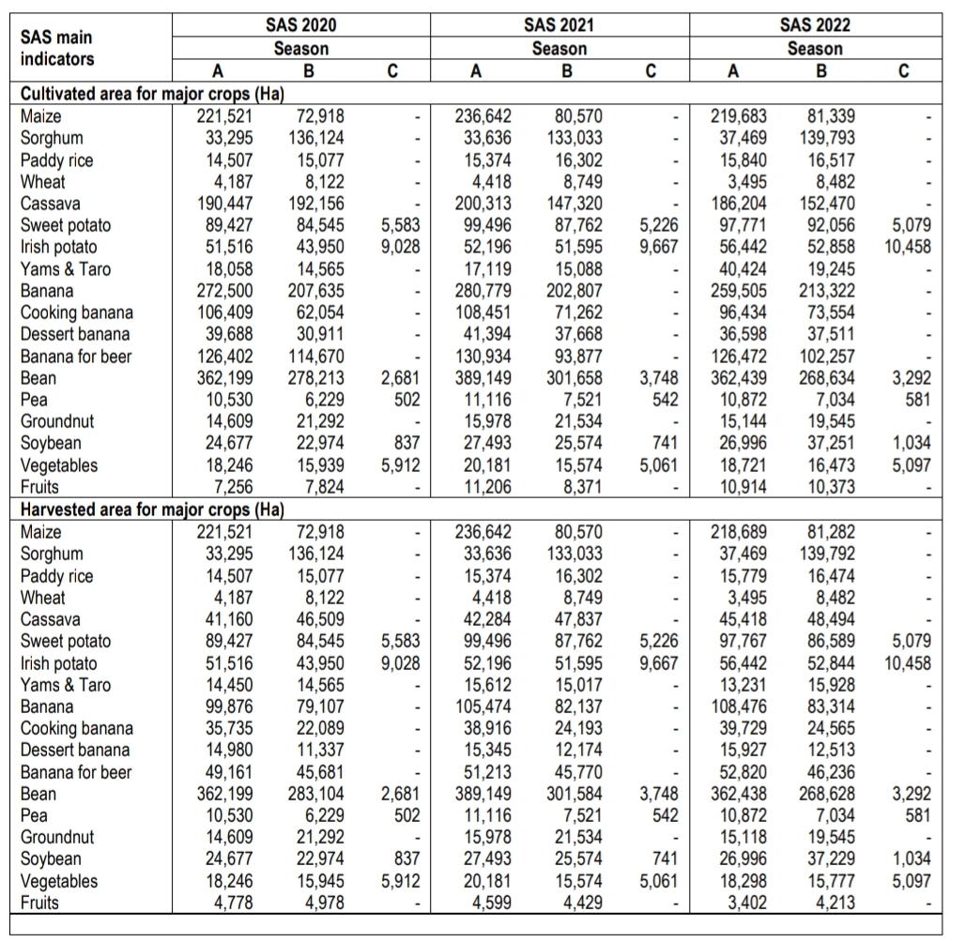

Slide 6
Policies for Mitigation of Inflation - Agriculture
Increasing subsidy on agriculture for food production
  Government increased subsidy allocation on fertilizers
    In 2021: 20.7 billion subsidy on fertilizers
    In 2022: 35.1 billion subsidy on fertilizers
  In particular, in season 2023A, Government provide to farmers DAP and urea fertilizers at 100% subsidy to be applied at the time of weeding
  Distribution of seed/planting materials of drought tolerant crops (cassava, sweet potato) and early maturing crops (beans, vegetables)
Increasing area under agriculture production
Increasing irrigated area, e.g.
  Gabiro Agribusiness Hub – phase 1: 5600 ha. Phase 2: 6,000 ha.
  Irrigation projects in Kirehe District
  Total area under irrigation currently 67,000 ha irrigated. Targeting to reach 102,400 ha irrigated by next year 2024
Other flagship projects, e.g. CDAT project (300 million USD /300 billion Frw)
    Irrigation & Land husbandry
    Access to finance
    Agriculture insurance

Slide 7
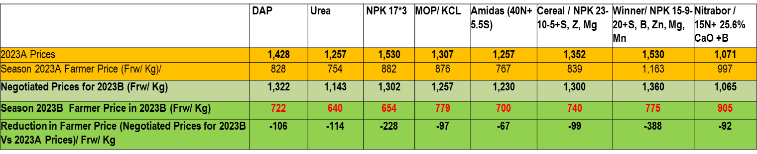
Fertilizer Prices Season 2023B

Slide 8
THANK YOU

