Slide 1
National Institute of Statistics of Rwanda
Rwanda Poverty Panel Report
Policy Dialogue about Poverty and Inequality
EPRN and UNDP
Marriott Hotel, Kigali
May 28, 2019
Presented by:
KAMANA Roger
Data Analyst

Slide 2
Outline
Background: Evolution of GDP and poverty
How poverty is measured
Poverty dynamics:
Moving into and out of poverty
Moving up and down the income distribution
Linking economic growth to changes in poverty
Who has gained from economic growth?
Correlates of movements into and out of poverty

Slide 3
Outline
Background: Evolution of GDP and poverty
How poverty is measured
Poverty dynamics:
Moving into and out of poverty
Moving up and down the income distribution
Linking economic growth to changes in poverty
Who has gained from economic growth?
Correlates of movements into and out of poverty

Slide 4
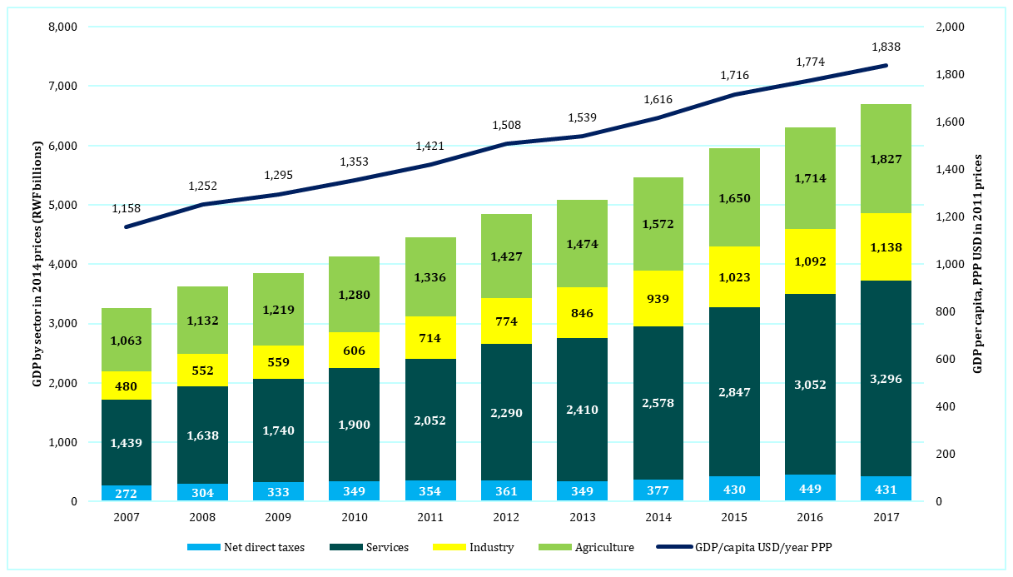
Real GDP growth
Notes:
The top line shows GDP per capita in 2011 US dollars, adjusted for purchasing power parity, using the vertical scale on the right-hand side. This measure rose 59% between 2007 and 2017.
The bars show GDP in billions of RWF in 2014 prices. GDP is separated into the contributions of agriculture (light green), industry (yellow), and services (dark green). The blue represent net direct taxes, which get included when GDP is measured in market prices. The dynamism of the economy is clear.

Slide 5
1. Poverty update: Nationally
Notes:
The EICV5 data (2016/17) show that 38.2% of people were poor. This is below the poverty rate of 39.1% observed in 2013/14, but the reduction is not statistically significant.

Slide 6
Outline
Background: Evolution of GDP and poverty
How poverty is measured
Poverty dynamics:
Moving into and out of poverty
Moving up and down the income distribution
Linking economic growth to changes in poverty
Who has gained from economic growth?
Correlates of movements into and out of poverty

Slide 7
Measuring poverty: EICV surveys
EICV5: data
14,580 households, surveyed 10/2016 – 10/2017
All districts; stratified multi-stage cluster design
Wellbeing
Real consumption per adult equivalent per year
Spending + auto-consumption + value of durables + actual or imputed house rent + in-kind wages & remittances
Deflated to January 2014 prices.
Poverty line: RWF 159,375 per adult equivalent per year
Notes:
The EICV surveys are nationally representative, and interview households in all districts of the country. In Kigali City, 9 households were interviewed in 60 clusters chosen in each of the three districts. In each of the other 27 districts, 40 sample clusters were chosen and 12 households interviewed in each of these. Sampling was done in proportion to population, as measured by the 2012 census. Each household was visited multiple times. For the first time, the data were directly recorded on tablet computers rather than on paper.

Slide 8
Change in real expenditure/ae/yr
 | EICV3 | EICV4 | EICV5 | % change, 2014-2017
 | Thousands of RWF per year
Area of residence
Urban | 646 | 607 | 570 | -6.2
Rural | 198 | 217 | 216 | -0.6
Province
Kigali City | 588 | 528 | 597 | 12.2
Southern | 218 | 264 | 230 | -13.7 *
Western | 245 | 246 | 219 | -11.7
Northern | 223 | 229 | 230 | 0.4
Eastern | 239 | 259 | 242 | -6.8
Quintiles
Q1: poor | 76 | 85 | 86 | 0.6
Q2 | 123 | 138 | 140 | 1.4 *
Q3: middle | 171 | 188 | 192 | 2.1 *
Q4 | 247 | 270 | 279 | 3.4 *
Q5: rich | 710 | 734 | 699 | -4.9
Total (mean) | 265 | 282 | 279 | -1.2
Total (median) | 169 | 187 | 191 | 2.1
No. of observations | 14,308 | 14,419 | 14,580
Notes:
Mean expenditure per adult equivalent fell, but all of this was due to a lower reported level of per capita spending at the high end of the distribution. There was little change at the low end. Kigali saw gains in mean spending per adult equivalent, but the rest of the country did not. Median expenditure per adult equivalent rose slightly (+2.1%) over the three-year period: income distribution improved.

Slide 9
Outline
Background: Evolution of GDP and poverty
How poverty is measured
Poverty dynamics:
Moving into and out of poverty
Moving up and down the income distribution
Linking economic growth to changes in poverty
Who has gained from economic growth?
Correlates of movements into and out of poverty

Slide 10
Dynamics: Poverty Transitions
 |  | EICV5: 2016/17
 |  | Poor | Not poor | Total
EICV4: 2013/14 | Poor | 24.6 | 13.4 | 38.1
 | Not poor | 11.7 | 50.2 | 61.9
 | Total | 36.3 | 63.7 | 100.0
Totals may not sum to 100 due to rounding errors. Percentages use base-year (EICV4) sampling weights.
Half were not poor in 2013/14 or 2016/17
A quarter were poor in both years
A quarter were poor in one year, not both
Based on panel dataset (surveyed in both years)
Notes:
These numbers are based on the panel dataset, which followed the same households in 2013/14 and 2016/17. This allows us to determine who moves into, and out of, poverty over time. About half of the people in the sample were not poor in either year, and a quarter were poor in both years. The rest either moved out of poverty (13% of the sample) or into poverty (12%). These latter are the transient poor. This means that about half of the population is either poor, or vulnerable to being poor.

Slide 11
Movement into/out of poverty 2010/11 to 2013/14 to 2016/17
Notes:
This diagram tracks the poor and non-poor over three periods, using a panel of households who were surveyed in 2010/11, and again in 2013/14 and 2016/17. This is an unusual panel, in that it carefully tracked the original households and any household members who “split” off from those households. This is the correct way to follow people over time, but is rarely done in practice.

Slide 12
Very poor, poor, not poor
“poor”
Poverty Status | Extreme poor in 2016/17 | Moderate poor in 2016/17 | Non poor in 2016/17 | Total
Extreme poor in 2013/14 | 8.2 | 3.2 | 4.0 | 15.3
Moderately poor in 2013/14 | 4.0 | 9.3 | 9.5 | 22.8
Non poor in 2013/14 | 2.5 | 9.2 | 50.2 | 61.9
Total | 14.7 | 21.7 | 63.6 | 100

Slide 13
Persistent vs. transitory poverty
 | Chronically poor |  | Transient but not chronic | Never poor
 | Persistent | Transient but chronic
 | Row %
Rwanda | 19.2 | 15.0 | 27.8 | 38.1
Urban/rural
Urban | 9.0 | 7.8 | 22.4 | 60.9
Rural | 21.9 | 17.0 | 29.2 | 32.0
Provinces
City of Kigali | 10.8 | 11.1 | 15.4 | 62.8
Southern Province | 20.4 | 17.3 | 26.7 | 35.7
Western Province | 21.0 | 14.0 | 29.5 | 35.5
Northern Province | 24.5 | 14.3 | 33.8 | 27.5
Eastern Province | 15.7 | 15.8 | 27.4 | 41.0
Chronically poor: Poor on average throughout
Persistently poor: Poor every year
Transient poor: Poor some years but not every year
Persistent poverty: needs economic development
Transient poverty: needs insurance
Notes:
People are chronically poor if, on average, their consumption per adult equivalent in 2010/11, 2013/14, and 2016/17 was below the poverty line. Just over a third of the population was chronically poor by this measure.
The persistently poor were poor in all three years.
The transient poor are those who were poor in one or two survey years, but not in all three. About a third of the transient poor were chronically poor (i.e. poor on average), while the rest were not poor on average, but fell into poverty on occasion.
An estimated 38% of the population was not poor in any of the three survey years.

Slide 14
Outline
Background: Evolution of GDP and poverty
How poverty is measured
Poverty dynamics:
Moving into and out of poverty
Moving up and down the income distribution
Linking economic growth to changes in poverty
Who has gained from economic growth?
Correlates of movements into and out of poverty

Slide 15
Fast growth, slow poverty fall
Country and period | Income elasticity of poverty
Rwanda, 2011 – 2014 | -1.01
Rwanda, 2014 – 2017 | -0.17
Uganda, 1993 – 2003 | -0.8
Uganda, 2003 – 2006 | -3.1
Zambia, 1996 – 2004 | -0.22
Global experience (Ram 2010) | -0.84
South Asia (Ram 2010) | -0.22
India (Ram 2010) | -0.13
India (Ram 2015), 1990 – 2005 | -0.35
If price of food had stayed on trend:
Estimated poverty rate of 35.2% (instead of 38.2%)
Income elasticity of poverty of -0.77
General point: Link between GDP growth and poverty reduction is not watertight.
Notes:
The GDP elasticity of poverty measures the percentage change in the poverty rate divided by the percentage change in GDP.
Example: If GDP rises by 10%, and the poverty rate goes from 40% to 38% (i.e. a 5% drop in the poverty rate), the elasticity would be -0.5.
Between 2010/11 and 2013/14, the poverty elasticity in Rwanda was relatively high, at -1.01; and between 2013/14 and 2016/17 is was relatively low (mainly, we believe, because of the food price spike).
Suppose the price of food had risen following its long-run trend (rather than spiking). Then we estimate that the poverty rate would have fallen from 39.1% to 35.2% instead of the observed fall to 38.2%. This is a simulated result, included here to give a sense of the impact of the food price spike.

Slide 16
Food price spike
Notes:
Between 2010 and 2015, food and non-food prices rose at about the same rate. But during the period of the EICV5 survey – shown by the two right-hand vertical lines – food prices, and especially the prices of vegetables (which are important for poor people) was unusually high. This is important, because the high relative prices of food during the survey period help explain why the change in the poverty rate was so modest, despite the rapid growth of GDP.

Slide 17
Shocks can hurt
Notes:
A quarter of households reported a farm shock (e.g. drought) in EICV5; 8% reported shocks due to high food prices, and 8% due to health problems (see bottom line of table). Many responded by buying less food.

Slide 18
Analysis: Inequality
 | 2014 | 2017 | Change
Gini coefficient
Estimate | 0.447 | 0.429 | -0.018
95% confidence interval | 0.436-0.459 | 0.420-0.438
Theil’s T [= GE(1)]
All Rwanda | 0.442 | 0.374 | -0.068
Urban | 0.533 | 0.417 | -0.116
Rural | 0.225 | 0.198 | -0.027
Decomposition:
“within” inequality | 0.335 | 0.277 | -0.058
“between” inequality | 0.107 | 0.097 | -0.010
Memo: “between” inequality as % of total inequality | 24% | 26%
Inequality fell between 2013/14 and 2016/17
Rural inequality is low
A quarter of inequality is due to urban/rural divide
Why? Mainly because reported expend./ae of rich fell
Notes:
The Gini coefficient measures inequality: a value of 0 means perfect equality, 1 shows perfect inequality.
The Gini coefficient fell from 0.447 to 0.429 between 2013/14 and 2016/17, meaning that inequality fell. This was mainly due to a reduction in consumption in households at the top of the income distribution.
Theil’s T also measures inequality, and goes from 0 (equal) to 1 (unequal), but can be decomposed into the sources of inequality. If there were no difference in consumption levels (per adult equivalent) between urban and rural areas, inequality would fall by a quarter – this is the “between” inequality. Inequality fall both within urban and within rural areas. Urban inequality is much greater than rural inequality.

Slide 19
Analysis: Shift-share
 | Total poverty
 | Absolute change | Percentage change
Change in headcount poverty | -0.90 | 100.00
of which
Intra-sectoral effect | -0.60 | 66.9
Population-shift effect | -0.30 | 33.9
Interaction effect | 0.01 | -0.8
Intra-sectoral effects
Urban | -0.01 | 0.7
Rural | -0.59 | 66.2
A third of poverty reduction was due to movement from poorer rural to richer urban areas
Notes:
A way of looking at changes in poverty is to ask how much change occurs because poverty rates fall within urban and within rural areas, and how much is due to the movement of people from (poorer) rural areas to (richer) urban areas. We find that two-thirds of the reduction in poverty is within urban and rural areas (the “intra-sectoral effect”), and a third is because people moved from poorer to richer areas (the “population-shift effect”).

Slide 20
Outline
Background: Evolution of GDP and poverty
How poverty is measured
Poverty dynamics:
Moving into and out of poverty
Moving up and down the income distribution
Linking economic growth to changes in poverty
Who has gained from economic growth?
Correlates of movements into and out of poverty

Slide 21
Geographic pattern
 | Total Poverty
 | 2014 (EICV4) | 2017 (EICV5) | Change % points
 | percentages
Nationally
Rwanda | 39.1 | 38.2 | -0.9
Standard error | 0.62 | 0.61 | 0.87
Area of Residence
Urban | 15.9 | 15.8 | 0.0
Rural | 43.7 | 43.1 | -0.7
Province
City of Kigali | 20.9 | 13.9 | -6.9 *
Southern Province | 38.4 | 41.4 | 3.1
Western Province | 45.2 | 47.1 | 1.9
Northern Province | 45.9 | 42.3 | -3.6
Eastern Province | 38.0 | 37.4 | -0.6
Only the change (reduction) in Kigali City is statistically significant
Notes:
Poverty is lower in urban than rural areas, and in Kigali City compared to the other provinces. There was a statistically significant reduction in the headcount poverty rate in Kigali City, but not elsewhere.

Slide 22
Mobility by area and province
 | Stayed poor | Became poor | Exited poverty | Never poor | Total across | % population within group
Nationally
Rwanda | 24.6 | 11.7 | 13.4 | 50.2 | 100.0 | 100.0
Area of Residence, 2017
Urban | 12.6 | 5.0 | 11.3 | 71.1 | 100.0 | 21.8
Rural | 28.0 | 13.6 | 14.0 | 44.4 | 100.0 | 78.2
Province
City of Kigali | 14.5 | 1.9 | 12.5 | 71.2 | 100.0 | 10.0
Southern Province | 26.9 | 14.1 | 9.4 | 49.6 | 100.0 | 24.0
Western Province | 27.9 | 15.7 | 12.1 | 44.3 | 100.0 | 24.0
Northern Province | 29.9 | 8.2 | 15.9 | 46.0 | 100.0 | 16.8
Eastern Province | 19.9 | 11.9 | 17.3 | 51.0 | 100.0 | 25.2
High persistent poverty in Southern, Western, Northern
Mobility high, even in Kigali City
Notes:
This is another way of looking at mobility, but just between 2013/14 and 2016/17. There is considerable movement into and out of poverty in all provinces (except Kigali City).

Slide 23
Outline
Background: Evolution of GDP and poverty
How poverty is measured
Poverty dynamics:
Moving into and out of poverty
Moving up and down the income distribution
Linking economic growth to changes in poverty
Who has gained from economic growth?
Correlates of movements into and out of poverty

Slide 24
Correlates of changes in poverty
If household size or number of elderly or children, falls, household is more likely to get out of poverty.

Slide 25
Correlates (2)
Difficult to see clear patterns.
Farmers are poorer, and farm income is less stable: they are more likely to move into or out of poverty than non-farmers.

Slide 26
Thank you
http://www.statistics.gov.rw/

