Slide 1
Education and Internet & Digital connectivity in schools
June 2024

Slide 2
Policy and Guidelines
National Strategy for Transformation 2017-24
(draft) RWANDA EdTech Policy
Education Sector Strategic Plan 2018/19 – 2023/24
ICT in Education Policy 2015
Rwandan Education Sector Policy (2003)

Slide 3
Administration of IT ecosystem for Schools
Connectivity
Content
Devices
REB
eLearning &MIS (REB)

Slide 4
IT Systems interoperability
SDMS
REB eLearning system
TMIS
API
API
ICTE-MIS
nnbnbnbnb

Slide 5
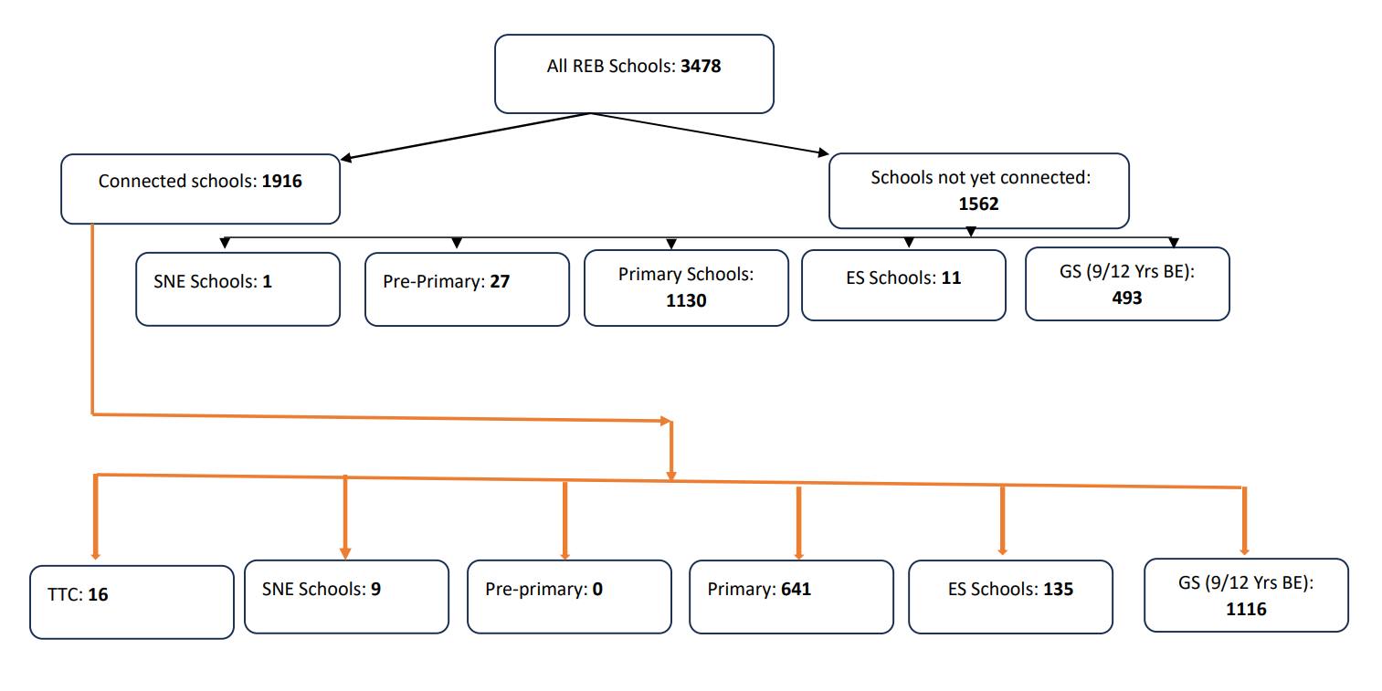
Schools access to internet

Slide 6
IT SYSTEMS AND CONNECTIVITY
Corporate IT infrastructure:
Connectivity infrastructure and project in pipeline:
E-learning platform and other support system(TMIS,TLMMIS,ICTEMIS)
Smart Education Project (1500 Schools, HLI and Research center ”the project has connected 800 schools in Basic Education sector”)
Connectivity of schools in Remote area (50 Schools under Pilot has been connected to high speed internet over satellite, and project will cover another batch of 500 schools in remote area)

Slide 7
LMS and Support System
Core LMS and Support System:
REB elearning: https://elearning.reb.rw/
2. VLAB: https://csmis.reb.rw/vlab/
3. ICTE MIS:

Slide 8
Smart Classroom
Smart classrooms are classrooms that use digital equipment like laptops as student gadget, digital smartboards,screens and projectors to help make learning and teaching better.
These digital resources are connected through internet. It is an innovative way in which teachers can engage with learners.

Slide 9
Robotics and AI
REB has embarked in Incorporating robotics and artificial intelligence (AI) into schools and it gives a range of educational benefits and helps prepare students for the future job market.

Slide 10
Enhanced Learning Experiences
Interactive Learning: Robotics kits and AI tools provide hands-on learning opportunities that engage students more effectively than traditional methods.
Problem-Solving Skills: Building and programming robots encourage students to think critically and solve problems creatively.
Collaboration: Group projects involving robotics and AI foster teamwork and communication skills.

Slide 11
Preparation for the Future
Job Market Readiness: Familiarity with robotics and AI is providing a competitive edge in the job market as these technologies become increasingly prevalent in various industries.
STEM Engagement: Robotics and AI sparks interest in STEM (Science, Technology, Engineering, and Mathematics) fields, leading more students to pursue these areas in their career path education and careers.

Slide 12

Online child protection
In the community
At home
Travelling to and
from school
At school - in an out of class
in cyber-space

Slide 13
Thank You! MURAKOZE

